Slide 1
Security QoS Modeling (SQML) for Enterprise DRE Systems (eDRE)
By
Akshay V. Dabholkar
<aky@dre.vanderbilt.edu>
Advisors
Aniruddha Gokhale, Doug Schmidt
{a.gokhale,d.schmidt}@vanderbilt.edu
CS 388: Model Integrated Computing
Notes:
My project is about Security Quality of Service modeling of enterprise DRE systems
It tries to apply access control and security policy mechanism for these kind of systems
In this case our targets are systems based on the CORBA component model.

Slide 2
Motivation
Security is one of the key QoS Aspects in addition to Real-Time, & Fault Tolerance in making Enterprise DRE (eDRE) systems Trustworthy
Apply the MDE approach to security to be able to express security policy annotations at a higher level and evaluate conflicting requirements at modeling time
Goal is to add model-driven security enhancements to component middleware like CCM (CORBA Component Model)
CS 388: Model Integrated Computing
Notes:
In order to make a system trustworthy there are many aspects to it. One of them is Security whereas others are real-time guarantees
The ability to apply the MDE approach to security enables us to express model high level security concerns easily and define policies, evaluate conflicting requirements and apply them at the modeling time itself. Finally generate access control permissions and control on systems at their deployment time.

Slide 3
Security
Definition of security
  “Safety“ or “freedom from worry“
Types of protection:
  Authorization
    Access control and data protection (untrusted environment)
  Accountability
    Audit (weaker) and non-repudiation (stronger)
  Availability
    Service continuity and disaster recovery
  Assurance
    System safety and operational correctness
Handled at different layers in a system
CS 388: Model Integrated Computing
Notes:
Authorization protects the system against attempts to „break the rule“
Rule examples :
Authorizations mechanisms :
1. Access Control mechanisms enforce the rules. They are used in environments that can be trusted to run a program to check whether the rules are violated. In environments like this, whenever anyone asks the system for access to a protected resource, the system checks its authorization rules to see whether the access is allowed; this is called an access control check. If the rules permit the access, the system proceeds normally, but if the rules forbid the access the system generates an error message and doesn’t allow the access.
2. Data protection mechanisms are used when the environment isn’t able to run a program to check the rules or isn’t trusted to enforce the rules even if it can check them. ( For example: a telephone wire )
Data protection is used to enforce authorization in environments like these.
Confidentiality protection keeps the unauthorized readers from snooping through protected data;
integrity protection keeps vandals from making unauthorized changes to protected data. Data protection is normally implemented using encryption. The theory behind data protection is that you have to break the encryption to break the rules, and breaking the encryption is just too expensive.
Accountability
Enforcing the rules isn’t always enough to keep protected resources safe. There is no way to prevent authorized users with evil intent from doing things which the rules allow. Accountability means you can tell who did what when.
There are two strengths of accountability : audit and non-repudiation.
Audit is the weak form of accountability, when the each user’s actions are recorded in an audit log. Privileged users may be able to impersonate other users without detection; corrupt system administrators may be able to tamper with audit logs to cover their tracks.
Non-repudiation protection is a stronger form of accountability. It requires users to “sign” their requests for the system actions, so that their signatures can be used as evidence against them if the actions are later to have been harmful. Non-repudiation protection depends on the strength of a digital signature algorithm and the secrecy of each user’s signature key to guarantee that privileged users and the system administrators can’t forge other users’ signatures.
Availability
A resource is available if it’s there when you need it. Attacks :
destroy
Interfere with the communications between you an the resource
Interfere with your ability to pass the authorization check required for use of the resource.
Availability protection defends you against bad guys who want to do these sort of things.
There are two approaches to availability protection: service continuity and disaster recovery.
Assurance
What the computer industry does to provide freedom from worry is called assurance. Assurance is the set of things the builder and the operator of a system do to convince you that it really is safe to use. The theory behind the assurance is that the computer industry knows what things need to be done to make the a system secure, can convince you that doing those things will make the system secure, and can prove that those things have been done for your particular system.
The system can enforce the policy you’re interested in, and
the system works.
Assurance arguments usually try to prove :
1. The system’s protection mechanisms are correct
2. The system always uses the protection mechanisms when they are needed
3. There is no way to circumvent the system’s protection mechanisms (no back doors)
Assurance activities :
1. Design assurance
2. Development assurance
3. Operational assurance

Slide 4
Multiple Security Concerns
Role-Based Access Control (RBAC): for managing user identity and roles for authorization
Evidence Generation: Component code running in the CCM container can be restricted to only use well-defined interfaces, which allows security to be effectively enforced on the code enabling safe deployment of large applications with varying degrees of security enforcements
Multi-level Security Policies: Enterprise, Machine, User & Application Domain policy types
System Partitioning: Based on domain security policies
Container Security: Infrastructure support in the CCM leveraging the CORBA security service and supported protocols for communication, authentication, encryption, integrity and interoperability
CS 388: Model Integrated Computing
Notes:
Evidence Generation is about nonrepudiation and is helped by access control at the finer-grained levels which includes operation invocation security and property manipulation to be able to detailed produce evidence of user actions
There can be multilevel security policies. Levels define their scope of enforcement.

Slide 5
CORBA Security Model v1.8
Security protection based upon policy
  Policy may be domain specific
  Policy enforced by ORB
CCM Security adopts the EJB Security Specification
The ORB enforces
  Access Control
  Message Protection
  Audit Policy
The ORB implements
  PEP (Policy Evaluation Points)
  PDP (Policy Enforcement Points)
The ORB Services implement
  Policy Repository
  Security Protocols
  Authentication Methods
  Cryptographic Algorithms
Client Application
(Message Sender)
Target Object
ORB
Security Enforcement Subsystem
Execution Context
Message
Domain
Credential
Policy Enforcement Core
Domain Policy
Identity
Privileges
CS 388: Model Integrated Computing
Notes:
Conforms to the CORBA spec and enhances it.

Slide 6
Secure Invocation Model
Credentials
Credentials
Target
Client
Current
Current
Policy
Policy
Obj-Reference
ORB Security
ORB Security
Access Decision
Access Decision
Access control
Access control
Secure
Invocation
Secure
Invocation
Security Association
Security Association
ORB Core ORB Core
Secure Inter-operability
CS 388: Model Integrated Computing

Slide 7
Modeling Approach
Platform Independent Component Modeling Language (PICML)
  Captures CCM application lifecycle
  e.g., Assembly, Packaging, Deployment, etc.
Component QoS Modeling Language (CQML)
  Enhances PICML
  Captures Component QoS requirements
  Leverage and enhance to capture security requirements for eDRE applications
Solution: Security QoS Modeling Language (SQML)
CS 388: Model Integrated Computing
Notes:
PICML, a DSML that enables developers to define component interfaces, QoS parameters and software building rules, and also generates descriptor files that facilitate system deployment
CQML (a platform specific DSML for Component QoS Modeling that builds on PICML)

Slide 8
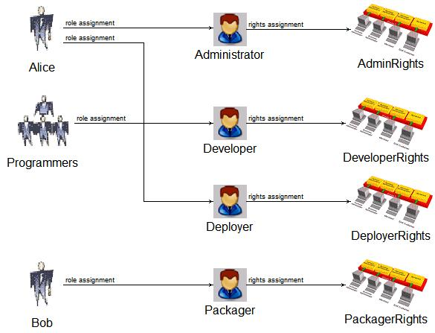
User-Role-Rights Mapping
(Effective Rights)
Responsibility of the System Administrator and defined in the application server deployment site through access control policies
The roles can be application specific or platform (CCM) specific
CCM Specific roles: Designer, Developer, Implementer, Assembler, Packager, Deployer, End-User
Application Specific roles: Administrator, User, Director, Programmer, Manager, etc.
The Users & Groups are shown for completeness. User/Group → Role mappings are defined in the application access policies
CS 388: Model Integrated Computing
Notes:
custom rights families to further refine your access control policies

Slide 9
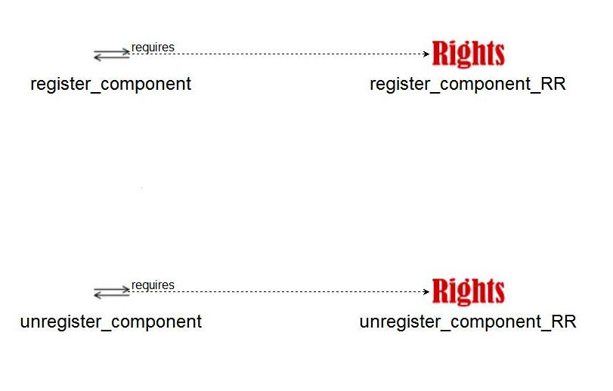
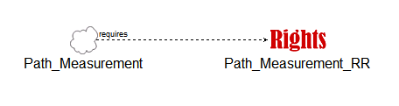
Operation/Interface Classification Modeling
(Required Rights)
Responsibility of the Component Developer
Operations/Interfaces are classified according to the standard CORBA family rights [corba:gsum]
Well-defined Component Interfaces
Allows for coarse-grained control over operation access
Used underneath in the container to determine access decisions to the operations
Granted Rights vs. Required Rights
Rights assignment on a two-way method
CS 388: Model Integrated Computing
Notes:
CORBA rights family has an interesting concept which assigns methods rights according to their types. The spec says that many times a method doesn’t actually perform what its signature says and

Slide 10
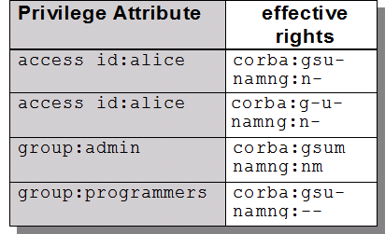
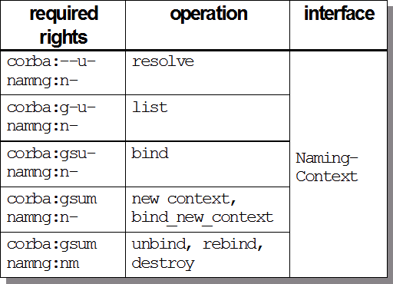
Effective Vs. Required Rights
Granted by Policy
Per domain
Specified by developers
  Per-type!
  System-wide!
Group operations by “sensitivity“
get(g), set(s), use(u), manage(m)
Rights Combinators: any, all
CS 388: Model Integrated Computing

Slide 11
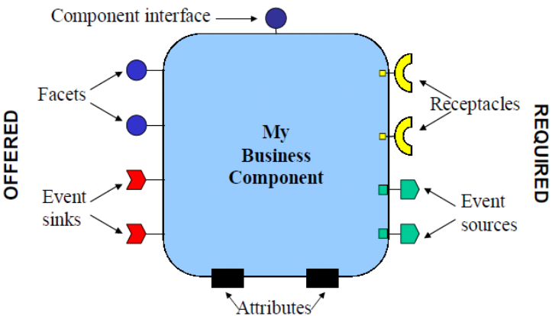
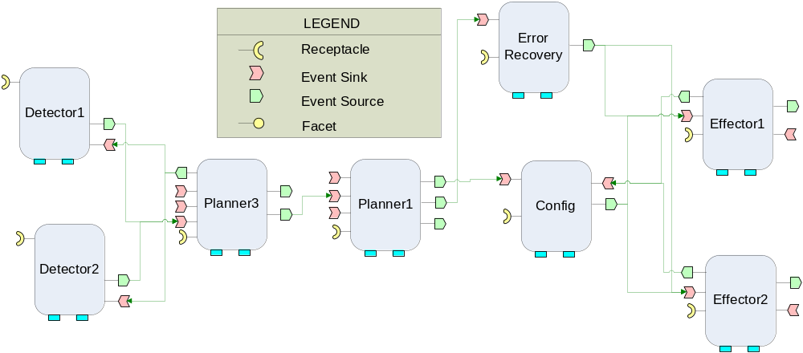
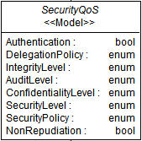
CCM QoS Levels
The CORBA Component Model
Address three CCM QoS levels – ports, components and assemblies
SQML provides fine-grained as well as coarse-grained access control and security guarantees
A CCM Assembly
Configure Security QoS Properties
CS 388: Model Integrated Computing

Slide 12
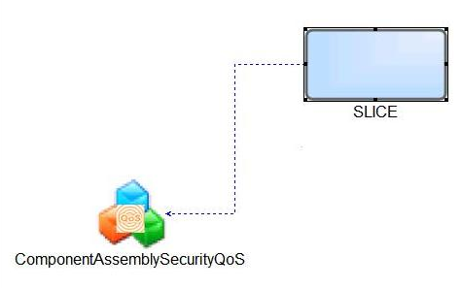
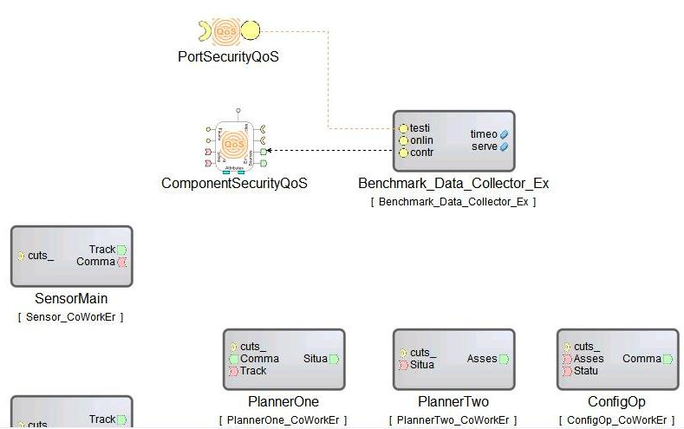
Access Control Granularity
Fine-grained:
  Interface Operation
  Assembly Property
  Component Attribute
Coarse-grained:
  Interface
  Set of Operations
  Class of Operations (based on Required Rights - corba:gsum)
  Inter-Component Execution Flow (Path in an Assembly)
CS 388: Model Integrated Computing

Slide 13
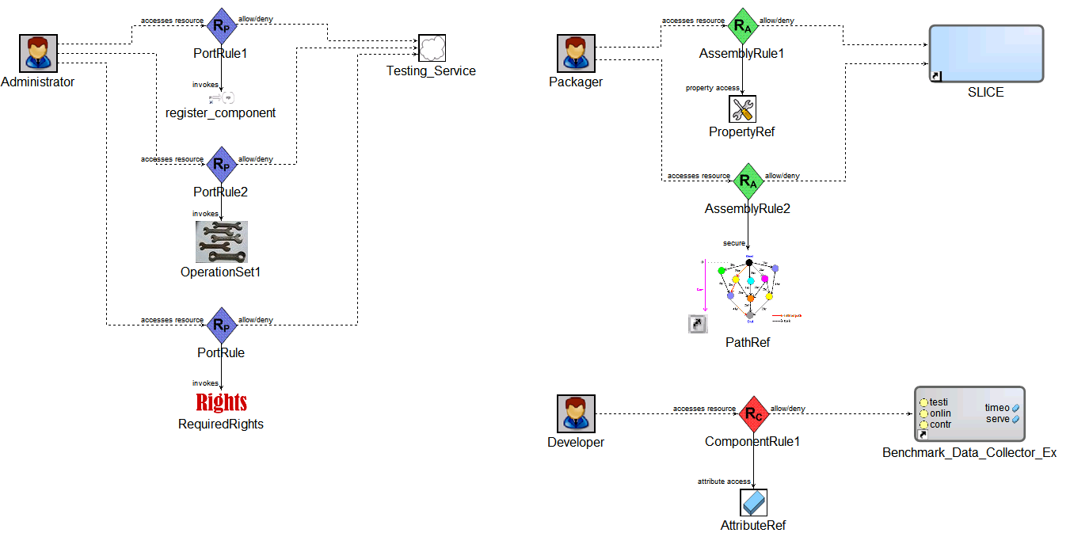
Policy Definition Rules
Two-Level evaluation: Operation name & Required Rights
Two-Level Evaluation: Operation name & Required Rights
Two-Level Evaluation: Operation name & Required Rights
Critical path in the system (part of a functionality/workflow)
Allow/Deny access to all operations with same rights
Component Attributes have implicit get/set rights
CS 388: Model Integrated Computing

Slide 14
Model Interpreter
Inject security related assertions and constraints to the CCM component deployment and configuration plan and generate security policies and permissions
Generate User → Role → Granted-Rights mappings defined by the system administrator for deployment in Security Assertion Markup Language (SAML)
Generate Operation → Required-Rights mapping for an interface that are determined by the component designer
Generate Policy definition files in eXtended Access Control Markup Language (XACML)
Based on the mappings and policy rules, it will generate method permissions that are defined on the operations of the interface definition for the User roles that have rights to invoke a method
Generate additional metadata to configure the CCM container for applying the defined Security policies and enforcing them on the object interactions
CS 388: Model Integrated Computing

Slide 15
Future Work
Define efficient rule and policy validation and rule combining algorithms.
Extend the critical path functionality to provide Business Process & Workflow security
Provide middleware infrastructure support for security in the CCM container through container portable interceptors, leveraging the facilities of the CORBA security service implementation available with TAO
Implement Policy Evaluation Point (PEP), Policy Decision Point (PDP), Policy Repository in CIAO
Enable D & C tools like DAnCE to integrate security QoS properties with application deployment and configure the CCM middleware to enforce them
This project will be extended in future R&D activities at ISIS to support Security QoS that is independent of the underlying middleware technology
Weaving of Concerns: Investigate the ramifications of having FT, RT and Security working in tandem
CS 388: Model Integrated Computing

Slide 16
Questions?
CS 388: Model Integrated Computing

