Slide 1
Quality of Service Configuration DSML for the Data Distribution Service
Joe Hoffert
jhoffert@dre.vanderbilt.edu

Slide 2
Outline
Data Distribution Service (DDS)
  DDS Quality of Service (QoS) Policies
DDS QoS Configuration Metamodel
DDS Benchmark Environment (DBE)
DBE Interpreter
DDS QoS DSML Demonstration
Help Topics
Future Direction

Slide 3
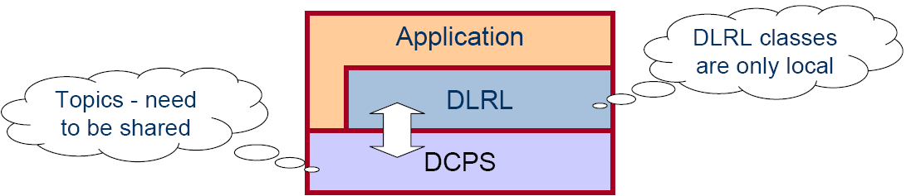
The OMG Data Distribution Service (DDS)
Application
write
read
Application
‘Global’ Data Store
write
Application
write
write
Application
read
read
Application
Provides flexibility, power and modular structure by decoupling:
  Location – anonymous pub/sub
  Redundancy – any number of readers & writers
  Time – asynchronous, time-independent data distribution
  Platform – same as CORBA middleware
Architecturally Broken into
Data Centric Pub/Sub (DCPS)
  - Lower layer APIs to exchange topic data based on QoS policies
Data Local Reconstruction Layer (DLRL)
  - Upper layer APIs that make topic data appear local

Slide 4
DDS Domains & Domain Participants
The Domain is the basic construct used to bind individual applications together for communication
  Like a VPN
Domain 2
Domain 3
2
3
1
1
Node
Node
Node
2
3
1
1
Node
Node
Node
DomainParticipant
Domain 1

Slide 5
DCPS Entities
DCPS Entities include
  Topics
    Typed data
  Publishers
    Contain DataWriters
  Subscribers
    Contain DataReaders
  DomainParticipants
    Entry points
Data can be accessed in two ways
  Wait-based (synchronous calls)
  Listener-based (asynchronous callbacks)
Sophisticated support for filtering
  e.g., Topic, Content-FilteredTopic, or MultiTopic
Configurable via (many) QoS policies
Topic
Topic
Topic
Domain Participant
Data Reader
Data Writer
Data Writer
Data Reader
Data Reader
Data Writer
Subscriber
Publisher
Subscriber
Publisher
Data Domain

Slide 6
QoS Policies Supported by DDS
DCPS entities (e.g., topics, data readers/writers) configurable via QoS policies
QoS tailored to data distribution in tactical information systems
Request/offered compatibility checked by DDS at Runtime
Consistency checked by DDS at Runtime
  DEADLINE
    Establishes contract regarding rate at which periodic data is refreshed
  LATENCY_BUDGET
    Establishes guidelines for acceptable end-to-end delays
  TIME_BASED_FILTER
    Mediates exchanges between slow consumers & fast producers
  RESOURCE_LIMITS
    Controls resources utilized by service
  RELIABILITY (BEST_EFFORT, RELIABLE)
    Enables use of real-time transports for data
  HISTORY (KEEP_LAST, KEEP_ALL)
    Controls which (of multiple) data values are delivered
  DURABILITY (VOLATILE, TRANSIENT, PERSISTENT)
    Determines if data outlives time when they are written
  … and 15 more …

Slide 7
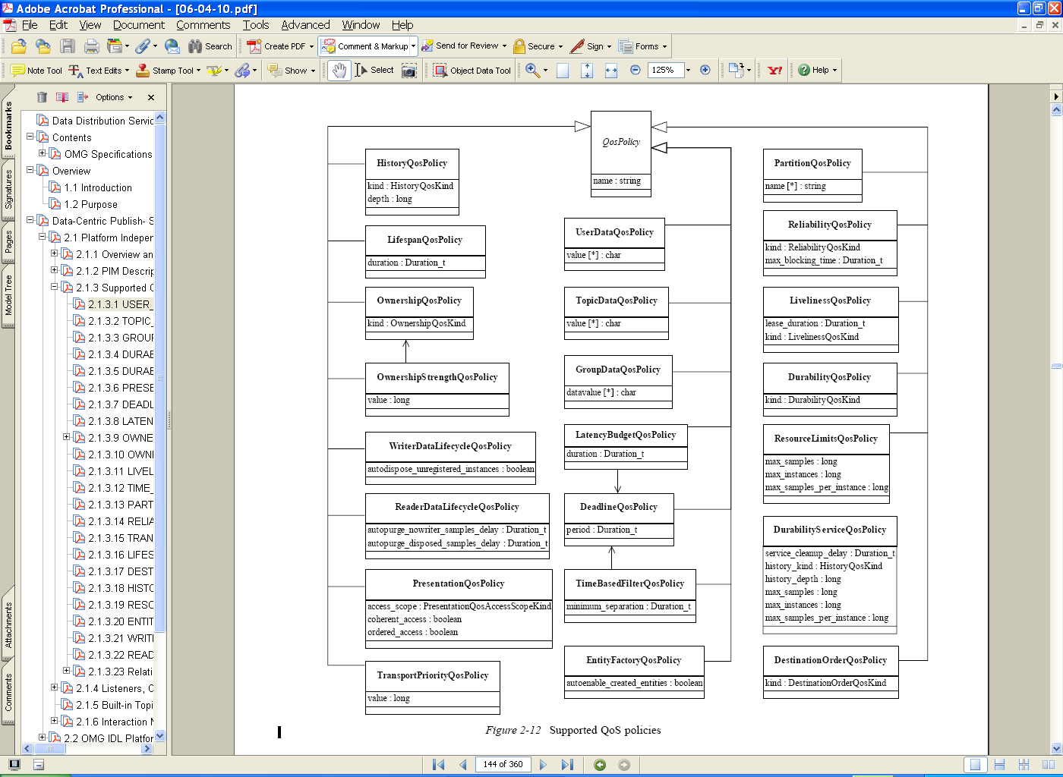








DDS QoS Policies
Interactions of QoS Policies have implications for:
  Consistency/Validity
  e.g., Deadline period < TimeBasedFilter minimum separation (for a DataReader)
  Compatibility/Connectivity
  e.g., best-effort communication offered (by DataWriter), reliable communication requested (by DataReader)
DataWriter
DataReader
Deadline-
10ms
Will Data Flow?
Or Will Recoding Be Required?
Durability-
Volatile
Timebased-
15ms
Durability-
Transient
Deadline-
20ms
Liveliness-
Manual By Topic
DataWriter
Topic
DataReader
Reliability-
Best Effort
Reliability-
Reliable
Will Settings Be Consistent?
Or Will Recoding Be Required?
Liveliness-
Automatic

Slide 8
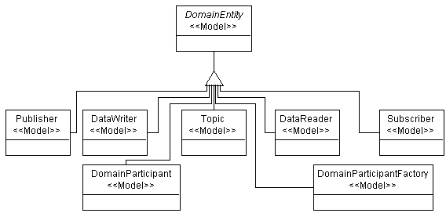
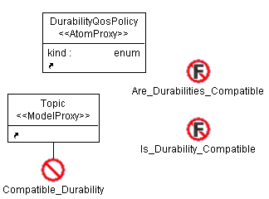
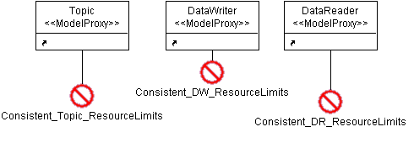
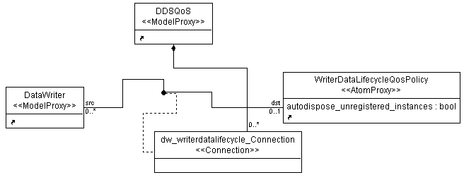
DDS QoS Configuration Metamodel
Scope:
  Only Modeling DDS Entities Applicable to QoS Policies
  Not modeling deployment or general DDS entities
OCL Constraints for
  Compatibility
  Consistency
Cardinality Handled in Metamodel

Slide 9
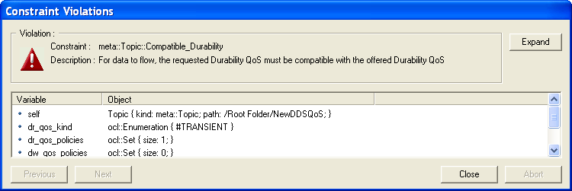
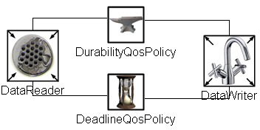
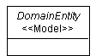
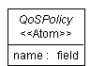
Metamodel Design Decisions
No Abortive Errors
  User can ignore constraint errors
  May be useful for developing pieces of a distributed application
  Err on side of flexibility initially
Associations vs. Containment
  Entities and QoS Policies associated via connections rather than containment
  Provides more flexibility and reusability
Entities as Models,
QoS Policies as Atoms
  Entities don’t (currently) need to contain anything
  Initially wasn’t sure

Slide 10


DDS Benchmark Environment (DBE)
Part of Real-Time DDS Examination & Evaluation Project (RT-DEEP)
Developed by DRE Group at ISIS
DBE runs Perl scripts to deploy DataReaders and DataWriters onto nodes
Passes files for QoS settings
Test environment for Modeling Language
QoS
QoS
QoS
DataReader
DataReader
QoS
DataReader
DataReader
QoS
QoS
DataWriter
DataWriter
QoS
QoS
DataWriter
DataWriter

Slide 11
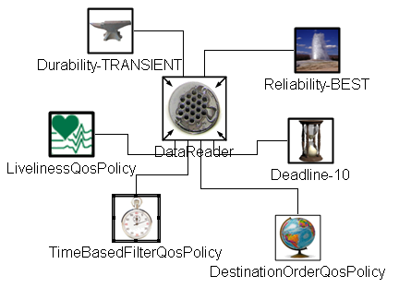
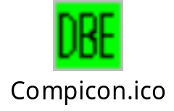
DBE Interpreter
Generates One QoS Settings File for Each DBE
DataReader and DataWriter to Use
DataReader
QoS Settings
Invoke the DBE
Interpreter in GME
DBE
Model the Desired
QoS Policies in GME
QoS Settings
DataWriter
Have DBE Launch DataReaders
and DataWriters with Generated
QoS Settings Files

Slide 12
DDS QoS Modeling Language Demonstration
Create DDS entities, QoS policies, and connections
Run constraint checking
  consistency check
  compatibility check
Invoke DBE Interpreter
Compare output to desired format

Slide 13










Feedback
User Feedback
  Icons
  Usability
  Scalability
GME Modeling Feedback
  Structure of OCL Constraints
    More Informative Messages
      Maybe add “unneeded” parameters for clarification
  Converting Models to Atoms (for the DDS Entities)
    GReAT?

Slide 14
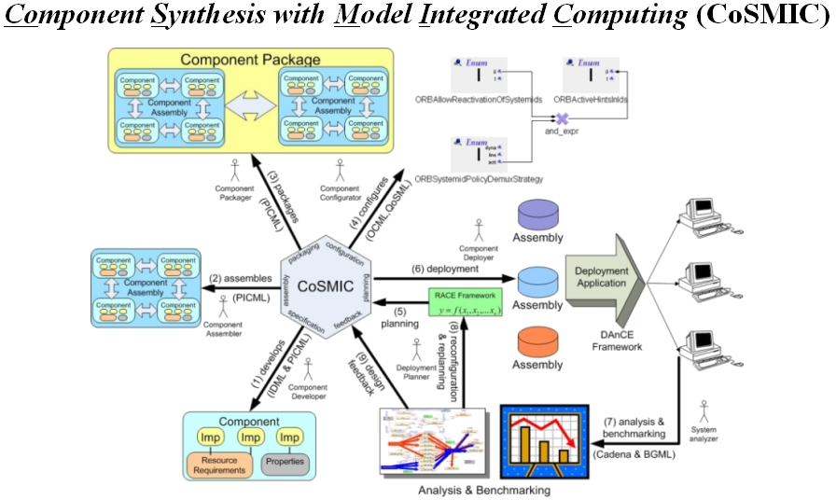
Future Work
Keep DDS QoS ML in step with DBE
  Support current DBE
  Update for other entities and scenarios as needed
    (e.g., Topics, Subscribers, Publishers)
Incorporate with other Deployment Tools
  e.g., Deployment and Configuration Engine (DAnCE) in CoSMIC Tool Chain
DAnCE
Incorporate with TRUST Trustworthy Systems
  e.g., merging different dimensions (such as RT, FT, security) to provide trustworthy computing capabilities to enterprise DRE systems

