Slide 1


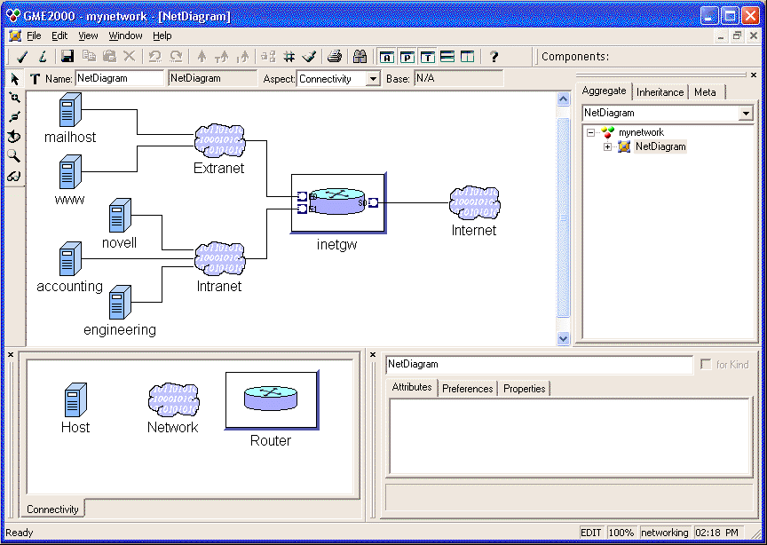
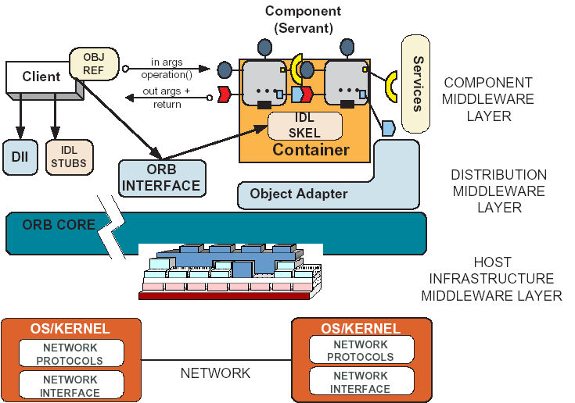
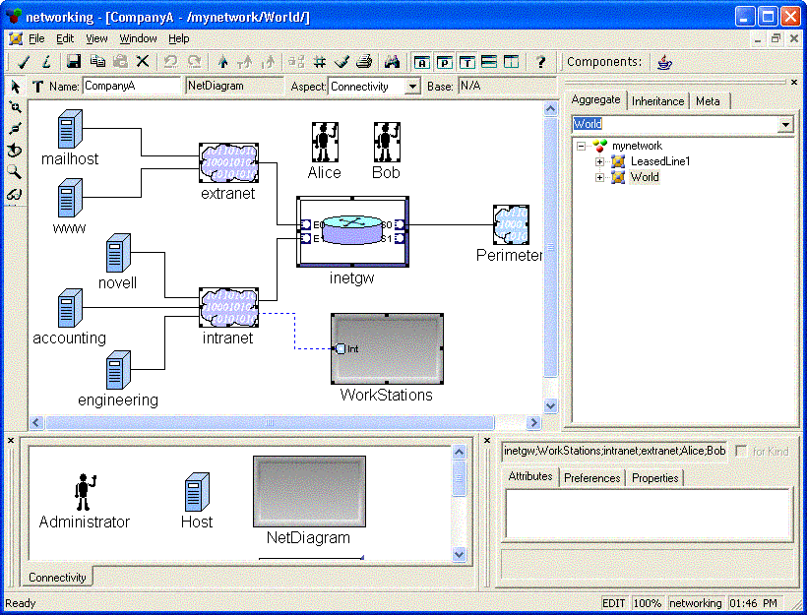
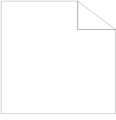
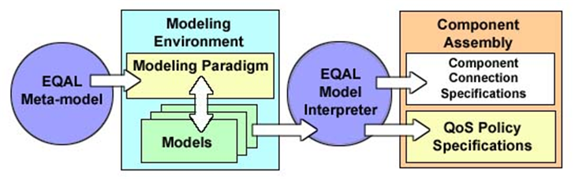
CoSMIC: Tool-suite for capturing Deployment & Configuration concerns of CCM implementations
Institute for Software Integrated Systems, Vanderbilt University, Nashville, TN
http://www.dre.vanderbilt.edu/cosmic
Interface Definition Modeling Language (IDML)
Publisher/Subscriber Service Configuration Challenges
Create Model
Graphical modeling language.
Component middleware building blocks.
Integrated with PICML.
Export model to equivalent XML format.
Generate middleware-specific application code.
  IDL generator finished
  Planned generators for EJB and SLICE
Context
  Publisher/subscriber services are highly configurable
  XML-based specification of QoS properties
Problems
  Multiple dissimilar services
  Semantically invalid operating policies
  Error-prone handwritten XML
Solution
  Use models to enforce policy constraints and synthesize configuration files
Modify Model
Export
XML
IDL Generator
Generate
IDL
EJB
SLICE
Event QoS Aspect Language (EQAL)
Importing CCM Applications Into IDML
EQAL is a Model-Driven Middleware (MDM) tool
  Built in the Generic Modeling Environment (GME)
  Addresses publisher/subscriber service configuration and deployment challenges
    Models specify service configurations and deployments
    Aspects decouple D&C concerns
    Constraints ensure semantic validity
    Interpreters generate descriptor files
IDL
IDL Importer translates IDL into IDML’s XML format.
Import XML into graphical modeling tool.
  Translate to other middleware platform.
Develop model further
  Regenerate IDL.
  Generate application code for a different middleware platform.
IDL Importer
XML
Import
Modify Model
IDL
EJB
SLICE
Generate
Evaluating EQAL
Toward MOF-Compliant Modeling
Use MOF to IDL mapping to generate IDL interfaces.
  Inheriting from the MOF abstract IDL interfaces.
  Used to implement a repository for models.
Through repository, models are accessible to other MOF-compliant tools.
  For generation
  For further development
  For reuse in other projects
  For analysis
  For simulation
EQAL eliminates the need to write some C++ code
  Manages event channel lifecycles
  Initializes suppliers, consumers, and gateways
  Specifies service properties
EQAL alleviates key sources of complexity
  Modularizes cross-cutting concerns
    Service configuration vs. component functionality
  Reduces ad-hoc component development
    Provides a methodology for creating specifications
  Identifies design flaws earlier
    Developers are notified of invalid configurations
  Provides a reusable and maintainable representation of application properties
    Models are easy to understand and evolve
MOF Abstract Mapping (IDL)
MOF2IDL
inherits
Repository IDL
implement
MOF Modeling Environment
Model Repository
MOF-Compliant Tool
MOF-Compliant Tool

