Slide 1



Overview of the OMG
Data Distribution Service
Dr. Douglas C. Schmidt
d.schmidt@vanderbilt.edu
http://www.dre.vanderbilt.edu/~schmidt/
Jeff Parsons
j.parsons@vanderbilt.edu

Slide 2


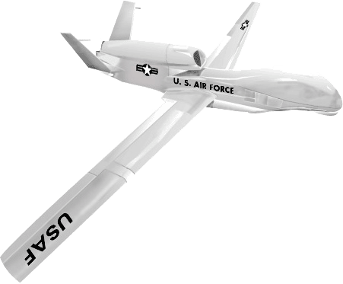

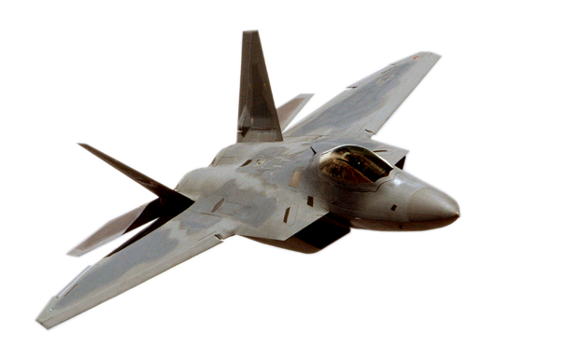
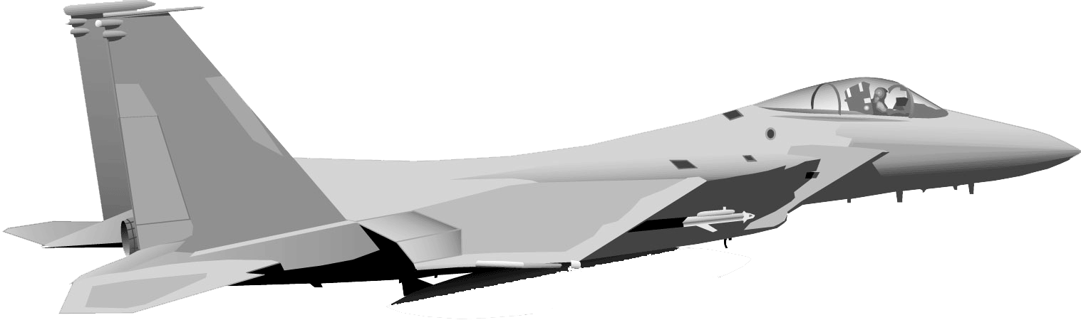
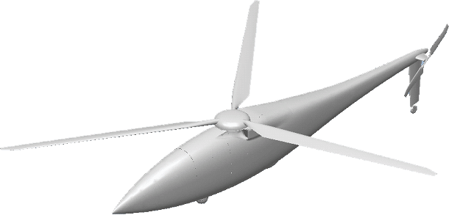
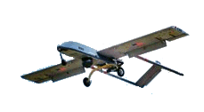


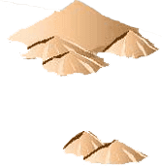
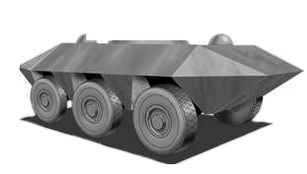
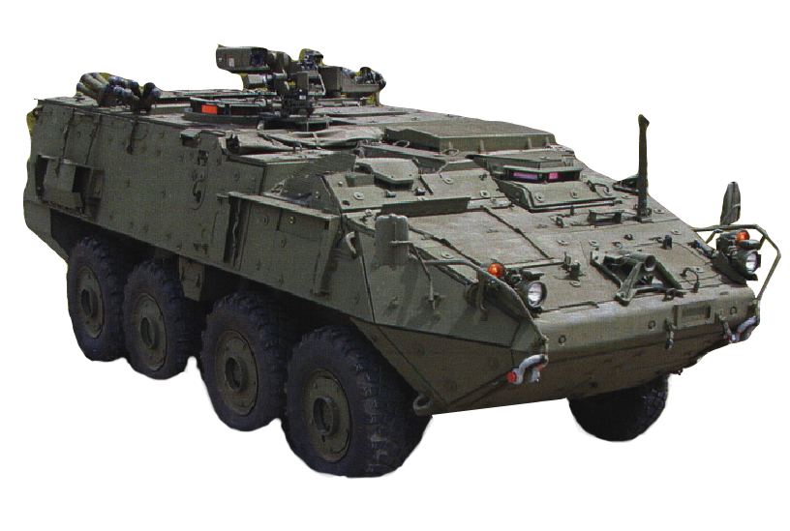
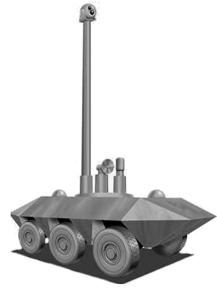
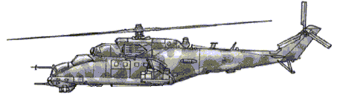
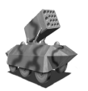


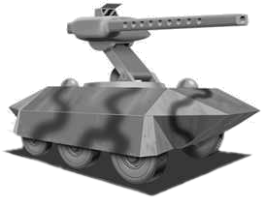
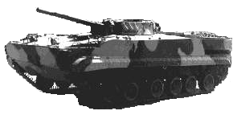
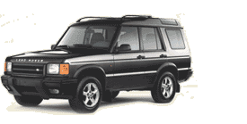
New Demands on DRE Systems
Key problem space challenges
  Large-scale, network-centric, dynamic, systems of systems
  Simultaneous QoS demands with insufficient resources
    e.g., wireless with intermittent connectivity
  Highly diverse & complex problem domains
Key solution space challenges
  Enormous accidental & inherent complexities
  Continuous technology evolution refresh, & change
  Highly heterogeneous platform, language, & tool environments
Utility “Curve”
Desired
Utility
Curve
Utility
“Working
Range”
“Broken”
“Works”
Utility
Resources
Resources
“Harder” Requirements
“Softer” Requirements

Slide 3
Promising Approach:
The OMG Data Distribution Service (DDS)
Application
write
read
Application
‘Global’ Data Store
write
Application
write
write
Application
read
read
Application
Provides flexibility, power and modular structure by decoupling:
  Location – anonymous pub/sub
  Redundancy – any number of readers & writers
  Time – asynchronous, time-independent data distribution
  Platform – same as CORBA middleware

Slide 4
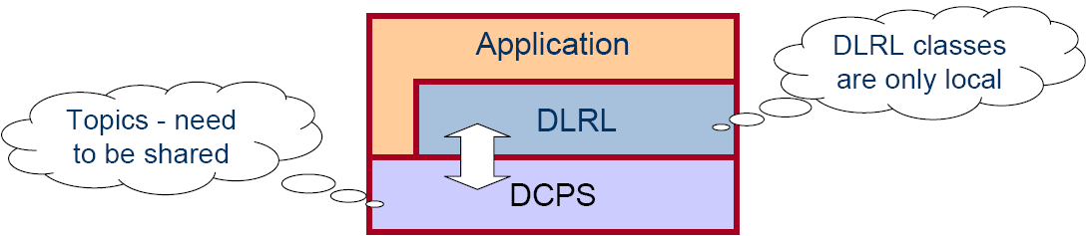
DDS Architectural Elements
Data-Centric Publish-Subscribe (DCPS)
  The lower layer APIs apps can use to exchange topic data with other DDS-enabled apps according to designated QoS policies
Data Local Reconstruction Layer (DLRL)
  The upper layer APIs that define how to build a local object cache so apps can access topic data as if it were local
DDS spec only defines policies & interfaces between application & service
  Doesn’t address protocols & techniques for different actors implementing the service
  Doesn’t address management of internal DDS resources

Slide 5
DDS Application Architecture
{
The Application
Application
Application
Application
Application
DLRL
DLRL
DLRL
DLRL
DCPS
Communication

Slide 6
DDS Domains & Domain Participants
The Domain is the basic construct used to bind individual applications together for communication
  Like a VPN
Domain 2
Domain 3
2
3
1
1
Node
Node
Node
2
3
1
1
Node
Node
Node
DomainParticipant
Domain 1

Slide 7
DCPS Entities
DCPS Entities include
  Topics
    Typed data
  Publishers
    Contain DataWriters
  Subscribers
    Contain DataReaders
  DomainParticipants
    Entry points
Data can be accessed in two ways
  Wait-based (synchronous calls)
  Listener-based (asynchronous callbacks)
Sophisticated support for filtering
  e.g., Topic, Content-FilteredTopic, or MultiTopic
Configurable via (many) QoS policies
Topic
Topic
Topic
Domain Participant
Data Reader
Data Writer
Data Writer
Data Reader
Data Reader
Data Writer
Subscriber
Publisher
Subscriber
Publisher
Data Domain

Slide 8
QoS Policies Supported by DDS
DCPS entities (i.e., topics, data readers/writers) configurable via QoS policies
QoS tailored to data distribution in tactical information systems
Request/offered compatibility checked by DDS
  DEADLINE
    Establishes contract regarding rate at which periodic data is refreshed
  LATENCY_BUDGET
    Establishes guidelines for acceptable end-to-end delays
  TIME_BASED_FILTER
    Mediates exchanges between slow consumers & fast producers
  RESOURCE_LIMITS
    Controls resources utilized by service
  RELIABILITY (BEST_EFFORT, RELIABLE)
    Enables use of real-time transports for data
  HISTORY (KEEP_LAST, KEEP_ALL)
    Controls which (of multiple) data values are delivered
  DURABILITY (VOLATILE, TRANSIENT, PERSISTENT)
    Determines if data outlives time when they are written
  … and many more …

Slide 9
Types & Keys
A DDS Type is represented by a collection of data items.
  e.g. “IDL struct” in the CORBA PSM
    struct AnalogSensor {
    string sensor_id; // key
    float value; // other sensor data
    };
A subset of the collection is designated as the Key.
  The Key can be indicated by IDL annotation in CORBA PSM, e.g.,
    #pragma DDS_KEY AnalogSensor::sensor_id
It’s manipulated by means of automatically-generated typed interfaces.
  IDL compiler may be used in CORBA PSM implementation
A Type is associated with generated code:
  AnalogSensorDataWriter // write values
  AnalogSensorDataReader // read values
  AnalogSensorType // can register itself with Domain

Slide 10
Topics
A DDS Topic is the connection between publishers & subscribers.
A Topic is comprised of a Name and a Type.
  Name must be unique in the Domain.
  Many Topics can have the same Type.
Provision is made for content-based subscriptions.
  MultiTopics correspond to SQL join
  Content-Filtered Topics correspond to SQL select.
Domain
ID
35
Topic
name
“MySensor”
Type
name
“AnalogSensor”
string
sensor_id
[ key ]
float
value

Slide 11
Example: Create Domain Participant
Singleton DomainParticipantFactory creates DomainParticipant objects.
DomainParticipant object in turn acts as factory for Publisher, Subscriber and Topic objects.
// used to identify the participant
DomainId_t domain_id;
// get the singleton factory instance
DomainParticipantFactory_var dpf =
DomainParticipantFactory::get_instance ();
// create domain participant from factory
DomainParticipant_var dp =
dpf->create_participant (domain_id,
PARTICIPANT_QOS_DEFAULT,
NULL);

Slide 12
Example: Create Topic
……
// register the data type associated with the topic
FooDataType foo_dt;
foo_dt.register_type (dp,“Foo”);
// create a topic
Topic_var foo_topic =
dp->create_topic (“Foo_topic”, //topic name
“Foo”, // type name
TOPIC_QOS_DEFAULT, // Qos policy
NULL); // topic listener

Slide 13
Example: Create Subscriber and DataReader
……
// create a subscriber from the domain participant
SubscriberQos sQos;
dp->get_default_subscriber_qos (sQos);
Subscriber_var s =
dp->create_subscriber (sQos,
NULL);
// create a data reader from the subscriber
// and associate it with the created topic
DataReader_var reader =
s->create_datareader (foo_topic.in (),
DATAREADER_QOS_DEFAULT,
NULL);
FooDataReader_var foo_reader =
FooDataReader::_narrow (reader.in ());

Slide 14
Example: Create Publisher and DataWriter
……
// create a publisher from the domain participant
PublisherQos pQos;
dp->get_default_publisher_qos (pQos);
Publisher_var p =
dp->create_publisher (pQos, NULL);
// create a data writer from the publisher
// and associate it with the created topic
DataWriter_var writer =
p->create_datawriter (foo_topic.in (), DATAWRITER_QOS_DEFAULT,
NULL);
// narrow down to specific data writer
FooDataWriter_var foo_writer =
FooDataWriter::_narrow (writer);
// publish user-defined data
Foo foo_data;
foo_writer->write (foo_data);

Slide 15



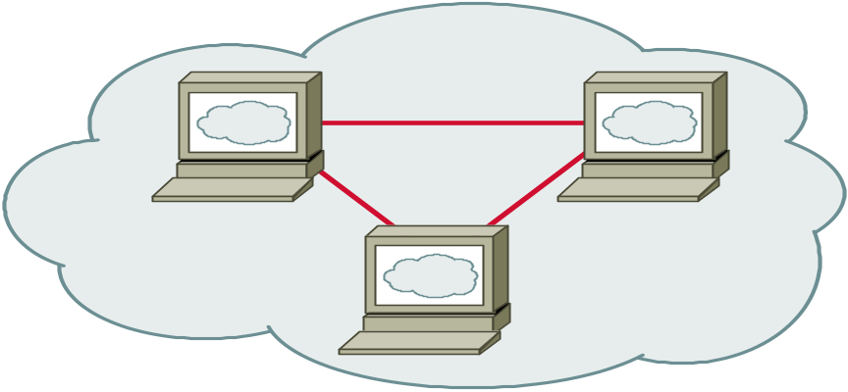




Summary of DCPS features
DDS
subscribers
publishers
Information consumer subscribe to information of interest
Information producer publish information
DDS matches & routes relevant info to interested subscribers
Efficient Publish/Subscribe interfaces
QoS suitable for real-time systems
  deadlines, levels of reliability, latency, resource usage, time-based filter
Listener & wait-based data access suits different application styles
Support for content-based subscriptions
Support for data-ownership
Support for history & persistence of data-modifications

Slide 16
Goals of DLRL
Data Local Reconstruction Layer (DLRL) model is local to an application
“Object-oriented” access to data
Application developers can
  describe classes with their methods, data fields, & relations
  attach some of those data fields to DCPS entities
  manipulate these objects (i.e., create, read, write, delete) using native language constructs
  activate attached DCPS entities to update objects
  have these objects managed in a cache
Like a mapping or binding (intuition only)

Slide 17
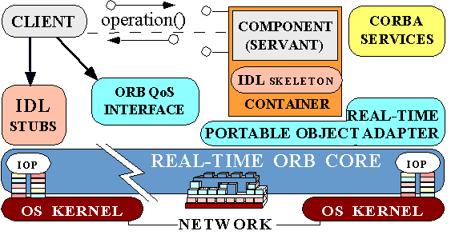
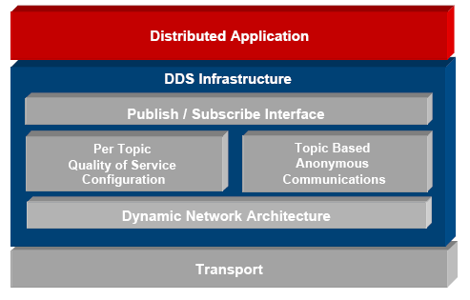
Comparing CORBA with DDS
Distributed object
• Client/server
• Remote method calls
• Reliable transport
Best for
• Remote command processing
• File transfer
• Synchronous transactions
Distributed data
• Publish/subscribe
• Multicast data
• Configurable QoS
Best for
• Quick dissemination to many nodes
• Dynamic nets
• Flexible delivery requirements
DDS & CORBA address different needs
Complex systems often need both…

