Slide 1
TIMERS & COUNTERS
D. Mohan Kumar

Slide 2
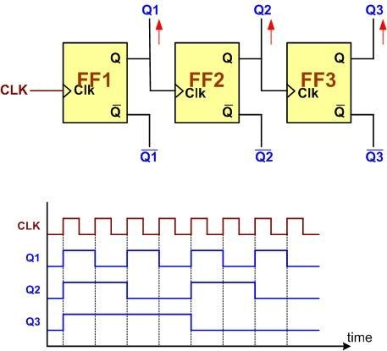
COUNTER

Slide 3


Types of counters
Up - Counter
Down - Counter

Slide 4
Counter Functions
Creating events
Making delays
Measuring the Time between 2 events

Slide 5

Creating Events

Slide 6
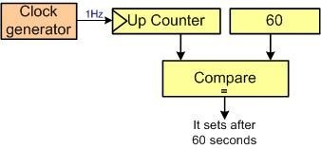
2. Making Delays

Slide 7

3. Measuring Time between 2 events

Slide 8
TIMERS
Timers can be used as a Time Base Generators
Timers can be used to measure the frequency of an external event
Timers can control the output waveform or to indicate when period of time has elapsed
Timer is an External clock

Slide 9
Types of Timers
Advanced Timers
Basic Times
General Purpose Timers

Slide 10
Registers used in Timers
Timer Count Register (TIMx_CNT)
Timer Auto Reload Register (Timx_ARR)
Timer Prescaler Register (TIMx_PSC)

Slide 11
Timer Modes
Input Capture Mode
Output Compare Mode
PWM Mode
One Pulse Mode

Slide 12
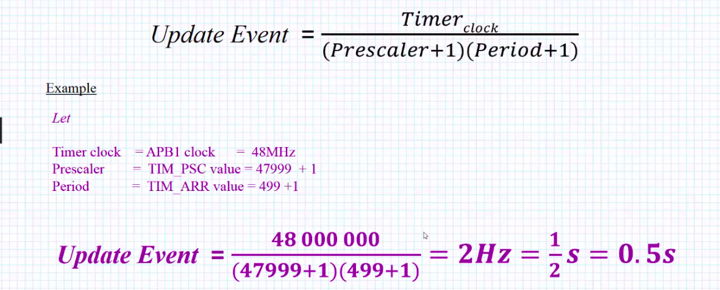
How to Calculate Update event

Slide 13
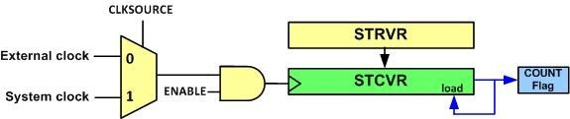
SysTick Timer

Slide 14
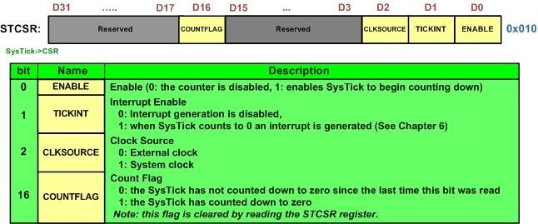
SysTick Timer Registers

Slide 15
Examples of Timers
PLL
XTAL
RC

Slide 16
THANK YOU

