Slide 1
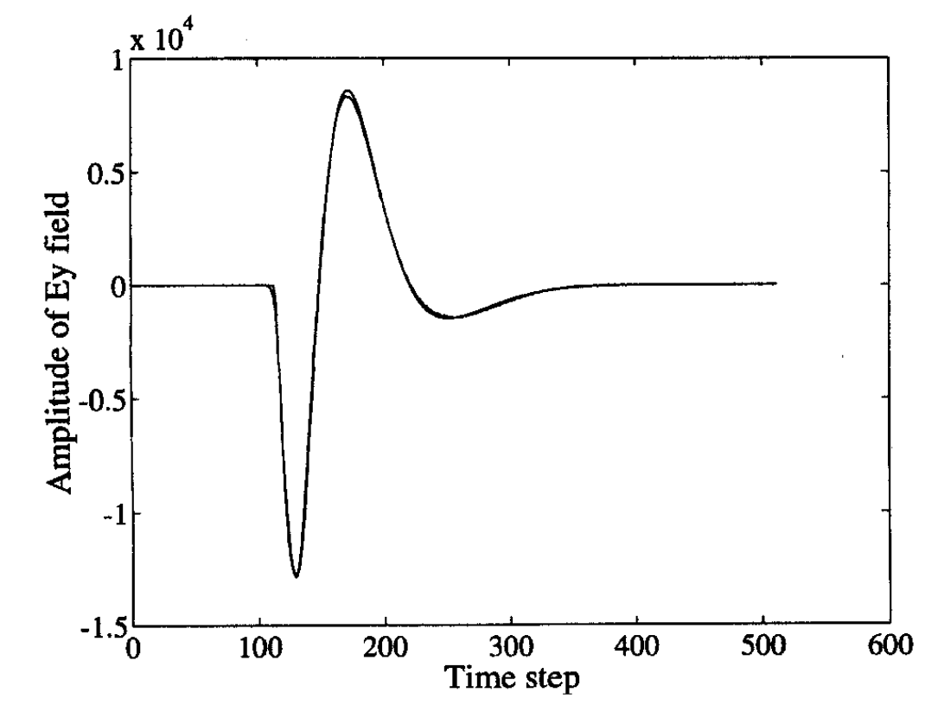
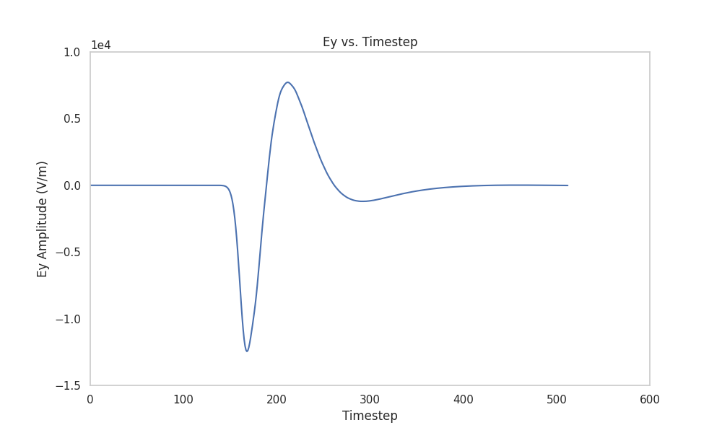
FerroDyn PML Tests
Test #1 – Benchmark test problem from Chew & Weedon (1994).
Case setup: Free-space discretized using a 3D grid of size 128x128x32, with an electric dipole generating a time-dependent source pulse. The domain is enveloped by PML boundaries on all sides to model free-space.
Electric field is sampled at a point sufficiently distant from the point source and plotted over time.

Slide 2
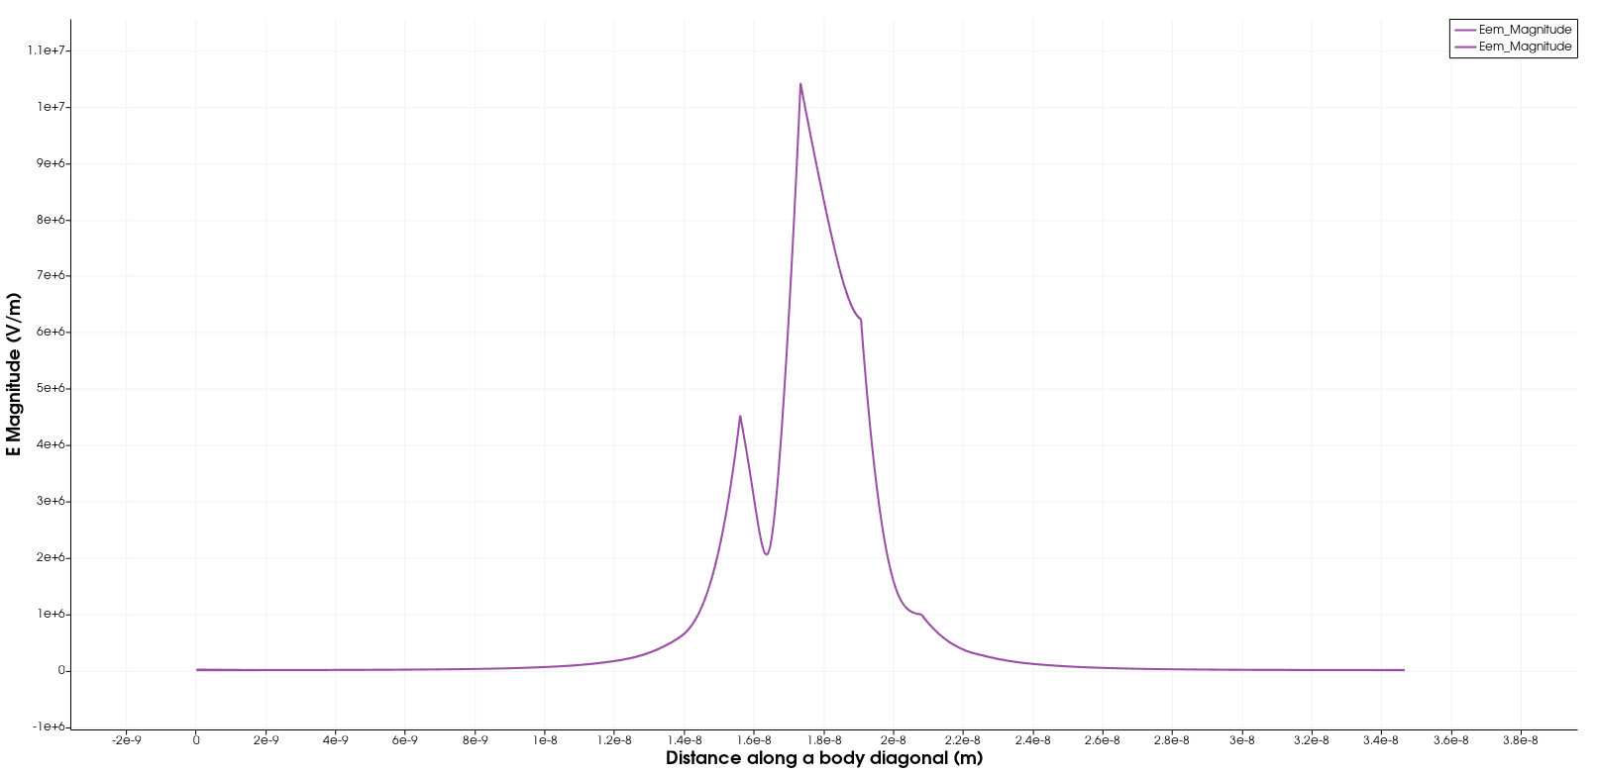
Test #2
Case setup: An infinitesimal light source is placed at the center of a cubic domain, with PML boundaries on all sides. Increasing the domain size, while keeping the source at the center, should preserve the E field profile at a fixed distance from the source.
In simpler words, the E field at a distance x from the source should remain invariant as the domain size changes.

Slide 3
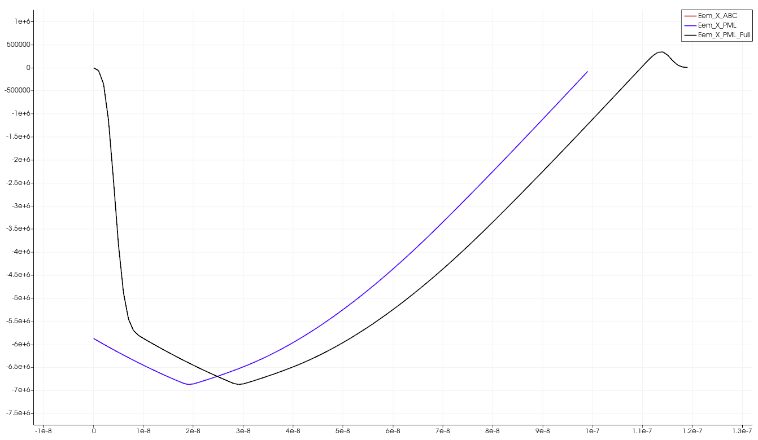
Test #3
2 | 0 | 0
0 | 2 | 0
0 | 0 | 2
Both the PML and the ABC should work in this case
Dielectric with isotropic permittivity
x
Planar current source
Relative permittivity
Black line represents wave amplitude including the solution within the PML region.
Purple lines (overlapping) represent the wave amplitude in the physical domain.
 | E_x | E_y | E_z | H_x | H_y | H_z
Average Relative Error | 2.24704e-05 | 0.0 | 0.0 | 0.0 | 7.27529e-05 | 0.0

Slide 4
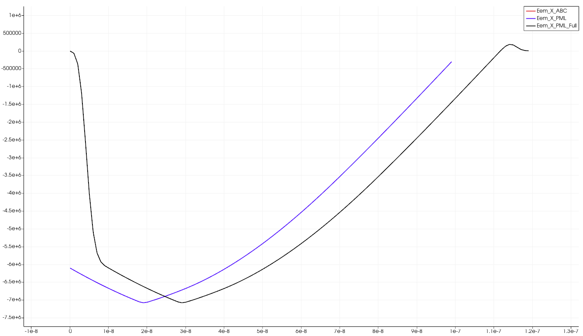
Test #4
PML is needed to ensure that there is no EM wave reflection from the corner
2 | 0 | 0
0 | 8 | 0
0 | 0 | 8
Dielectric with anisotropic permittivity
Planar current source
Relative permittivity
 | E_x | E_y | E_z | H_x | H_y | H_z
Average Relative Error | 1.27162e-05 | 9.14771e-06 | 0.0 | 9.70195e-05 | 6.97178e-05 | 0.0

Slide 5
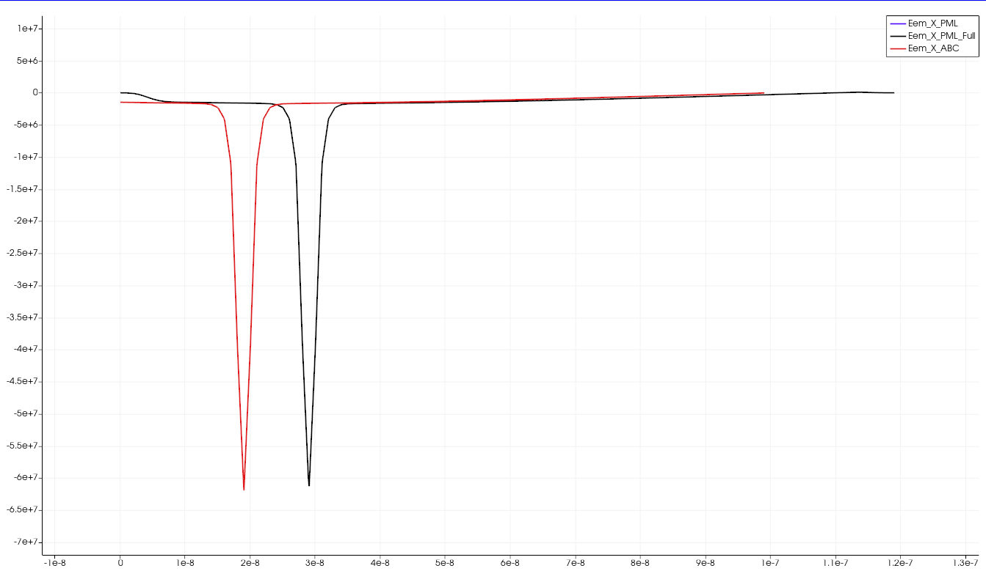
Test #5
2 | 0 | 0
0 | 2 | 0
0 | 0 | 2
PML is needed to ensure that there is no EM wave reflection from the corner
Dielectric with either isotropic or anisotropic permittivity
Planar current source
wavevector
Relative permittivity
4x4x100
Dielectric is at z = 30-60.
Planar current source is at z = 20
 | E_x | E_y | E_z | H_x | H_y | H_z
Average Relative Error | 1.25257e-05 | 8.78869e-13 | 3.58303e-06 | 5.0e-01 | 7.2888e-05 | 7.31158e-04

