Slide 1
RF Model for Salinity, Temperature and Turbidity
Sofia Avendaño

Slide 2
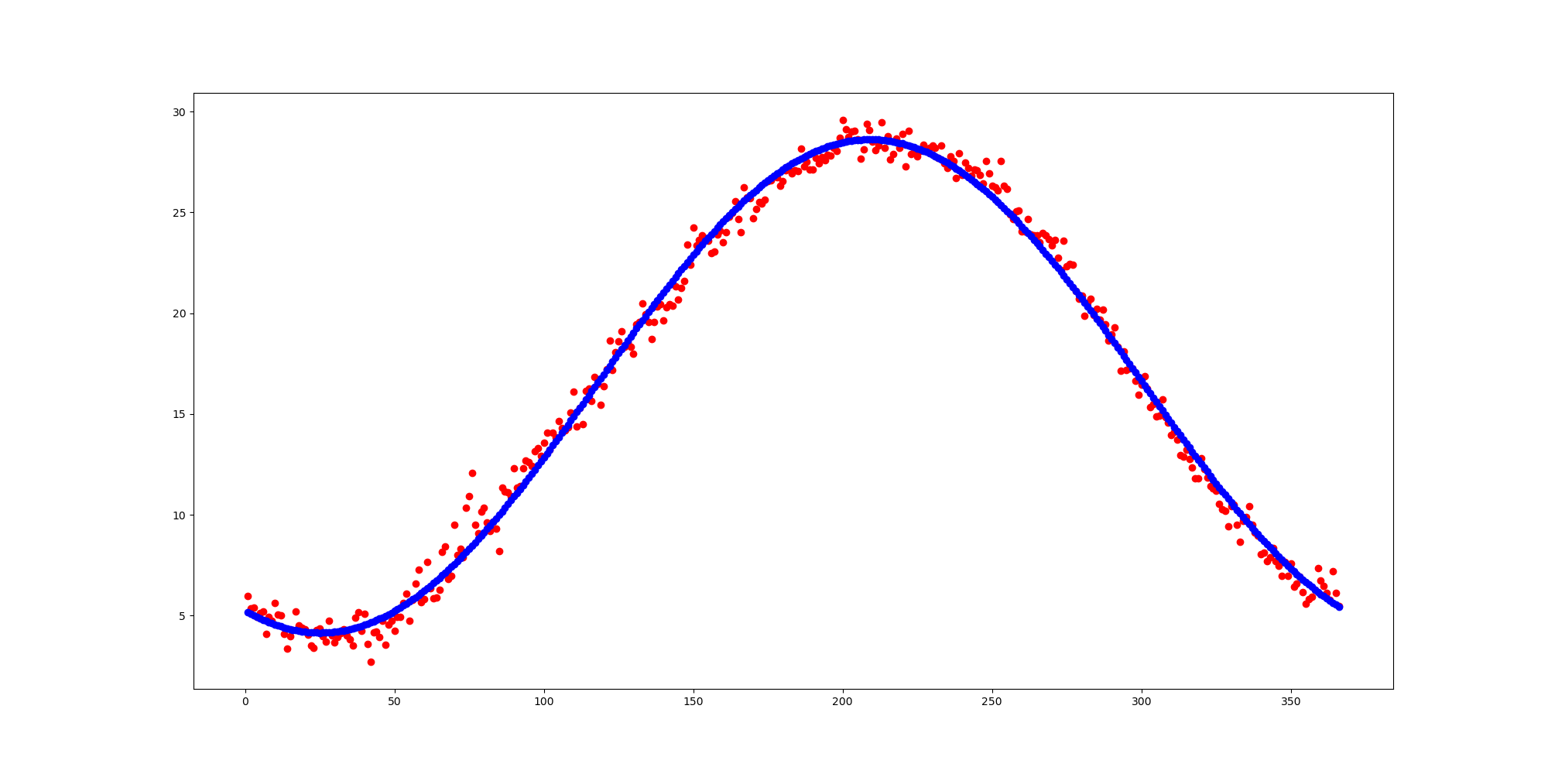
Temperature Curve Fit
Fit is in blue, data is in red
Data is averaged by day (actual
data spans around a decade)
Mean Temperature by Day
Day of Year

Slide 3
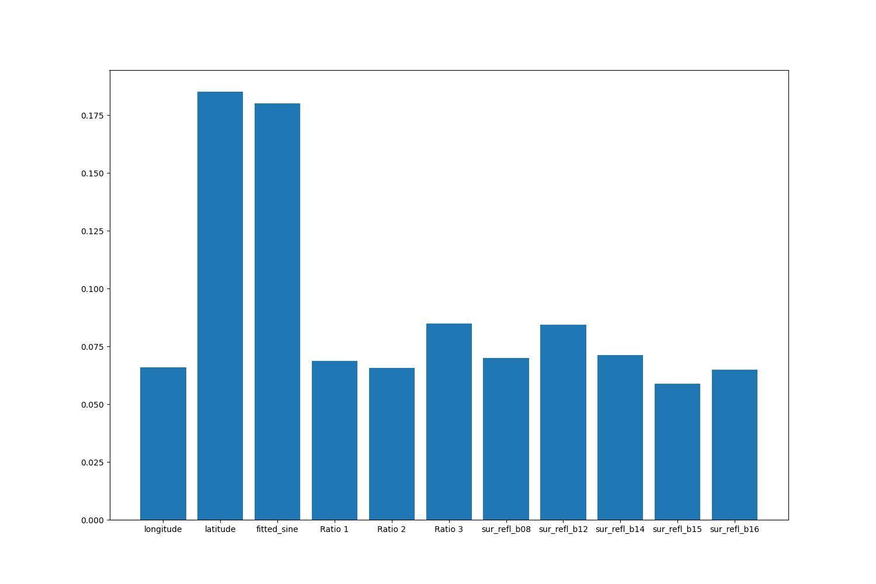
Temperature Important Features
Feature Importance
Features

Slide 4
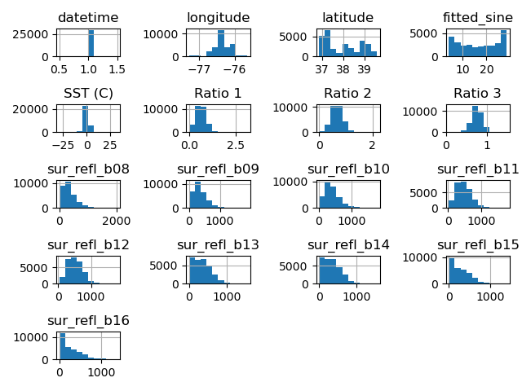
Temperature Data Histogram

Slide 5
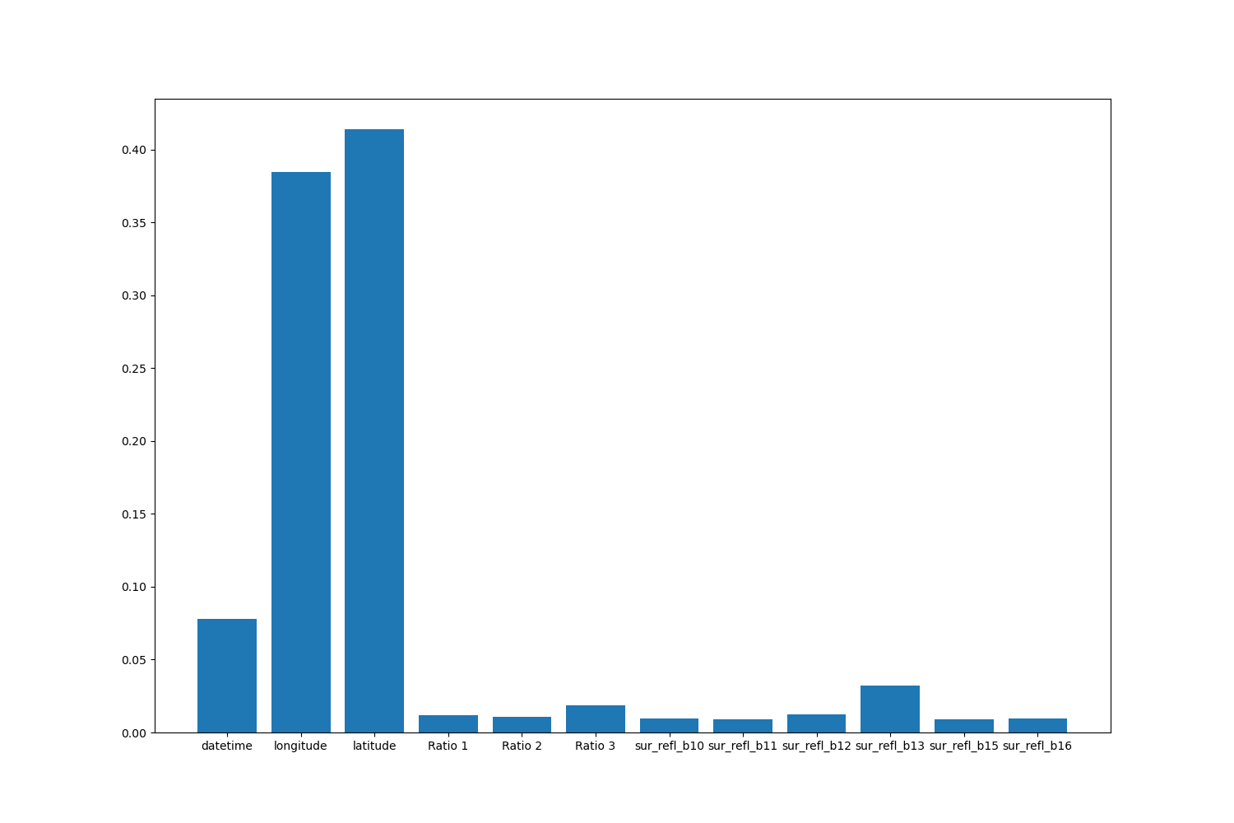
Salinity Important Features
Feature Importance
Features

Slide 6
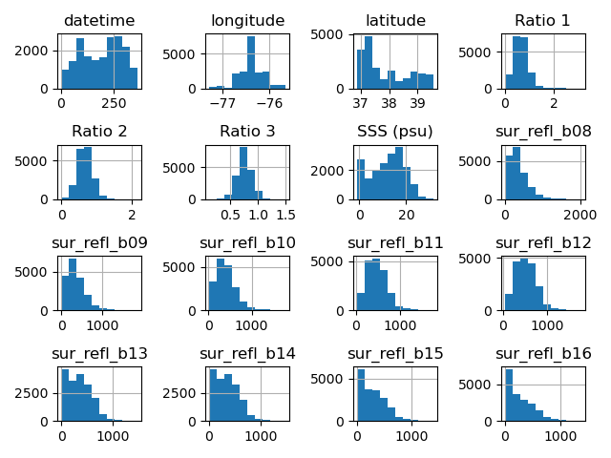
Salinity Data Histogram

