Slide 1
Progress toward observational datasets for ICoM
development and validation
Jon Schwenk
Mulu Fratkin (no more)
Sofia Avendano

Slide 2
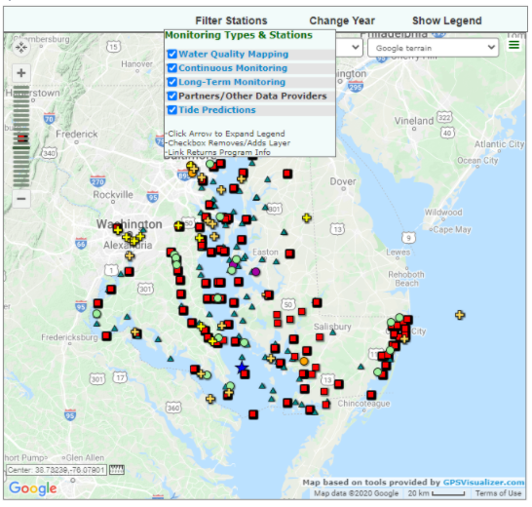
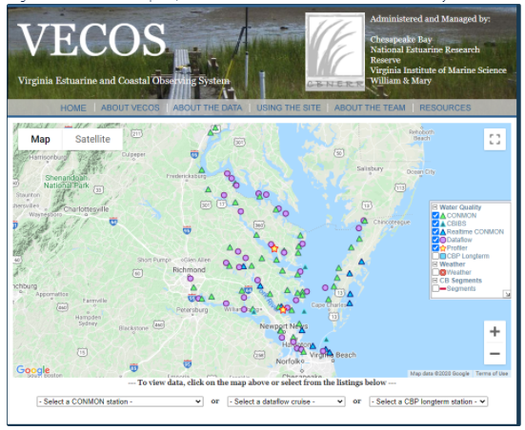
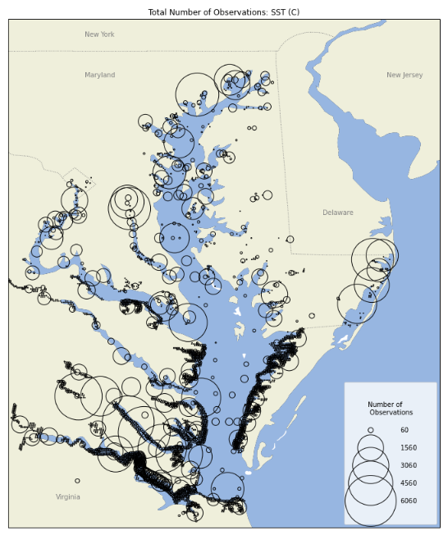
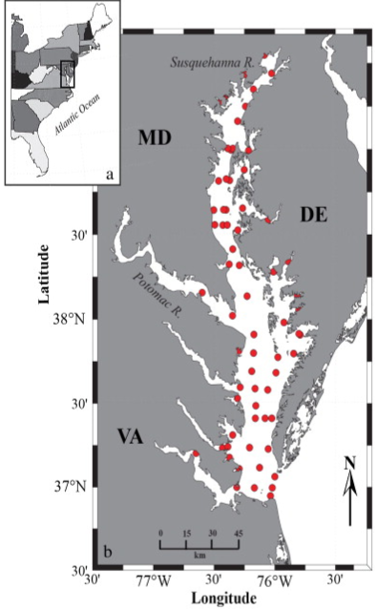
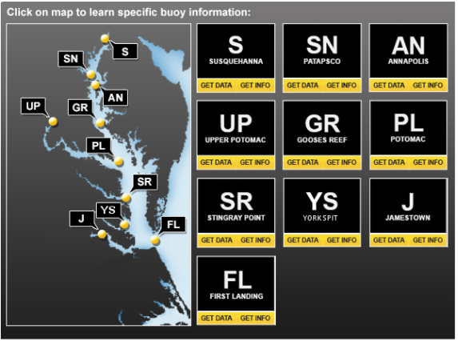
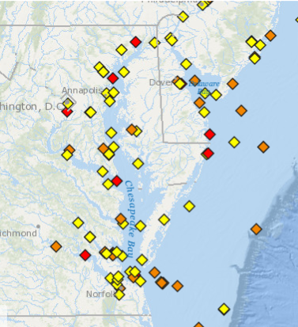
N = 56,322,842

Slide 3
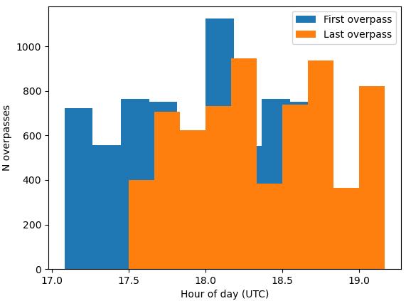
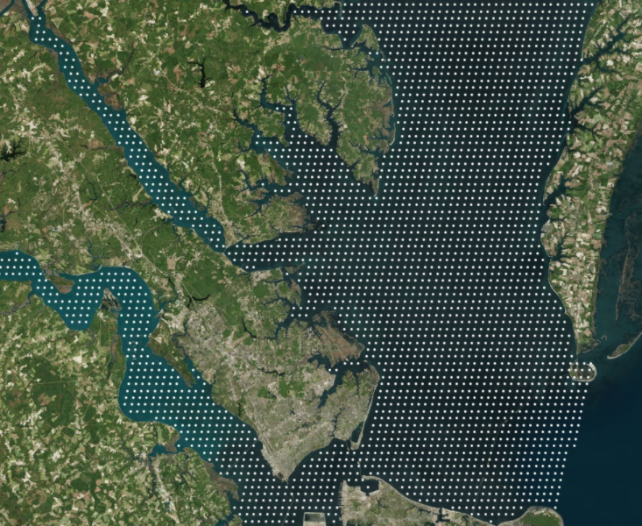
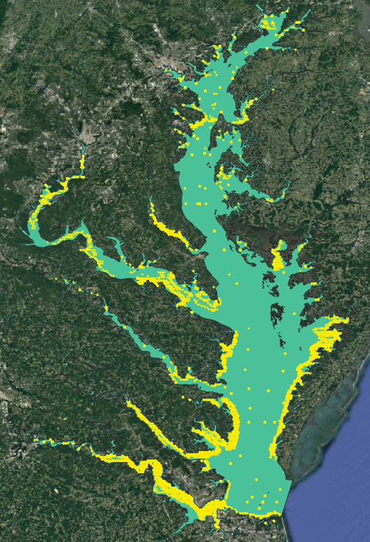
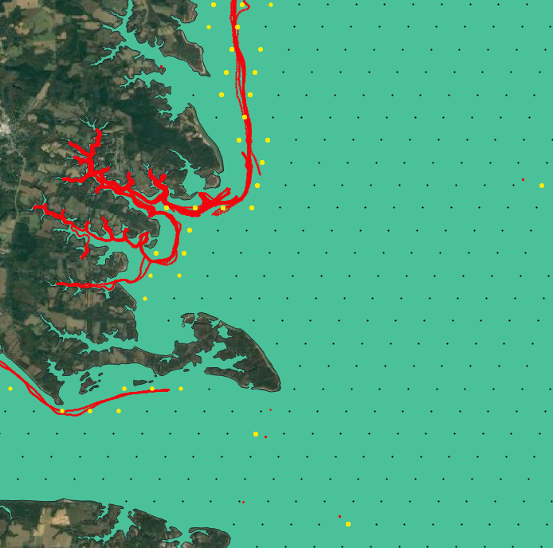
temporal filter
spatial filter
depth filter
filtering
D <= 1 meter
MODIS pixel center
Data counts (SST)
filtered obs
'raw': 56322842, 'dateloc_nan_post': 56322789, 'bounding_box_post': 42894150, 'filter_post': 3861198, 'duplicates': 3776363, 'mapped_to_pixel_centers': 1585636, 'aggregated': 31160
aggregated obs
aggregating

Slide 4
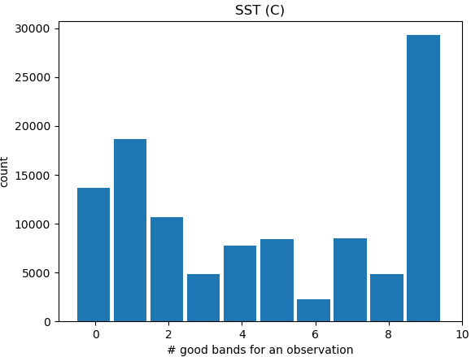
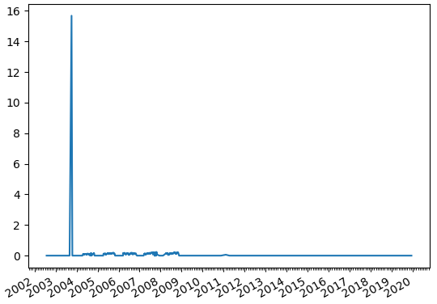
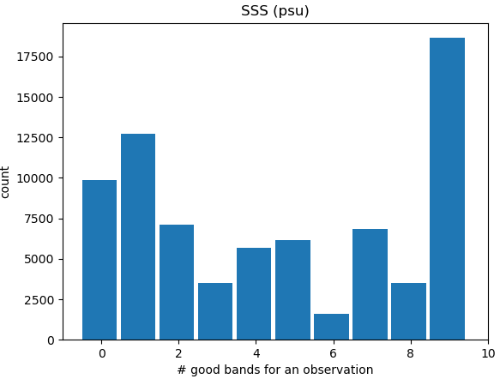
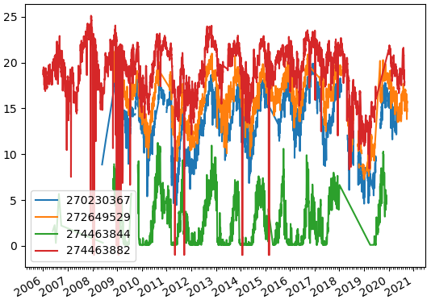
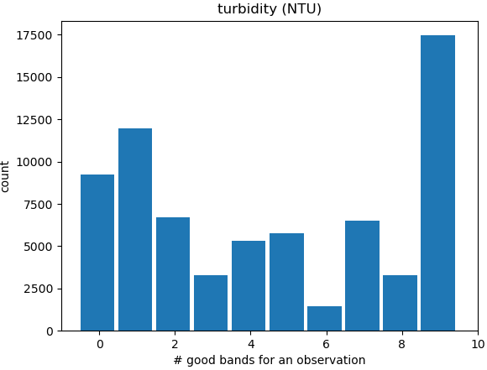
Needs more raw data filtering…
turbidity (NTU)
SST = f(band values)
ML (random forest, neural net, etc.)
SSS (PSU)
pixel IDs

