Slide 1

Enhancing Data Quality in Industry and Occupation Coding: Evaluating Automated Standardized Data Cleaning and Coding Methods at the Washington State Department of Health
Chunyi Wu, PhD, MPH, Cheri Levenson, MPA, LSSBB, Philip Crain, MPH, and Alex Cox, SM

Slide 2
Roadmap
Why is Industry & Occupation (I&O) data important?
What is I&O coding?
Why and how did we implement automated standardized data cleaning?
What was the impact on quality of I&O coded data?
What did we learn?

Slide 3
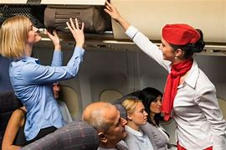



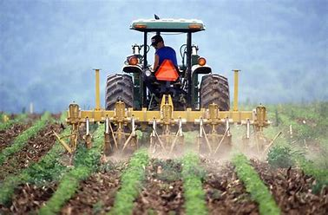

Why is I&O data important?
Notes:
In public health, work information like occupation and industry can be valuable for understanding specific health risks and burden of disease associated with different professions, and can help to target interventions to specific workplaces or industries
These data are often collected through different means, such as case investigation interviews, surveys, medical records, etc. Often these data are collected as free entry text fields and are difficult to make use of for analysis.

Slide 4
What is I&O coding?

Slide 5
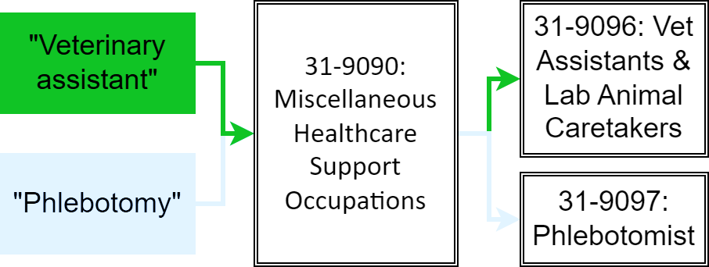
What is Industry & Occupation (I&O) coding?
Conversion of free-text data into standardized groups with assigned codes
Provides a systematic approach for data analysis
Standardized U.S. coding schemes
North American Industry Classification System (NAICS) – industry codes
Standard Occupational Classification System (SOC) – occupation codes
Census Industry and Occupation Classification System – industry codes and/or occupation codes, often used as a pair
Notes:
SOC is a coding scheme for Occupation codes. NAICS is an industry coding scheme. Census Industry codes and Occupation codes also exist
Example: free-text data gets turned into codes. There are codes for less specific groups (i.e., misc healthcare support) and more specific groups. Phlebotomists and vet assistants aren’t related at the most granular level but do fall into the same bucket if you get less granular. Shows example of the hierarchical structure of the coding systems.

Slide 6
NIOCCS Autocoder
NIOSH Industry and Occupation Computerized Coding System (NIOCCS)
Free web application provided by CDC/NIOSH
Machine learning approach
Assigns probabilities to coding schemes
API allows for calls to web app via URL structure:
https://wwwn.cdc.gov/nioccs/IOCode?i=outpatient%20clinic&o=phlebotomist
{"Industry":[{
"Code":"6214",
"Title":"Outpatient Care Centers",
"Probability":0.995814264}],
"Occupation":[{
"Code":"31-9097",
"Title":"Phlebotomists",
"Probability":0.999990344}],
"Scheme": "NAICS 2017 and SOC 2018"}
Notes:
NIOCCS = NIOSH Industry and Occupation Computerized Coding System. Acronymception
NIOSH = National Institute for Occupational Safety and Health
This is a CDC-created and maintained tool. Uses ML to calc probabilities of i&o codes being correct. You can specify schemes and how many codes you want to return (i.e., return the top 3 most likely codes). We set this up to return only the most probable codes. We also went through a scheme update during the project so old values were archived/replaced with new a new schema.
Calls to the API were set up to utilize multisession processing in R. This was set up using furrr and future packages. The data are sent to the API one at a time by each session, with X number of sessions going at once. Usually on a laptop X == 5. In that case the autocoding is returned ~5x quicker than if this were done w/o the multisession processing. Quicker on a more powerful machine that can create more sessions at once.

Slide 7
Why and how did we implement automated standardized data cleaning?

Slide 8

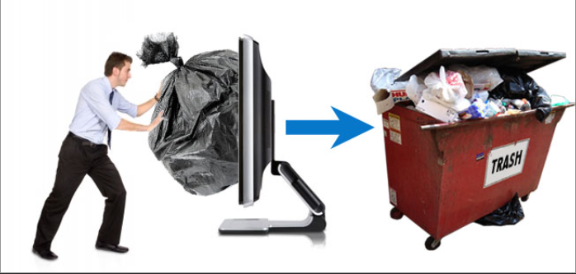
Why?
#1 GIGO: Garbage In, Garbage Out
#2 People are our most valuable resource
Notes:
Why did we determine it would be valuable to develop this automated and systematic approach?
Two reasons:
The results we receive from the autocoder will only ever be as good as the data that we put into it. As we all know, collecting high quality data at the source is the best way to ensure data quality, but the next best thing is to apply standardized data cleaning methods. This would help us ensure that all data are cleaned using the same methods and standards, and reduce biases that could be introduced by ad hoc data cleaning.
Our agency has one I&O epi, who has a lot of responsibilities. Manual cleaning of I&O data is not a good use of her precious time.

Slide 9
Automated Data Standardization Pipeline
1) Pull I&O data fields out of surveillance system
2) Clean & impute I&O data fields
4) Update surveillance system with coded data
3) Send data to NIOCCS web API and get I&O code results
Notes:
An automated pipeline was developed using R to extract and transform data.
Previously, the existing process was highly manual, and involved multiple data management steps to extract data from the surveillance system, clean the data, and transform the data to be sent through the autocoder. After coding, additional steps were needed to transform and manipulate the results into the surveillance system.
A pipeline was developed to automate all of these steps. Using GitHub from the start of the project enabled epis across different teams to collaborate on this work, and facilitates and tracks enhancements to the data cleaning approach over time.

Slide 10
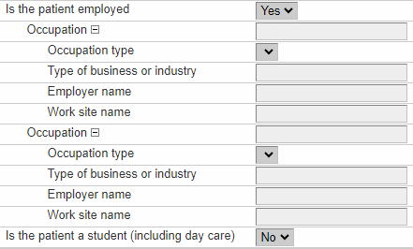
Data Cleaning Methods
1) Replace invalid data with blanks:
“refuse”/ “refusal”/ “refual”/ “unknown” / “uknown” / “unk” / "unk-” → N/A
2) Substitute acronyms:
“LHC” / “LTC” / “LTFC” / “LTHC” / “LTCF” → “LONG TERM CARE FACILITY”
“H2A” → “seasonal farm and agriculture”
3) Impute missing I&O information from related work information:
If occupation is missing, fill with employer or work site
If industry is missing, fill with work site or employer
Notes:
A few of our key data cleaning methods:
These are the fields pulled and used for i&o or imputation:
Occupation = the occupation.
Type of business or industry (OCCUPATION_BUSINESS_TYPE in the backend) = the industry.
Employer and work site were used for imputing missing values.
Replacing invalid data might reduce inaccurate coding if sending junk data to autocoder, but more importantly allows for imputation of data if missing after cleaning
Work name is the actual location a person works (e.g., SeaTac Airport) whereas employer is the employer name (e.g., Delta Airlines). These are often the same (e.g., "Walmart" & "Walmart") even though they should be different (e.g., "Issaquah Walmart Superstore" & "Walmart", or "Generic Office Building" and "Walmart", or "Issaquah Walmart Superstore Pharmacy" and "Walmart", etc.)
Repeatable fields -- It was not uncommon for a case to have 2+ iterations of i&o fields.
A lot of the cleaning code is also trying to identify which iteration to use. The code is set up to select the same iteration for each field after an initial selection. I.e., if occupation = "na,na,epidemiologist" the iteration selected would be the third (epidemiologist). If industry = "coffee shop,na,health department" the third iteration would be selected (health department).

Slide 11
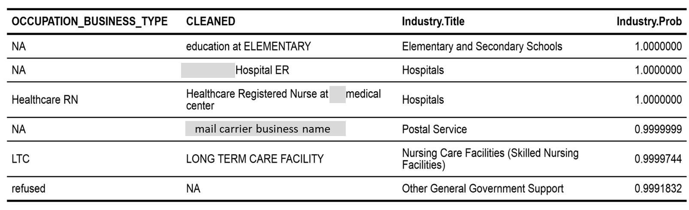
Industry Cleaning & Coding Examples
Original Values
Cleaned Values
Coded Values
Notes:
Row1: value was NA, but work name was something like “ABC ELEMENTARY”. Industry was filled with “education at ELEMENTARY” and then coded correctly as “Elementary and Secondary Schools”
Row2: value was NA, but filled with work name which in this case was an emergency room. Industry was coded correctly as “Hospitals”
Row3: The provided value is their occupation NOT industry. RN replaced with registered nurse. Nurses can work a lot of places (school, hospital, outpatient, nursing home, etc.) so we append their work name. Industry coded as “Hospital”
Row4: NA value filled with employer. Luckily this is a well-known employer so having their name is all we need to know they likely work for a postal service.
Row5: LTC replaced with Long Term Care Facility. The fully written out name provides a lot better probability than just “LTC”.
Row6: refused changed to NA. In this case there must be a value in OCCUPATION that led to the Industry having such as high probability. Removing refused here probably doesn’t do much but it gives the cleaning code a chance to impute with other values. Since nothing was filled, it remains NA and we at least aren’t sending junk data to NIOCCS.

Slide 12
What was the impact on quality of I&O coded data?

Slide 13
Evaluation Approach
Goal: To quantify the impact of the automated data cleaning process
Methods: Data were run through the NIOCCS autocoder before & after automated data cleaning
Evaluation metrics:
Completeness = non-missing I&O coding values
Accuracy = probability score > 0.6
Assessed using probability scores returned by NIOCCS API
Measure of expected accuracy of returned code
Range from 0 – 1 (1 being best match)
Notes:
Probability scores indicate the expected accuracy of the SOC (occupation) or NAICS (industry) code.
The expected accuracy of the SOC (occupation) or NAICS (industry) code. Score indicates how well the returned occupation or industry matches the actual occupation or industry if the text was unambiguous. Note that a vague or blank response may result in a score of 1 and an "insufficient information" result.
Scores for 'insufficient information’ were hardcoded as 0 in both the original and enhanced coded scores for this evaluation, as they do not provide additional value for accurately assigning the category of industry and occupational data.
Range from 0-1 with 1 being the highest probability of the code being correct

Slide 14
Eligibility Criteria
222,438 cases that met the eligibility criteria are included in this evaluation:
Cases that indicated that they are currently employed
Records with a ‘completed’ investigation status
Cases with a positive COVID-19 test (detected through PCR or antigen testing)
Residents of the State of Washington
Individuals aged 18 to 65 years old
The timeframe for eligibility spans from January 20, 2020, to July 31, 2023

Slide 15
Completeness increased more for industry codes
Industry
Occupation
+10.6%
Added=24,641
Lost=1,165
+2.0%
Added=6,231
Lost=1,791
Notes:
Many codes were added due to the cleaning process, and some were lost due to removal of invalid data.
For industry, 0.5% of cases LOST a code after cleaning
For occupation, 0.8% of cases LOST a code after cleaning
Lost codes included some amount of “good” codes (codes that could have been assigned if reviewed manually) and many “bad” codes (codes would not be assigned if reviewed manually). Probabilities of codes that were lost were mixed.
An example is “work from home” was assigned as “Homemaker (unpaid)” with a ~0.9 probability for many cases. These codes were lost after cleaning.

Slide 16
Accuracy increased more for industry codes
Industry
Occupation

Slide 17
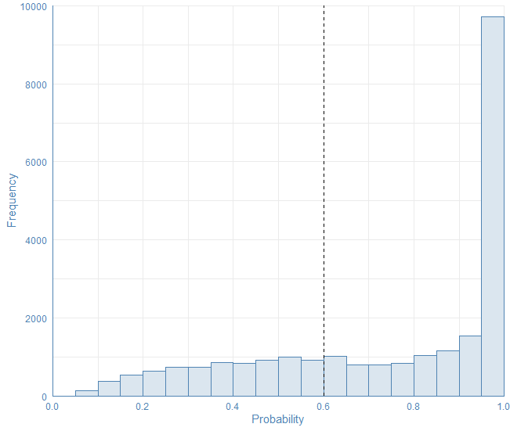
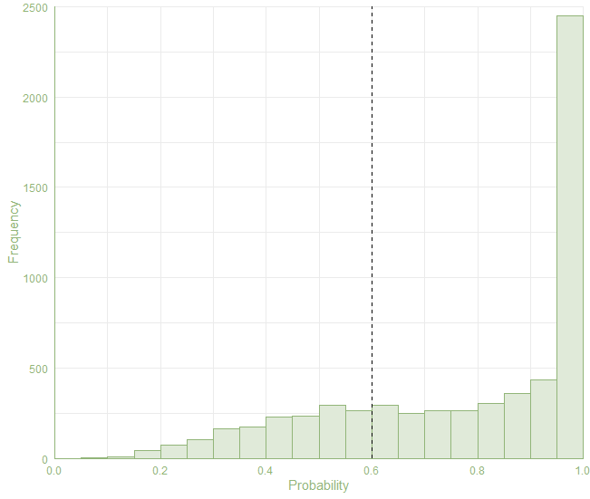
Majority of newly added codes were accurate (>0.6 threshold)
Added Industry (n=24,641)
Added Occupation (n=6,231)
68.7%
74.2%
31.3%
25.8%
Notes:
We set a threshold of 0.6 for evaluating accuracy (a threshold used in I&O literature)
Over 2/3 of added industry codes met the accuracy threshold
Nearly 3/4 of added occupation codes met the accuracy threshold
Mean occupation: 0.776 (95% CI: 0.770 – 0.782)
Mean industry: 0.741 (95% CI: 0.738 – 0.745)

Slide 18
Imputation was a valuable strategy
Imputing missing data from relevant work information contributed to:
95.2% (N=23,469) of new industry codes
80.2% (N=4,994) of new occupation codes
Percentage of cases lacking both industry and occupation codes decreased from 7.2% (N=16,009) to 2.7% (N=5,594)
Notes:
Imputing missing data from relevant work information contributed to over 3/4 of new codes
It cut the percent of cases missing both I&O codes by 2/3

Slide 19
What did we learn?
Systematic data cleaning & standardization was effective in improving completeness of I&O coded data quality
Improvements were greater for industry vs occupation codes
Imputing missing data from work information was a helpful technique
As always, quality of cleaned data is limited by quality of the source data
Automated process saves person-time, can improve timeliness of I&O data for real-time analysis, and is adaptable to additional diseases

Slide 20

Acknowledgements
WA DOH project team:
Chunyi Wu, PhD, MPH, Data Integration Epidemiologist
Cheri Levenson, MPA, LSSBB, Industry & Occupation Epidemiologist
Philip Crain, MPH, Data Integration Epidemiologist
Alex Cox, SM, Data Integration & Quality Assurance Manager
Local Health Jurisdiction & WA DOH case investigators

Slide 21

Thank you!
Extraction
Transformation
Analysis:
Notes:
R code for this project is available on GitHub

Slide 22
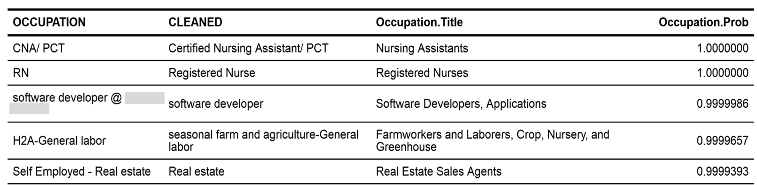
Occupation Cleaning & Coding
Original Values
Cleaned Values
Coded Values
Notes:
Row1: CNA/ PCT changed to spell out CNA. Future addition: could add PCT changing to Patient Care Tech. That acronym is not as common.
Row2: RN changed to registered nurse, same as above.
Row3: remove junk text. Sometimes it is nice to have an employer name included, but often it just provides more text to confuse the autocoder. The cleaning code removes “@ xyz” text.
Row4: H2A replaced with seasonal farm and ag. This was the easiest line of code and does wonders for data completeness and helps improve coding for underrepresented groups. H2A is a type of visa for seasonal immigrant farm workers and often appears during summer months in central WA where many people are hired to pick fruit for farms. H2A was not recognized by the autocoder with much certainty.
Row5: Remove self employed junk text. This gives no information about occupation and can mess with coding results.

Slide 23
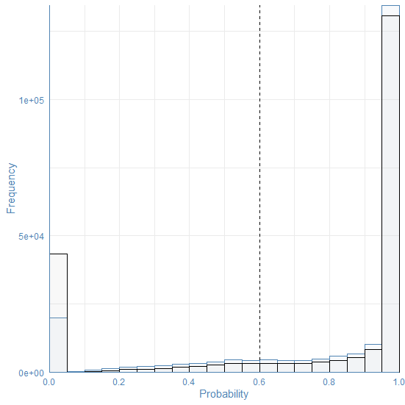
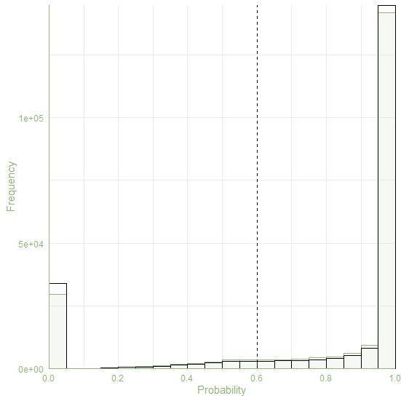
Changes in distribution of probability scores
Industry
Occupation
Pre-enhancement
Pre-enhancement
Post-enhancement
Post-enhancement
Drop in codes w/ insufficient information
Notes:
These graphs show the distribution of accuracy scores pre and post data cleaning. The black lines represent “pre’ and the blue/green represent “post”
Our best interpretation is that the imputation worked better for industry than for occupation. Employer name and work site probably are more related to the industry than the occupation. E.g. XYZ High School or ABC Medical Center give us a better idea of industry (schools or hospitals) than occupation (janitor? teacher? admin? doctor? nurse? Etc.)

