Slide 1

WA-HELP
Paul Unsworth
Cody Carmichael

Slide 2



Introduction to WA-HELP (Washington Health Ecosystem Landing Page)

Slide 3
Intro to the 5 Pillars

Slide 4
What HELP Is/ Is Not:
HELP is a platform that utilizing existing tools and data to help give operational insight into the operational realties of health systems.
tool creates a baseline that allows for projections that allows us to understand what normal operations are, what patient populations make up those baselines, and what impact events could be expected to have upon those operations.
The goal being when used with other tools and reporting we have a lens that helps all response decision making.
It is designed to work in coordination with other agency tools.
Its modular nature allows for it to natively absorb new information to improve its outputs.
HELP is NOT/Does Not:
A tool designed to support clinical interventions.
replace any existing systems or require new partner reporting.
replace any workflows.

Slide 5
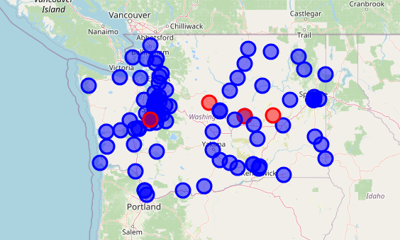
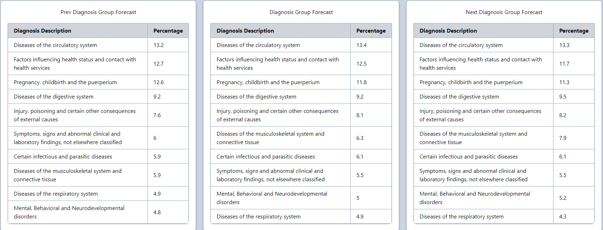
Planning/Training/Response
Have presented to the Training and Exercise Team
Immediate value found even with MVP.
Useful information on future directions.
Can currently create inferred conditions based off scenarios.
Future Development will include full interactive simulation.
In an Incident, where might the closest facility be?
Where might vulnerabilities in the health system be most at risk?
During Blue Skies environments, can be used as a background for scenario building.
Can allow for individuals and teams to think through processes and ramifications.

Slide 6
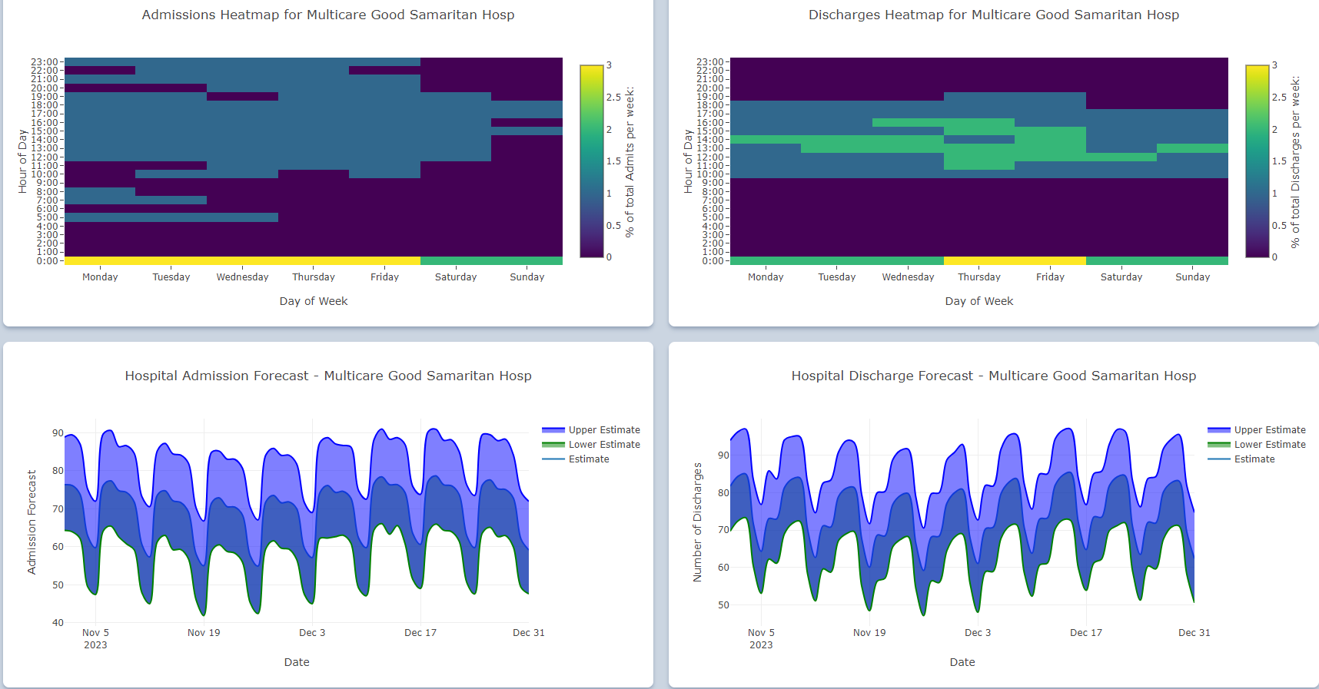
Organizing
Can aid in determining when and where future resources might be allocated.
Provides both large overviews and granular details
With improvement in data feed, might also be able to predict staffing needs well in advance.

Slide 7
Equipping/Funding
Uses novel technologies that are likely avenues for publication and grant revenue.
Requires no additional reporting from Non-Governmental Partners
Can reduce costs of Exercise Creation which also support grant work.

Slide 8

Technical Demo

Slide 9
Next Steps

