Slide 1



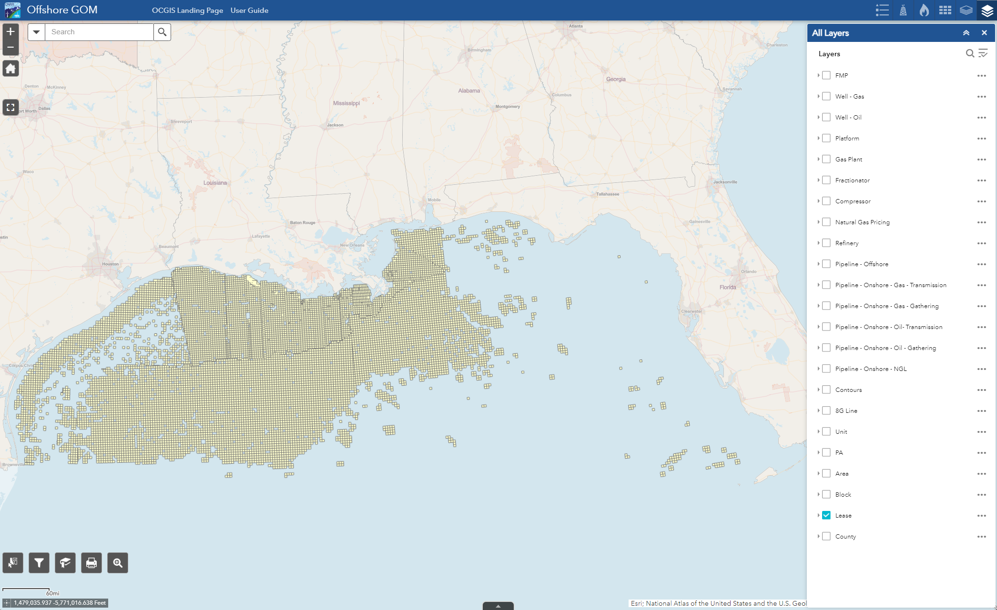






Offshore Application Quick Start Guide
The Offshore App allows you to explore the Offshore areas and associated Infrastructure including TIMS data
Layer List
Search Widget
Legend
View and toggle map layers using the following layer lists:
All Layers, Base Data, Property, Natural Gas, Crude Oil
Search within specific layers such as leases by contract number or FMPs by FMP number
Displays symbology for layers that are turned on
Zoom, Home and Full Screen
Zoom In/Out: Zoom in or out
Default Extent: Return to original map extent
Full Screen: View app in full screen
Select Widget
Select and highlight features in the map
Filter Widget
Filter layers by criteria such as pipelines by segment number
Bookmark Widget
Create or view saved bookmarks
Print Widget
Print your map into different formats
SearchPlus Widget
Attribute Table
Search multiple property layers
View data in an attribute table

