Slide 1
MODFLOW 6 Unstructured Grids

Slide 2
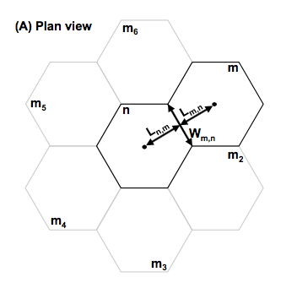
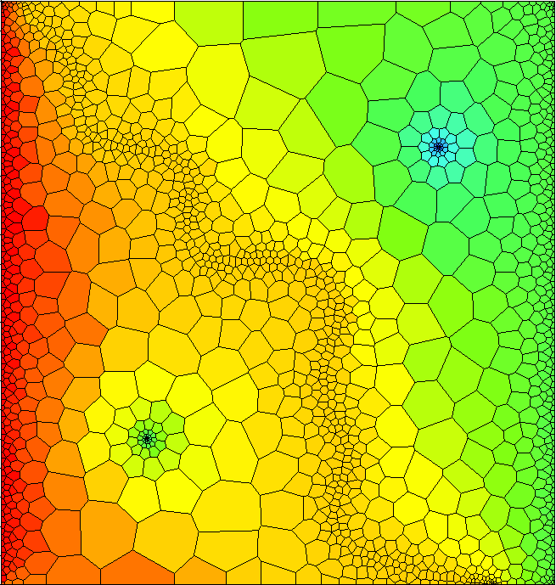
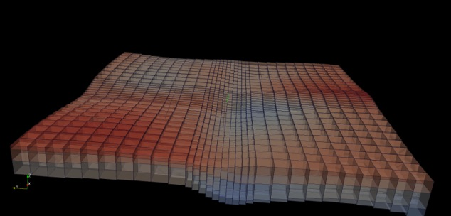
Spatial Discretization
Three ways to enter grid
DIS – regular MODFLOW grid
DISV – discretization by vertices
DISU – fully unstructured

Slide 3
Unstructured Grids
What do we mean by unstructured?
1. Cell can be connected to any number of surrounding cells
2. Not a regular MODFLOW grid
Why use them?
Grid can conform to irregular model domain boundaries
Resolution can be added in areas of interest
Why not use them?
More complicated to work with
Poor grid design can lead to errors in the flow solution that are difficult to find and quantify

Slide 4
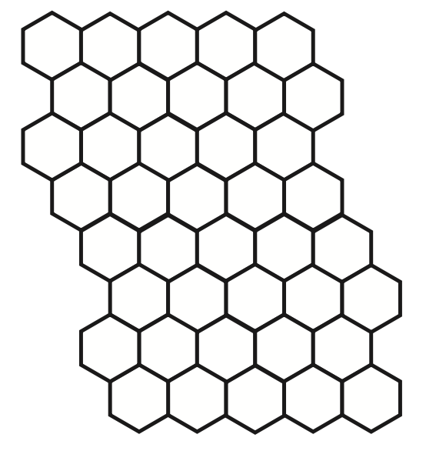
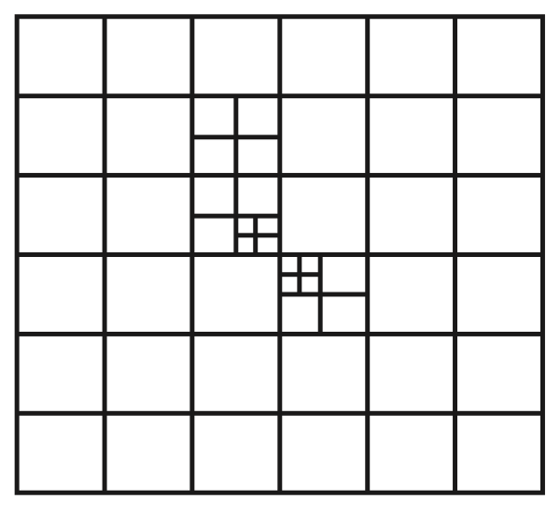
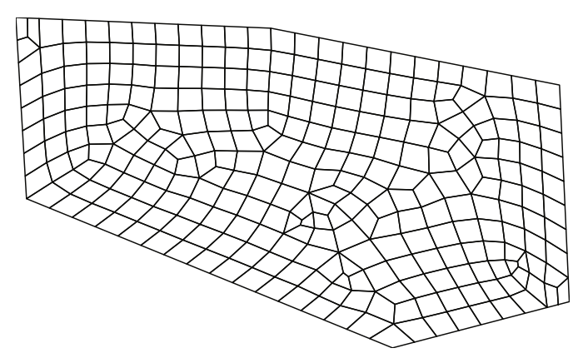
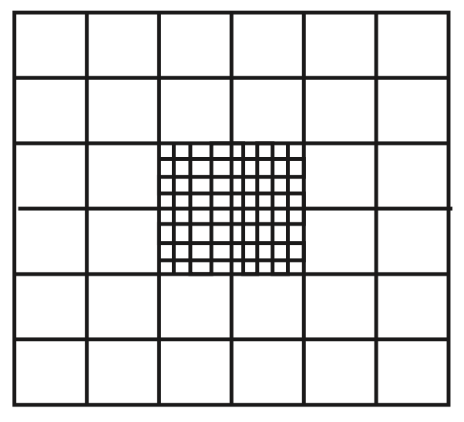
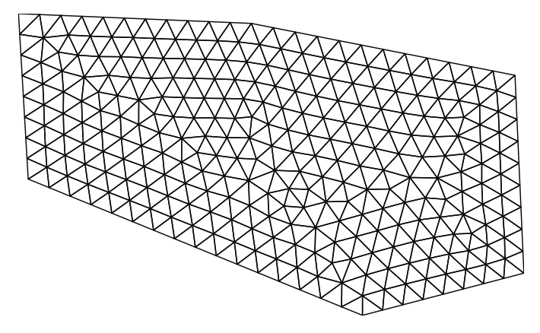
Types of Unstructured Grids
Rectangular based
Quadpatch
Quadtree / Octree
Triangular
Voronoi
Others

Slide 5
Multi-Model Simulations (LGR)

Slide 6
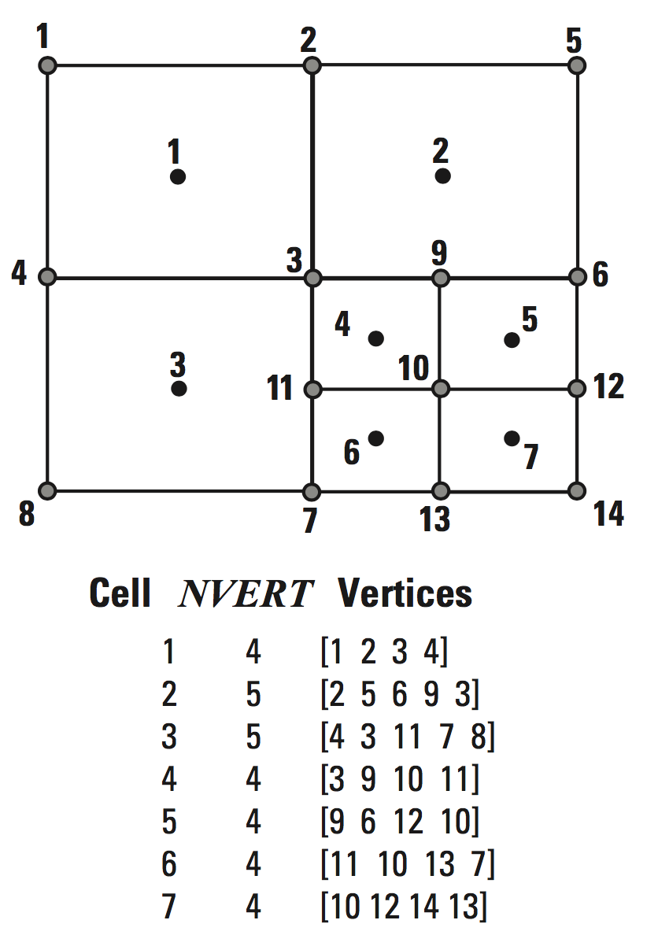
DISV Package

Slide 7
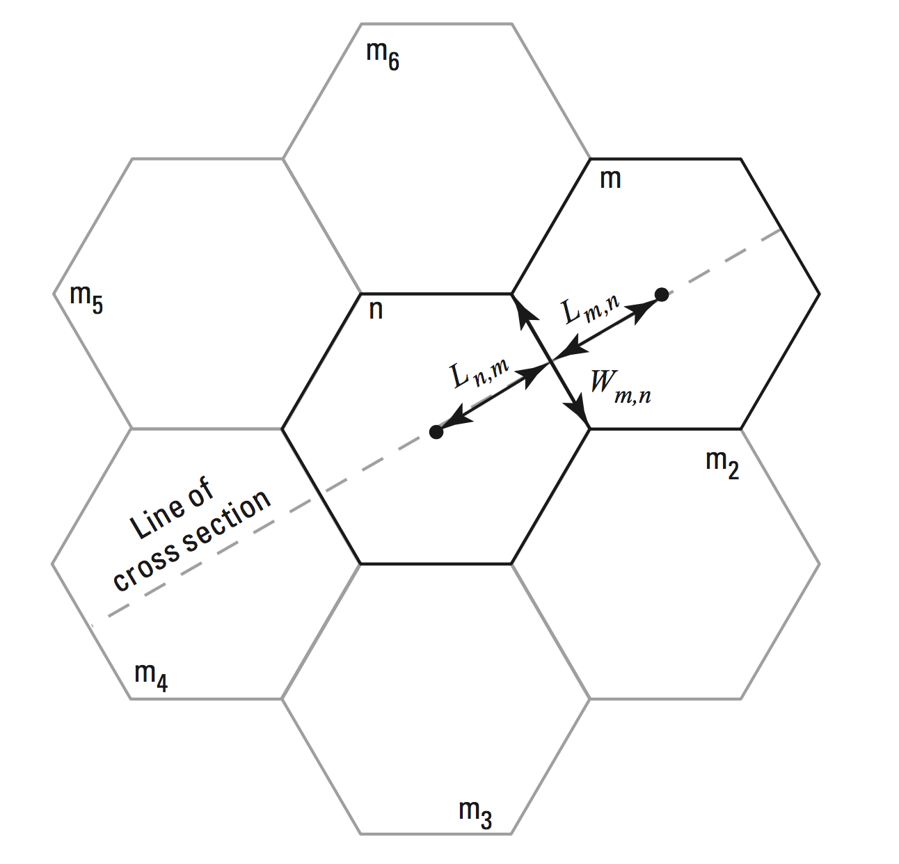
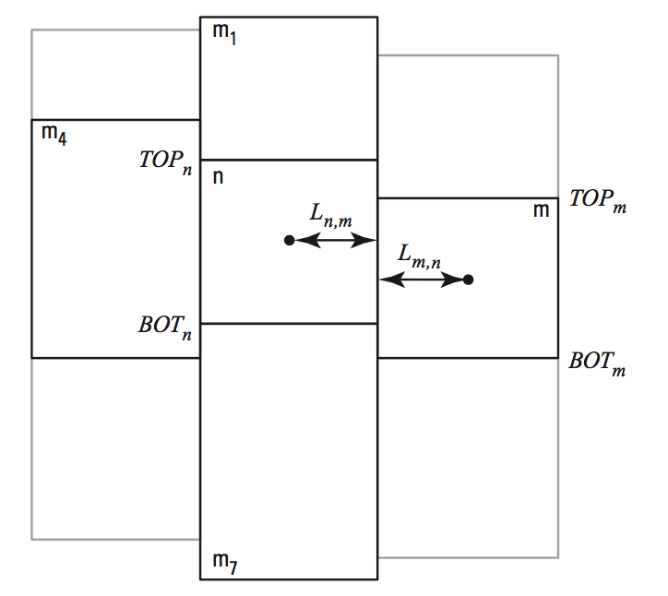
DISU Package – Connections

Slide 8
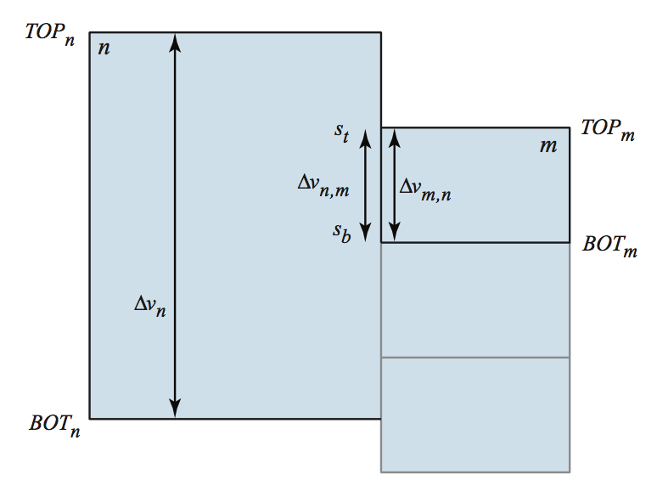
DISU Package – Vertically Staggered Connections
Cell can be connected to more than one cell in a single horizontal direction

