Slide 1
What is Python and why would we want to use it?
USGS Python for Hydrology Course
Madison, WI, Sept. 22–26, 2025

Slide 2
Motivations for scripting
Automate tedious, boring and repetitive tasks (and manage cognitive load)
Escape limits imposed by other people’s software
Improve quality and efficiency of work (and life)
Open science, repeatability and reproducibility
See also this recent debate about GUIs vs scripting
Notes:
The first two of these are probably apparent the instant you successfully run a script that automates a process or answers a question that couldn’t have been answered.
Any important (and often less discussed) point of the GMDSI debate is the quality of life benefit.

Slide 3
Repeatability is critical for good science
“an article about [a] computational result is advertising, not scholarship. The actual scholarship is the full software environment, code and data, that produced the result.”
Buckheit and Donoho (1995), paraphrasing John Claerbout
Buckheit JB, Donoho DL. 1995. Wavelab and reproducible research. In Wavelets and Statistics, ed. A Antoniadis, pp. 55–81. New York: Springer-Verlag
Notes:
Advances in collective knowledge and the authority of science rest on consensus, not the work of a single person or the authority of an expert. Consensus usually requires reproducibility.
Repeatability of a workflow or study can ultimately enable reproducibility.

Slide 4
Other benefits of open science and repeatability
Maintain or increase trust in science
(explaining not just what we know, but how we know it)
Accelerate discovery
Spread benefits of science to all
Notes:
Example: the pandas python library was originally developed for quantitative finance, but now we can use it in [less well-
funded] water resources work
* Conda was developed "out of [a] need to bring Python into business data analytics. ” (https://www.anaconda.com/about-us)
• Example: MODFLOW provides for free what might otherwise cost tens of thousands in license fees
• High-quality open code, worked examples and other educational materials can help fill apprenticeship/mentoring gap for
those without access

Slide 5
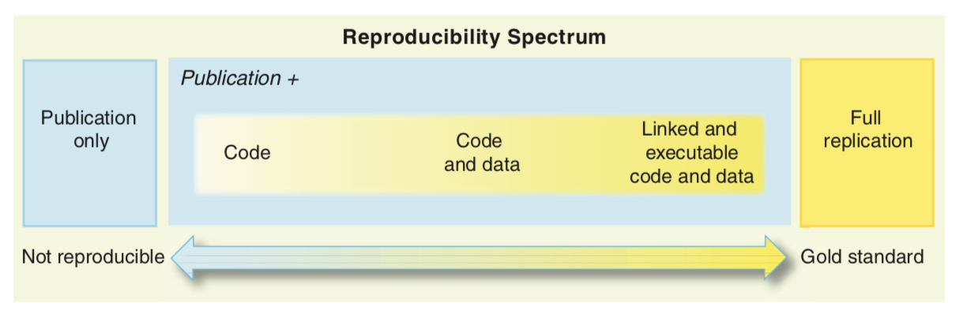
“Don’t let the perfect be the enemy of the good”
Peng, R.D. 2011. Reproducible Research in Computational Science, Science 334, p 1226-1227
Notes:
Full replication is still very difficult.
The goal of this class is to help you on your journey down the spectrum.
Repeatable vs Reproducible
Fienen and Bakker (2016):
"a repeatable process is one in which all steps are documented and the exact steps of data processing can be repeated."
NIST defines “reproducible” as “closeness of the agreement between the results of measurements of the same measurand carried out under changed conditions of measurement” and repeatability as “closeness of the agreement between the results of successive measurements of the same measurand carried out under the same conditions of measurement” (Taylor and Kuyatt, 1994)
"reproducible" implies that a different group given the same data and following the same protocols will interpret and process them in the same way, resulting in the same outcome as another group

Slide 6
What is Python?
The most popular programming language
Interpreted, high-level; general-purpose
Object-oriented
Highly extensible
Besides standard library, large ”ecosystem” of packages for diverse purposes
Emphasizes code readability, simplicity and flexibility
Guido van Rossum
Notes:
...In December 1989, I was looking for a "hobby" programming project that would keep me occupied during the week around Christmas. My office ... would be closed, but I had a home computer, and not much else on my hands. I decided to write an interpreter for the new scripting language I had been thinking about lately: a descendant of ABC that would appeal to Unix/C hackers. I chose Python as a working title for the project, being in a slightly irreverent mood (and a big fan of Monty Python's Flying Circus).
— Guido van Rossum

Slide 7
What does it mean to be pythonic?
Some of the core principals:
Beautiful is better than ugly
Explicit is better than implicit
Simple is better than complex
Complex is better than complicated
Readability counts
https://en.wikipedia.org/wiki/Zen_of_Python
Notes:
...In December 1989, I was looking for a "hobby" programming project that would keep me occupied during the week around Christmas. My office ... would be closed, but I had a home computer, and not much else on my hands. I decided to write an interpreter for the new scripting language I had been thinking about lately: a descendant of ABC that would appeal to Unix/C hackers. I chose Python as a working title for the project, being in a slightly irreverent mood (and a big fan of Monty Python's Flying Circus).
— Guido van Rossum

Slide 8
Why Python?
Easy to write code
Easy to read
General purpose:
Large standard library
Larger collection of add-on packages
Platform-independent
Popular (now the #1 language)
Free!
Notes:
The python interpreter translates the Python code into machine language, so the same python code can be run on different hardware and operating systems

Slide 9
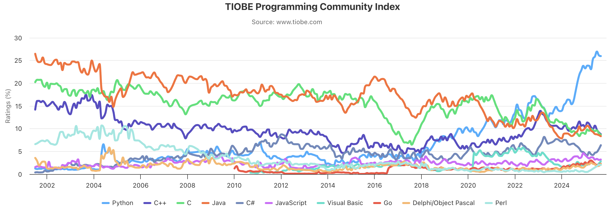
TIOBE Index (September 2025)
https://www.tiobe.com/tiobe-index/
Notes:
The TIOBE Programming Community index is an indicator of the popularity of programming languages. The index is updated once a month. The ratings are based on the number of skilled engineers world-wide, courses and third party vendors. Popular search engines such as Google, Bing, Yahoo!, Wikipedia, Amazon, YouTube and Baidu are used to calculate the ratings. It is important to note that the TIOBE index is not about the best programming language or the language in which most lines of code have been written.
Since 2024, Python is the most popular language on GitHub.

Slide 10
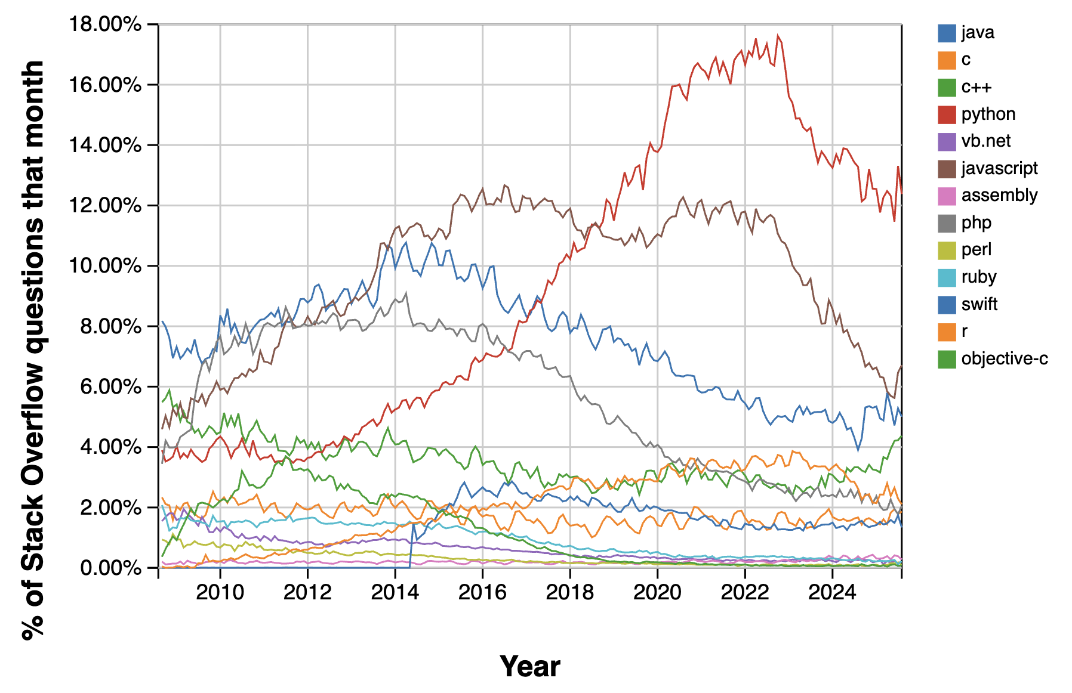
Stack Overflow Questions by language
https://insights.stackoverflow.com/trends
Notes:
Based on this blog post: https://blog.pythonanywhere.com/67/, and the graph above, total number of users worldwide might be around 10 million as of 2018.
In 2024, Anaconda's user base reached 45 million users (Wikipedia)

Slide 11
Disadvantages
Can be slower than other languages
Somewhat decentralized
Changes frequently
Installation/Hard to get started
Easy to write bad code
https://towardsdatascience.com/5-reasons-why-jupyter-notebooks-suck-4dc201e27086
Notes:
If you’re new to scripting, learning Python can require some time.
And you get what you put in. The better you know Python, the more you can do, and the faster you can do it with less effort.

Slide 12
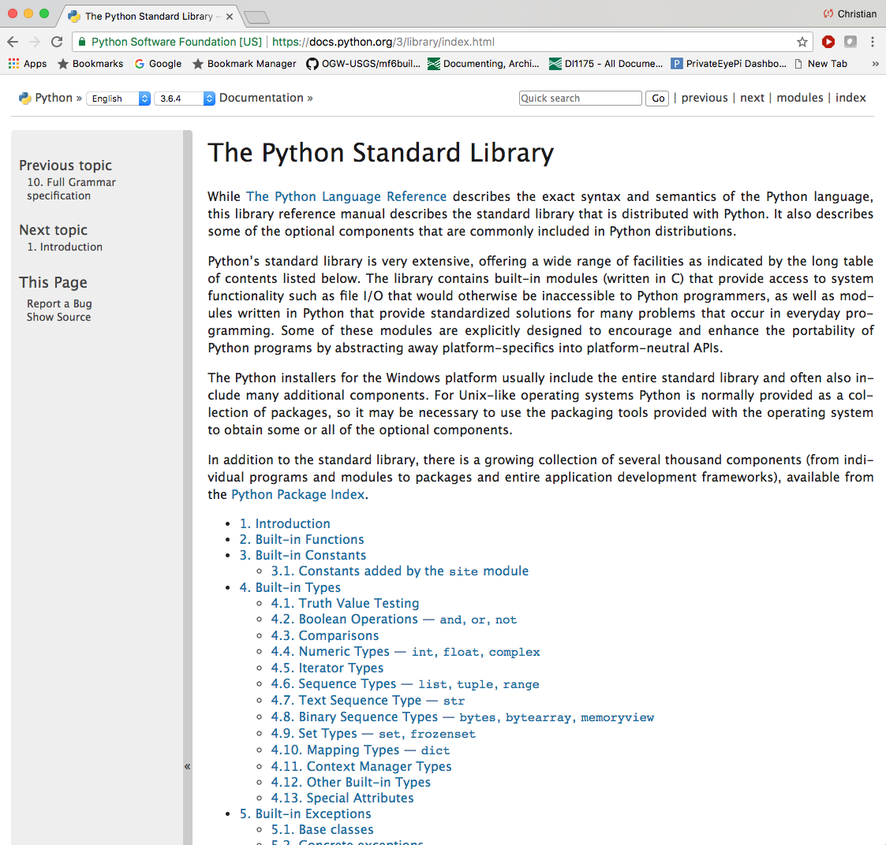
Python Standard Library
Notes:
Maintained by the Python Software Foundation
Includes many packages (pathlib, os, shutil, zipfile, etc)

Slide 13
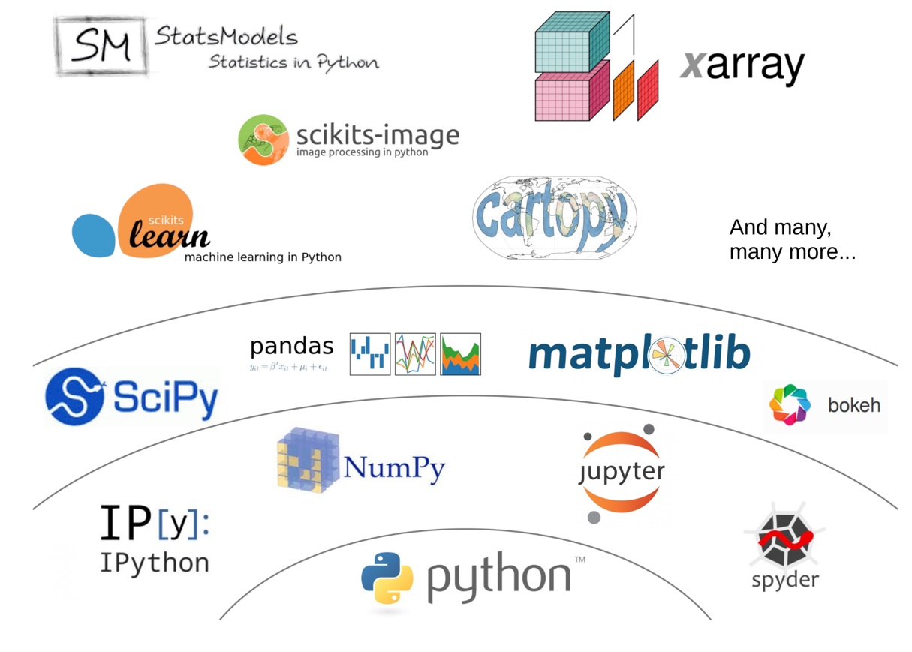
Python's scientific ecosystem
https://fabienmaussion.info/scientific_programming/week_05/02-Scientific-Python.html
Notes:
Unlike Matlab, the set of Python tools used by scientists does not come from one single source. It is the result of a non-coordinated, chaotic and creative development process originating from a community of volunteers and professionals.

Slide 14
Ways to interact with Python: Development Environments
Python interpreter
IPython
Jupyter Notebook or Jupyter Lab
Best for data exploration, demonstrations, works in progress, simple one-off code, etc.
IDE (integrated development environment) such as VS Code
Best option for developing “production” or “operational” code- anything you want to re-use!
Notes:
Key benefits of Jupyter notebook are non-linear execution, and embedded plots and annotations
Non-linear workflow is also key disadvantage- easy to write code that doesn’t work
No linting
No debugging
Hard to re-use code
Some people also use Spyder, which has a Matlab-like feel, and is interactive, but without any of the reproducibility aspects of Jupyter Notebooks

Slide 15
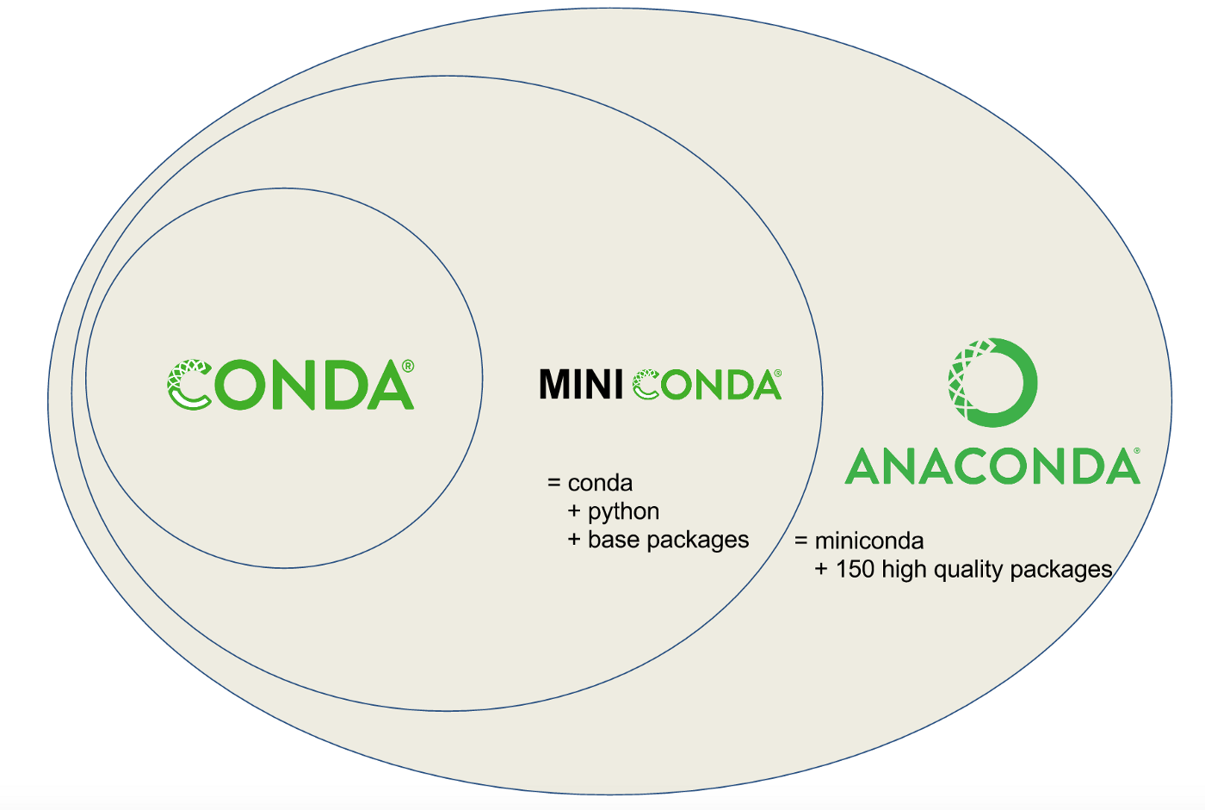
Python comes in many flavors
Distribution: A bundled collection of Python and some packages
Examples
Anaconda/Miniconda/Miniforge
Python.org
Your system python
ArcGIS or QGIS python
Etc
Just use Miniforge!
mamba
Miniforge
https://towardsdatascience.com/managing-project-specific-environments-with-conda-b8b50aa8be0e
Notes:
Also used to be Enthought Canopy, Python x,y, etc.

Slide 16
Downloading and managing packages
Conda is a package manager (software)
Pip is an alternative package manager
Mamba was developed as a faster and more robust C++ version of Conda
Conda now uses the mamba solver by default
Just use Miniforge!
mamba
Miniforge
https://towardsdatascience.com/managing-project-specific-environments-with-conda-b8b50aa8be0e
Notes:
Also used to be Enthought Canopy, Python x,y, etc.

Slide 17

Where to get packages
Conda fetches packages from channels
Conda-forge is a popular community-based channel
Anaconda (company that first developed Conda) has its own ”defaults” channel; “bioconda” is also popular
Pip fetches packages from the Python Package Index (PyPI) and can also fetch them from GitHub
Miniforge is configured to use conda-forge by default (generally best for our work)
Best practice is to stick to single channel; only use pip for packages not on conda-forge
Notes:
Also used to be Enthought Canopy, Python x,y, etc.
Conflicts between

Slide 18
Virtual environments
Many Python packages have dependencies, which in turn have dependencies…
Oftentimes, we may need different collections of packages for projects, or different versions of packages
Environments can help us manage these
We created a pyclass environment for this class
If you look in the repo, you’ll also find a pyclass-docs environment with extra packages for testing the course content and building t
Conda comes with a default base environment
Best practice is to leave the base alone and make new environments for each project
Notes:
The constantly changing nature of open-source software and potential for dependency conflict is one reason why package managers are critical.
Examples
You have a project that’s almost done, and you don’t want to refactor your codebase to fix breaking changes in a dependency. But you also want to start the next project fresh with the latest versions.
You bricked a Python environment somehow, and don’t want to have to reinstall everything
You create a Jupyter Notebook demo for a cooperator, or want to collaborate on a workflow or code base. You want to make sure that the other people are running the exact same versions of packages that you are, but you don’t want to share all of the packages that you each use for every task.
You are maintaining a Python package, and want to test it against multiple versions of python, and potentially, multiple versions of dependencies
Conda is pretty efficient at sharing packages across environments where appropriate, to minimize the disk space needed.

Slide 19
Python Versions
There was a Python 2
We are using Python 3.12 for the class
Notes:
Major.Minor.Patch
Python 3.13 is available on conda-forge. Python 3.14 is due out later this year.

