Slide 1
Basin Flowers
03/20/2023

Slide 2
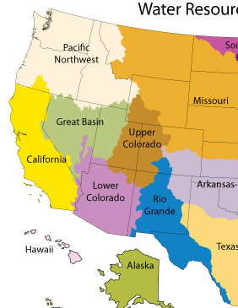
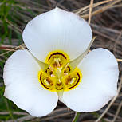
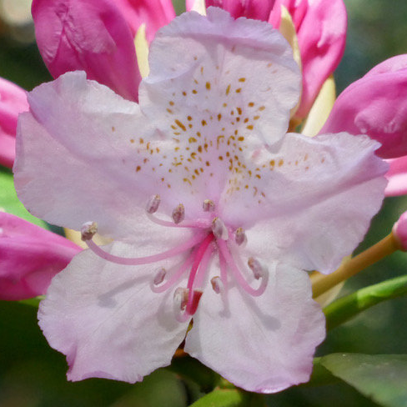

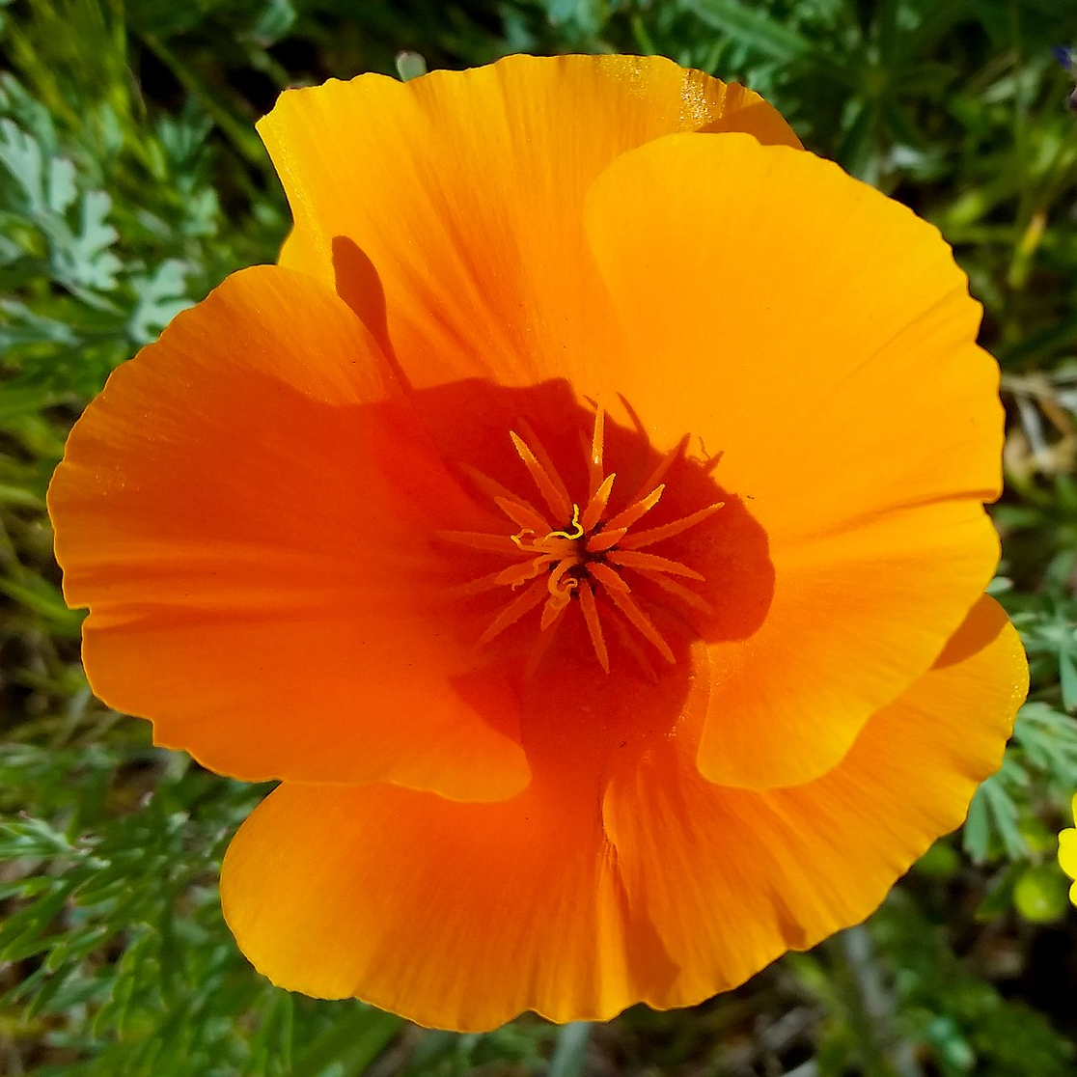

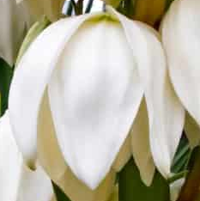

Slide 4
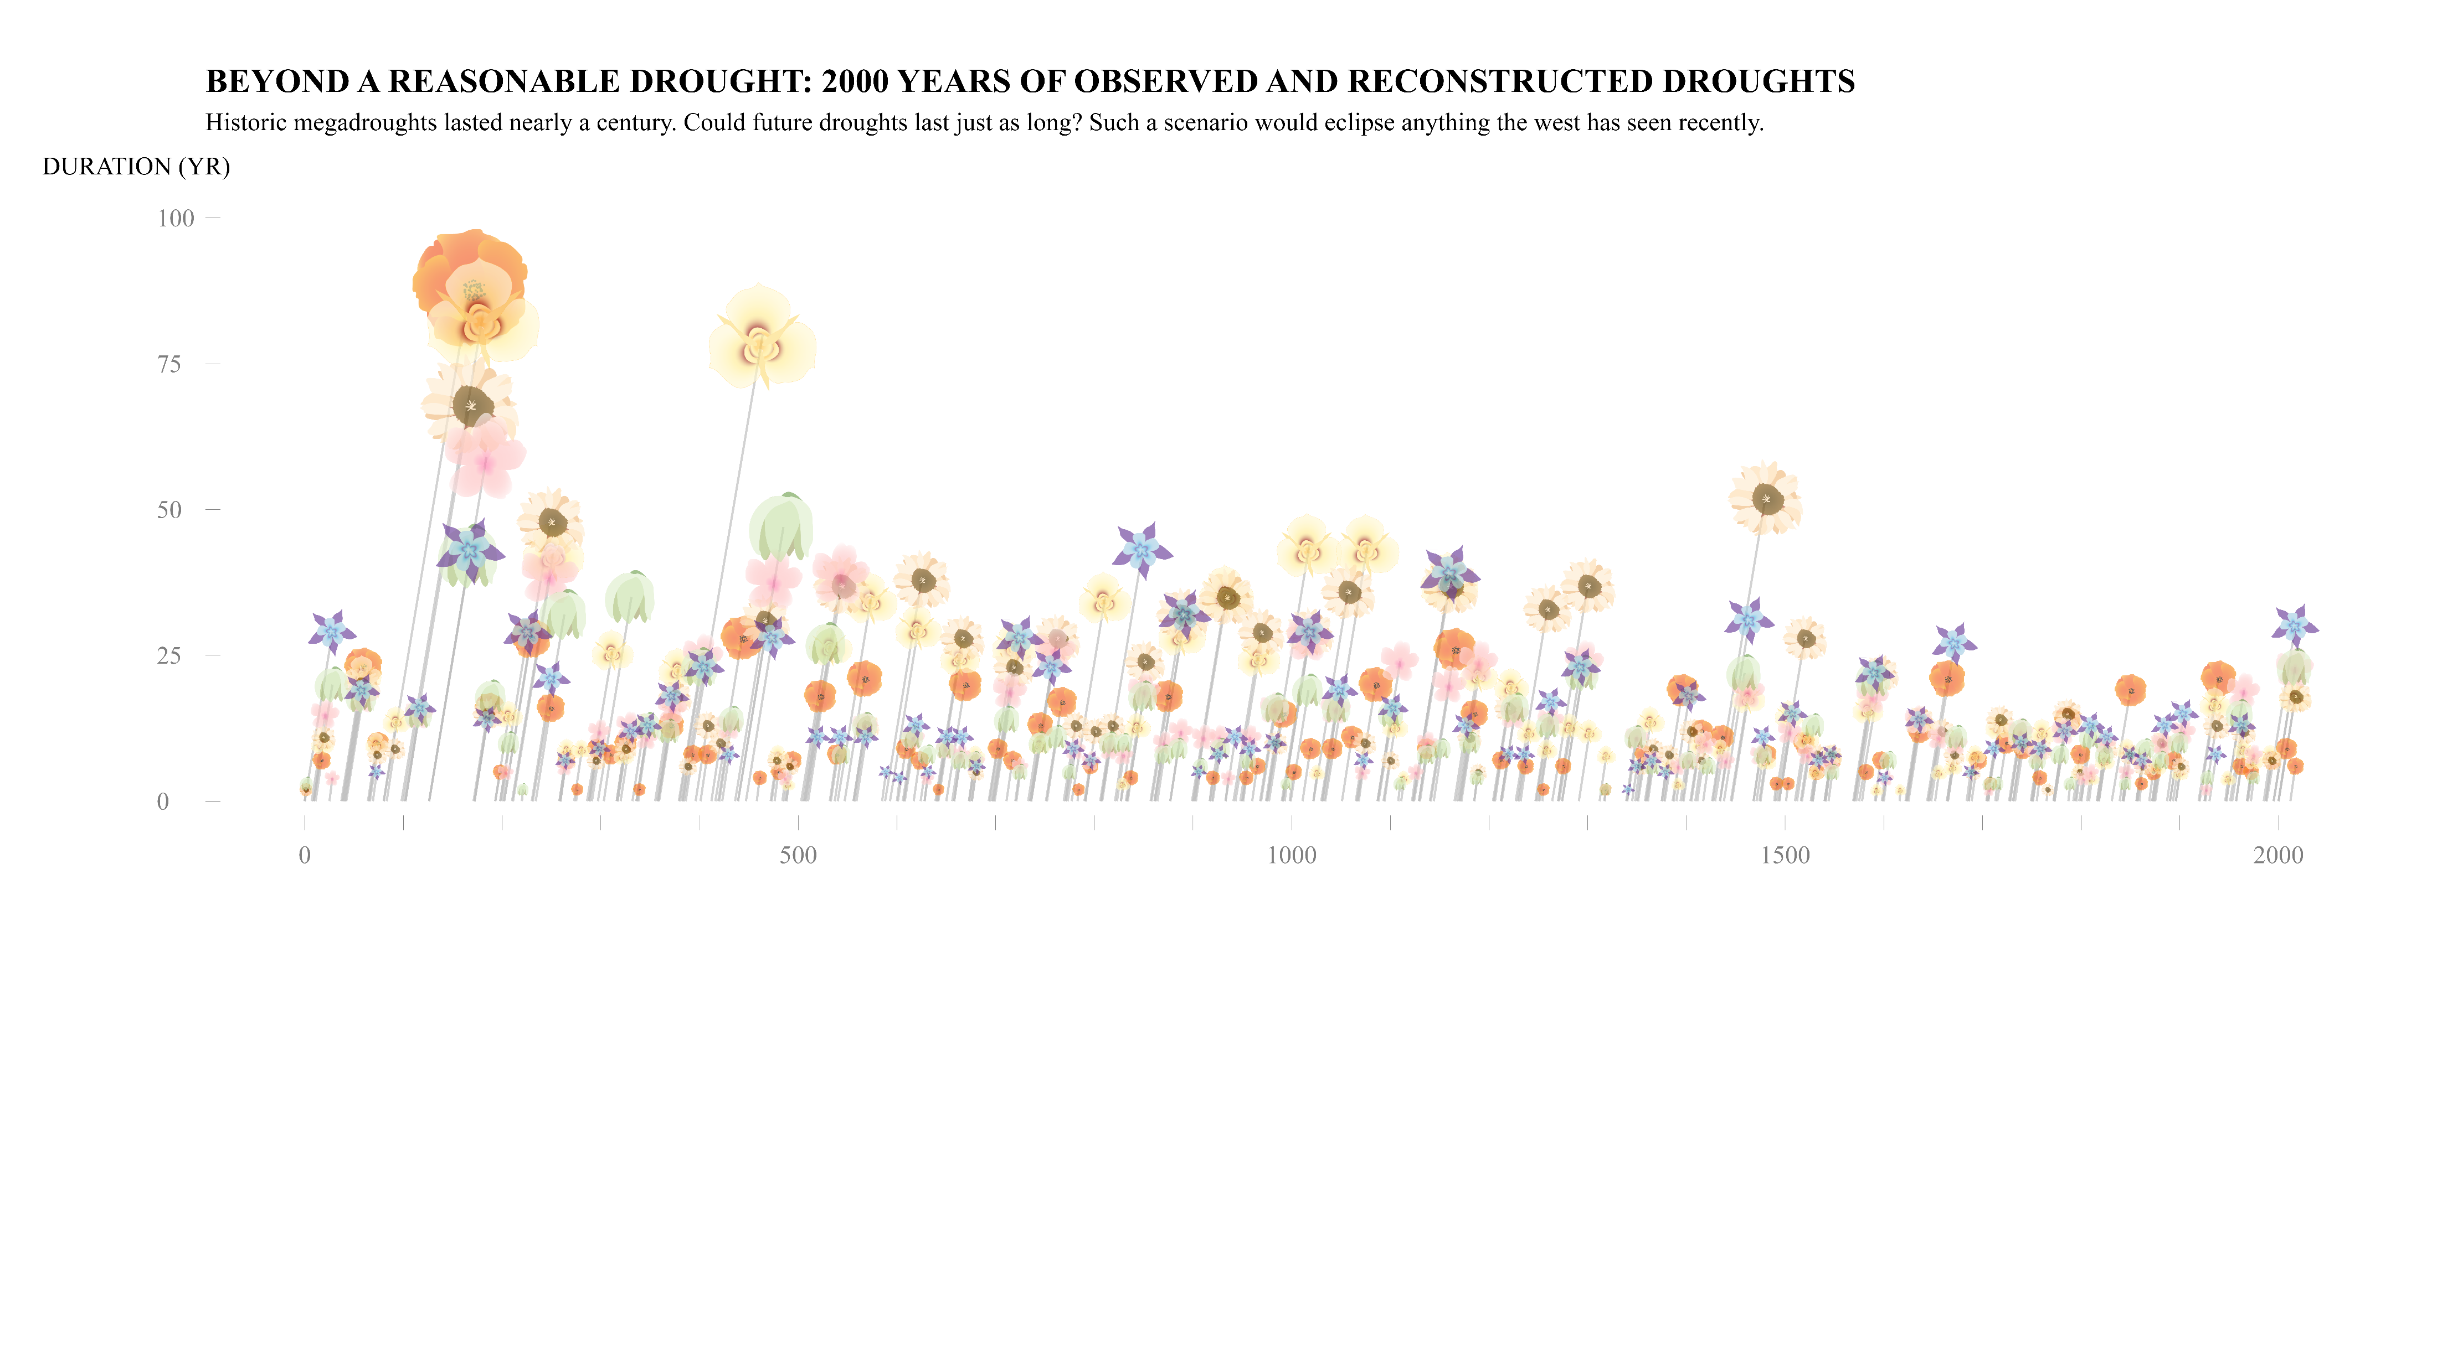







Megadroughts
Medieval Warm Period
Extreme
droughts
ANCIENT TIMES
MIDDLE AGES
MODERN ERA
Start of Common Era
Prophet Mohammed
Columbus Reaches America
French Revolution
World War I
HOW TO READ THE DIAGRAM
WATER RESOURCES REGIONS
The underlying data are tree-ring drought atlases that reconstruct and provide a paleoclimate analog to modern drought indices such as the Palmer Modified Drought Index (PMDI).
AREA
Severity
(sum of annual PMDI over drought duration)
California
Great Basin
Lower Colorado
Pacific N.W.
Rio Grande
Upper Colorado
DURATION
Start
End
TIMELINE
Data Source: Living Blended Drought Atlas (LBDA V2).
Flowers by Althea Archer; Plot by Ellie White ewhite@usgs.gov 04/19/2023

Slide 5
Extra text
The underlying data are tree-ring drought atlases that reconstruct and provide a paleoclimate analog to modern drought indices such as the Palmer Modified Drought Index (PMDI).
Plot was made using:
The PMDI raster maps,
A simple calculation of the Drought Area Index (DAI),
LOESS fit with span = 0.01 for smoothing, and
Pooling drought events with an inter-event duration of 2 years to make sure coming out and back into a drought counts as one longer event.

