Slide 2
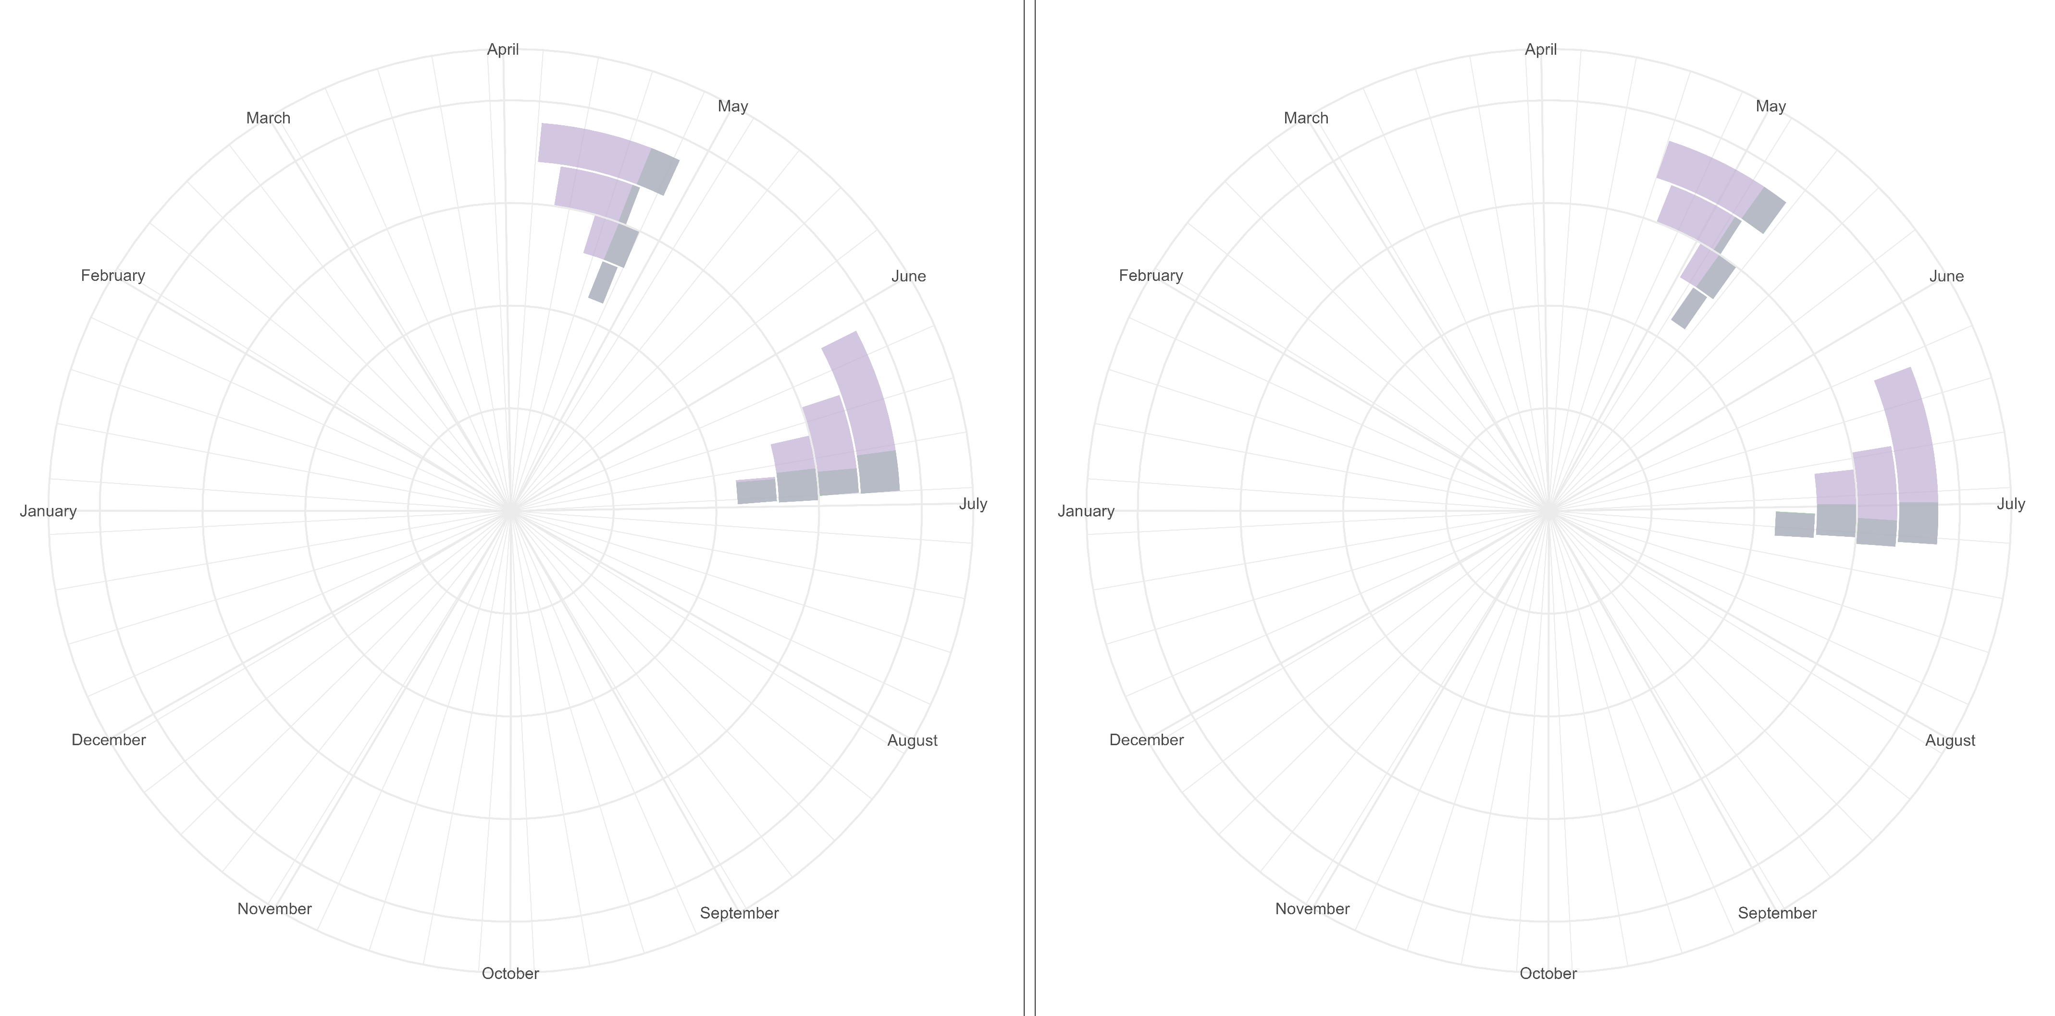
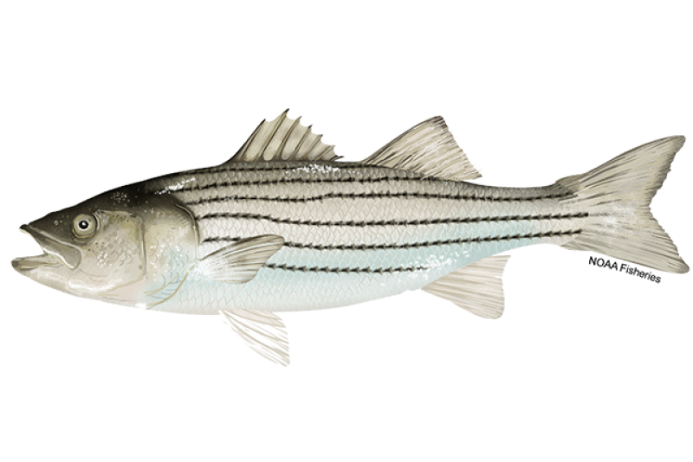
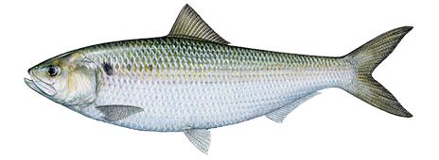

FISH IN HOT WATER
The Striped Bass and American Shad of the Hudson River are projected to spawn earlier with climate change.
Historical (1950 – 2012)
Projected (2012 – 2099)
RCP
8.5
RCP
8.5
RCP
6.0
RCP
6.0
RCP
4.5
Onset
RCP
2.6
RCP
4.5
Onset
RCP
2.6
RCP
8.5
RCP
8.5
RCP
6.0
American Shad
RCP
4.5
Striped Bass
RCP
6.0
RCP
2.6
RCP
4.5
Cessation
RCP
2.6
Cessation
Data Source: Nack, C. et. al. (2019). https://doi.org/10.1002/mcf2.10076
Plot made by Ellie White, ewhite@usgs.gov 04/02/2023

