Slide 2
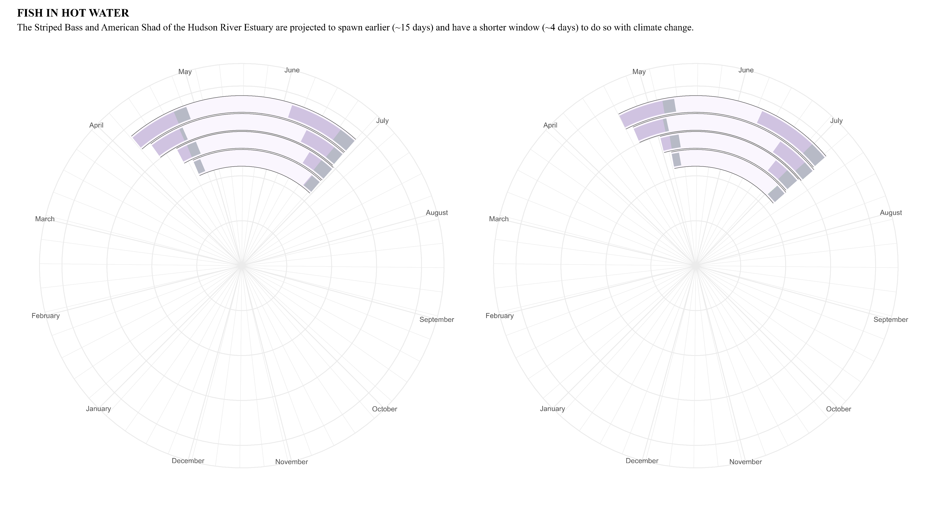
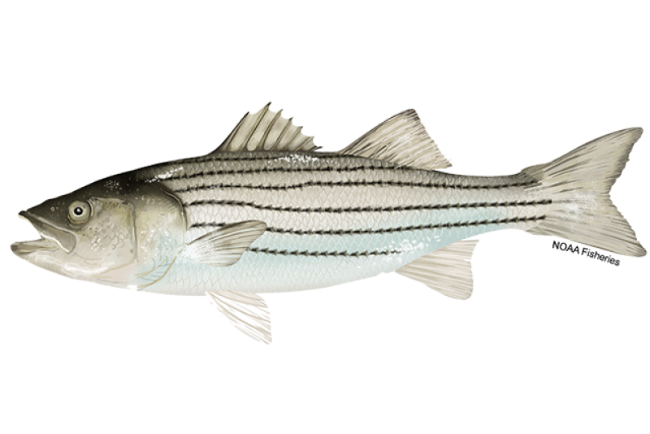
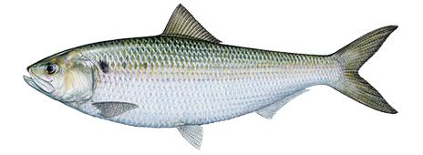
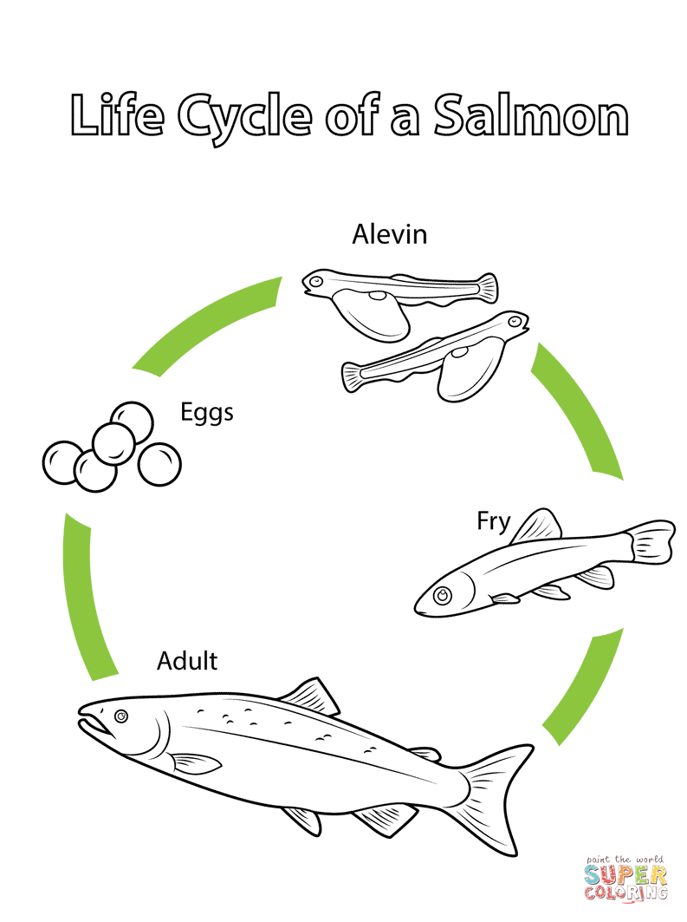

Historical (1950 – 2012)
Projected (2012 – 2099)
RCP
8.5
RCP
8.5
6.0
6.0
4.5
4.5
2.6
2.6
Start
Start
End
End
Adult
American Shad
Eggs
Striped Bass
HOW TO READ THE PLOT
The Representative Concentration Pathways (RCP) labeled are future scenarios constructed to represent how well we are able to curb and contain greenhouse gas emissions with RCP 2.6 implementing the most aggressive strategies and RCP 8.5 being “business-as-usual.” Their position on the y-axis of the plot above is from least likely (RCP 2.6) to most likely (RCP 8.5) but their distance from the center of the circle is not significant.
Historical values come from modeled results (are not directly observed) which is why they differ slightly.
Larva
The American Shad and the Striped Bass are migratory species needing both freshwater and marine habitats to complete their life cycle. This makes them particularly vulnerable to human activities. Native and Colonial Americans fished them for sustenance, smoked the flesh, and ate the roe as a delicacy.
The Hudson River Shad has declined in stock so much that all its fisheries were closed in 2010. The Striped Bass, while declining in relative abundance, still remains the most important game fish in the Hudson River.
Fry
Data Source: Nack, C. et. al. (2019). https://doi.org/10.1002/mcf2.10076
Fish images from www.takemefishing.org and NOAA Fisheries
Plot made by Ellie White, ewhite@usgs.gov 04/08/2023

