Slide 1
Max Clique Approximation
By: Dawson Dolansky

Slide 2
Pseudocode and Big-O Runtime Analysis
Greedy Solution that finds an independent set starting from the largest degree vertex
H
ordered_set = { E,
B,
F,
D,
A,
C,
G,
H, }
G
D
E
F
A
B
C
Notes:
How does it work

Slide 3
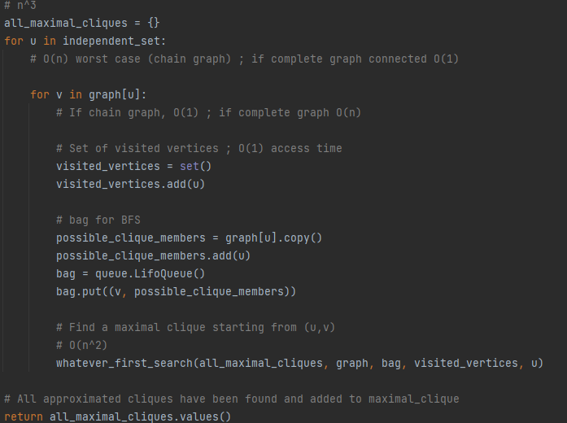
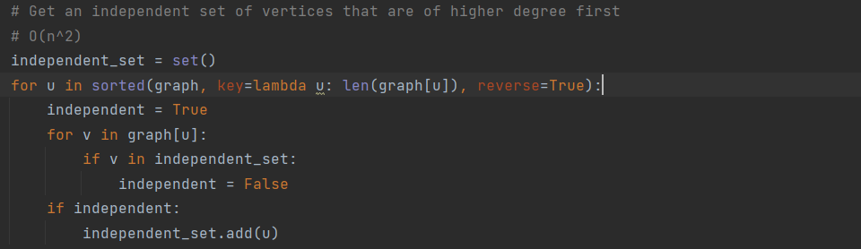
Pseudocode and Big-O Runtime Analysis
For each independent set vertex V, it finds any and all maximal cliques through BFS of each edge of V, ONLY including vertices neighboring V.
O(N³) is the theorized Big-O Runtime

Slide 4
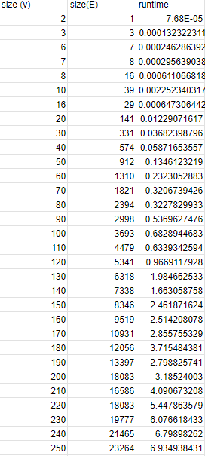
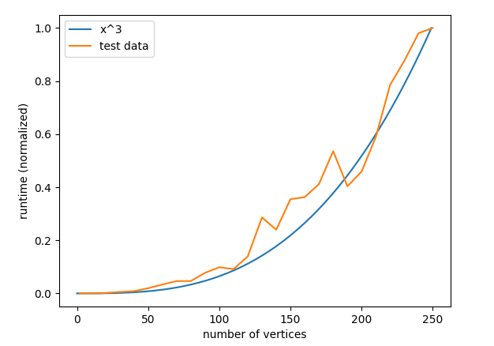
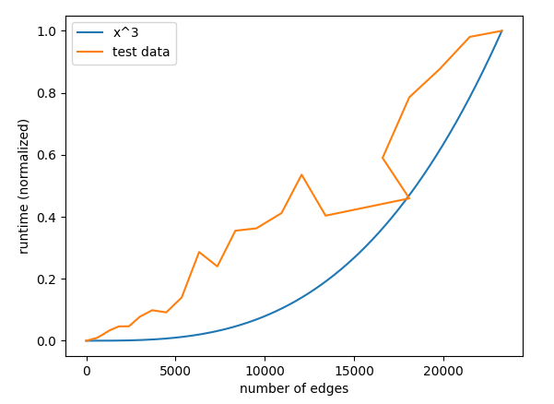
Empirical Runtime Analysis

Slide 5
Comparison between Approximation and Optimal
When is the approximation bad?
G
H
5
1
2
F
A
E
6
3
7
4
B
8
D
C

Slide 6
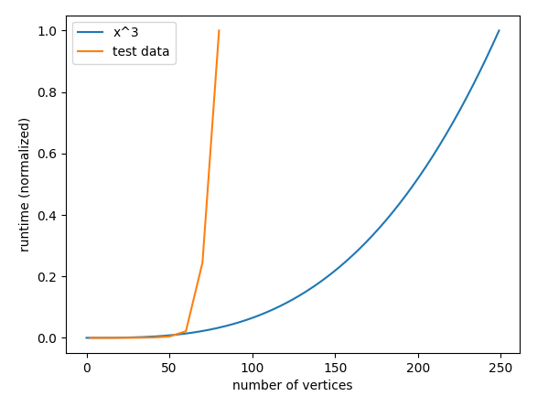
Comparison between Approximation and Optimal
Approximation
Exact Solution (Bron-Kerbosch)

