Slide 1
Max Clique Optimal
By: Dawson Dolansky

Slide 2
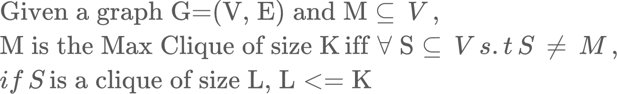
What is the Max Clique Problem
Definition of a Max Clique
A Graph
Maximal Clique
The largest size k of any clique possible across the graph
Max Clique
The largest Maximal Clique (arbitrary with multiple)
6
6
6
4
5
4
5
5
1
1
4
1
3
2
3
2
2
3

Slide 3
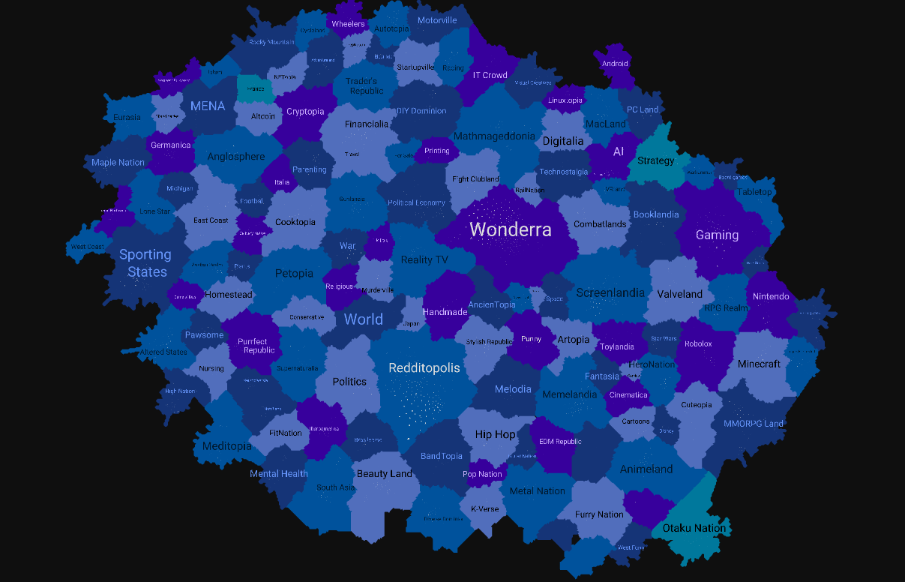
Usability of Max Clique
Computational Chemistry and Biology
Finding matchable/bindable groups at different levels of protein/molecule abstraction
Social Networks
Maximal Cliques can find large groups defined by certain characteristics
Matching recommendations with others of similar demographics

Slide 4
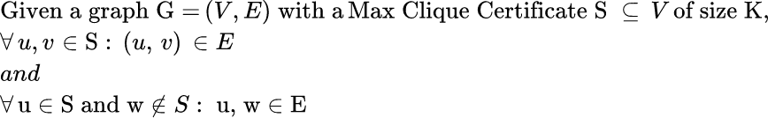
Certification
max_clique_certification(G=(V,E), M):
for (u, v) in S:
if (u, v) not in E:
return False
for (u, w) in E:
if (u, w) in S:
return False
return True
Thus the certification is polynomial, defined by the number of vertices in the certificate

Slide 5
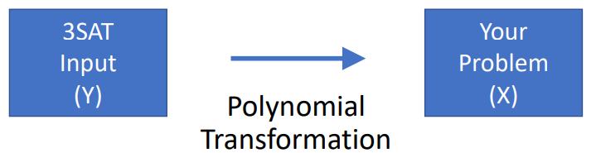
Reduction
Independent Set
Clique Set
We can utilize the complementary relationship of independent set to introduce a reduction from an NP-Problem
Independent Set Problem
Clique Problem
Notes:
Thus, any independent set in the complimentary graph is a clique in the original graph

Slide 6
Transformation
G
G
G
6
6
6
4
5
4
5
4
5
1
1
1
2
2
2
3
3
3

Slide 7

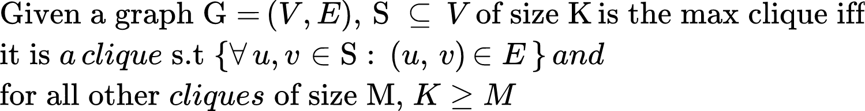
Reduction
Max Independent Set
Max Clique Set
We can utilize the complementary relationship of largest independent set to introduce a reduction to Max Clique
Largest Independent Set Problem
Max Clique Problem

Slide 8
Transformation
6
6
4
5
4
5
1
1
2
2
3
3

Slide 9
Implementation
algorithm BronKerbosch_Pivot(R, P, X) is
if P and X are both empty then
report R as a maximal clique
choose a pivot vertex u in P ⋃ X
for each vertex v in P \ N(u) do
BronKerbosch2(R ⋃ {v}, P ⋂ N(v), X ⋂ N(v))
P := P \ {v}
X := X ⋃ {v}
R: Set of vertices found to be in a clique
P: Set of possible vertex clique additions
X: An Empty Set for mathematical proof
Notes:
Ignore loops in processof vertex clique additions recurse

Slide 10
Bron-Kerbosch Algorithm
6
4
5
1
2
3
R =
{}
{2}
{2, 1}
{2, 1, 5}
{2, 3}
{4}
{4, 5}
{4, 3}
{4, 6}
P =
{1,2,3,4,5,6}
{1, 3, 5}
{5}
{}
{}
{3, 5, 6}
{}
{}
{}

Slide 11
Big-O Runtime analysis
Every possible clique is visited
Every edge is visited in the graph
6
algorithm BronKerbosch_Pivot(R, P, X) is
if P and X are both empty then
report R as a maximal clique
choose a pivot vertex u in P ⋃ X
for each vertex v in P \ N(u) do
BronKerbosch2(R ⋃ {v}, P ⋂ N(v), X ⋂ N(v))
P := P \ {v}
X := X ⋃ {v}
5
4
1
2
3

Slide 12
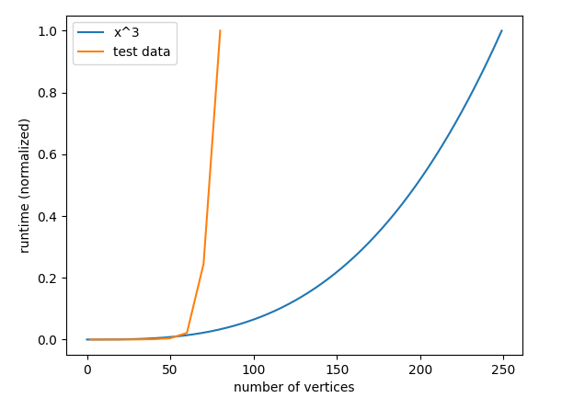
Empirical Analysis

