Slide 1

Department of Computer Science & Engineering Global Ground Water & Water Stress Analysis Batch no. 02 1. 2411CS010039 – A. THWISHIKA 2. 2411CS010088 – B. TEJASWINI 3. 2411CS010142 – D. CHANDRA 4. 2411CS010155 – E. AKSHAY KUMAR Guide Mrs. K. Manasa
Maisammaguda, Kompally, Medchal - Malkajgiri District Hyderabad - 500100, Telangana State. www.mallareddyuniversity.
(Telangana State Private Universities Act No. 13 of 2020 &
G.O.Ms. No. 14, Higher Education (UE) Department)

Slide 2
Table of Contents
Introduction
Abstract
Limitations of Existing Algorithms/Methodologies
Literature Survey
System Architecture & Data Flow Diagram
Modules
Hardware/Software Requirements
Screenshots
Conclusion

Slide 3
INTRODUCTION
Groundwater is one of the world’s most vital natural resources, serving as the primary source of freshwater for billions of people, sustaining vital ecosystems, and acting as the backbone of global agricultural irrigation. However, as highlighted in recent hydrological reports, the world is facing a severe and accelerating crisis known as groundwater depression a persistent, long-term decline in water table levels. Driven by rapid population growth, intensive agricultural demands, industrialization, and the compounding effects of climate change, aquifers across the globe are being depleted at rates that far exceed their natural capacity for recharge.

Slide 4
ABSTRACT
This project, explores the critical global issue of rapidly disappearing groundwater between the years 1990 and 2023. By combining real-world data from major organizations like the World Bank, the UN (FAO), and NASA , the project uses Python to calculate water stress and visualize the decline of underground water resources across 32 different countries. This analysis powers the interactive web dashboard we designed, which brings the data to life through dynamic maps and charts.

Slide 5
Literature survey:
1.The Global Groundwater Crisis and Depletion Trends
Recent hydrological literature emphasizes that groundwater depletion is no longer a localized issue but a systemic global crisis. Studies by Wada et al. (2010) and Famiglietti (2014) utilized GRACE (Gravity Recovery and Climate Experiment) satellite data to reveal that many of the world’s largest aquifers including those in Northwestern India, the North China Plain, and the Central Valley of California are being drawn down at unsustainable rates.
2.Transition from Reactive to Proactive Water Management
Historically, groundwater management has relied on reactive policies implemented only after significant depletion has occurred. Gleeson et al. (2012) introduced the concept of the "groundwater footprint," urging a shift toward proactive, sustainable yield assessments. Furthermore, research by the UN Water analytical briefs indicates a lack of accessible data visualization tools for local policymakers, which hinders proactive legislation.

Slide 6
Limitations of Existing Algorithms/Methodologies
Existing System
Data is scattered across difficult reports and spreadsheets.
Actions are reactive, usually waiting until a severe water crisis happens.
Predicting future water levels is very hard using old, complicated methods.
Current tools are basic and do not have interactive maps or graphs.
Seeing the big picture of global water stress quickly is nearly impossible.

Slide 7
Proposed System
Brings all global groundwater data into one easy-to-use website.
Uses smart artificial intelligence to predict water levels up to 15 years into the future.
Features interactive maps so users can easily click and find water stress hotspots.
Allows instant switching between a worldwide view and specific country details.
Helps leaders make smart, proactive choices to save water before it runs out.

Slide 8
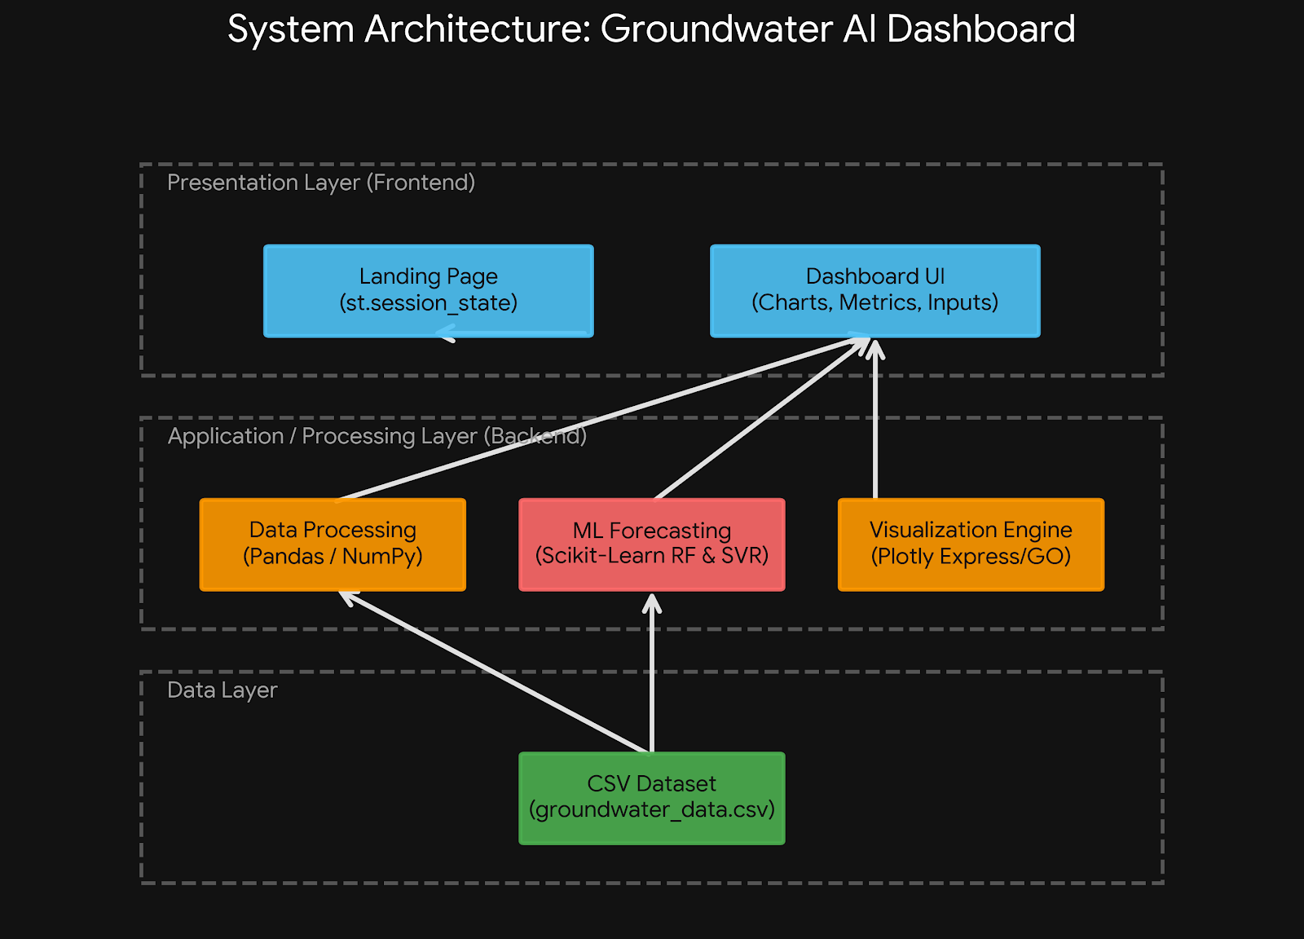
System Architecture

Slide 9
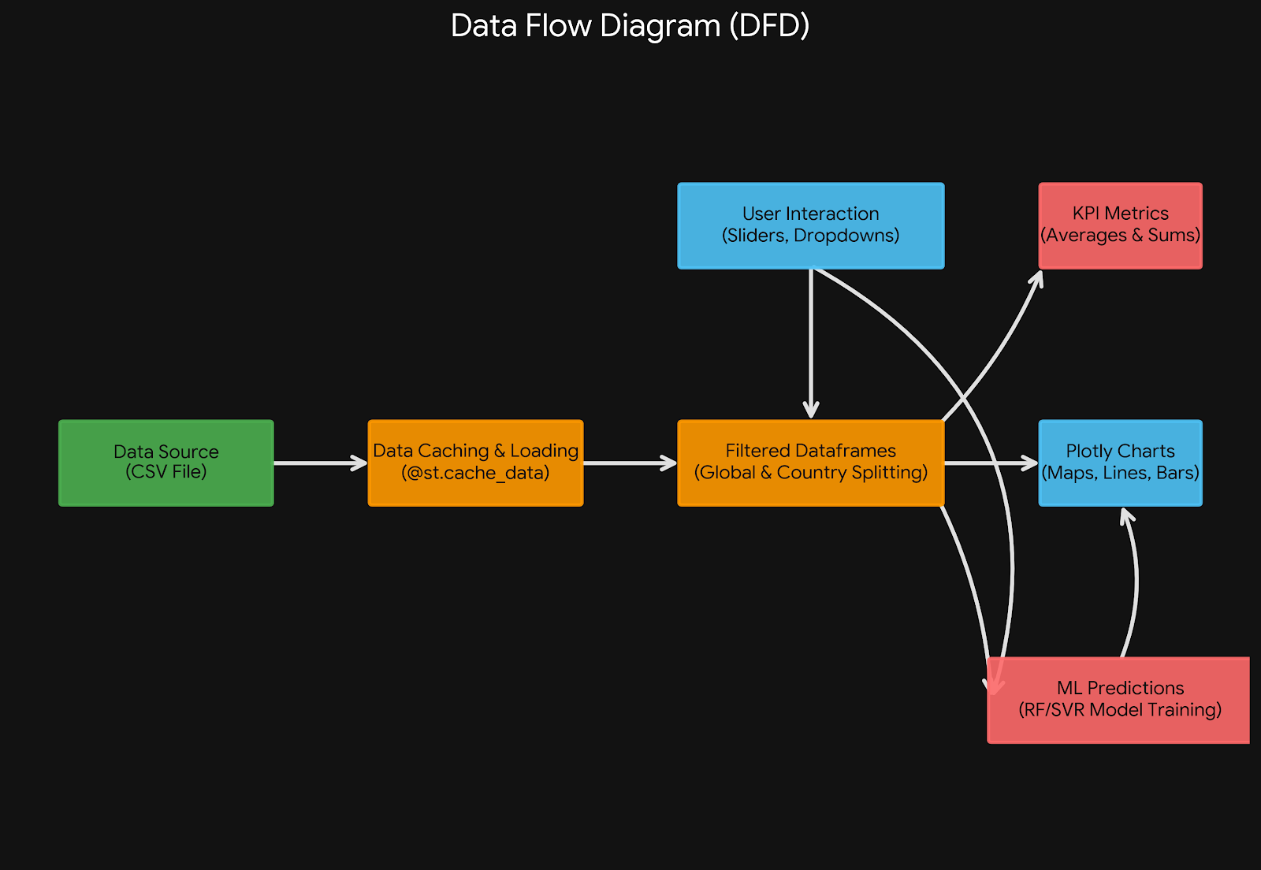
Data Flow Diagram

Slide 10
Modules
Module-1:Core Features
Global & Local Analytics Engine
Machine Learning Forecasting
Geospatial Water Stress Mapping
Correlation & Distribution Analysis
Module-2:System Features
State-Driven Navigation (SPA Architecture)
High-Performance Data Caching
Animated UI/UX Framework
Feedback & Communication Module

Slide 11
HARDWARE/SOFTWARE REQUIREMENTS
HARDWARE
SOFTWARE
Processor :- Intel Core i7 (13th gen)
RAM:- 16GB
Storage:- 512 GB
OS:- Windows 11
Language:- Python
IDE:- VS Code
Libraries:- NumPy, Pandas, Scikit-learn, Matplotlib, SVM, RFR
Framework:- Streamlit

Slide 12
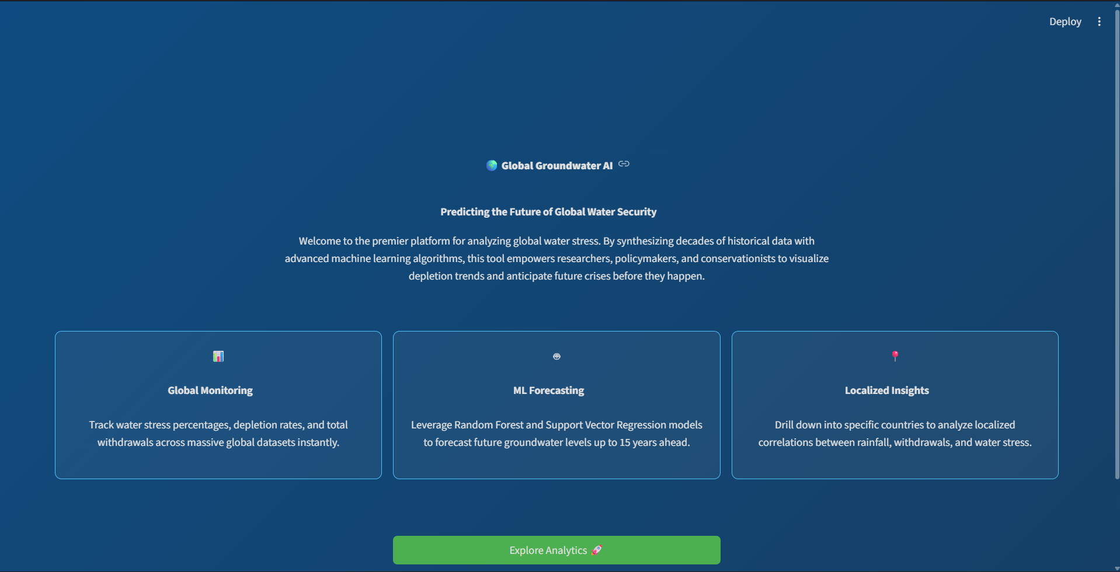
Screenshots
Dashboard Page

Slide 13
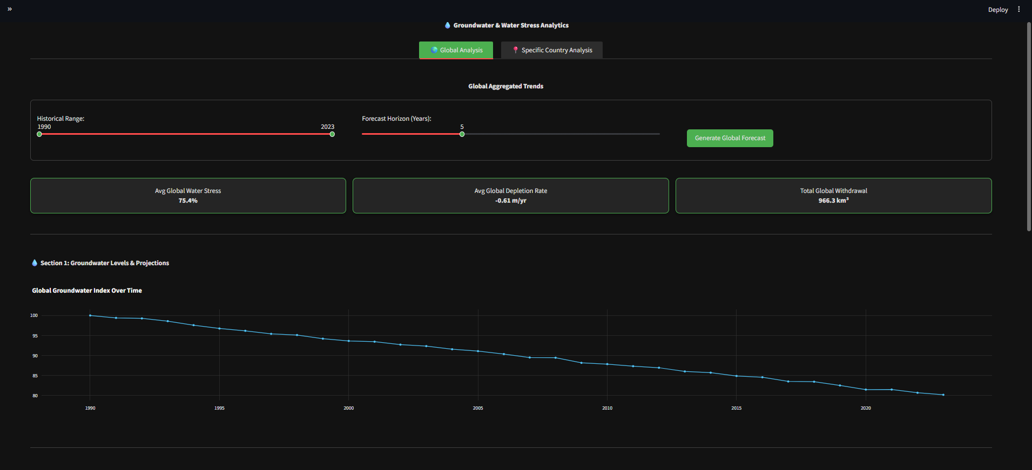
Global Analysis

Slide 14
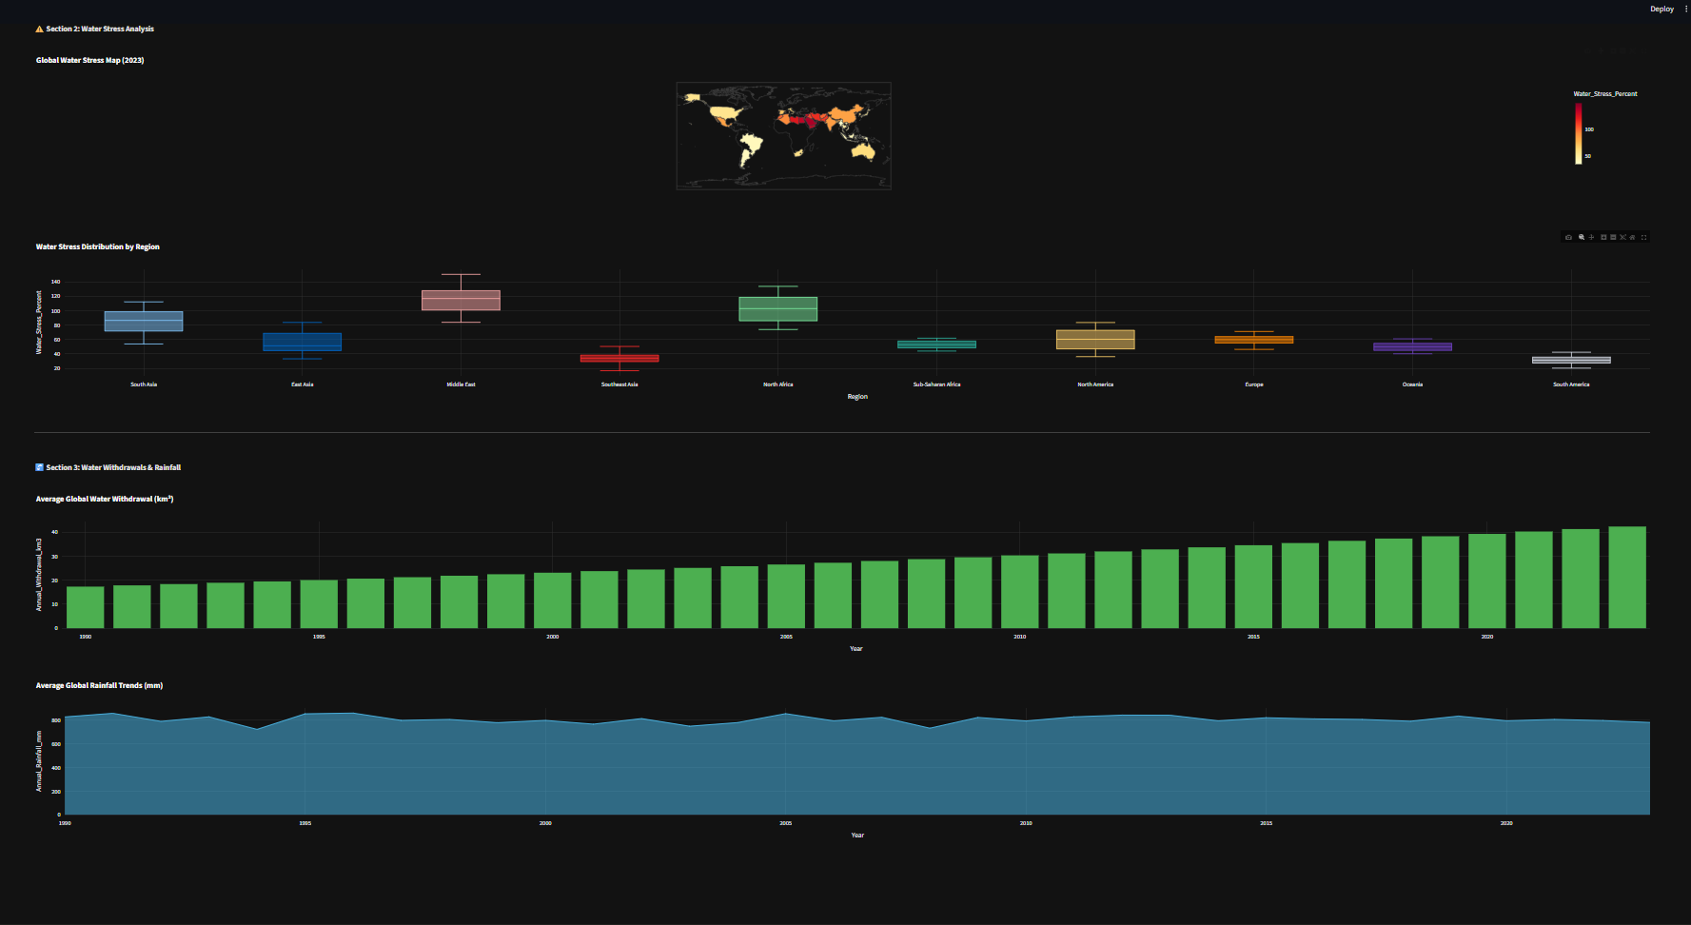
Global Analysis

Slide 15
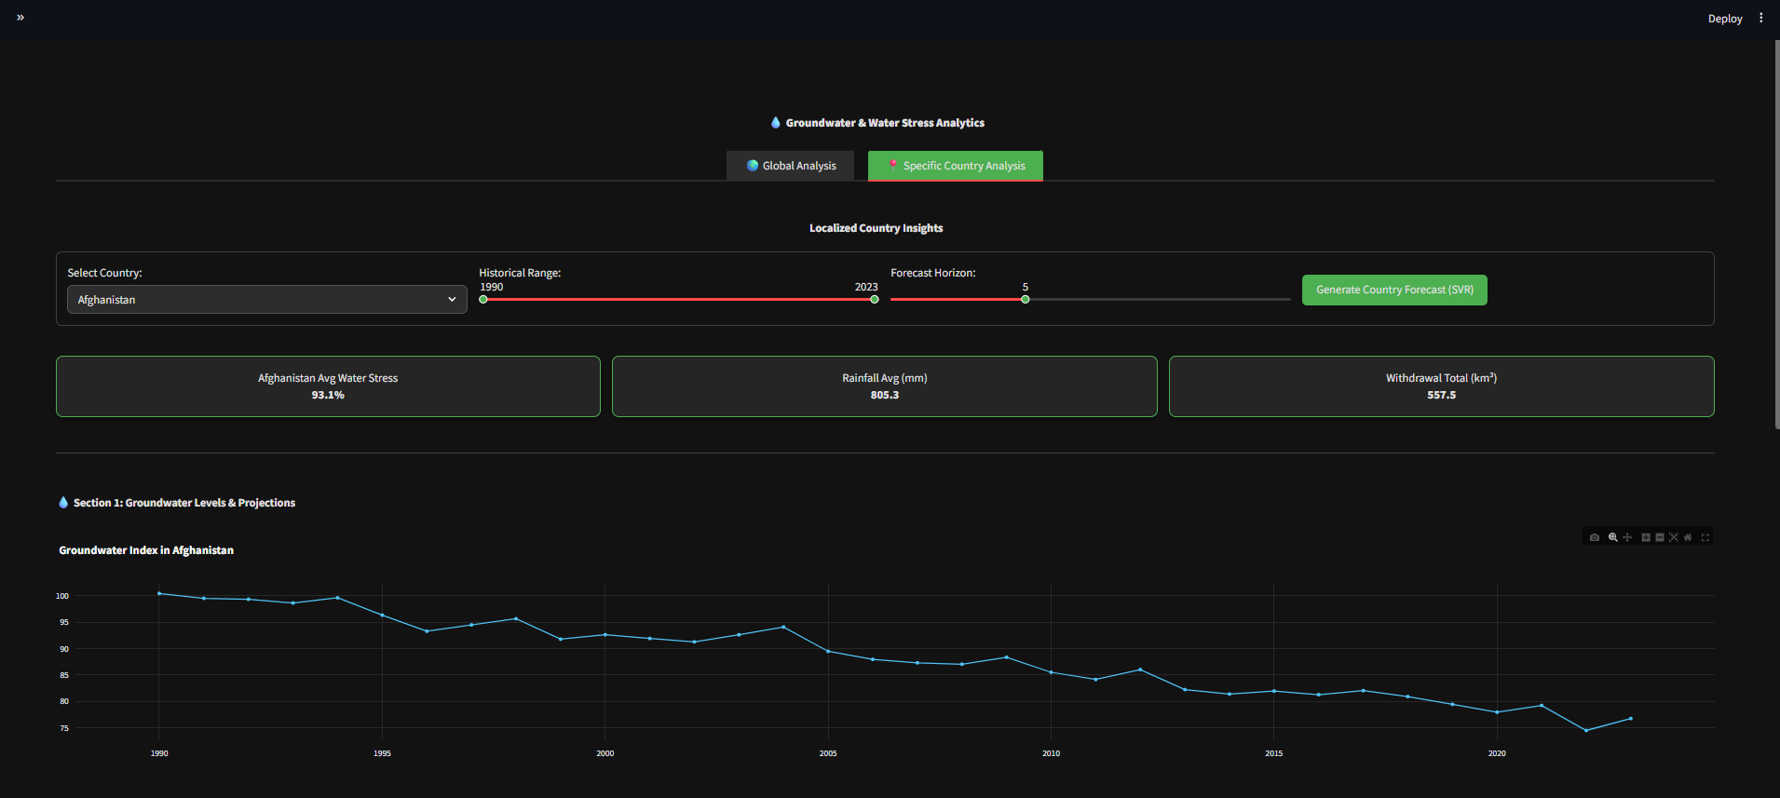
Specific Country Analysis

Slide 16
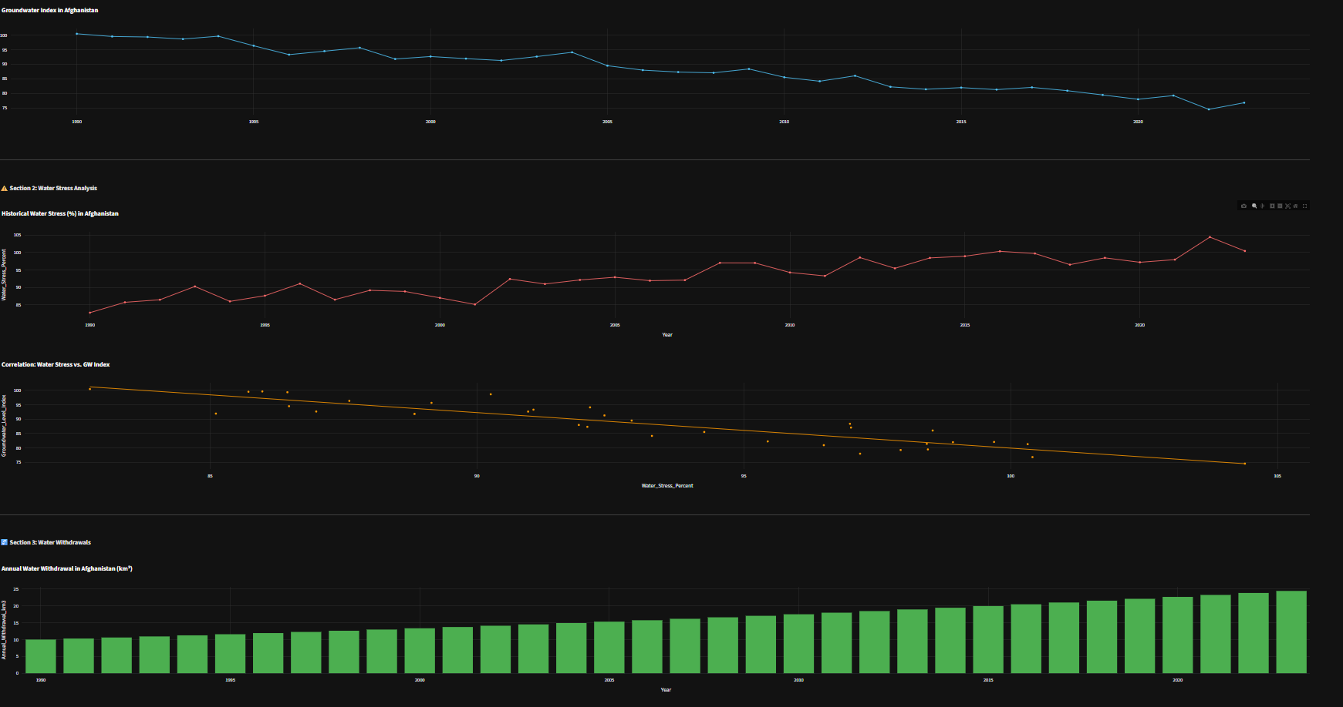
Specific Country Analysis

Slide 17
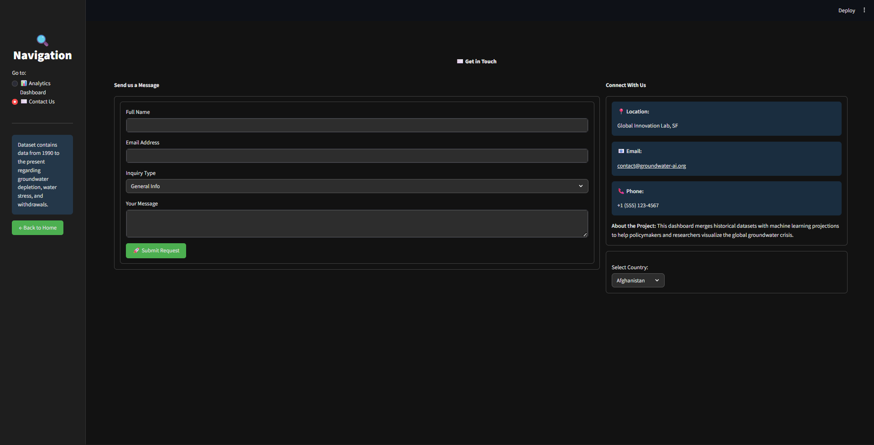
Contact Page

Slide 18
Conclusion:
The findings of this project highlight that groundwater depletion is no longer a looming threat, but an accelerating global crisis. Based on the assessment of 32 countries between 1990 and 2023, aquifer levels have seen alarming declines exceeding 30%, particularly in highly vulnerable regions such as South Asia and the Middle East. The data reveals an undeniable link between human activity and resource exhaustion, showing a strong negative correlation (r = -0.82) between water stress and groundwater levels, driven largely by population growth and agricultural demands.
If current extraction rates continue, these heavily stressed regions are projected to reach critical, irreversible water scarcity within the next 20 years. However, the sustainable water management models of nations like Israel and Singapore prove that this crisis is preventable if governments adopt proactive, data-driven policies and strict extraction regulations.

Slide 19
THANK YOU

