Slide 1


R.M.K. ENGINEERING COLLEGE
(An Autonomous Institution)
R.S.M. Nagar, Kavaraipettai, Gummidipoondi Taluk, Tiruvallur District, Tamil Nadu
Department of Electronics and Communication Engineering
24ME411 PRODUCT DEVELOPMENT LAB
An Edge-Based Low-Power Smart Soldier Health Monitoring System Using LoRa
PRESENTED BY:
111724104084 MA SESHASAAI – Team Lead
111724104069 KAMALESHWARAN M
111724104068 K BALA MANIKANTA

Slide 2
Introduction
Soldiers work in harsh and remote environments
Continuous monitoring is critical for safety
Wearable systems enable real-time health tracking
Uses multi-sensor data (heart rate, motion, temperature, GPS)
Edge processing enables smart decision making
LoRa provides long-range, low-power communication
Ensures reliable and efficient soldier monitoring

Slide 3
Problem Statement
Soldiers face extreme heat, cold & physical stress
Remote areas → no reliable GSM/Internet
Existing systems → high power consumption
Continuous transmission drains battery
Monitoring based on single parameter → false alerts
No context-aware health analysis (motion + vitals + environment)
Difficult to detect real emergencies vs normal conditions

Slide 4
Objectives
Develop a low-power wearable system for soldiers
Monitor heart rate, motion, temperature, humidity, GPS
Use multi-sensor fusion for accurate analysis
Implement edge-based Decision Tree logic
Reduce false alerts using context-aware detection
Enable long-range communication using LoRa
Achieve event-driven transmission for power saving
Ensure real-time emergency alert with location

Slide 5
Literature survey
S No. | Reference Name (Write Paper Title) | Seed Idea/ Work description | Problems found | Any other criteria | Proposed System
1 | Integrating LoRa and Image Processing for Enhanced Military Surveillance and Situational Awareness | ESP32 + LoRa based wearable; monitors heart rate, temperature, GPS and sends real-time data | No ML/decision logic; lacks context-aware analysis → possible false alerts, higher power use | Focus on real-time tracking & surveillance using LoRa communication | Multi-sensor + Decision Tree ML; context-aware detection; reduced false alerts + low power (event-driven LoRa)
2 | LifeLine: Smart Soldier Health Monitoring and Situational Awareness System Powered by ESP8266 and IoT Integration | IoT-based wearable using ESP8266; monitors HR, BP, SpO₂, temp + GPS; continuous real-time data transmission | Uses continuous transmission → high power; no implemented ML (only future scope); possible false alerts | Focus on IoT + real-time monitoring; suggests AI/ML for future improvement | Implements Decision Tree ML at edge; event-driven LoRa (low power); context-aware multi-sensor fusion → reduced false alerts
3 | Soldier Health and Position Tracking System | IoT system using NodeMCU + GPS + sensors; monitors HR, temperature, SpO₂ and sends data to control room | Uses basic monitoring (no ML/decision logic); single-parameter alerts → false alerts; possible higher power usage | Focus on health + position tracking; includes SOS-based alert system | Uses Decision Tree ML + multi-sensor fusion; context-aware analysis; event-driven LoRa → low power & accurate alerts
4 | Soldier Safety using GPS and GSM Modem | WBAN-based system using GSM + GPS; monitors heart rate, temperature and stores data in cloud | Uses GSM → high power & network dependency; no ML/decision logic; single-parameter alerts → false alerts | Focus on cloud storage + remote monitoring using GSM communication | Uses LoRa (no GSM, low power); Decision Tree ML + multi-sensor fusion; event-driven alerts → efficient & reliable

Slide 6
EXISTING METHODS
Uses GSM / IoT based communication
Monitors basic parameters (HR, temperature, GPS)
Mostly single-parameter based alerts
Uses continuous data transmission
Focus on real-time tracking only
Limitations:
High power consumption
Network dependency (GSM/Internet issues)
False alerts due to lack of context
No intelligent decision-making (ML absent)
Not suitable for long-duration remote deployment

Slide 7
PROPOSED METHOD
Wearable system using ESP32 + LoRa
Integrates MAX30102(Heart rate), MPU6050(Motion sensor), DHT22(Temperature and Humidity), GPS NEO-6M
Implements simple ML edge-based Decision Tree logic
Analyzes heart rate + temp trend + motion + environment
Motion used as supporting parameter
Context-aware health prediction (heatstroke, panic, etc.)
Event-driven LoRa transmission → low power
Sends emergency alert with location
Ensures accurate detection & reduced false alerts

Slide 8
SYSTEM ARCHITECTURE
Sensor Layer: MAX30102 (HR), MPU6050 (motion), DHT22 (temp & humidity), GPS NEO-6M
Processing Layer: ESP32 (edge processing)
Decision Layer: Decision Tree (simple ML logic)
Communication Layer: LoRa (RA-02 module)
Control Station: Receives alert + location data
Working Flow:
Sensors → ESP32 data collection
Data → Decision Tree analysis
Normal → Sleep mode (no transmission)
Emergency → LoRa alert + GPS location
Ensures low power + intelligent monitoring

Slide 9
Block Diagram
Sensors HR | Motion | Temp | Humidity | GPS
ESP32 Edge Decision Tree
LoRa Module Emergency Transmission
Control Station Alert + Location
Sleep Mode (No Transmission)
Normal → System stays in Sleep Mode (power saving)
Emergency → LoRa + GPS alert

Slide 10
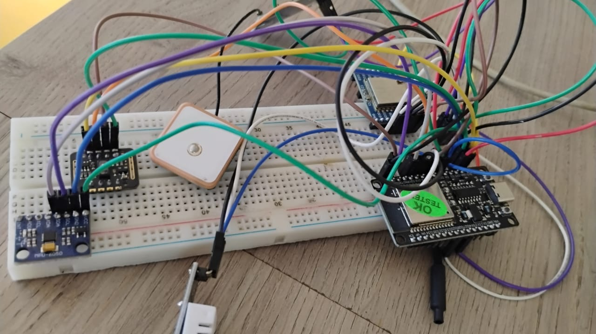
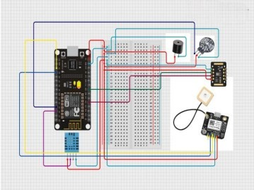
Circuit diagram

Slide 11
WORKING METHODOLOGY
Sensors continuously collect HR, motion, temp, humidity, GPS
Data sent to ESP32 for processing
Apply Decision Tree logic (edge ML)
Analyze HR vs temperature + motion + environment
Identify abnormal conditions (heatstroke, panic, etc.)
Motion used to avoid false alerts
If normal → system in sleep mode
If abnormal → trigger alert
LoRa transmits alert + GPS location to control station
Ensures accurate, low-power, real-time monitoring

Slide 12
Applications
The Applications are :
Military soldier health monitoring in border areas
Remote surveillance & safety systems
Disaster management & rescue operations
Firefighters / hazardous environment monitoring
Industrial worker safety monitoring
Forest & wildlife field operations
Wearable healthcare in remote regions
Useful in low-network, extreme environment conditions

Slide 13
Advantages
Low power consumption (event-driven LoRa)
Long-range communication without GSM/Internet
Reduced false alerts using context-aware analysis
Multi-sensor fusion → higher accuracy
Edge-based ML → fast decision making
Real-time emergency alert with location
Compact & wearable design
Suitable for remote and harsh environments

Slide 14
Limitations
DHT22 cannot measure exact body temperature (only near-skin trend)
Decision Tree is simple ML → limited accuracy in complex cases
LoRa has limited data rate (not suitable for large data)
Possible sensor errors / noise in harsh conditions
Battery life depends on usage & transmission frequency
Scope for improvement using advanced ML & better sensors

Slide 15
Conclusion & Future Work
Conclusion:
Developed a low-power wearable system for soldier safety
Uses multi-sensor fusion + Decision Tree (edge ML)
Achieves context-aware health monitoring
Reduces false alerts effectively
LoRa enables long-range communication without network
Suitable for remote and extreme environments
Future Works:
Cloud integration via LoRa receiver (ESP32 → Cloud → Laptop display) for replacement of LED display with real-time monitoring dashboard
Use Li-ion battery with voltage regulation circuits (safe power supply)
Improve system with advanced ML models
Implement data encryption for secure LoRa communication
Enhance accuracy using better body temperature sensors

Slide 16
Reference
J. J. Kang, W. Yang, G. Dermody, M. Ghasemian, S. Adibi, and P. Haskell-Dowland, “No soldiers left behind: An IoT-based low-power military mobile health system design,” IEEE Access, vol. 8, pp. 201498–201515, Nov. 2020, doi: 10.1109/ACCESS.2020.3035812.
D. J. Lin, A. Satish, K. L. S. Richardson, S. An, C. O. Yaldiz, and M. Buller, “Predicting soldier performance on structured military training marches with wearable accelerometer and physiological data,” IEEE Sensors Journal, vol. 24, no. 1, pp. 403–413, Jan. 2024, doi: 10.1109/JSEN.2023.3330409.
S. Thotakura, S. Movva, L. Apoorva, and J. Susmitha, “LifeLine: Smart soldier health monitoring and situational awareness system powered by ESP8266 and IoT integration,” in Proc. 2025 6th Int. Conf. Electronics and Sustainable Communication Systems (ICESC), Coimbatore, India, Sept. 2025, doi: 10.1109/ICESC65114.2025.11212282.
S. Umamaheswari, A. Ahmed Zintha, S. Abinesh, and P. Kalaiselvan, “Integrating LoRa and image processing for enhanced military surveillance and situational awareness,” in Proc. 2025 3rd Int. Conf. Advancements in Electrical, Electronics, Communication, Computing and Automation (ICAECA), Coimbatore, India, Apr. 2025, doi: 10.1109/ICAECA63854.2025.11012606.
A. Aggarwal, V. Kumar, V. Singhal, and R. Yadav, “Soldier health and position tracking system,” in Proc. Int. Conf. Sustainable Emerging Innovations in Engineering and Technology (ICSEIET), Ghaziabad, India, Sep. 2023, doi: 10.1109/ICSEIET58677.2023.10303559.

Slide 17
Thank you!

