Slide 1
AES

Slide 2
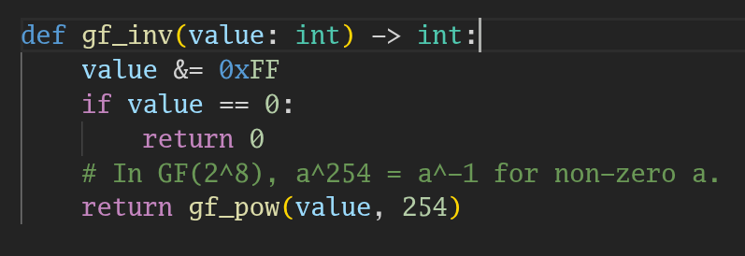
SBOX
Multiplicative Inverse

Slide 3
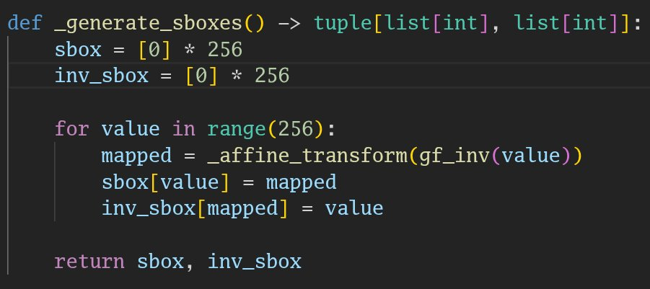
Affine Transformation

Slide 4
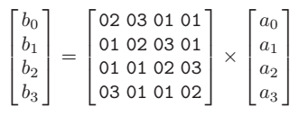

Multiplication under GF (2^8)
Diffusion
MDS matrix

Slide 5

