Slide 1
STROKE RISK PREDICTION DEPENDING ON THE PATIENT HEALTH SYMPTOMS: AN APPLICATION OF MACHINE LEARNING AND ARTIFICIAL INTELLIGENCE
Presented By:
Dominic N. Nwachukwu
sba24103

Slide 2
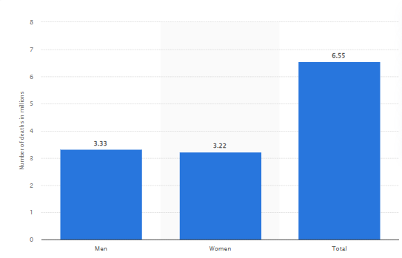
RESEARCH TITLE AND TOPIC AREA
Title: Stroke risk prediction depending on the patient health symptoms: An application of Machine Learning and Artificial Intelligence
6.55 million global deaths occurred from stroke (3.33 million males and 3.22 million females) in 2019-2022 (Elflein, 2023).
Symptoms such as slurred speech, loss of balance, paralysis or drooping indicate the prevalence of Stroke (MacGill, 2018).
Machine Learning can process large data on medical parameters, detect hidden patterns in health symptoms, providing early stroke risk assessment.
Figure 1:
Global deaths from stroke in 2019-2020
(Source: Elflein, 2023)
Notes:
Hello Everyone. In this presentation, I am going to present background context, rationale, objectives and data sources regarding the research related to development of Machine Learning models for early stroke detection. Stroke can be considered as a leading cause of death and disability, causing more than 6.55 million deaths worldwide, which often results from medical factors like chest pain, irregular heartbeat, edema, nausea and high Blood pressure. Conventional clinical assessments rely on statistical models, which may not effectively capture complex interactions among health symptoms. In this context, Machine Learning (ML) and Artificial Intelligence (AI) can offer advanced predictive capabilities by analysing vast datasets, identifying patterns, and providing more personalised risk assessments.

Slide 3
PROPOSED DOMAIN AREA AND PROBLEM AREA
Healthcare and Medical AI to focus on predictive analytics
(Machine Learning Modelling) in stroke risk assessment
Inaccurate and delayed stroke risk predictions can lead to
higher mortality as well as disability rates from stroke.
Traditional diagnostic methods (like brain imaging and blood tests)
show lack of effectiveness in predicting stroke.
Notes:
The domain area of this study falls under healthcare and medical AI, specifically in predictive analytics and ML modelling for stroke risk assessment. The main problems associated with traditional stroke risk assessment are low accuracy and delayed assessment due to handling of computed tomography and MRI images.

Slide 4
RESEARCH OBJECTIVES
Aim: The aim of this study is to predict stroke risks based on the health symptoms of patients.
Objectives:
To evaluate the association between health symptoms and the prevalence and severity of stroke
To develop Machine Learning models (such as Logistic Regression, Random Forest Classifiers, Voting Classifiers and Stacking Classifiers) for prediction of stroke based on clinical parameters
To evaluate predictive performance of developed ML models using metrics like accuracy, recall, false negative rates and f1 score
To deploy the best-fitted model into a Python-based web application using the Flask framework
Notes:
In this slide, I have presented the objective of this study, which includes development of ML models and deploying the best-fitted model for developing a Stroke Risk prediction system.

Slide 5
IDENTIFICATION OF POTENTIAL DATA SOURCE
The ‘Stroke Risk Prediction Dataset’ can be used in this study.
Target variable in the dataset is ‘Whether a person is at risk of a stroke’, which has two classes (Yes (1) and No (1)).
The dataset is generated from medical literature (American Stroke Association (ASA), mayo Clinic and Oxford University Press) (Tusher, 2021).
Notes:
The dataset includes medical factors like Chest Pain, Shortness of Breath, Irregular Heartbeat, Nausea, Chest Discomfort, Nausea and High Blood pressure. The availability of extensive factors related to Cardiovascular symptoms indicates relevance of the dataset for the development of ML models to predict stroke.

Slide 6
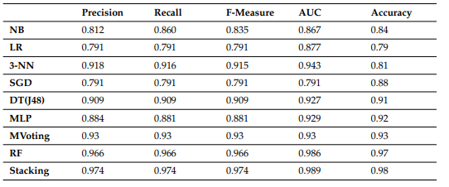
LITERATURE REVIEW
Dritsas and Trigka (2022)
Purpose: Development of ML framework for long-term risk prediction of stroke occurrence
Methods: Developed ML models like Naive Bayes, logistic Regression, KNN, Random Forest and Stacking classifier based on Stroke Prediction Dataset (containing 10 features)
Findings: Stacking Classifier obtained highest accuracy (98%) with an AUC of 98.9% and recall of 97.4%.
Notes:
The study by Dritsas and Trigka (2022) developed ML models like Naive Bayes, logistic Regression, KNN, Random Forest and Stacking classifier based on Stroke Prediction Dataset. Stacking classifier outperformed other models with an accuracy of 98% (with an AUC of 98%), indicating high relevance of the model.

Slide 7
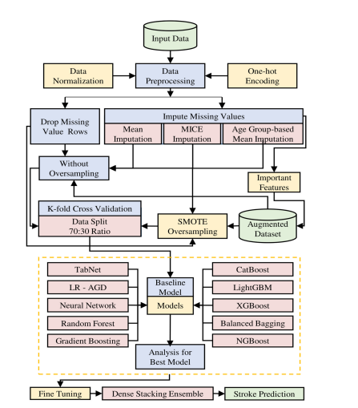
LITERATURE REVIEW CONTD.
Hassan et al. (2024)
Purpose: Identification of key risk factors for stroke
Methods: Study employs ML models (ensemble learning approach) based on imbalanced medical data.
Findings: Dense Stacking Ensemble (DSE) model obtained an accuracy of over 96% (with an AUC of 98.92% after class balancing using SMOTE).
Notes:
The research by Hassan et al. (2024) focuses on employing ensemble learning approaches (such as Stacking and Dense Stacking) to identify key risk factors for stroke. Findings revealed that factors like age, body mass index (BMI), hypertension, mean glucose level, and heart disease influence prevalence and severity of stroke.

Slide 8
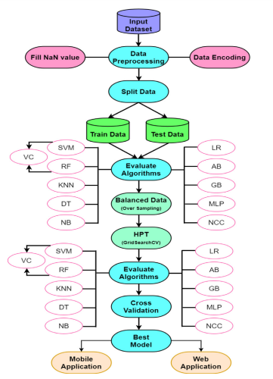
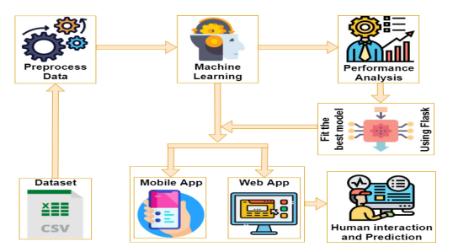
LITERATURE REVIEW CONTD.
Biswas et al. (2022)
Purpose: Detection of early-staged stroke based on imbalance data using Machine Learning
Methods: 11 ML models including SVM, KNN, Voting, Multi-layer perceptron, AdaBoost and Gradient Boosting Classifier
Findings: SVM Classifier outperformed other models with an accuracy of 99.99% (precision = 99.99% and recall = 99.99%).
Notes:
In the research of Biswas et al. (2022), the conduction of Random Oversampling method has helped in balancing the dataset, which has led to a high predictive accuracy (99.99%) of SVM Classifier model.

Slide 9
REFERENCES
Biswas, N., Uddin, K.M.M., Rikta, S.T. and Dey, S.K. (2022). A comparative analysis of machine learning classifiers for stroke prediction: A predictive analytics approach. Healthcare Analytics, [online] 2, p.100116. doi:https://doi.org/10.1016/j.health.2022.100116.
Dritsas, E. and Trigka, M. (2022). Stroke Risk Prediction with Machine Learning Techniques. Sensors, [online] 22(13), p.4670. doi:https://doi.org/10.3390/s22134670.
Elflein, J. (2023). Stroke deaths worldwide by gender 2019. [online] Statista. Available at: https://www.statista.com/statistics/1117504/worldwide-stroke-deaths/ [Accessed 28 Feb. 2025].
Hassan, A., Gulzar Ahmad, S., Ullah Munir, E., Ali Khan, I. and Ramzan, N. (2024). Predictive modelling and identification of key risk factors for stroke using machine learning. Scientific Reports, [online] 14(1), p.11498. doi:https://doi.org/10.1038/s41598-024-61665-4.
MacGill, M. (2018). Stroke and aneurysm: What is the difference? [online] Medicalnewstoday.com. Available at: https://www.medicalnewstoday.com/articles/313691#symptoms [Accessed 28 Feb. 2025].
Tusher, M.A. (2021). Stroke Risk Prediction Dataset Based on Symptoms. [online] Kaggle.com. Available at: https://www.kaggle.com/datasets/mahatiratusher/stroke-risk-prediction-dataset [Accessed 28 Feb. 2025].

Slide 10


