Slide 1
YOUR MOM
Team Noname

Slide 2




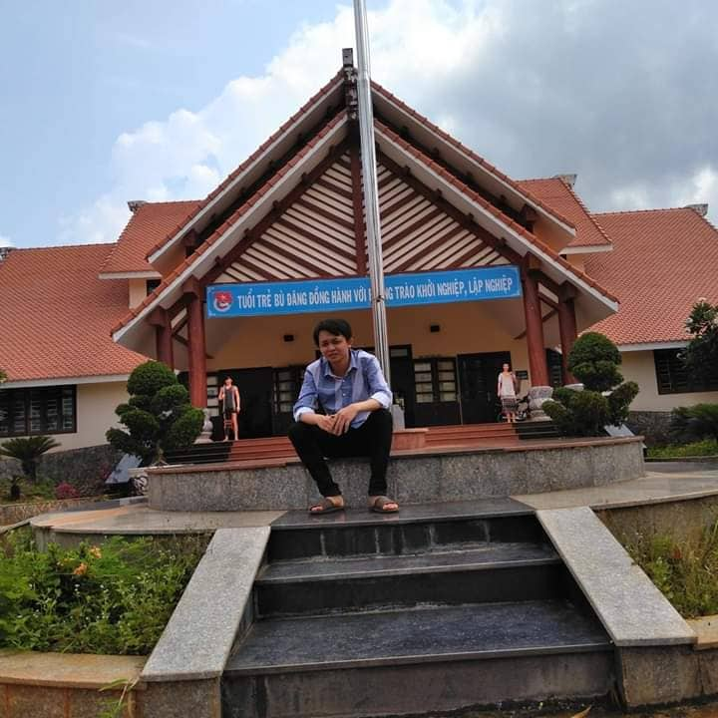

Team Members
Đỗ Đức Nam
namdoduc.hcm@gmail.com
Lâm Đức Long
longduc@gmail.com
Bùi Trung Quân
quanbui03@gmail.com
Lê Thanh Nguyên
nguyenle@gmail.com
Nguyễn Văn Phán
vanphan@gmail.com
Trịnh Lê Cát Tường
trinhtuong@gmail.com

Slide 3
01
Background
02
Operational Concepts
03
Agenda
Basic Layouts
04
System Architecture
05
Lifecycle Plan
06
Conclusion

Slide 4
Background
SLEEP
How many hours do you sleep at night?
MEALS
How many meals do you eat a day?
HABITS
Do you have good health habits?

Slide 5

Recommended Sleep Time
Infants
12 – 16 hours
Children
9 – 12 hours
Youth
8 – 10 hours
Aldults
7 – 9 hours

Slide 6


Slide 7
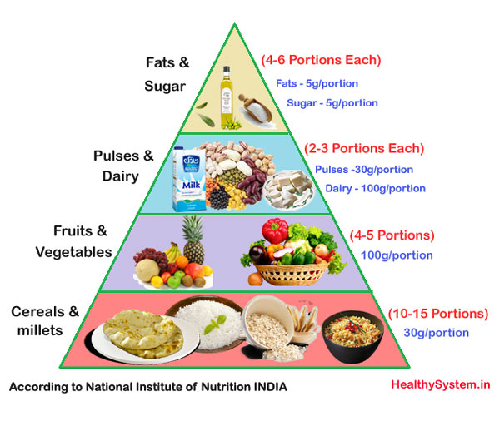
Meals

Slide 8

Meals

Slide 9


Problems
Mental Function
Weight
Gain
Depression
Fatigue
Weak Immune System
Heart Disease

Slide 10

Your MOM

Slide 11
Operational Concepts
Daily Habits
Customizations
” Your mom” provide list of healthy tasks for a whole day.
Users can rate which healthy list is good for themselves.
Focus Mode
Personalization
Focus mode will help user control resting time and working time.
Users can take note and make new challenges.
“Your MOM” is an app to track user habits and turn it into a healthier one

Slide 12
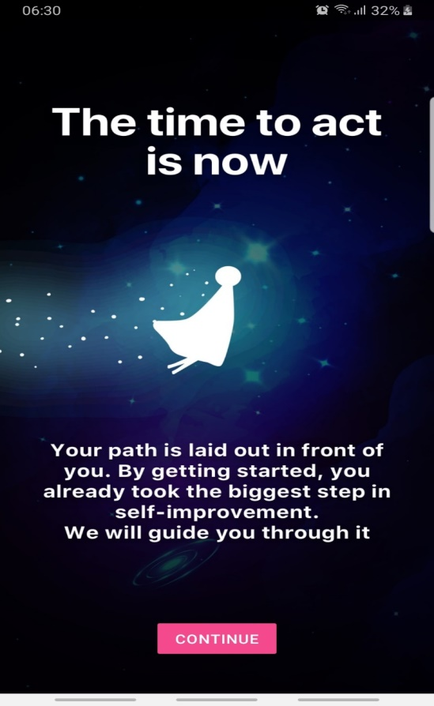
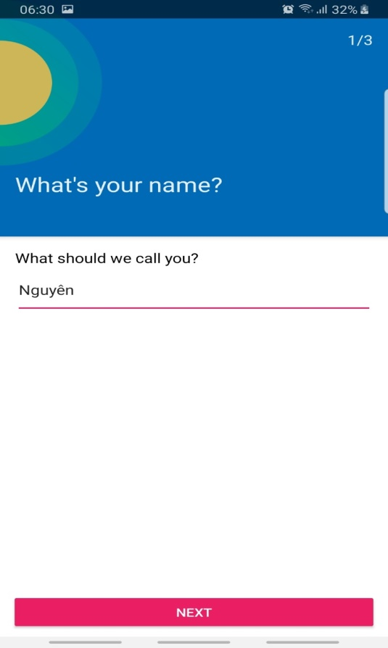
Basic Layouts

Slide 13
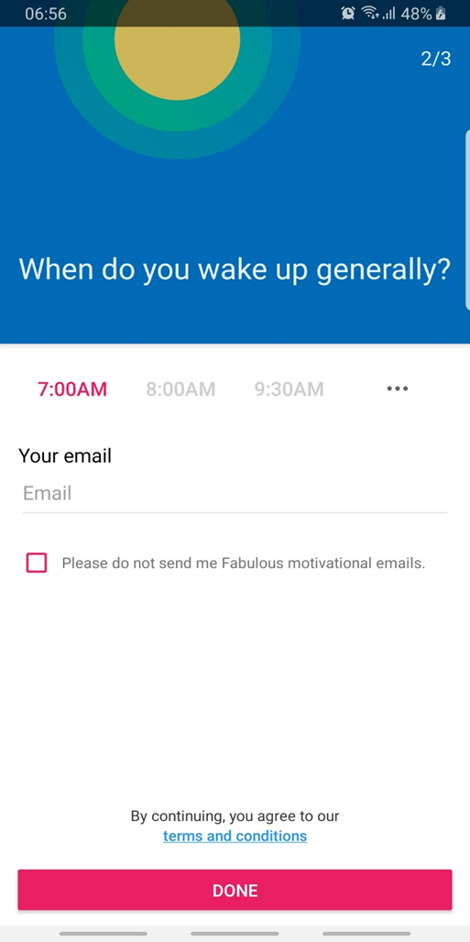
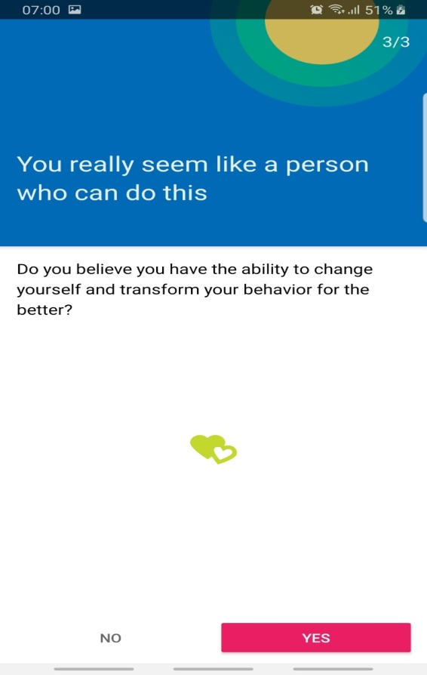
Basic Layouts

Slide 14
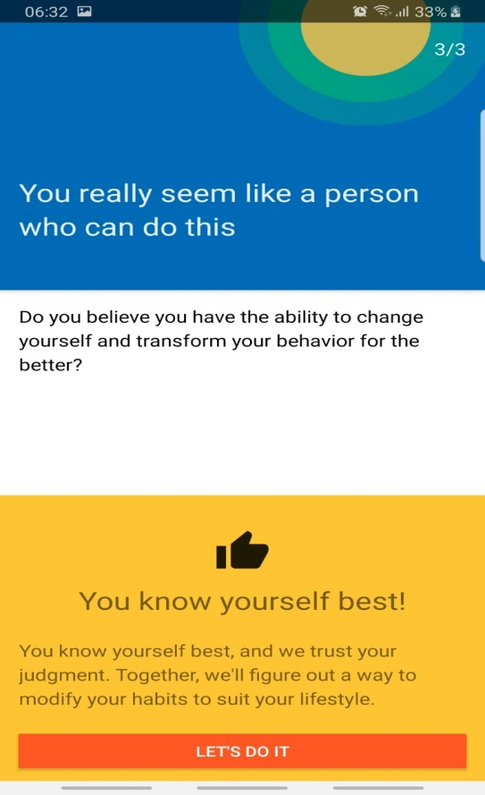
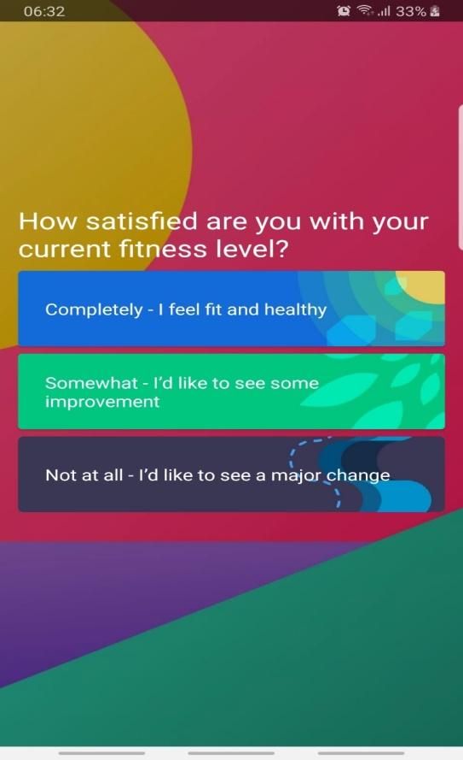
Basic Layouts

Slide 15
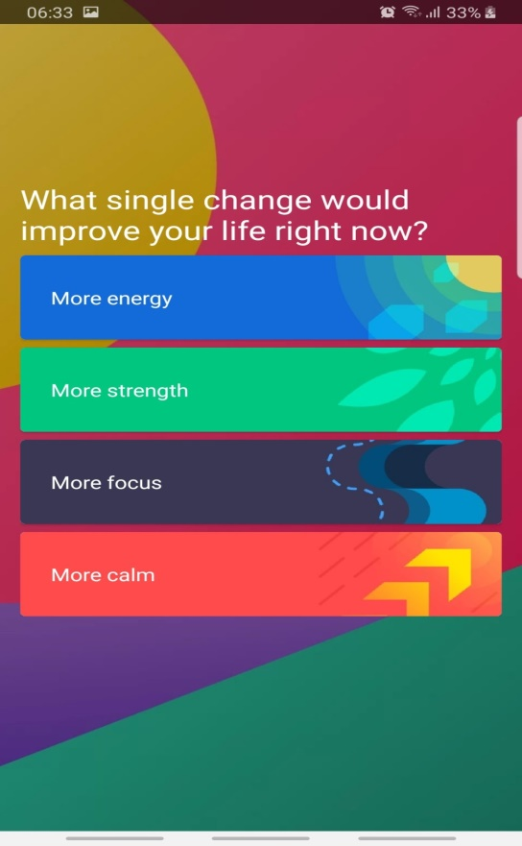
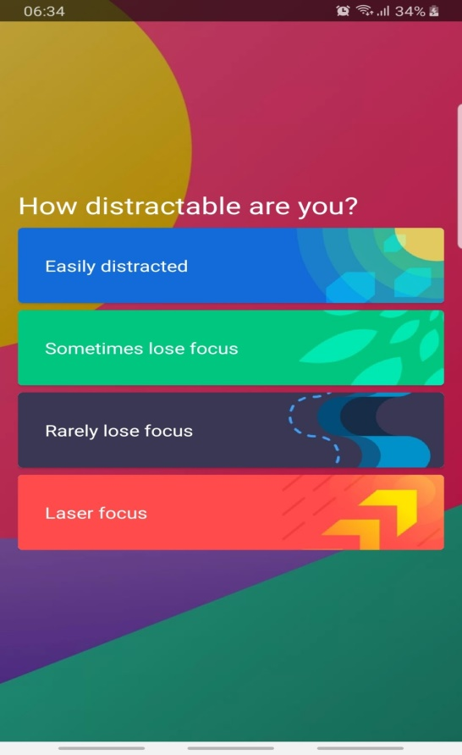
Basic Layouts

Slide 16
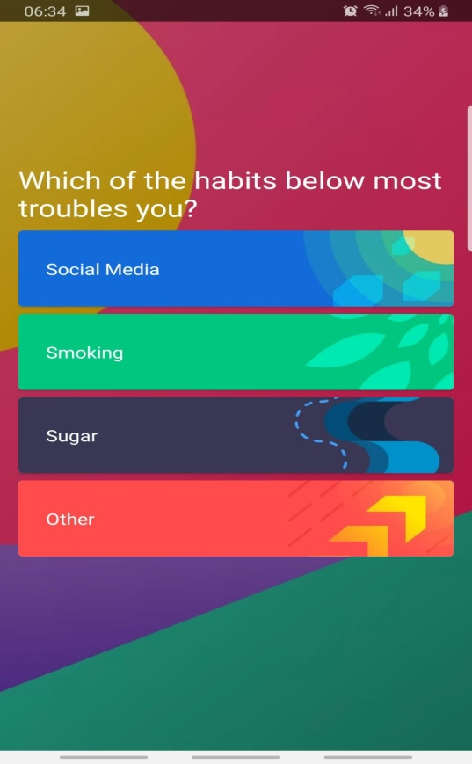
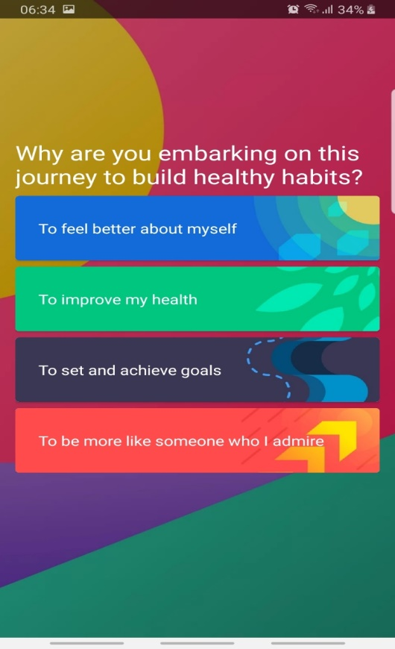
Basic Layouts

Slide 17
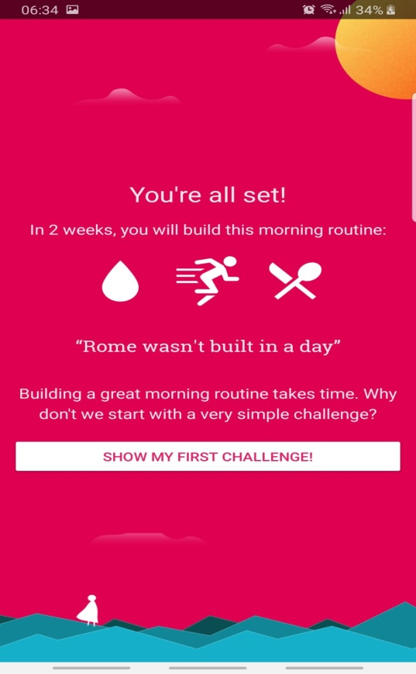
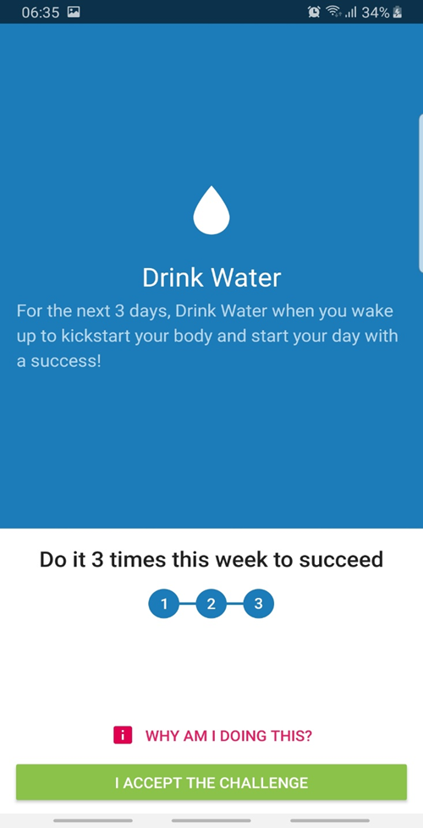
Basic Layouts

Slide 18
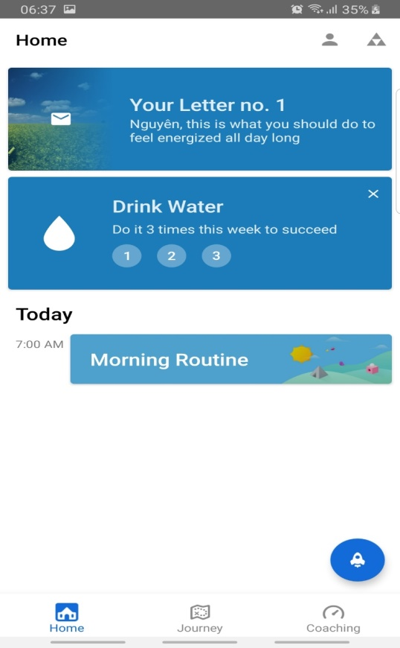
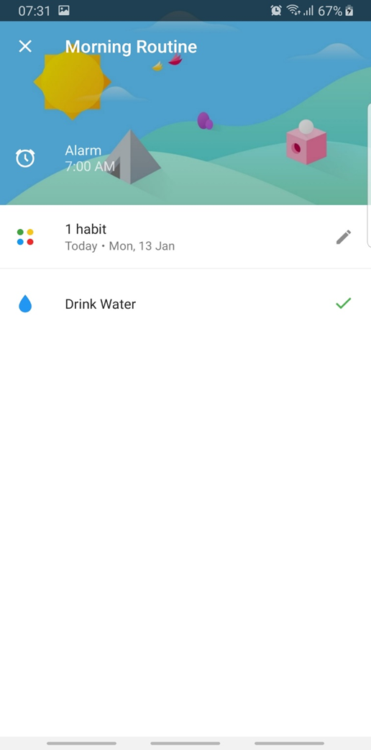
Basic Layouts

Slide 19
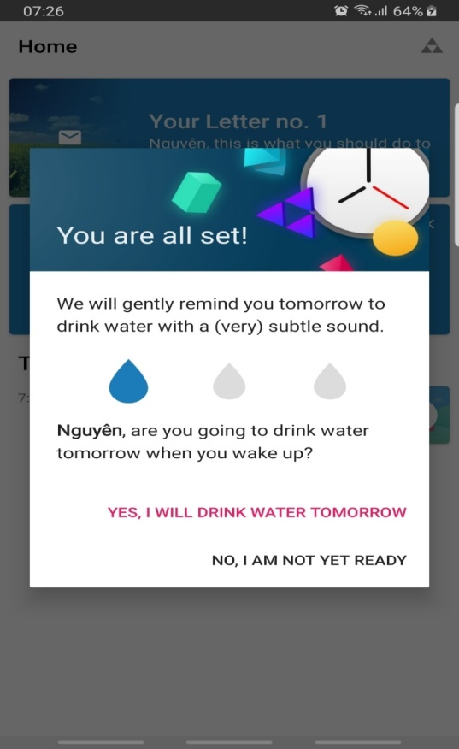
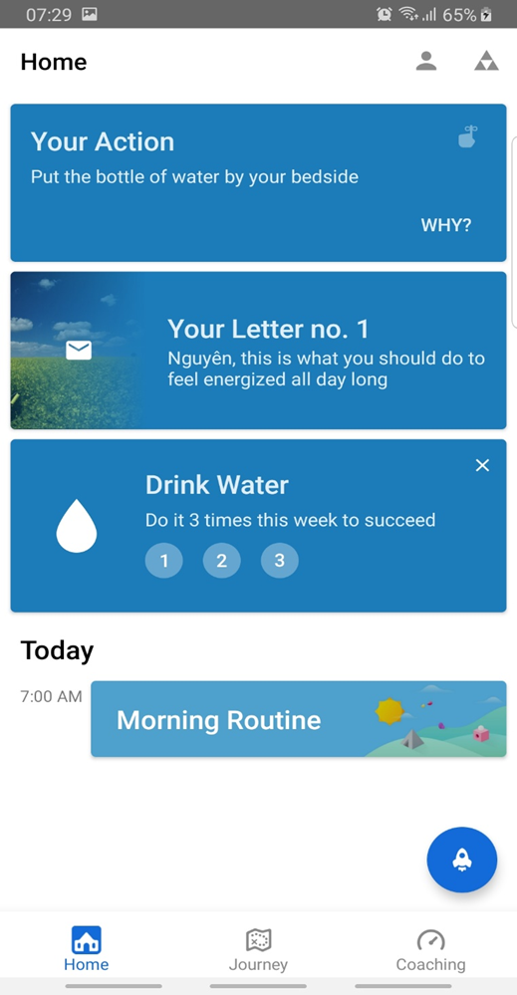
Basic Layouts

Slide 20
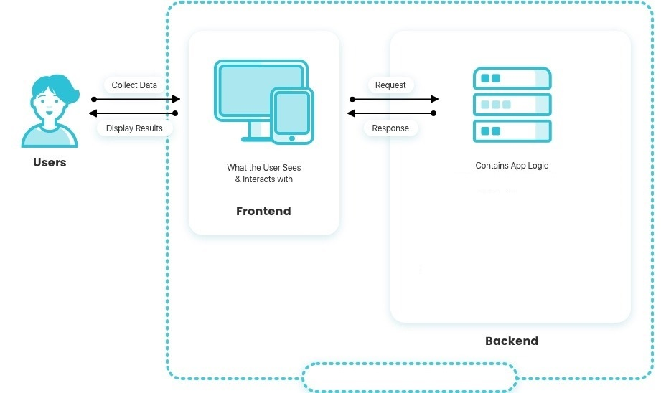




System Architecture
Your Mom Application

Slide 21
Lifecycle Plan
2016
2018
2020
Contents
Contents
Contents
Get a modern PowerPoint Presentation that is beautifully designed.
Get a modern PowerPoint Presentation that is beautifully designed.
Get a modern PowerPoint Presentation that is beautifully designed.
2019
2017
Contents
Contents
Get a modern PowerPoint Presentation that is beautifully designed.
Get a modern PowerPoint Presentation that is beautifully designed.

Slide 22
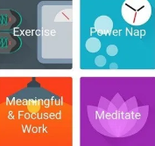



Conclusion
Your MOM is a great tool to help you lead a conscious and responsible life.

Slide 23
Thank you

