Slide 1
ComeBackHome
Team 6

Slide 2
Index
001/ Introduction
002/ Game Story
003/ Objects
004/ Overall Design
005/ Interface
006/ Extra Points
007/ Demo

Slide 3

1. Introduction
Game Title
Come Back Home
Team6
이름 | 학번
김동금 | 20131533
정채진 | 20134570

Slide 4
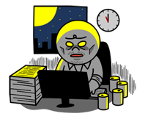
2. Game Story
The main character wants to go home on time after working in company. However, his boss asks him to work overtime.
The purpose of the game is to get home, avoiding lots of working documents, boss’s calls, alcohols, and collecting bonuses.
Can he arrive his home safely??

Slide 5
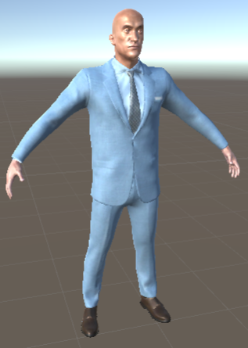
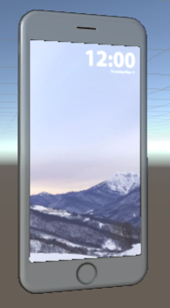
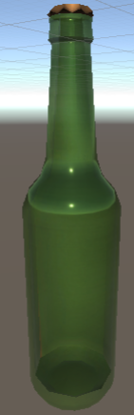
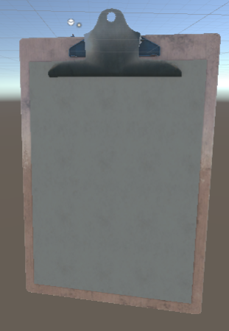
3. Objects
Character
Enemy
phone | alcohol | Working docs

Slide 6
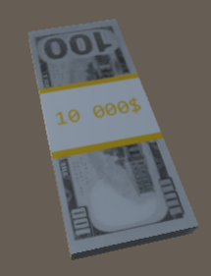
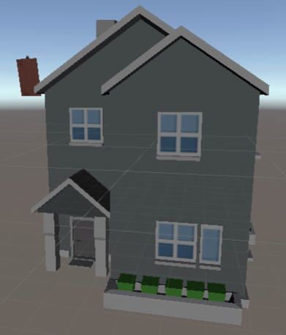
3. Objects
House
Coin
Imported on unity asset store
Free Assets

Slide 7
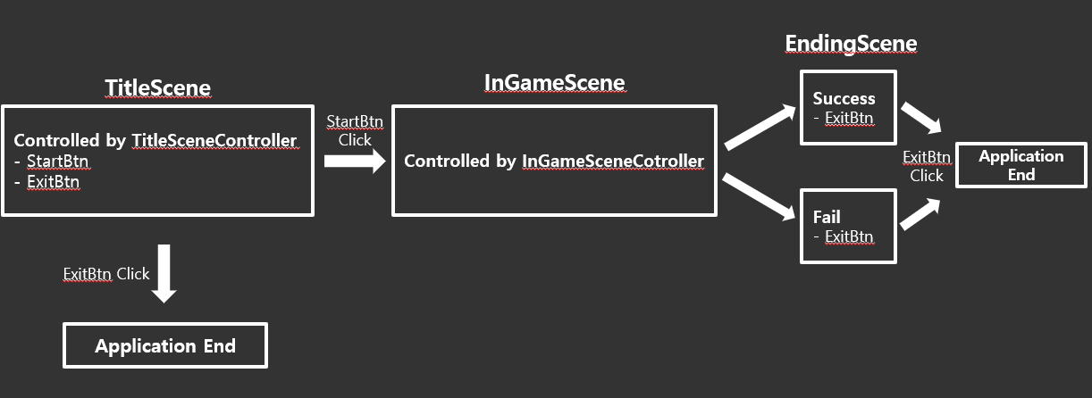
4. Overall Design
Sound Effect (Audio Source)

Slide 8
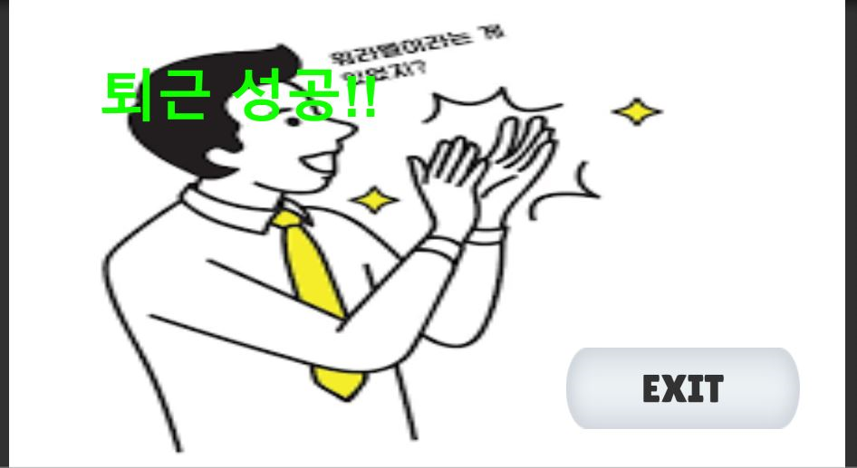
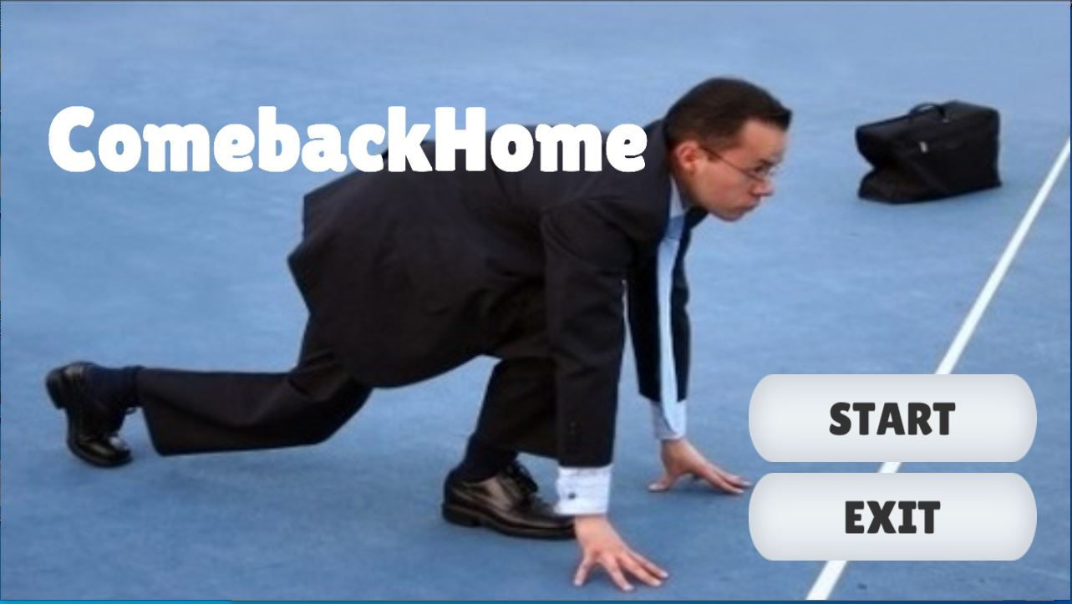
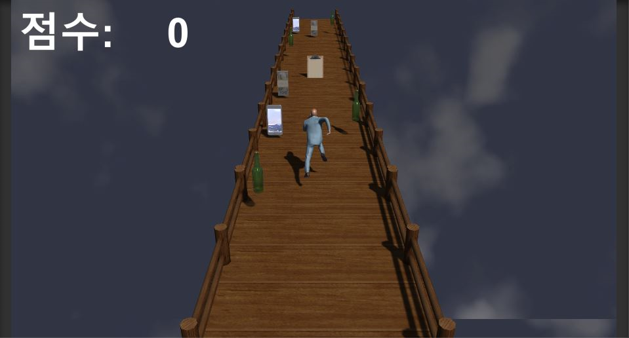
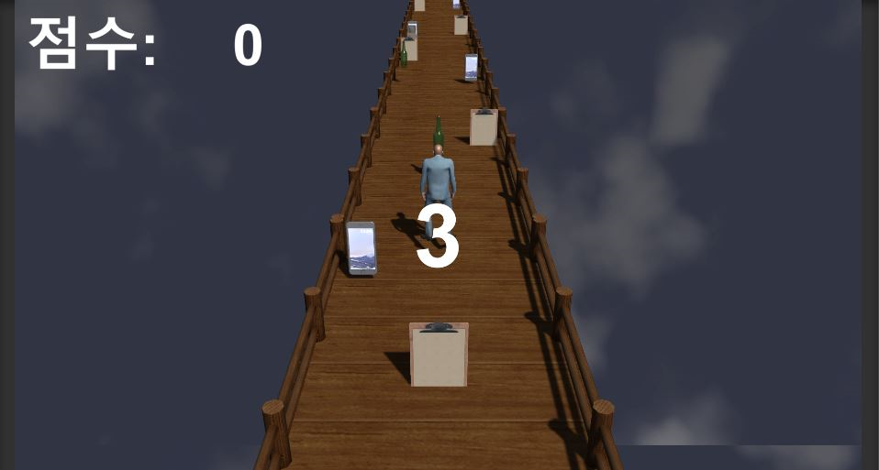
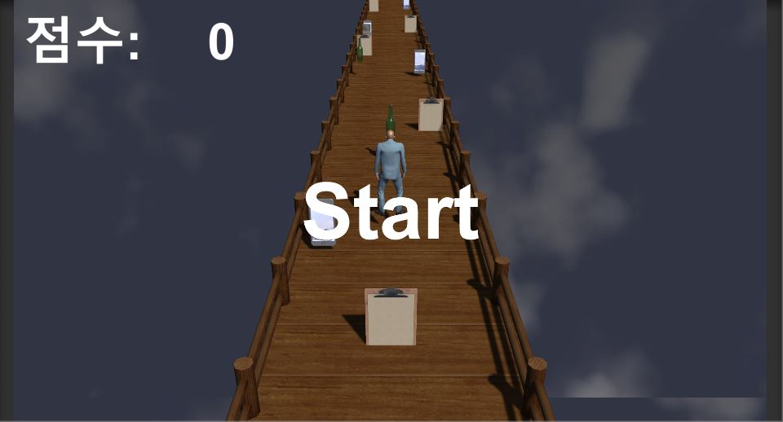
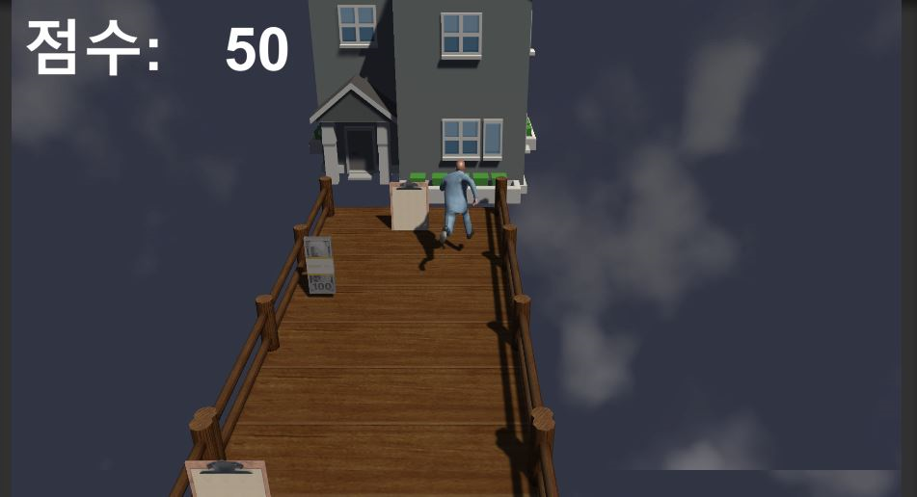
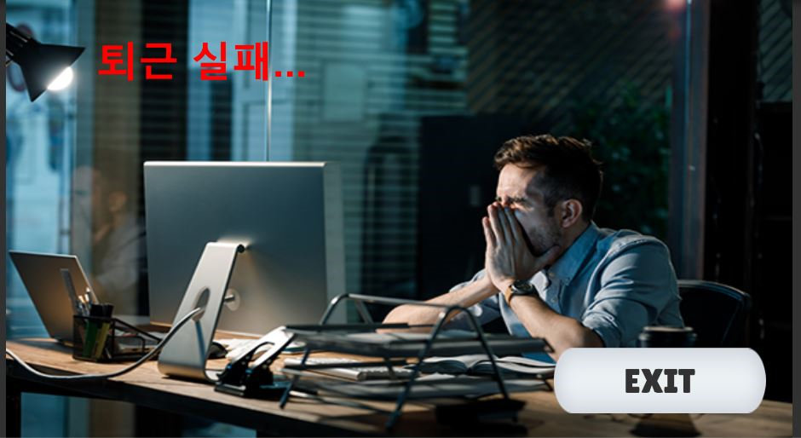
5. Interface

Slide 9
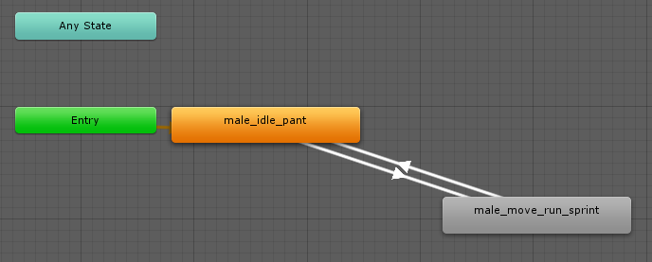

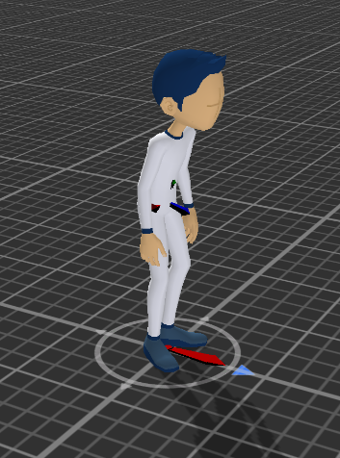
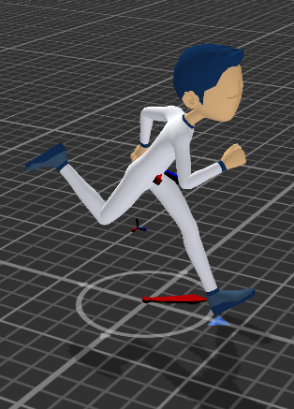
6. Extra Points
Collision Detection
Animation
User : Stop / Running Motion
Enemy Object - User : Game Over
Coin Object – User : Bonus Point
House – User : Success and Game Over
https://github.com/DONGKEUMKIM/Unity_GameProjectFinal.git

Slide 10

7. Demo
방법

Slide 11
Thank you

