Slide 1
Vehicle dataset from car dekho Used Cars and motorcycles data

Slide 2
INTRODUCTION
This Project contains information about cars.
Comparison between different Cars as per specifications.
We compare wagon r, sx4,ritz and ciaz selling price according to their specifications , features and Kms driven.

Slide 3
CAR’S PERFORMANCE DEPENDS ON
Car Maintenance
Wheels
Tires
Oil Change

Slide 4
We can Increase Car Performance By:
Tire Inflation.
Wheel Maintenance.
Engine Maintenance.
Regular Servicing.

Slide 5
We Can Evaluate Car Conditions AS Per Kms Driven
0 to 5500: New car or we can say car condition is good.
5500 to 10000: Used Car, more maintenance is required.
10000 to 15000: Old Car, basically car condition depend on maintenances like
1.Engine 2. Tire’s 3. wheel’s 4. Regular oil change.

Slide 6
Key Specification OF WAGON R
ARAI Mileage | 20.52 kmpl
Fuel Type | Petrol
Engine Displacement (cc) | 1197
Max Power (bhp@rpm) | 81.80bhp@6000rpm
Max Torque (nm@rpm) | 113Nm@4200rpm
Key Specifications of Maruti Wagon R

Slide 7
KEY FEATURE OF WAGON R
Power Steering.
Anti-locking Breaking System.
Driver Airbag
Wheel Cover
Air Bag
Passenger Airbag.
Fog light.

Slide 8
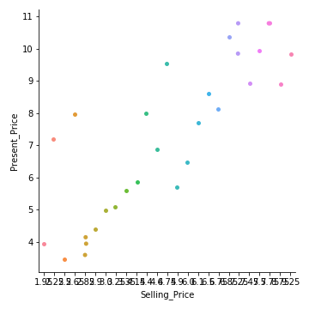
Inference: 1. By seeing this visualization, we can see the difference between selling price and present price.

Slide 9
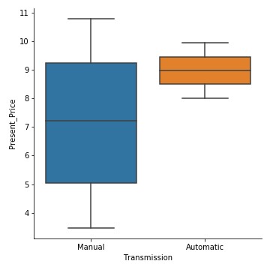
Inference:
1. In this visualization , we can observe that number of Manual cars is more as compared to Automatic.
2. we also observe new car have automatic transmission and Present price of Automatic transmission car is more as compared to manual transmission car.

Slide 10
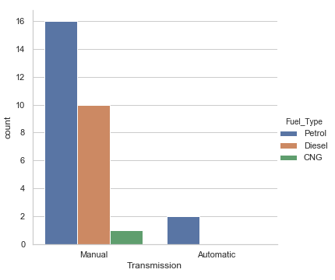
Inference:
1. In this , we can see more number of cars is manual and very less number of cars have CNG fuel type.
2. We also observe cars range between 0 to 16 have petrol fuel type, 0 to 10 have diesel fuel type and 0 to 1.
have CNG fuel type.
3. Cars which have automatic transmission mostly use Petrol as Fuel

Slide 11
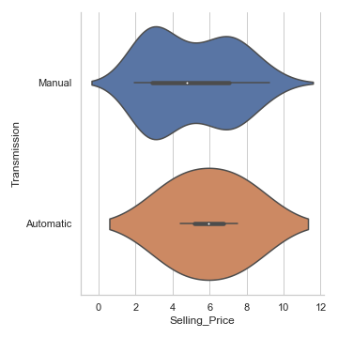
Inference:
1. By seeing this plot , we can say that Manual transmission car selling price ranges from 0 to 11.
2. We also observe Automatic transmission car selling price ranges from 1 to 11.

Slide 12
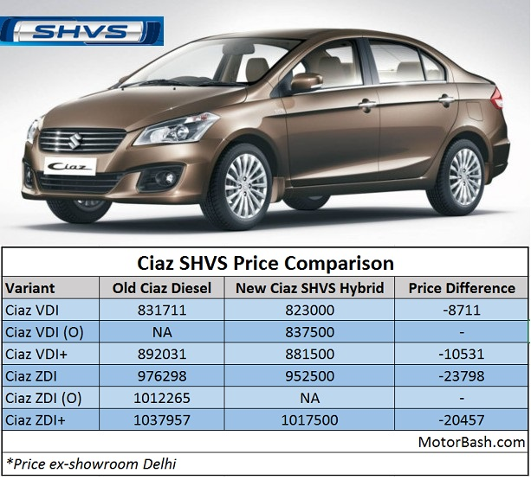
Ciaz Price Comparision

Slide 13
Specification of Ciaz
Mileage | 28.09 km/litre | Engine Displ. | 1248 cc
Transmission | Manual | Fuel Type | Diesel
Boot Space | 510 litres | Power Windows | All Windows
Airbags | Driver frontal airbag, Front passenger frontal airbag | ABS | Yes
Central Locking | Yes | Fog Lamps | Yes

Slide 14
Comparision Between SX4 AND RITZ
 | SX4 | RITZ
Engine | 1197cc, 4 Cylinders Inline, 4 Valves/Cylinder, DOHC | 1586cc, 4 Cylinders Inline, 4 Valves/Cylinder, DOHC
Engine Type | inline 4 cylinder petrol engine | 16V DOHC VVT
Fuel Type | Petrol | Petrol
Max Power (bhp@rpm) | 85 bhp @ 6000 rpm | 103 bhp @ 5600 rpm
Max Torque (Nm@rpm) | 113 Nm @ 4500 rpm | 145 Nm @ 4100 rpm
Mileage (ARAI) (kmpl) | 18.5 | 16.51
Drivetrain | FWD | FWD
Transmission | Manual - 5 Gears | Manual - 5 Gears

Slide 15
THANK YOU

