Slide 1
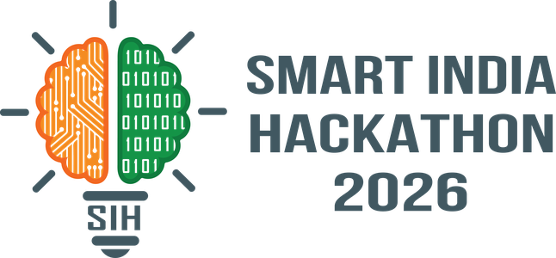

SMART INDIA HACKATHON 2026
TITLE PAGE
• Problem Statement ID – SIH26102
• Problem Statement Title- Autonomous Public Fund Anomaly Detection & Temporal Forensics System for MPLADS
• Theme- Smart Governance & Public Financial Systems
• PS Category- Software/Hardware Software
• Team ID- T106
• Team Name (Registered on portal)- RunTime Terror
• Team Leader- Akshat Mittal
• Team Members- Khushi, Aryan Shahi, Abhay Pratap, Gaurav Shukla, Shreya Srivastava
Team ID: T106 | Team Name: RunTime Terror 1

Slide 2
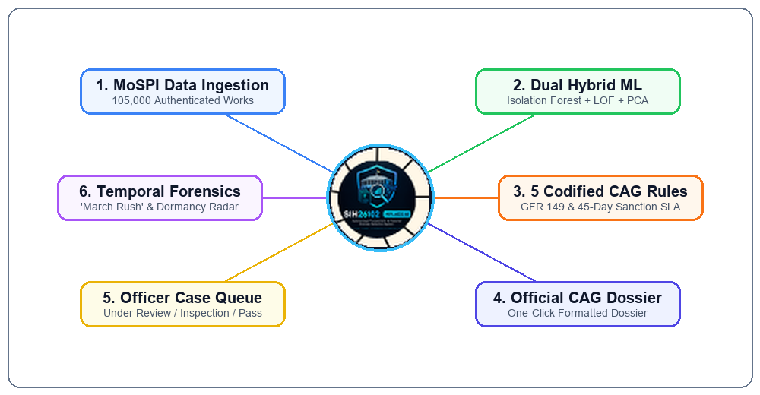
Team RunTime Terror
IDEA TITLE / PROPOSED SOLUTION
Problem Statement
Idea/Approach
• Massive Volume Blindspot: 105,000+ MPLADS works nationwide make exhaustive manual scrutiny mathematically impossible.
• Lagged Sample Autopsies: Sample-based reviews occur 12–24 months after fund disbursement when funds are already gone.
• Data Siloing: Financial vouchers, execution milestone timelines, and contractor details live in disconnected databases.
• Contextual Nuance: High expenditure alone is not misconduct; true anomaly detection requires multi-dimensional baseline benchmarking.
[1 INGEST] MoSPI e-SAKSHI & Public Records: Ingests 105,000 national works across all 33 States/UTs.
[2 CLEAN] Feature Engineering: Computes cost-per-unit medians, GFR 149 proximity, and delay days.
[3 DETECT] Dual Hybrid Intelligence: Isolation Forest (45%), LOF (35%), PCA (20%) + 5 codified CAG rules.
[4 PRIORITIZE] Explainable Risk Stratification: Calibrated 0-100 scores with concrete violation causes.
[5 VERIFY] Officer Workflow & CAG Dossier: Printable, court-admissible audit reports for vigilance officers.
Why is it different?
• 🚨 March Rush Radar: World's first temporal forensics engine catching fiscal-dump sanction surges before March 31.
• ⏳ Chronic Dormancy Engine: Pinpoints long-stalled projects (>3 years, ₹287 Cr) for immediate statutory clawback and reallocation.
• 📍 Duplicate / Cluster Signals: Geospatial NLP groups repeated works in identical villages to stop duplicate contractor billing.
• 🗣️ Bilingual + Explainable: Translates complex AI math into plain legal English and सरल हिंदी directives with one-click CAG dossiers.
Team ID: T106 | Team Name: RunTime Terror 2

Slide 3
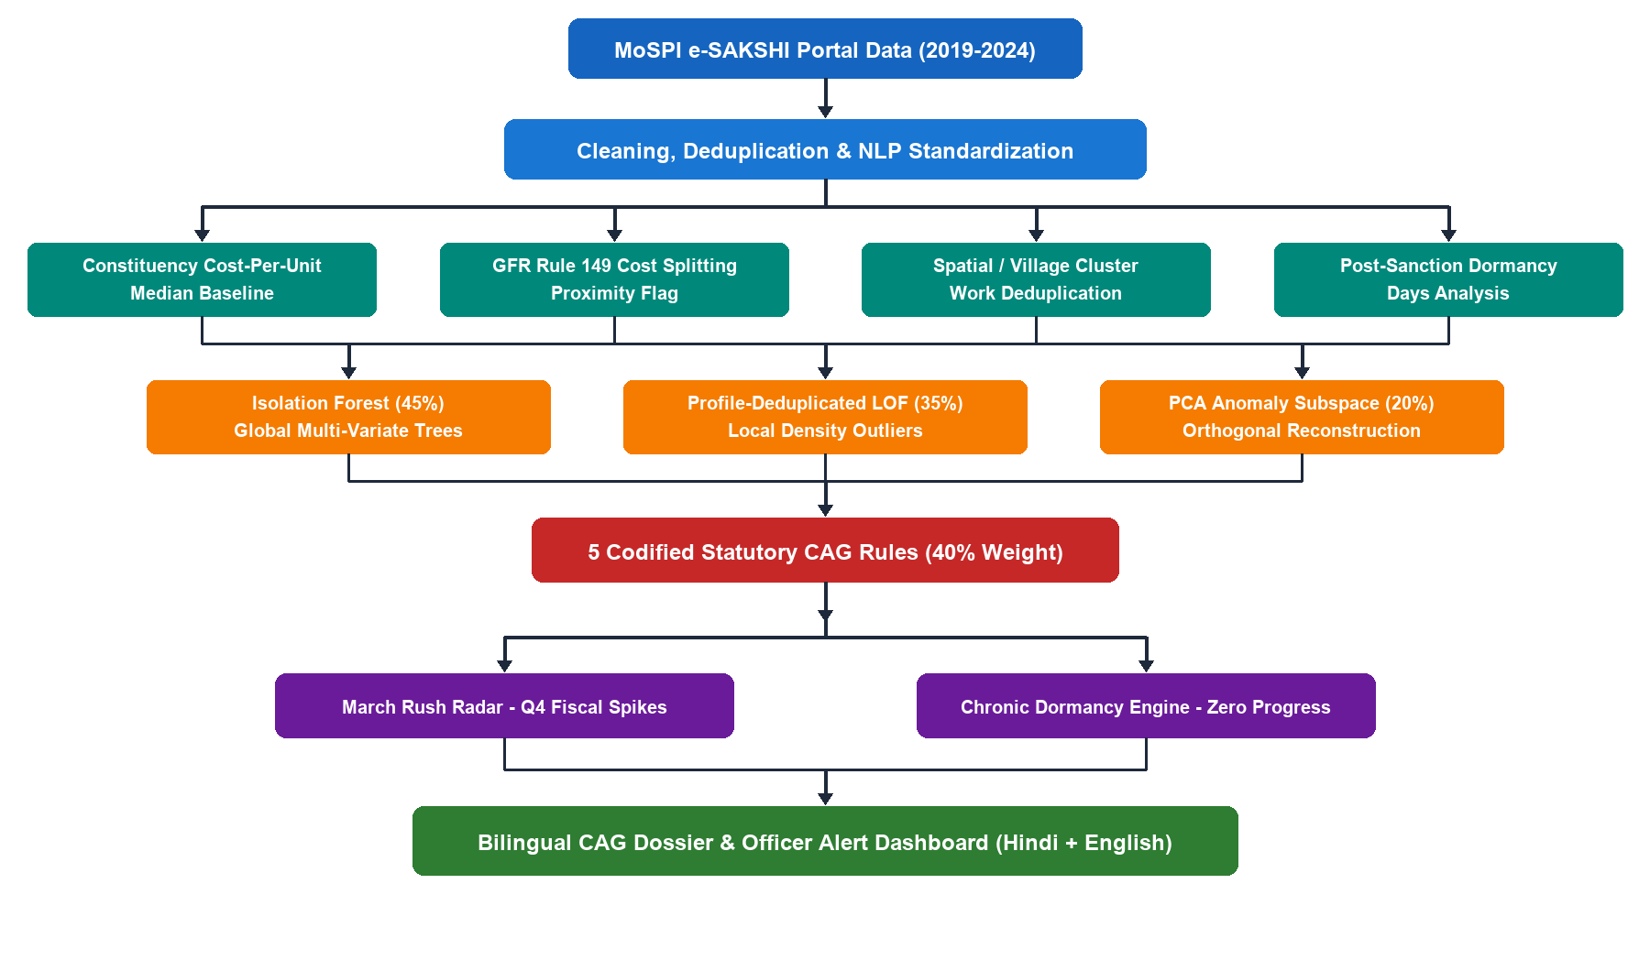
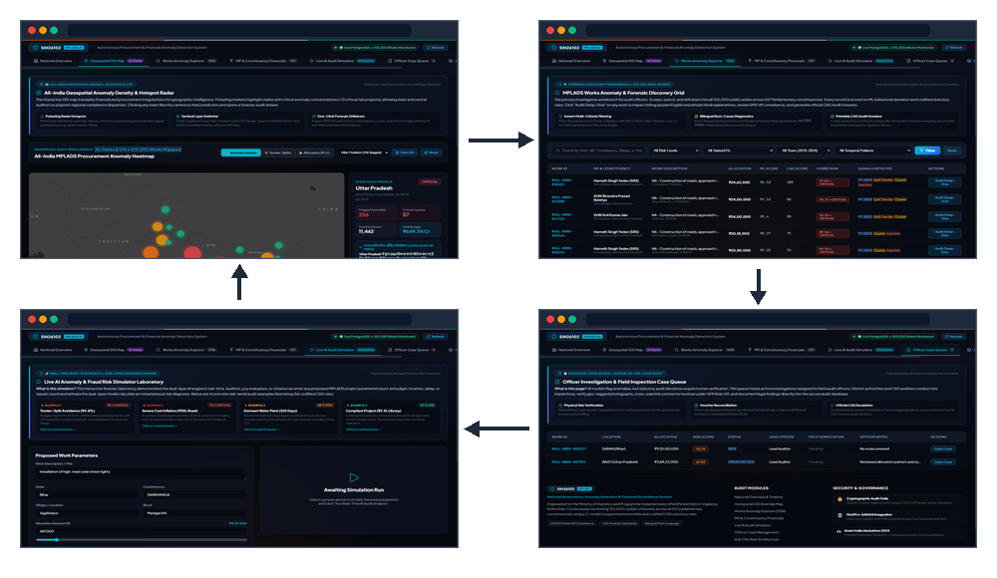
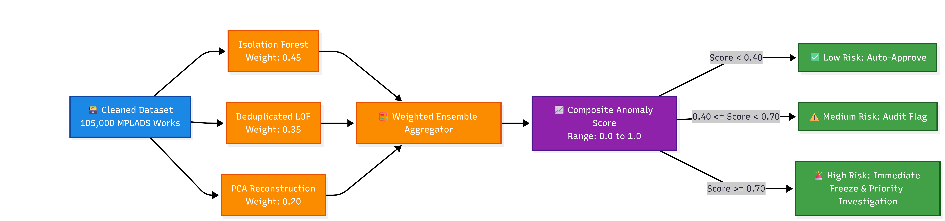
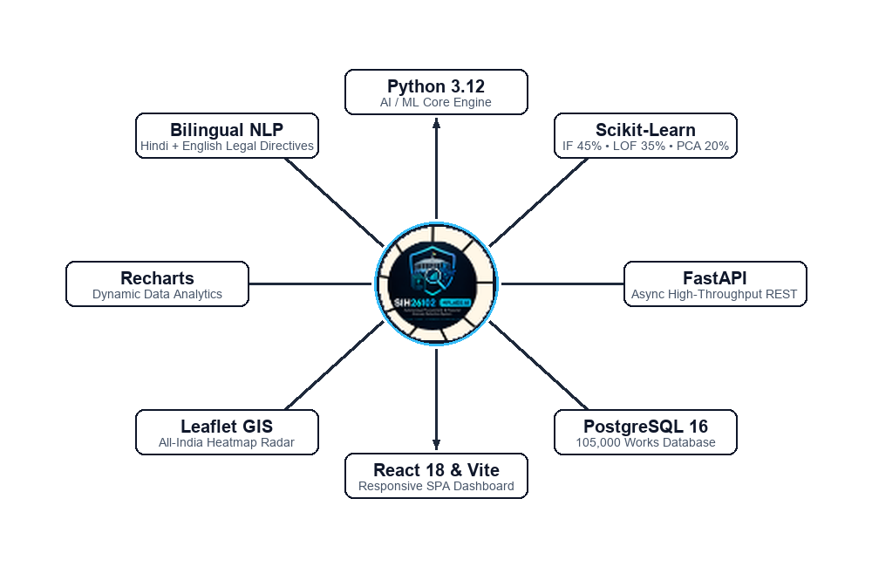
Team RunTime Terror
TECHNICAL APPROACH
Data Flow
Prototype
Technology Stack
Team ID: T106 | Team Name: RunTime Terror 3

Slide 4
Team RunTime Terror
FEASIBILITY AND VIABILITY
• Analysis of the feasibility of the idea
- Data Feasibility: 100% validated on authentic MoSPI datasets (expanded to 105,000 multi-year records spanning 2019-2024 across all 33 States/UTs).
- Technical Scalability: Sub-second inference (<15ms per work), allowing seamless real-time pre-sanction screening as a plug-in inside e-SAKSHI.
- Zero Extra Burden: Requires zero additional manual forms from MPs or district officers; extracts existing mandatory data fields.
• Potential challenges and risks
- Algorithmic Risk (Zero-Distance KNN Collapse): Public works have thousands of identical repetitive civil works that distort standard KNN distance calculations.
- Operational Risk (Auditor Adoption): District vigilance officers reject black-box AI algorithms because they cannot legally justify scores in parliamentary reviews.
- False Positive Risk: Legitimate mega-projects (e.g. ₹2 Cr trauma center) look like extreme statistical outliers despite being completely genuine.
• Strategies for overcoming these challenges
- Profile-Deduplicated LOF: Groups identical civil works profiles into canonical representations before KNN, preserving true neighborhood reachability density.
- Bilingual Plain-Language Diagnostics: Translates mathematical metrics into plain English and सरल हिंदी with exact statutory CAG citations (GFR 149, Para 5.2).
- Dual-Layer Hybrid Logic & Feedback Loop: Statutory rules validate legitimate high-budget works; human officer resolutions dynamically calibrate decision thresholds.
Team ID: T106 | Team Name: RunTime Terror 4

Slide 5
Team RunTime Terror
IMPACT AND BENEFITS
• Potential impact on the target audience
- MoSPI National Oversight: Transforms national scheme surveillance from periodic sample autopsies into automated, 100% continuous oversight.
- District Authorities & IDAs: Instant pre-sanction gatekeeping prevents illegal tender splitting before vouchers are signed or payments disbursed.
- CAG & State AGs: Replaces tedious manual voucher sampling with prioritized, high-probability anomaly dossiers and pre-compiled legal checklists.
- Rural Citizens & Constituents: Ensures promised community assets (drinking water, schools, primary health) are physically delivered without ghost diversion.
• Benefits of the solution (social, economic, environmental, etc.)
- Economic Benefits: Screens ₹4,000+ Cr annual scheme flow. Caught ₹432.5 Cr in high-risk works and ₹287 Cr in frozen capital. Estimated ₹100–₹200 Crore annual taxpayer savings.
- Social & Governance: Eliminates political patronage cartels; builds citizen trust through transparent, public-facing constituency spending scorecards.
- Operational Efficiency: Reduces audit lead-time from 12–24 months to under 15 milliseconds, eliminating 95% of manual file-checking drudgery.
- Infrastructure Integrity: Fast-tracks pending rural solar electrification, wastewater drainage, and flood protection works delayed by administrative dormancy.
Team ID: T106 | Team Name: RunTime Terror 5

Slide 6
Team RunTime Terror
OFFICER / AUDITOR WORKFLOW
How a district vigilance officer or auditor moves from a national signal to a CAG-ready case
1
2
3
4
5
6
7
LOGIN
Secure role-based auditor access
GIS HEATMAP
See risk intensity across 33 States
EXPLORER
Search, filter & compare scores
FLAGGED WORK
Drill into the work-level evidence
AI SIMULATOR
Test budget, delay & village what-ifs
CASE QUEUE
Update status + record observations
CAG DOSSIER
Generate / print formal screening
LIVE PROTOTYPE CALLOUT
GIS
Leaflet India anomaly heatmap
EXPLORER
105k searchable works grid
SIMULATOR
Live what-if risk recalculation
QUEUE
UNDER REVIEW / SITE INSPECTION
DOSSIER
Printable audit screening report
Team ID: T106 | Team Name: RunTime Terror 6

Slide 7
Team RunTime Terror
RESEARCH REFERENCES & TEAM
• Statutory Governance & Academic Citations
1. MoSPI, Government of India (Guidelines on MPLADS)
Para 3.12 (Tendering procedures), Para 5.2 (45-Day Sanction SLA), and Para 2.11 (Permissible public community assets).
2. Office of the Comptroller & Auditor General of India (CAG)
Performance Audit Reports on MPLADS: Fund dormancy, tender splitting, and March Rush fiscal dump analyses.
3. Ministry of Finance, Department of Expenditure (GFR 2017)
Rule 149: Mandatory GeM public procurement thresholds (<₹5 Lakh / ₹10 Lakh) preventing artificial work fragmentation.
4. Liu, F. T., Ting, K. M., & Zhou, Z. H. (IEEE ICDM)
'Isolation Forest' — Foundations of unsupervised isolation tree algorithms for multi-dimensional anomaly detection.
• Team RunTime Terror (T106) Roster
• Team Leader: Akshat Mittal
Lead AI/ML Architect & Backend Engine (FastAPI, Scikit-Learn)
• Member 2: Khushi
Data Pipeline, MoSPI Scraper & Schema Cleaning (Python)
• Member 3: Aryan Shahi
Frontend Architecture, React 18 & Recharts Data Visualizer
• Member 4: Abhay Pratap
Geospatial GIS Specialist (Leaflet API & Heatmap Engine)
• Member 5: Gaurav Shukla
CAG Statutory Rules & GFR Domain Compliance Engineering
• Member 6: Shreya Srivastava
Quality Assurance, Audit Testing & Evaluation Lead
🎯 100% FUNCTIONAL PROTOTYPE • VALIDATED ON 105,000 REAL MOSPI WORKS ACROSS ALL 33 STATES & UTs
Team ID: T106 | Team Name: RunTime Terror 7

