Slide 1
ST662 Chapter 9
Binomial GLM’s - Link Function Selection

Slide 2

RoadMap
Quick Outline
Theory Refresher (SLR vs GLM)
Theory Refresher (GLM Components)
Theory Refresher (EDMs)
Binomial GLMs
Binomial GLMs (Mathematical Support)
Binomial GLMs (Link Function Derivation)
Data Analysis (Diabetes)
Data Analysis (TBD)
Part G

Slide 3

Theory
Refresher

Slide 4


Linear Regression Model
A quick refresher
Linear Regression Formula
Simple
Multi
If we take the expected value of Y conditional on X, we can rewrite this as a combination of vectors:
We have the following unknowns:
Our error term varies randomly according to the normal distribution, but no matter what value our X takes on, the variance of said error term will not change. It is constant.
Assumptions:
Linearity
Normality of Error Terms
Homoscedasticity

Slide 5

Generalized Linear Regression Model
A quick refresher
Generalized Linear Model Formula
We have our X ∈ R and some Y. This formula has three key components:
Random Component - Distribution for Y conditional on X, or Y|X
Systematic Component - Relates some parameter η to our X’s
Link Component - Connects the random and systematic components together (g(u) = η)
Our link component (function) allows us to map a non-linear relationship to a linear one. In the case of our linear model:
Random Component - Y|X ≈ N(µ,σ²)
Systematic Component - η = β^{T}X
Link Component - g(µ) = µ
And thus, we see η = g(µ) = β^{T}X becomes µ = β^{T}X or E[Y|X] = β^{T}X as shown previously.

Slide 6
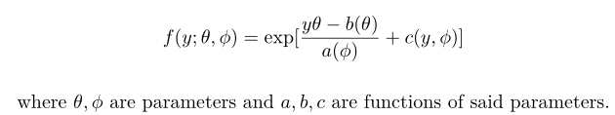
Acceptable Density Functions
A quick refresher
The Exponential Family / Exponential Dispersion Models
An important assumption for our Generalized Linear Models (GLMs) is that our random component Y|X is assumed to have a probability density/mass function of the above form.
The expectation and variance of said distribution, E[Y|X] & Var[Y|X] respectively, can be found:
E[Y|X] = µ = b’(θ)
Var[Y|X] = b’’(θ) a(φ)

Slide 7
Background Theory Wrap-Up
A quick refresher
Linear Model Vs. Generalized Linear Model
For basic linear regression, we assume Homoscedasticity & Normality of our error terms.
When these assumptions change, we utilize a more generalized model, the generalized linear model (GLM).
η = g(E[Y|X]) = g(µ) = β^{T}X
To summarize some notational aspects, we have:
E[Y|X] is what we want to estimate.
θ determines the shape of our density for Y|X.
φ is our dispersion parameter for the density of Y|X.
g(.) is our link function that maps a non-linear relationship to a linear one.
η is our parameter used to model our transformation of E[Y|X] by a function X (for GLM this is simply η = β^{T}X, a linear transformation).

Slide 8
Binomial
GLMs

Slide 9
The Case for Binomial GLM’s
Why we might utilize a binomial GLM
Situations where Binomial GLMs arise
There are two cases in which our variance is not constant with respect to the binomial GLM. In both cases, Y ∈ [0,1].
Y might be a proportion (such as a total number of counts).
Y might be a binary value (0 for false, 1 for true).
Why not use a Linear Model?
Y is bounded by [0,1], thus our assumptions of Homoscedasticity and Normality fail.
As our main assumptions for utilizing a basic linear model fail, we utilize a GLM.
We must now map some Y∈R to Y∈[0,1].
We could utilize basic linear regression if so chosen, but it would likely provide poor results.

Slide 10
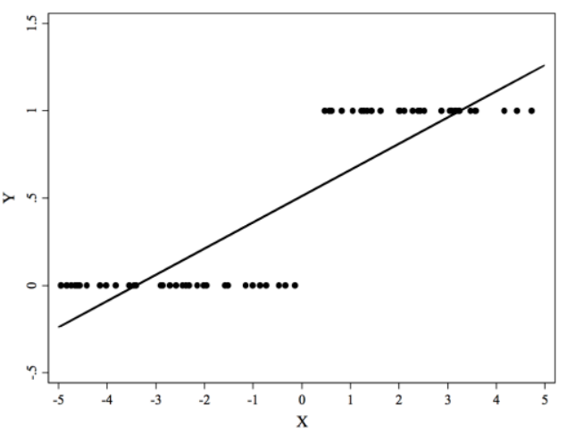
The Case for Binomial GLM’s
Why we might utilize a binomial GLM
Situations where Binomial GLMs arise

Slide 11
The Case for Binomial GLM’s
Why we might utilize a binomial GLM
Mathematical Support
Consider some theoretical binary data. Examining under a basic linear model, we have:
E[Y] = β^{T}X
We would find our expected value of Y for binary data to be:
E[Y] = P(Y = 1)(1) + P(Y = 0)(0)
E[Y] = P(Y = 1)
However, our variance would be:
Var[Y] = E[Y](1 − E[Y])
Var[Y] = β^{T}X(1 − β^{T}X)
And so, our variance is clearly not Homoscedastic as it depends on X.
Similarly for our error terms, as the data is binary, they cannot be normally distributed.
Thus, our assumptions for a basic linear model fail.
We assume our Y|X follows some binomial distribution, but what about our error terms?

Slide 12
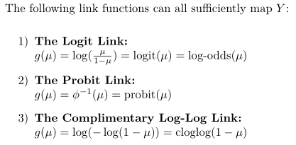
Link Functions for Binomial GLM’s
The Different Links & How They’re Derived
Link Function Options
For proportions or binary data, we want our Y∈[0,1].
And so, we must determine a link function to map Y from the reals to this boundary.
Each of the above has a different use case and can be derived from an assumed error term distribution.

Slide 13
Link Functions for Binomial GLM’s
The Different Links & How They’re Derived
The Logit Link Function
Is the default link function and generally works well for most data.
Arises from the fact that error terms will not be normally distributed nor constant across X.
So, what distribution does our error term follow? Often, we might need to make an assumption for this based on the underlying data.
The Logit Link is utilized when we assume the error terms follow a logistic distribution.
Is also called the Log-Odds Ratio and is one of the easier link functions to understand predictor impact (more interpretable).

Slide 14
Link Functions for Binomial GLM’s
The Different Links & How They’re Derived
The Probit Link Function
Is similar to the Logit link.
The Probit Link is utilized when we assume the error terms follow a normal distribution.
This may sound contradictory as it's previously been emphasized that error terms do not follow normal distributions for our data.
However, consider taking some data and dichotomizing it. We lose some information in the process. This new dichotomized data is derived from some latent variable.
The underlying data may have originally been continuous in nature and as a result we could in fact assume the error terms are also normally distributed in this case.

Slide 15
Link Functions for Binomial GLM’s
The Different Links & How They’re Derived
The Complementary Log-Log Link Function
The Complementary Log-Log (cloglog) Link is utilized when we assume the error terms follow an extreme value distribution (e.g. Weibull, Gumbal).
However, it is somewhat different in nature as when compared to the Logit and Probit links.
As an illustrating example, take the injection of some chemical into an animal for testing purposes. Examine the latent variable of if the animal survives or not.

Slide 16
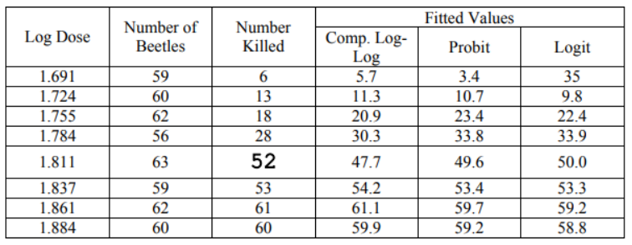
Link Functions for Binomial GLM’s
The Different Links & How They’re Derived
The Complementary Log-Log Link Function
The Complementary Log-Log (cloglog) Link is utilized when we assume the error terms follow an extreme value distribution (e.g., Weibull, Gumbal).
However, it is somewhat different in nature as when compared to the Logit and Probit links.
As an illustrating example, take the injection of some chemical into an animal for testing purposes. Examine the latent variable of if the animal survives or not.

Slide 17

Link Functions for Binomial GLM’s
The Different Links & How They’re Derived
Threshold/Tolerance Distributions
These link functions can be derived in a more mathematical way utilizing tolerance distributions.
It is the distribution that one believes a latent variable may conform to and thus impacts the error term.
We utilize the Turbine dataset from the textbook.
…………………….………………………………………………………………………….…

Slide 18



Link Functions for Binomial GLM’s
The Different Links & How They’re Derived
Threshold/Tolerance Distributions
Let us now assume that turbines have some tolerance (t_{i}) for hours used, and when this tolerance is below a certain threshold T, fissures develop. Assume this tolerance follows a normal distribution with mean tolerance τ_{i}. With this in mind, we have:
And we can write a turbine developing fissures or not as:
And so, the probability of developing a fissure is:

Slide 19


Link Functions for Binomial GLM’s
The Different Links & How They’re Derived
Threshold/Tolerance Distributions
If we now plug in our τ_{i}, we find:
Lastly, if we replace our terms with beta’ as some beta, we can find:
Which gives us our link function:

Slide 20
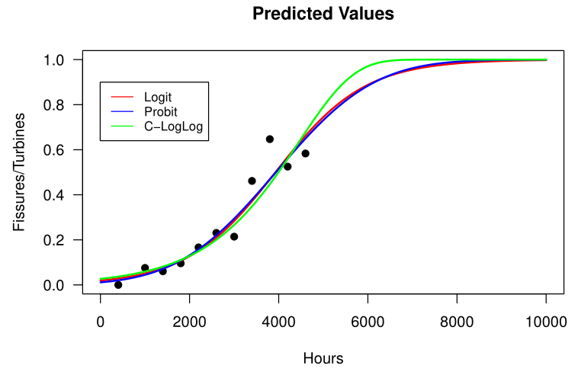
Link Functions for Binomial GLM’s
The Different Links & How They’re Derived
Turbine Example

Slide 21
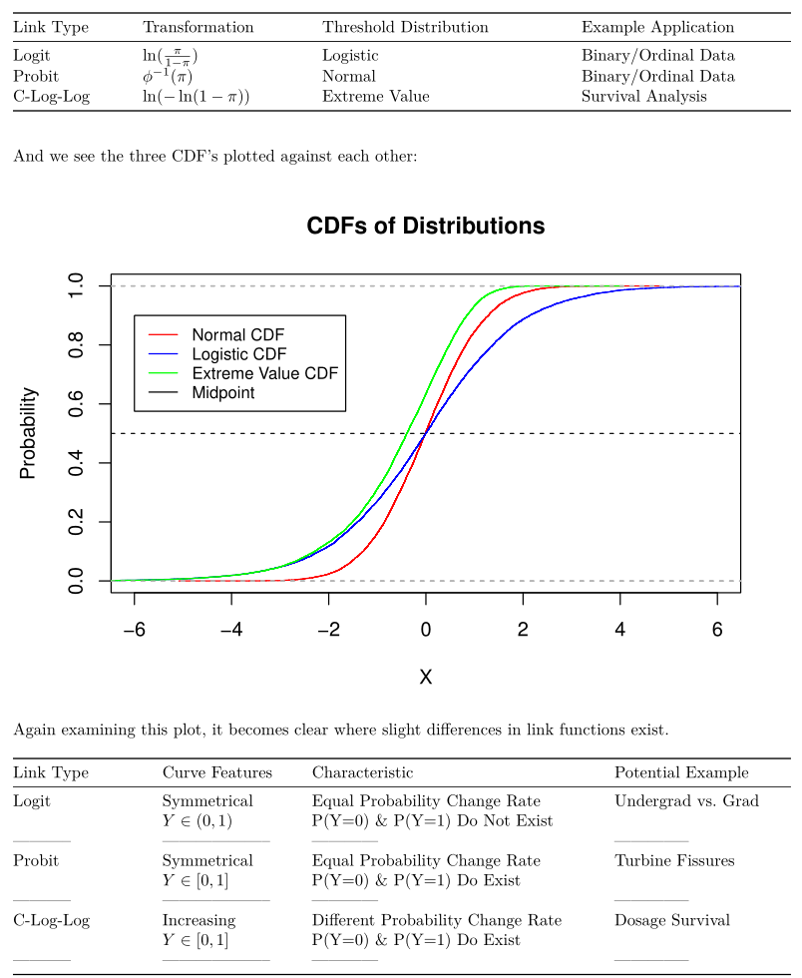
Link Functions for Binomial GLM’s
The Different Links & How They’re Derived
Summary

Slide 22
Link Functions for Binomial GLM’s
The Different Links & How They’re Derived
Summary

Slide 23
Diabetes
Dataset

Slide 24
Data Cleaning & Adjustments
Examining & Preparing our Data
Characteristics
Our diabetes dataset has the following characteristics:
403 African American individuals had medical metrics gathered for themselves.
In total, 19 metrics were gathered, both a mix of discrete and continuous.
A glycosylated hemoglobin greater than 7.0 is usually considered a positive diagnosis of diabetes. We will construct our dichotomized latent variable from this.
GlyHB > 7 = +Diabetes
GlyHB < 7 = -Diabetes
We will call this “status”.

Slide 25
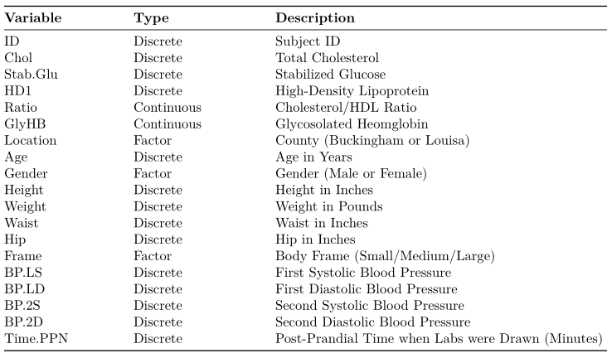
Data Cleaning & Adjustments
Examining & Preparing our Data
Characteristics

Slide 26
Data Cleaning & Adjustments
Examining & Preparing our Data
Cleaning
We first examine the dataset for NA entries.
As a result of this analysis:
3 columns are removed (ID, BP.2S, BP.2D)
13 rows are removed (no glyHB present)
The remaining rows have some NA values but nothing significant.

Slide 27
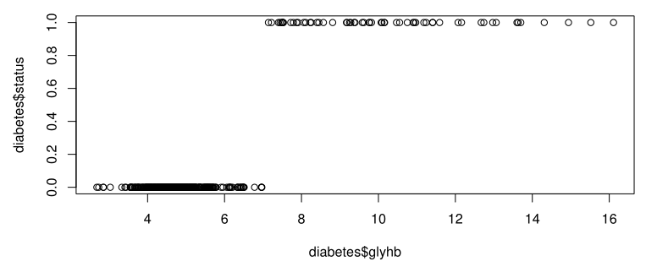
GLM Model Examination
Deciding on Appropriate Models
Underlying Vs. Latent Variable
Notes:
Note - Range

Slide 28
GLM
Models

Slide 29
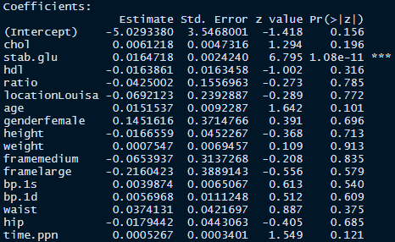
GLM Model Examination
Deciding on Appropriate Models
Maximal Probit Model
Notes:
Note - Range

Slide 30
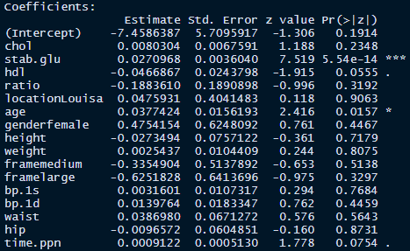
GLM Model Examination
Deciding on Appropriate Models
Maximal CLogLog Model
Notes:
Note - Range

Slide 31
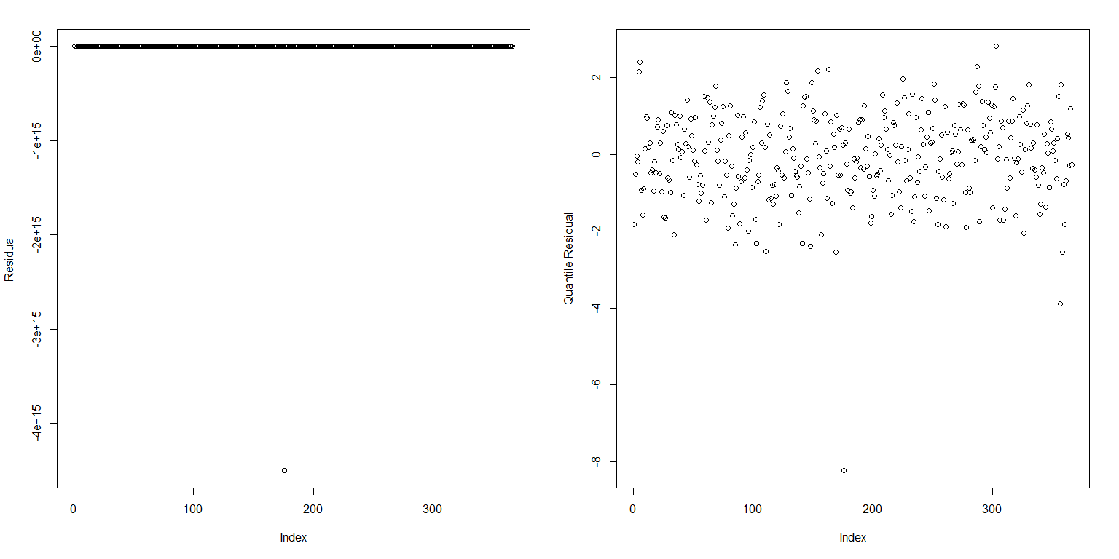
GLM Model Examination
Deciding on Appropriate Models
Quick Residual Check
Notes:
Note - Range

Slide 32
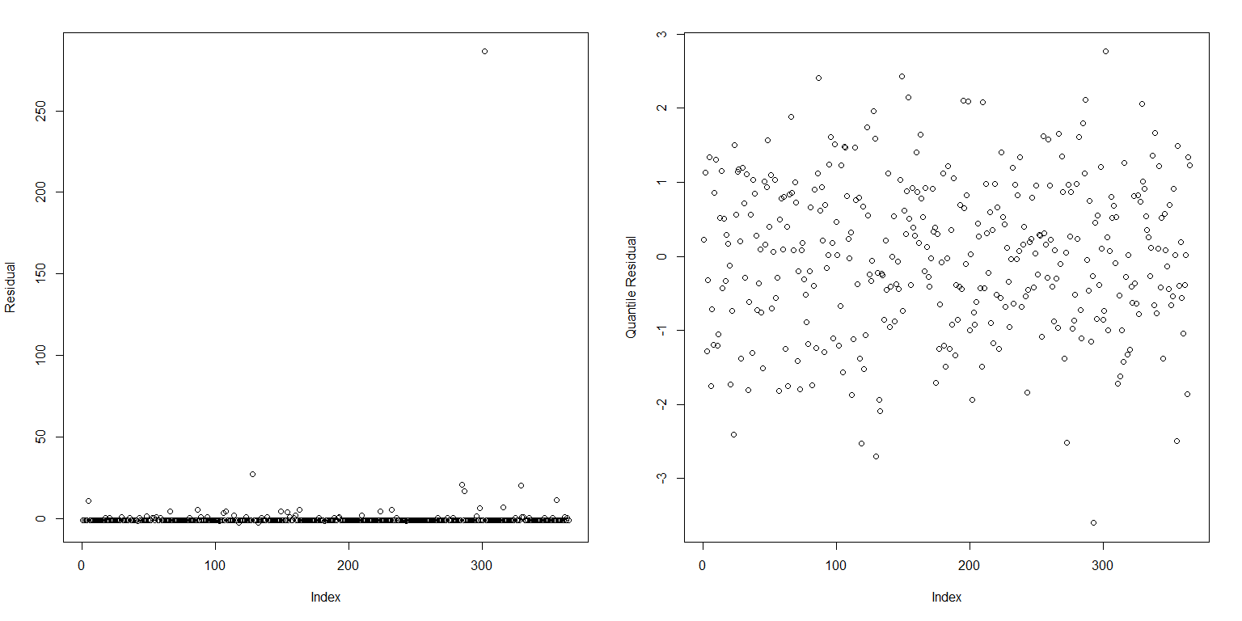
GLM Model Examination
Deciding on Appropriate Models
Quick Residual Check
Notes:
Note - Range

Slide 33
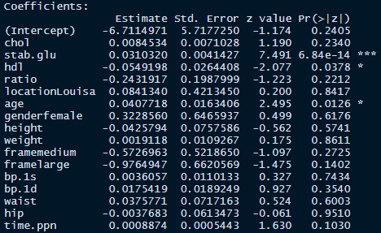

GLM Model Examination
Deciding on Appropriate Models
Updated Maximal CLogLog Model
Notes:
Note - Range

Slide 34

GLM Model Examination
Deciding on Appropriate Models
Comparing Models
For binary data, residual deviance & pearson goodness-of-fit statistics are determined entirely by the fitted values and hence are not meaningful.
Instead, we utilize a Likelihood Ratio Test:
And test the hypothesis:
We utilize a X² test with df=(17-4) and the likelihood ratio, giving a p-value of 0.98.
Thus, we fail to reject the null hypothesis and use the nested model:
Notes:
Note - Range

Slide 35
GAM
Models

Slide 36
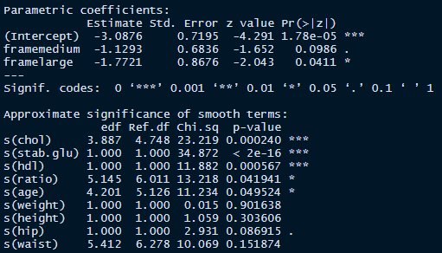
GAM Model Examination
Deciding on Appropriate Models
Initial CLogLog Model
Notes:
Note - Range

Slide 37
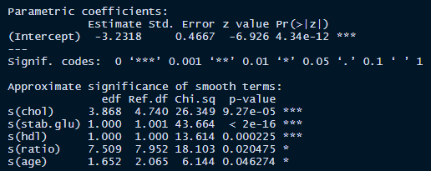
GAM Model Examination
Deciding on Appropriate Models
Nested CLogLog Model
Notes:
Note - Range

Slide 38
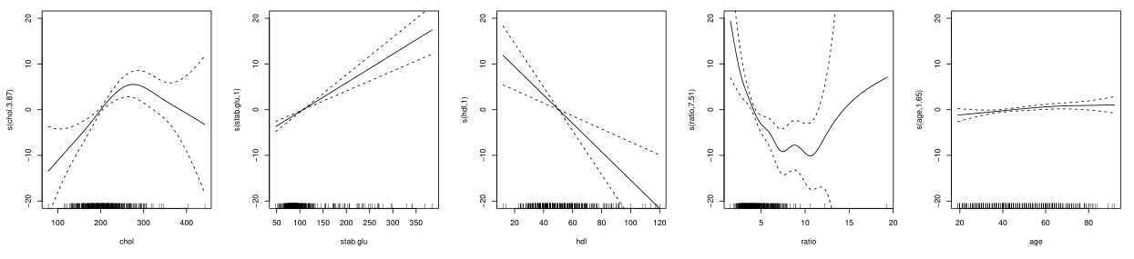
GAM Model Examination
Deciding on Appropriate Models
Nested CLogLog Model
Linear
Linear
Notes:
Note - Range

Slide 39
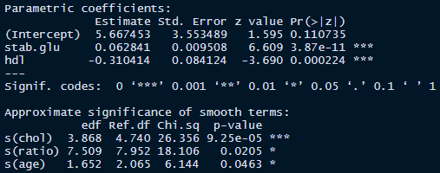
GAM Model Examination
Deciding on Appropriate Models
Non-Smooth Nested CLogLog Model
In comparing this model to the initial model via LRT, we found a p-value of 0.003 and hence reject the nested model in favor of the “maximal” (initial) model.
Notes:
Note - Range

Slide 40
Results

Slide 41
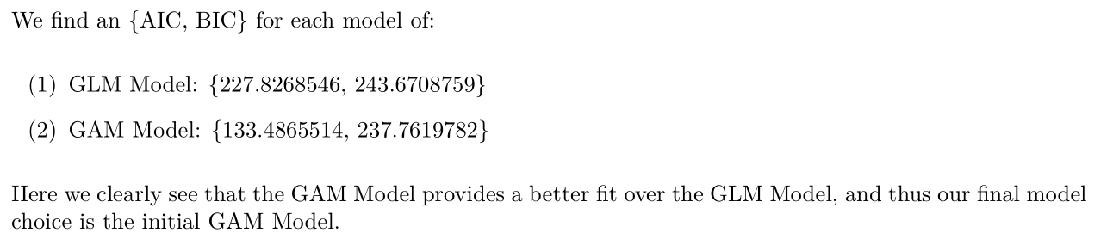
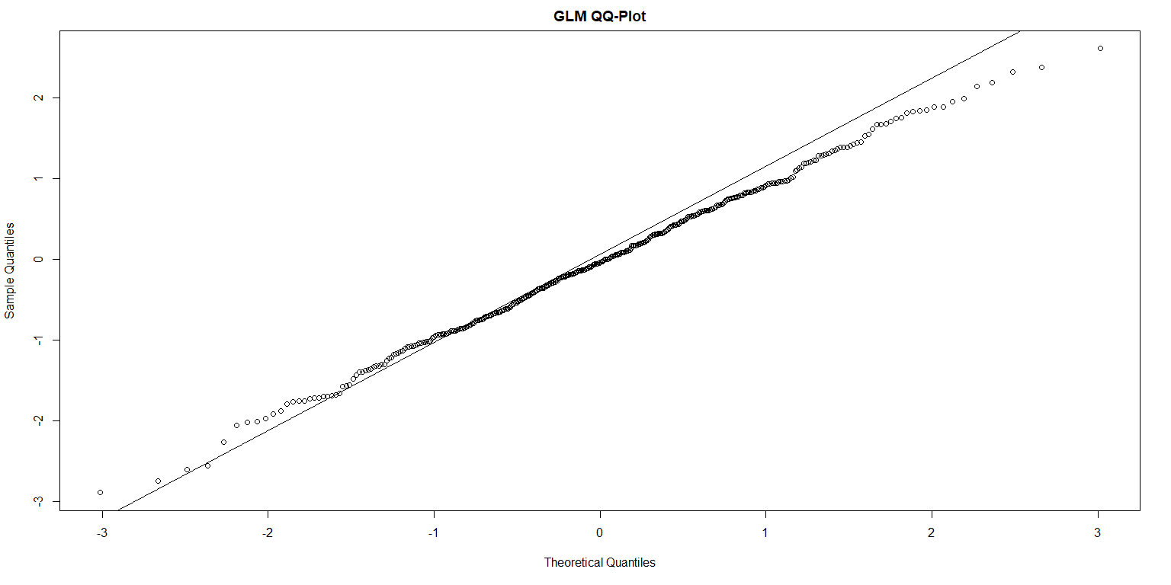
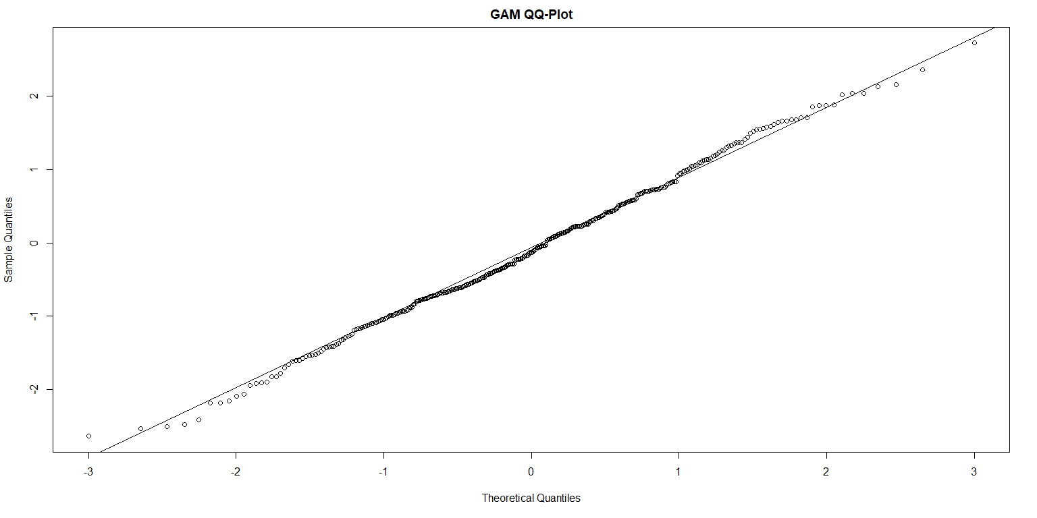
Final Model Selection
Deciding a Final Model
Non-Nested Models & AIC/BIC
Notes:
Note - Range

Slide 42
Questions ☺

