Slide 1
Enhancing Low-Resource Named Entity Recognition Results with
Data Augmentation via
Abstractive Summarization
Major Research Project Presentation
Douglas Bowen
August 29th, 2022

Slide 2

Presentation Overview
Roadmap
Problem Identification and Motivation
Literature Review
Background Information
Methodology
Dataset
Research Results
Future Work

Slide 3
The
Problem
Identifying the problem that provides motivation for this research

Slide 4
Low-Resource Data
The Challenge
For Natural Language Processing (NLP) tasks, models require large amounts of diverse data to train on to become sufficiently accurate.
Creating Viable Training Data is:
Costly
Time-Consuming
Can Require a High Level of Domain Expertise
As a result, research into Data Augmentation (DA) aims to increase the amount of viable training data through artificial (non-human) means.
NLP Task Examples
Topic Modelling
Summarization
Translation
Generation
Sentiment Analysis
Named Entity Recognition

Slide 5
NER Specifics
What does DA have to account for?
Data Augmentation Considerations for NER
Sentence Structure
Words (Tokens) and Entity Status
BIO Labels
Sentence | Mark | Zuckerberg | Is | The | Founder | Of | Facebook
Entity Type | PERson | PERson | N/A | N/A | N/A | N/A | BUSiness
BIO | Beginning | Inside | Outside | Outside | Outside | Outside | Beginning
BIO Label | B-PER | I-PER | O | O | O | O | B-BUS

Slide 6
Literature
Review
Reviewing similar research into the same problem

Slide 7
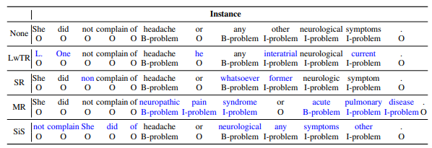
Literature Review
Current Research into Data Augmentation for NER
Rule-Based Approach
Label-Wise Token Replacement
Synonym Replacement
Mention Replacement
Shuffle within Segment
Examples from:
Dai and Adel, 2020, “An Analysis of Simple Data Augmentation for Named Entity Recognition”, 2010.11683

Slide 8
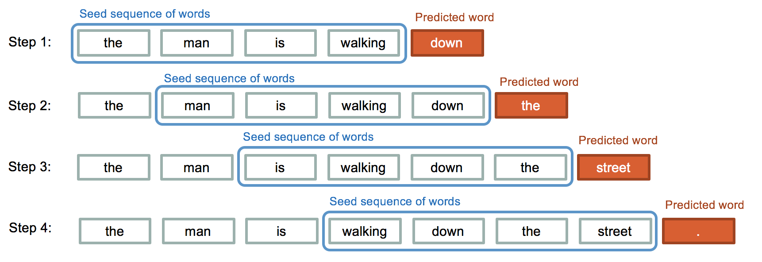
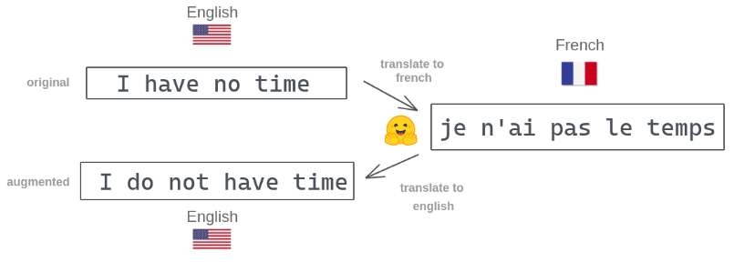
Literature Review
Current Research into Data Augmentation for NER
Model Approach
Sequential Text Generation Model
Back-Translation Model
Paraphrasing Model
Cross-Domain Model
Picture From:
IQ.OpenGenus.Org
Picture From:
Amit Chaudhary, https://amitness.com/back-translation/

Slide 9
Background
Information
Important Concepts & Information Required to Enhance Understanding

Slide 10
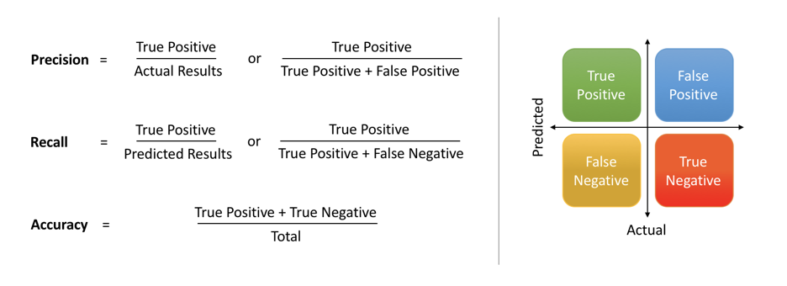
Background Information
Important Concepts & Information Required to Enhance Understanding
NER Standard Metrics:
Precision
Recall
F1
Summary Standard Metrics:
ROUGE*-K
*Recall Oriented Understudy for Gisting Evaluation

Slide 11
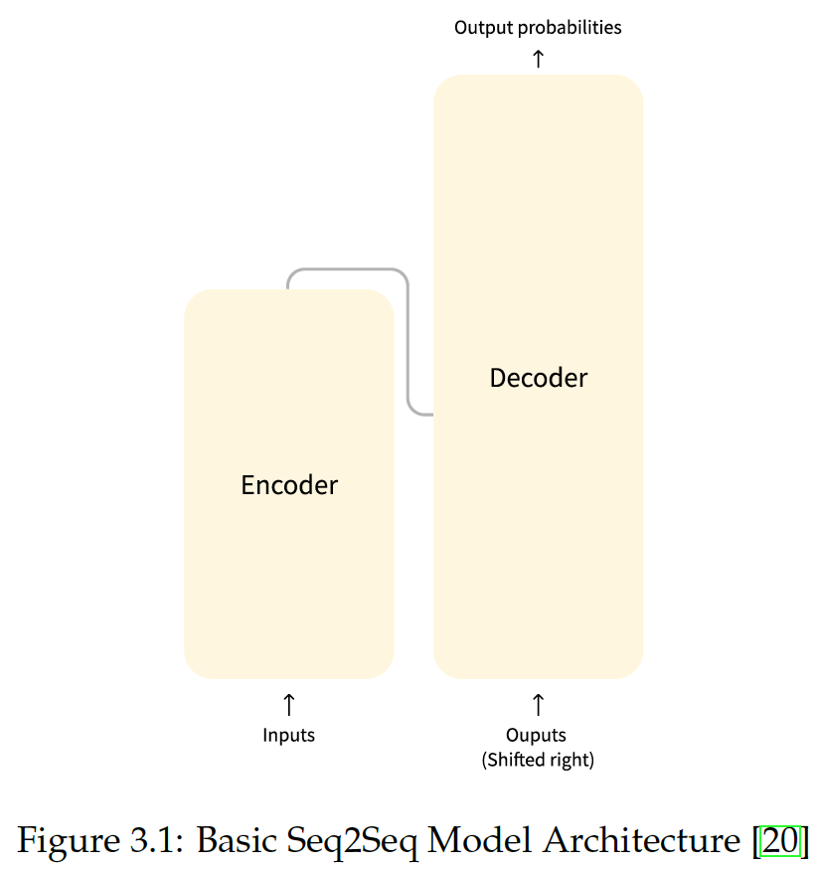
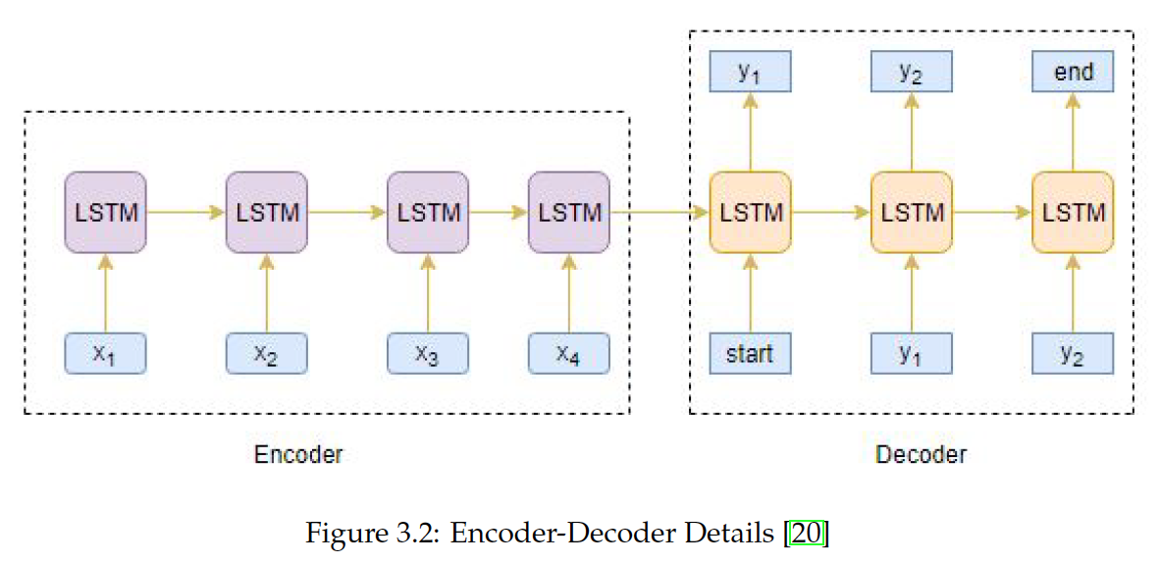
Background Information
Important Concepts & Information Required to Enhance Understanding
Seq2Seq Models
Also called Encoder-Decoder Models
Encoder takes an input
Encoder interprets and “understands” input, outputs “context vector”
Inputs context vector (and potentially other information) into Decoder
Decoder reads input(s), predicts an output
Often Recurrent Neural Network (RNN) Structured

Slide 12
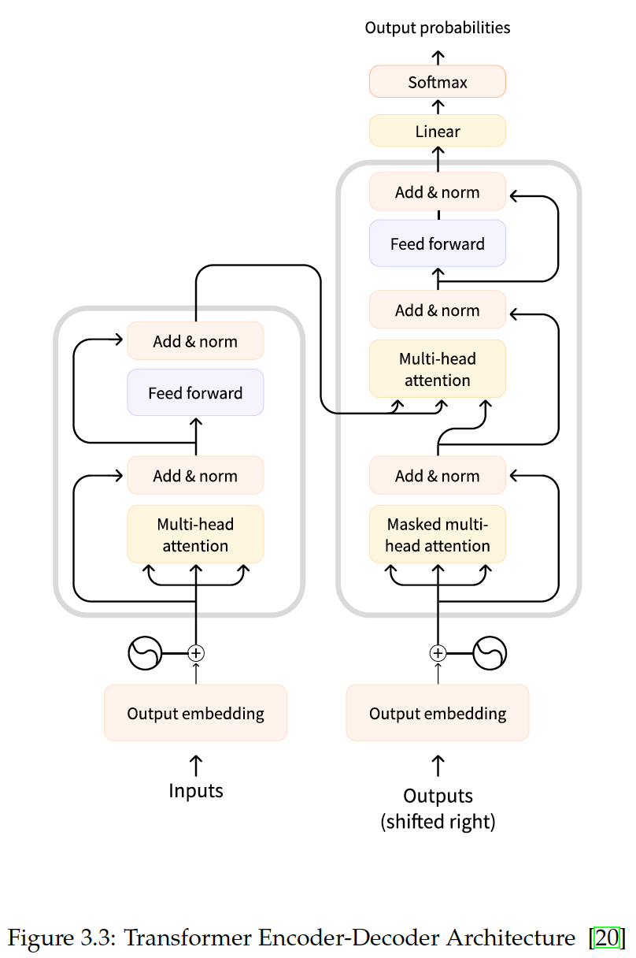
Background Information
Important Concepts & Information Required to Enhance Understanding
Transformer Models
Built with “attention” in mind
Encoders & Decoders are only fed relevant inputs (via weighting)
Weights adjusted over time via feed-forward network

Slide 13
Background Information
Important Concepts & Information Required to Enhance Understanding
Generation Hyper-Parameter Choices
Minimum & Maximum Length:
Sets a minimum* and/or maximum length that the generated output can take.
*Only reaches minimum length if more tokens exist
Notes:
https://huggingface.co/transformers/v2.9.1/main_classes/model.html

Slide 14
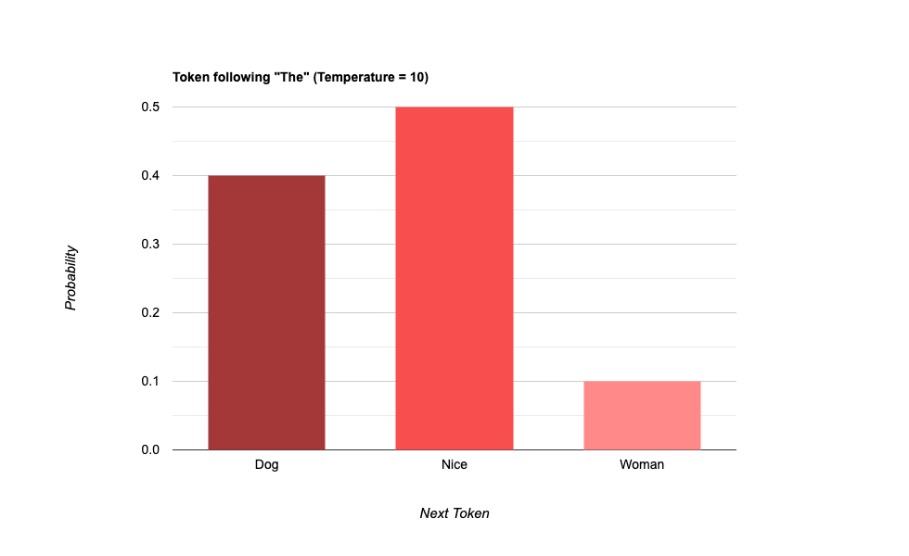
Background Information
Important Concepts & Information Required to Enhance Understanding
Generation Hyper-Parameter Choices
Temperature:
Increases or decreases the confidence the model has in the most likely response.
Notes:
#A43838
#F84E4E
#FF8989

Slide 15
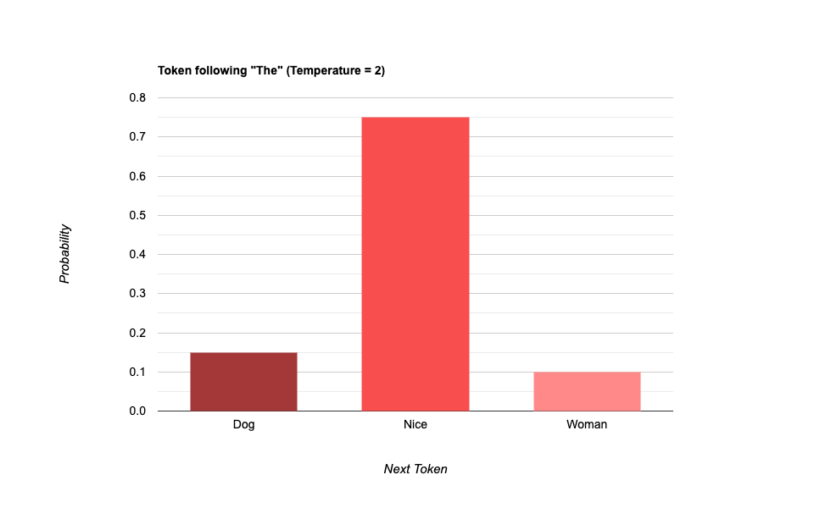
Background Information
Important Concepts & Information Required to Enhance Understanding
Generation Hyper-Parameter Choices
Temperature:
Increases or decreases the confidence the model has in the most likely response.
Notes:
https://huggingface.co/transformers/v2.9.1/main_classes/model.html

Slide 16
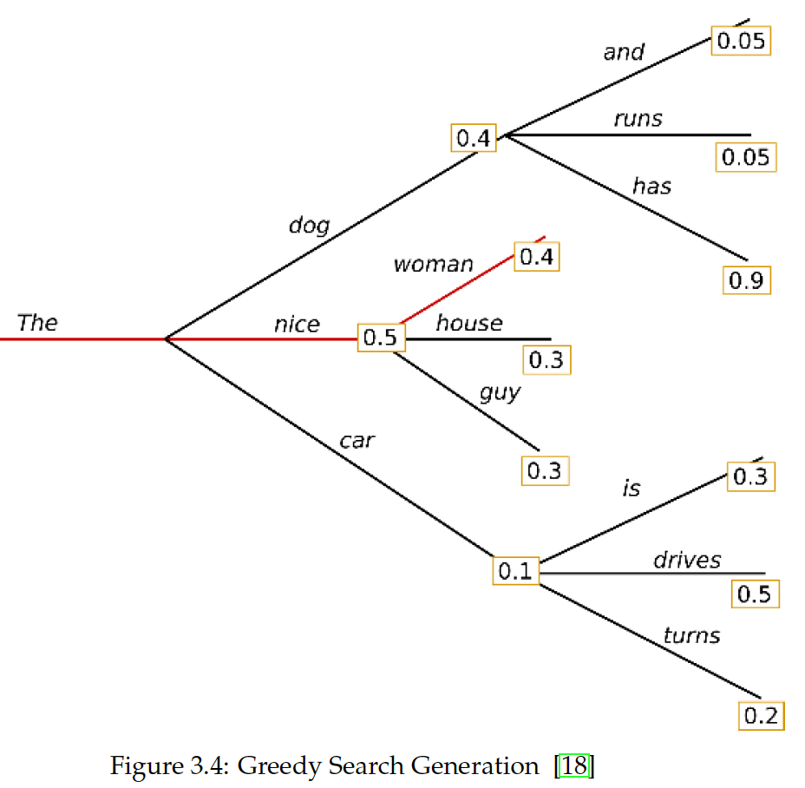
Background Information
Important Concepts & Information Required to Enhance Understanding
Generation Hyper-Parameter Choices
Greedy Search:
Selects the next token with the highest probability.
Notes:
https://huggingface.co/transformers/v2.9.1/main_classes/model.html

Slide 17
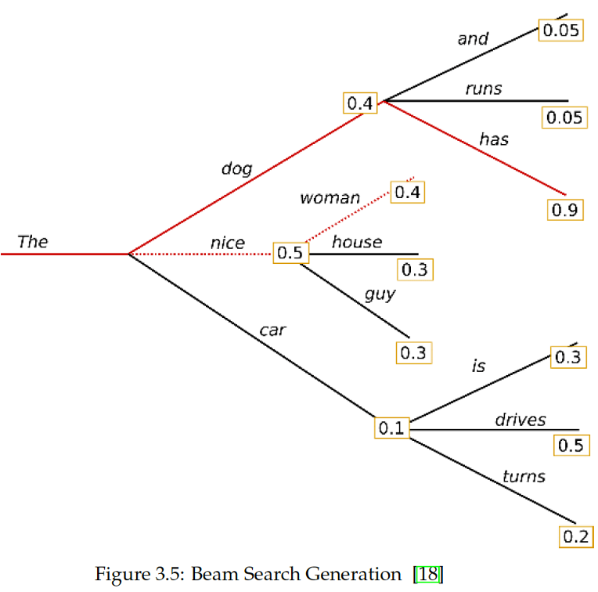
Background Information
Important Concepts & Information Required to Enhance Understanding
Generation Hyper-Parameter Choices
Beam Search:
Selects the next token with the highest combined probability for an n-beam chain.
Notes:
https://huggingface.co/transformers/v2.9.1/main_classes/model.html

Slide 18
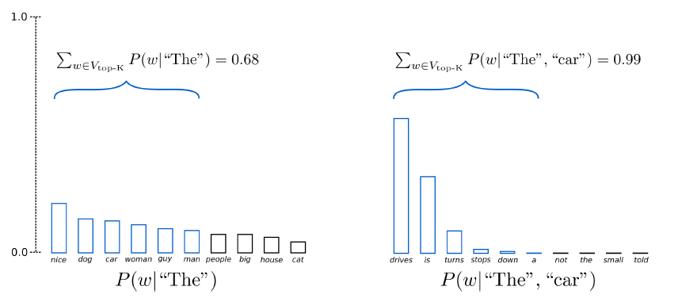
Background Information
Important Concepts & Information Required to Enhance Understanding
Generation Hyper-Parameter Choices
Sampling:
Randomly selects the next word based on the conditional probability distribution of the prior words.
Top-K Sampling:
The K most likely words are selected.
Notes:
https://huggingface.co/transformers/v2.9.1/main_classes/model.html

Slide 19
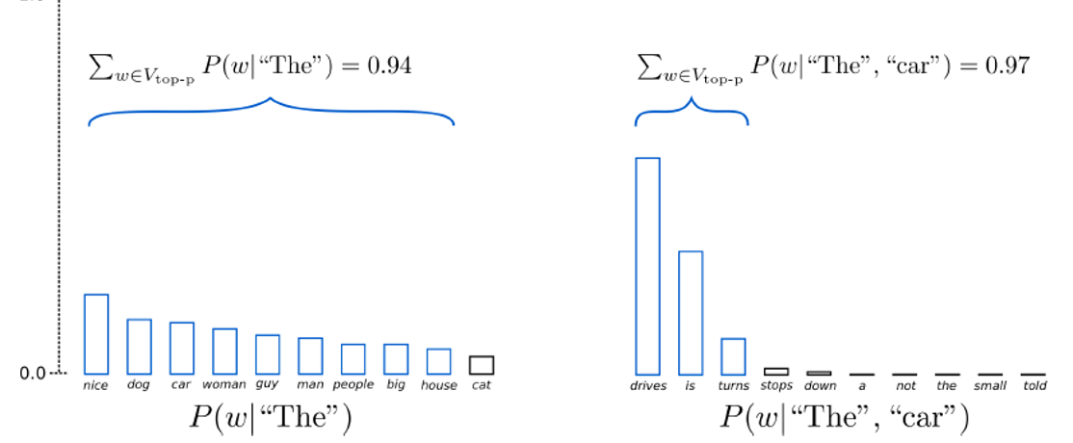
Background Information
Important Concepts & Information Required to Enhance Understanding
Generation Hyper-Parameter Choices
Sampling:
Randomly selects the next word based on the conditional probability distribution of the prior words.
Top-P Sampling:
The smallest group of words with total probability > p are selected.
Notes:
https://huggingface.co/transformers/v2.9.1/main_classes/model.html

Slide 20
Background Information
Important Concepts & Information Required to Enhance Understanding
Generation Hyper-Parameter Choices
Repetition Penalty:
Reduces the value given to a token that has already appeared.
Notes:
https://huggingface.co/transformers/v2.9.1/main_classes/model.html

Slide 21
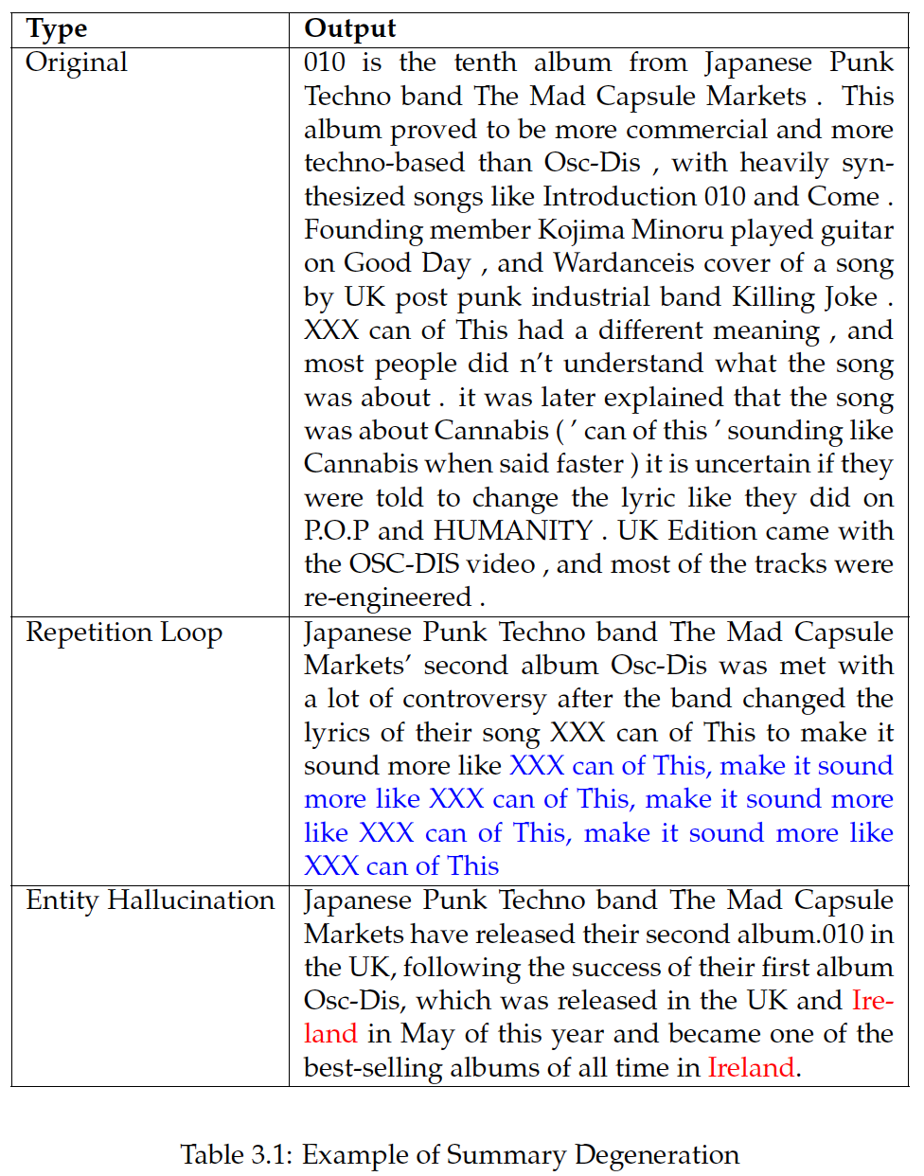
Background Information
Important Concepts & Information Required to Enhance Understanding
Known Summary Generation Issues
Repetition Loops:
Often, generated outputs can get caught in a loop where it repeats the same sequence of tokens over and over again.
Entity Hallucination:
Another issue is that generated outputs can sometimes create entities that do not exist in the original text due to model training data.
Notes:
https://huggingface.co/transformers/v2.9.1/main_classes/model.html

Slide 22
Process Pipeline:
(1) Summarization Methods
(2) Pre-Trained Summarization Models
(3) NER Model Selection
(4) Increasing Named Entity Occurrence
(5) Output Generation & Filtering
(6) Model Evaluation & Comparison
Methodology
Discussing the approach to be taken

Slide 23
Summarization Method
Approach Taken to Utilize Summarization
Example Article:
In 2010, an earthquake of magnitude 7 hit Haiti. This toppled buildings, shut down essential services, and caused a large food and water shortage. The president, Rene Preval, sent out an open request for aid. To support recovery efforts, Stephen Harper signed off on official humanitarian efforts by Canada. Canada pledged to supply approximately $5 million in supplies. This included medical equipment, food, water, and machinery.
Extractive Summary:
In 2010, an earthquake of magnitude 7 hit Haiti. Canada pledged to supply approximately $5 million in supplies. This included medical equipment, food, water, and machinery.
Abstractive Summary:
Canada’s government sent $5M in humanitarian aid to Haiti after a 7.0 earthquake crippled infrastructure. This aid alleviated the food and water shortages and provided vital medical aid and machinery.
Choice of Summarization Method
Extractive Summarization:
Concatenates sentences directly from articles.
Abstractive Summarization:
Generates new sentences to form a summary.
Notes:
https://huggingface.co/transformers/v2.9.1/main_classes/model.html

Slide 24
Available Summarization Models
Approach Taken to Utilize Summarization
Encoder & Decoder Uses
Pre-Trained Models Available
Encoders:
Encoders are good at tasks requiring an understanding of the full sentence.
Decoders:
Decoders are good at tasks requiring text generation (only see words prior to current word).
Name:
BART
T5
PEGASUS
Notes:
Selection Choice Discussed at ROUGE Filtering

Slide 25
NER Model Choice
Approach Taken to Utilize Summarization
NER Models
Details on BERT Structure
Unlike summarization models, NER models perform consistently.
A common choice for NER models is BERT, which also has two basic variants (among others):
BERT Cased
BERT Un-Cased
Pre-Trained on a large corpus of text data in the English language
Unsupervised (No Labels)
Masked Language Model (15%)
Bi-Directional
Training Tasks:
Word Detection
Sentence Continuity
Notes:
https://huggingface.co/transformers/v2.9.1/main_classes/model.html

Slide 26
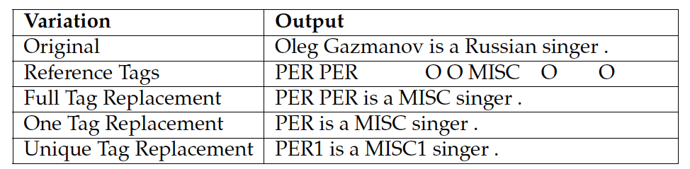
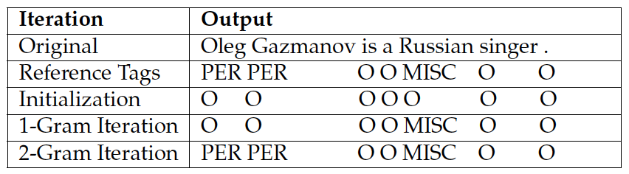
Data Changes & Mapping
Approach Taken to Utilize Summarization
Variations on Source Text & Mapping
Variations on Original Article
Variations:
Original
Linearized
Full Tag Replacement
One Tag Replacement
Unique Tag Replacement
Entity Mapping Methods:
Sliding n-gram [OR] Substitution
Sliding N-Gram Mapping
Notes:
https://huggingface.co/transformers/v2.9.1/main_classes/model.html

Slide 27
Increasing NE Output Rate
Approach Taken to Utilize Summarization
Improving Named Entity Occurrence
Quick Example:
John worked at Facebook for 3 years. [3/8]
While working at Facebook, he was promoted to senior developer. [1/10]
John later worked at Google from home in Los Angeles. [4/10]
He enjoys his work very much. [0/6]
Weighted:
John later worked at Google from home in Los Angeles.
John worked at Facebook for 3 years.
While working at Facebook, he was promoted to senior developer.
He enjoys his work very much.
Stemmed:
John worked at Facebook for 3 years.
While working at Facebook, he was promoted to senior developer.
John later worked at Google from home in Los Angeles.
Two approaches were taken in an attempt to increase the number of named entities in the generated summary:
Weighted Shuffling
Article Stemming
Notes:
https://huggingface.co/transformers/v2.9.1/main_classes/model.html

Slide 28
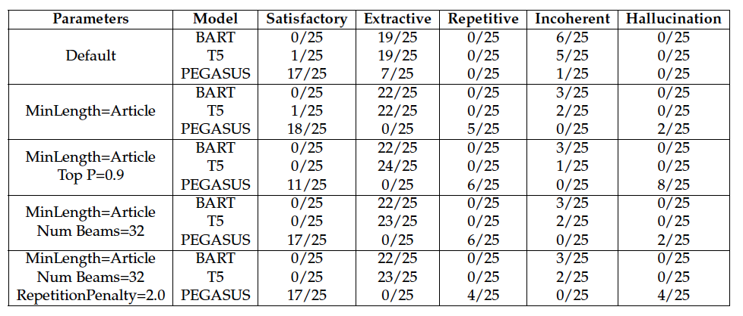
Generation & Filtering
Approach Taken to Utilize Summarization
Creating & Filtering Poor Generations
Shuffling:
To create a sufficient number of augmented sentences from article summaries, shuffling is required.
ROUGE Filtering:
Summaries are not perfect and are prone to hallucination and repetition. Low ROUGE scores can be used to filter exceedingly poor outputs.
Notes:
https://huggingface.co/transformers/v2.9.1/main_classes/model.html

Slide 29
Model Evaluation and Comparison
Creating a Baseline
Baseline Testing for Validation
Sample Sentence:
In the early 1930s the band moved to the Grill Room of the Taft Hotel in New York; the band was renamed "George Hall and his Hotel Taft Orchestra".
Shuffle Within Segment:
In early the 1930s band the moved the to Grill Room of the Hotel Taft in New York; renamed the band was “George Hall and his Hotel Taft Orchestra”.
Synonym Replacement:
In the fresh 1930s the band lifted to the Grill Room about the Taft Hostel in New York; the band abide renamed “George Entrance and his Hostel Taft Band”.
Paraphrased Generation:
Early in the 1930s in New York, the band moved to the Taft Hotel, Grill Room. They were renamed "George Hall and his Hotel Taft Orchestra".
Baseline Methods:
The previous methods found in literature can be utilized as a means of validating against and serving as a baseline.
Rules-Based Approach Methods
Paraphrasing Method
Notes:
Make into two slides, one for baseline testing, one for summarization approach (Give a sentence on what each method does high-level), indicate function creation
Summarization Approach FIRST, THEN baseline mention for validating

Slide 30
Dataset
Selection
Quick overview of dataset chosen

Slide 31
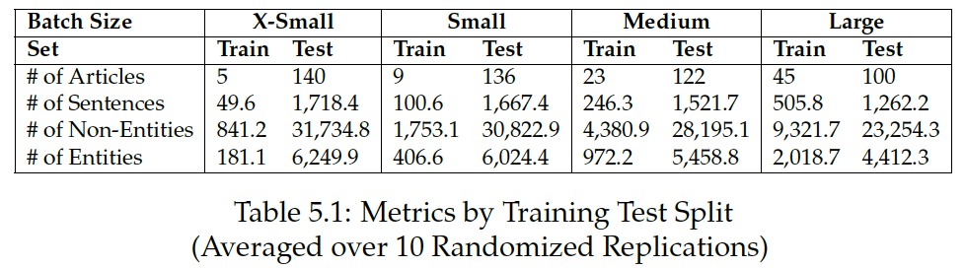
The WikiGold Dataset
Basic Information
Batching
Requirements:
Named Entity Tags for Each Token
Organized Sentences creating an Paragraph
Characteristics:
# of Articles: 145
# of Sentences: 1,768
# of Tokens: 39,007
# of Entities: 6,431
Entity Categories: O, ORG, LOC, PER, MISC
Method:
Count Sentences Per Article
Randomly select articles until batch size reached give or take 10%
Remainder left for testing
Characteristics:
Notes:
Make into two slides, one for baseline testing, one for summarization approach (Give a sentence on what each method does high-level), indicate function creation
Summarization Approach FIRST, THEN baseline mention for validating

Slide 32
Results
Discussing the results of the research

Slide 33
Application of Methodology
Unsuccessful Methods
NER Model Settings
Linearization
Named Entity Weighting
Article Stemming
Full Tag Variant
Epochs = 3*
Learning Rate of 2e-5 (0.00002)
Weight Decay Rate of 0.01
With more time, higher epochs would be ideal.
Notes:
https://huggingface.co/transformers/v2.9.1/main_classes/model.html

Slide 34
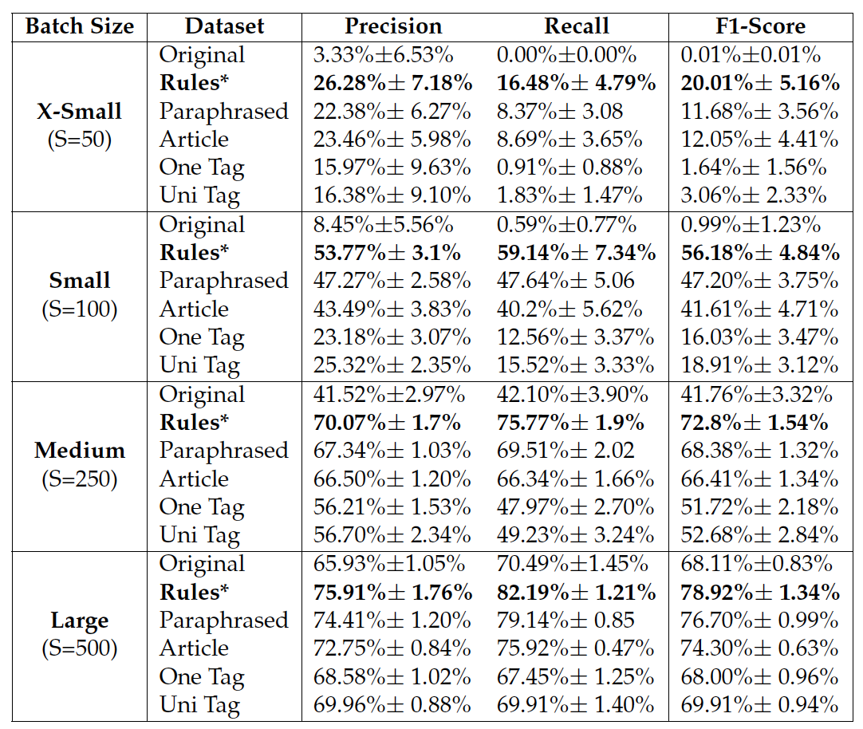
Notes:
https://huggingface.co/transformers/v2.9.1/main_classes/model.html

Slide 35
Future Work
Potential routes to take for future work

Slide 36
A More Rigorous Examination
Fine-Tuning
More Augmented Samples/Epochs
Model Hyper-Parameters
Article Variations
Shuffle Variations
Only 3 epochs were used for NER model.
A multiple of 3 augmented sentences per original sentence was also used.
Notes:
https://huggingface.co/transformers/v2.9.1/main_classes/model.html

Slide 37
Acknowledgements
Fundings:
Natural Science and Engineering Research Council
MITACS Accelerate Program
The Quantum Insider (TQI)
Advisors:
Dr. Yang Liu
Dr. Xu (Sunny) Wang
Team:
Yanan Chen
Ian Fraser
Jason Lechter
Herteg Kohar

Slide 38
Thank you
Questions?

Slide 39
Appendices

Slide 40
Encoder-Decoder Structure
BART AND T5 STRUCTURE INFO
Notes:
What can encoder achieves vs decoder

Slide 41
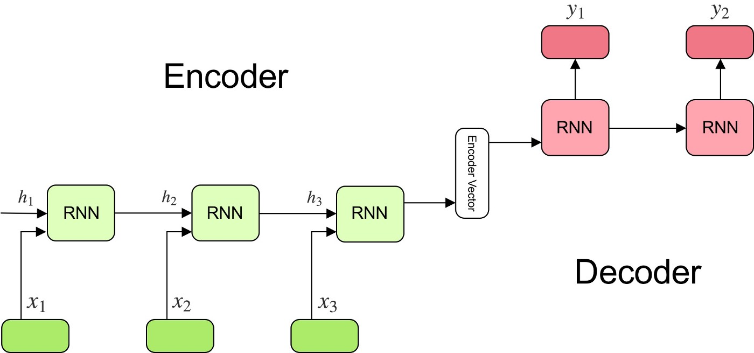
Encoder-Decoder Structure
Recurrent Neural Networks
Diagram from:
Simeon Kostadinov, “Understanding Encoder-Decoder Seq2Seq Model”, Towardsdatascience.com
Context Vectors:
A numerical output vector that quantifies a relationship/the “context” of words in a sentence. Long sentences are an issue.
Passes final hidden state to decoder.
Notes:
What can encoder achieves vs decoder

Slide 42
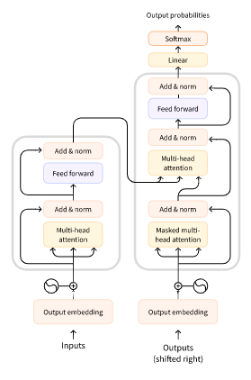
Encoder-Decoder Structure
Transformers
Diagram from:
Vaswani et al, 2017, “Attention is all you need”, 1706.03762
Attention:
Inputs are assigned weightings where higher weights denote a higher importance. Prediction is attempted with higher weighted portions.
Hidden State:
Passes ALL hidden states to decoder. Each hidden state gives more attention to a different word.
Masking:
Prevents decoder from “looking ahead” and “cheating”.

