Slide 1
Selected Image
UP live line view
Down live line view
Live
Select from Database
شمای کلی بالا ورق
شمای کلی پایین ورق

Slide 2
Croped Image (300x300)
عیب دارد؟
نوع لیبل : ماسک یا باندینگ باکس
نوع عیب؟
نوع عیب؟

Slide 3
Algoritm Type
(Binary, Local, Classifiaction)
Algoritm name
Setting Panel
Epochs,
Batch
Lr
Class num
.
.
.
Start

Slide 4
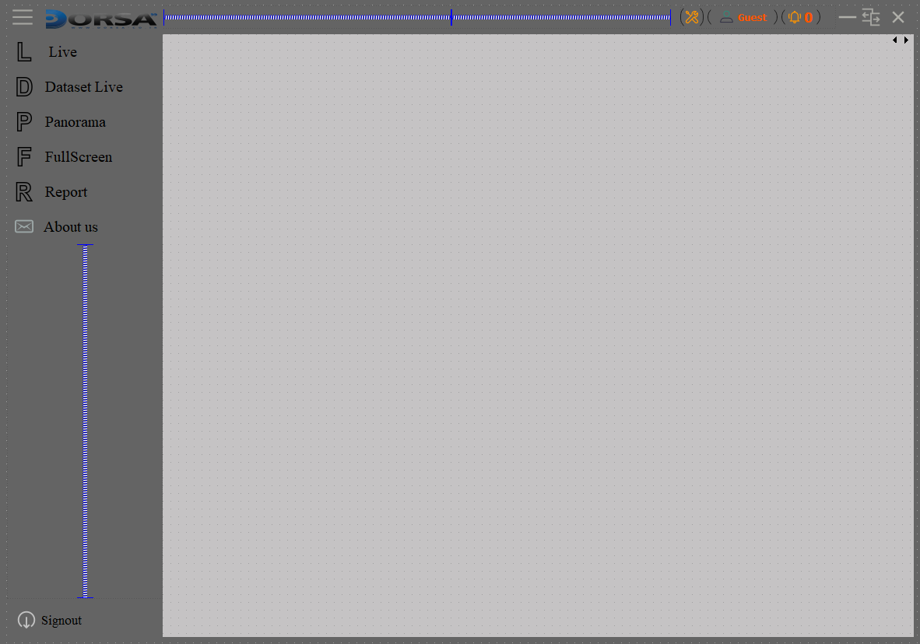
Data auquzation
--------------------
tuning
------------------------
Manage pipline
-----------------------
Add new defect class | defect list | |Training| History training
Percentage details , num of classification
Classification
_____________
Binary
-----------------------
Localization
Load images from database with filters , show predict and labes in selected algorithm
Select algorithm & weights |offline test| |save costumize

Slide 5
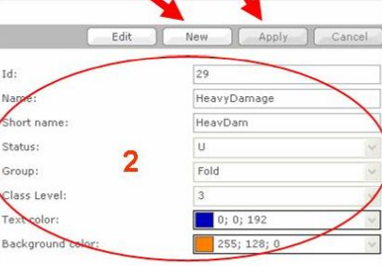
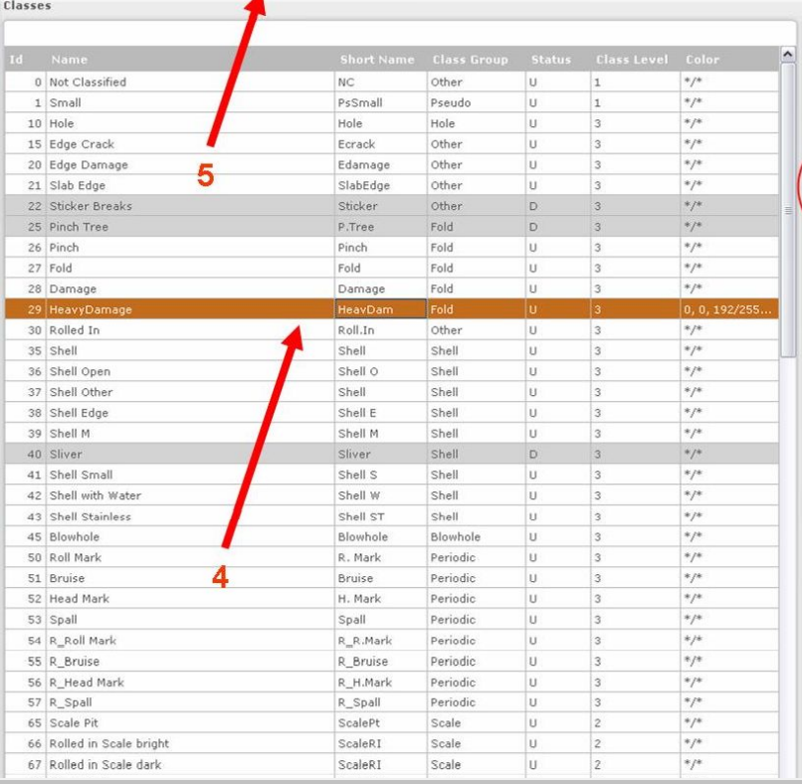
Id : 22
Name : oil heavy
Shortname: OH
Status : ?
Group: liquid
Class level : *(1-3)
Is defect : true-false
Color : rgb
Add defect class
Suggest: edit new apply

Slide 6
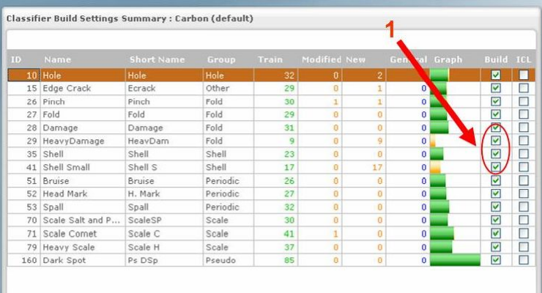
Show dataset and report new image and all images

