Slide 1
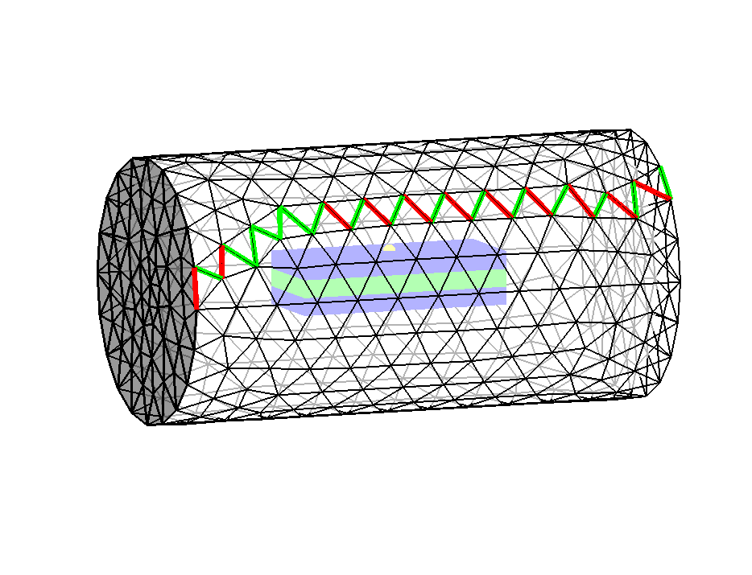



$$Nonzero edge values a_{k}=B.S_{0}$$
M
P
M
$$S_{0}$$
$$B$$
Fixed points (in yellow)

