Slide 1
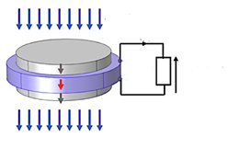
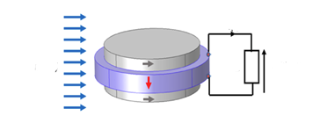






$$H_{ext}=H_{dc}+h_{ac}(t)$$
$$H_{ext}=H_{dc}+h_{ac}(t)$$
$$Z$$
$$V(t)$$
$$Z$$
$$V(t)$$

