Slide 1











Slide 2







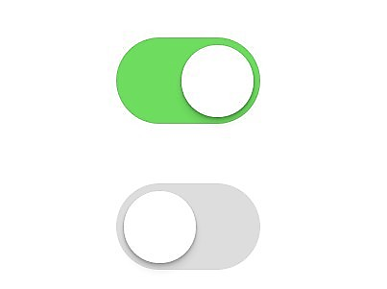

Slide 3




Success
Warning
Error
Info

Slide 4

























Slide 5



