Slide 1
gwloggeR v0.1.5
https://dov-vlaanderen.github.io/groundwater-logger-validation/gwloggeR/

Slide 2
Agenda
gwloggeR website
Core: 2 algorithms
Air pressure
Hydrostatic pressure
Demo
Future work
Discussion

Slide 3
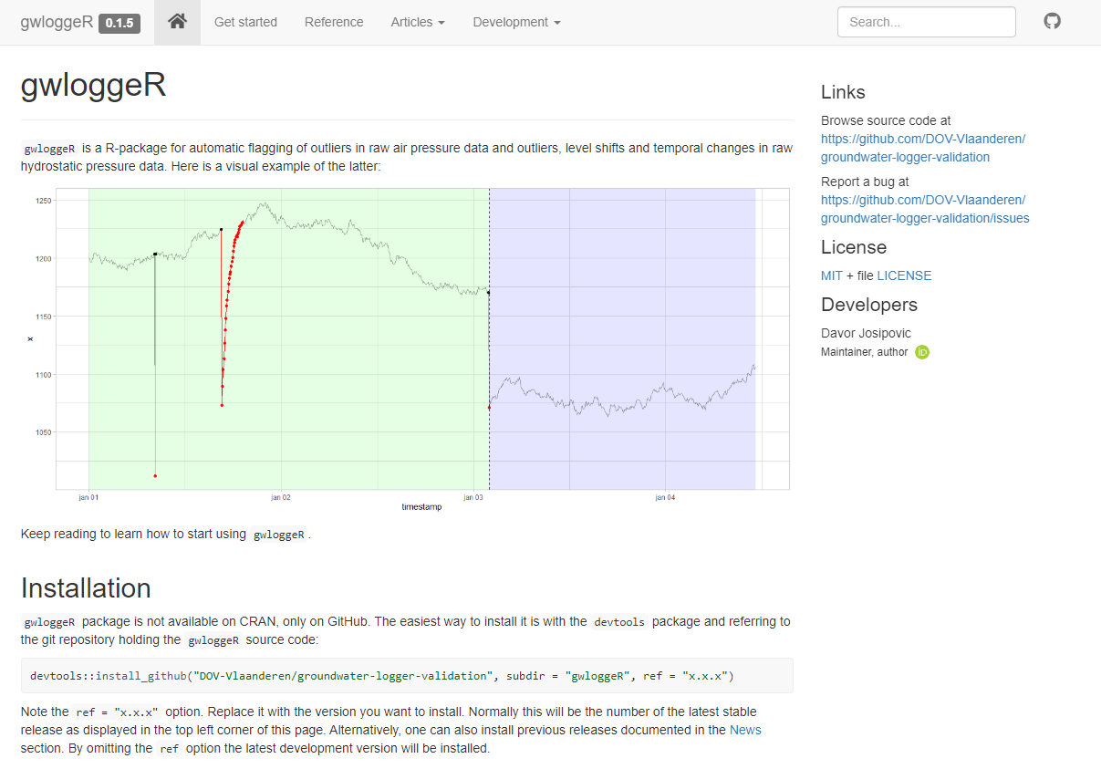
gwloggeR: website

Slide 4
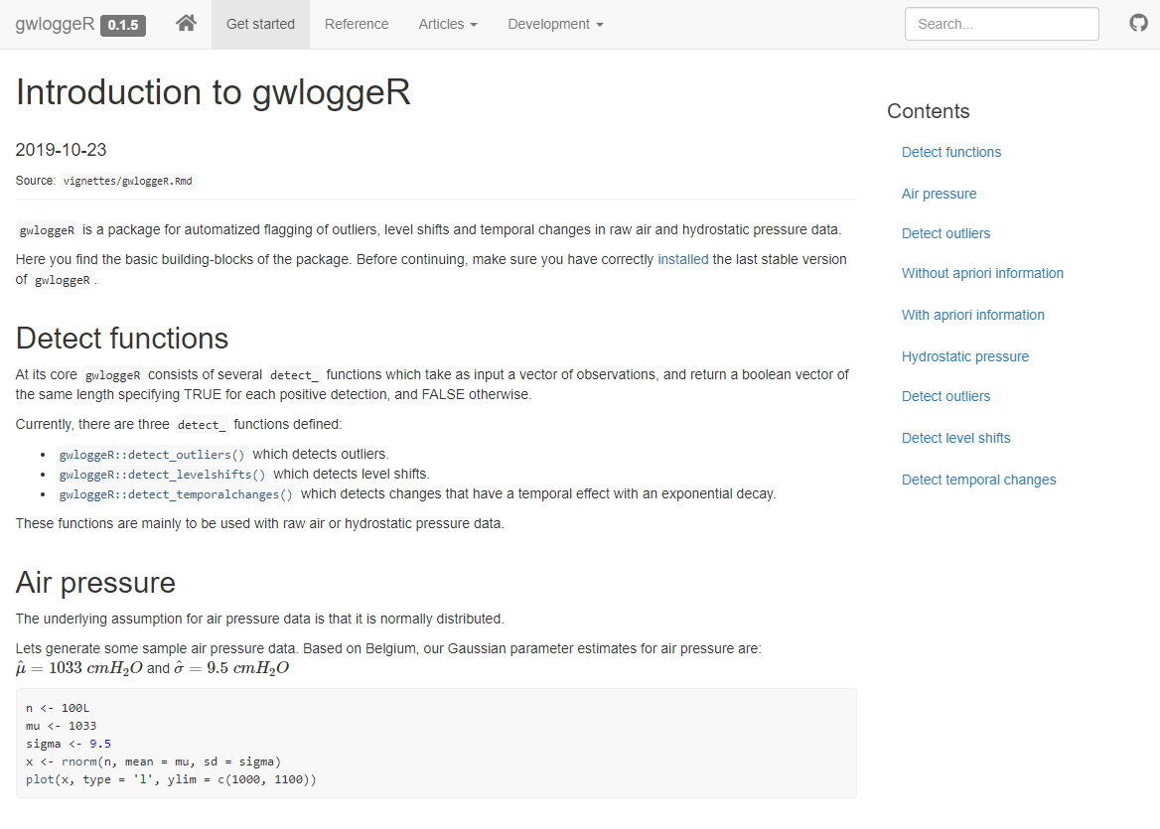
gwloggeR: getting started manual

Slide 5
Air pressure
Outlier detection.

Slide 6
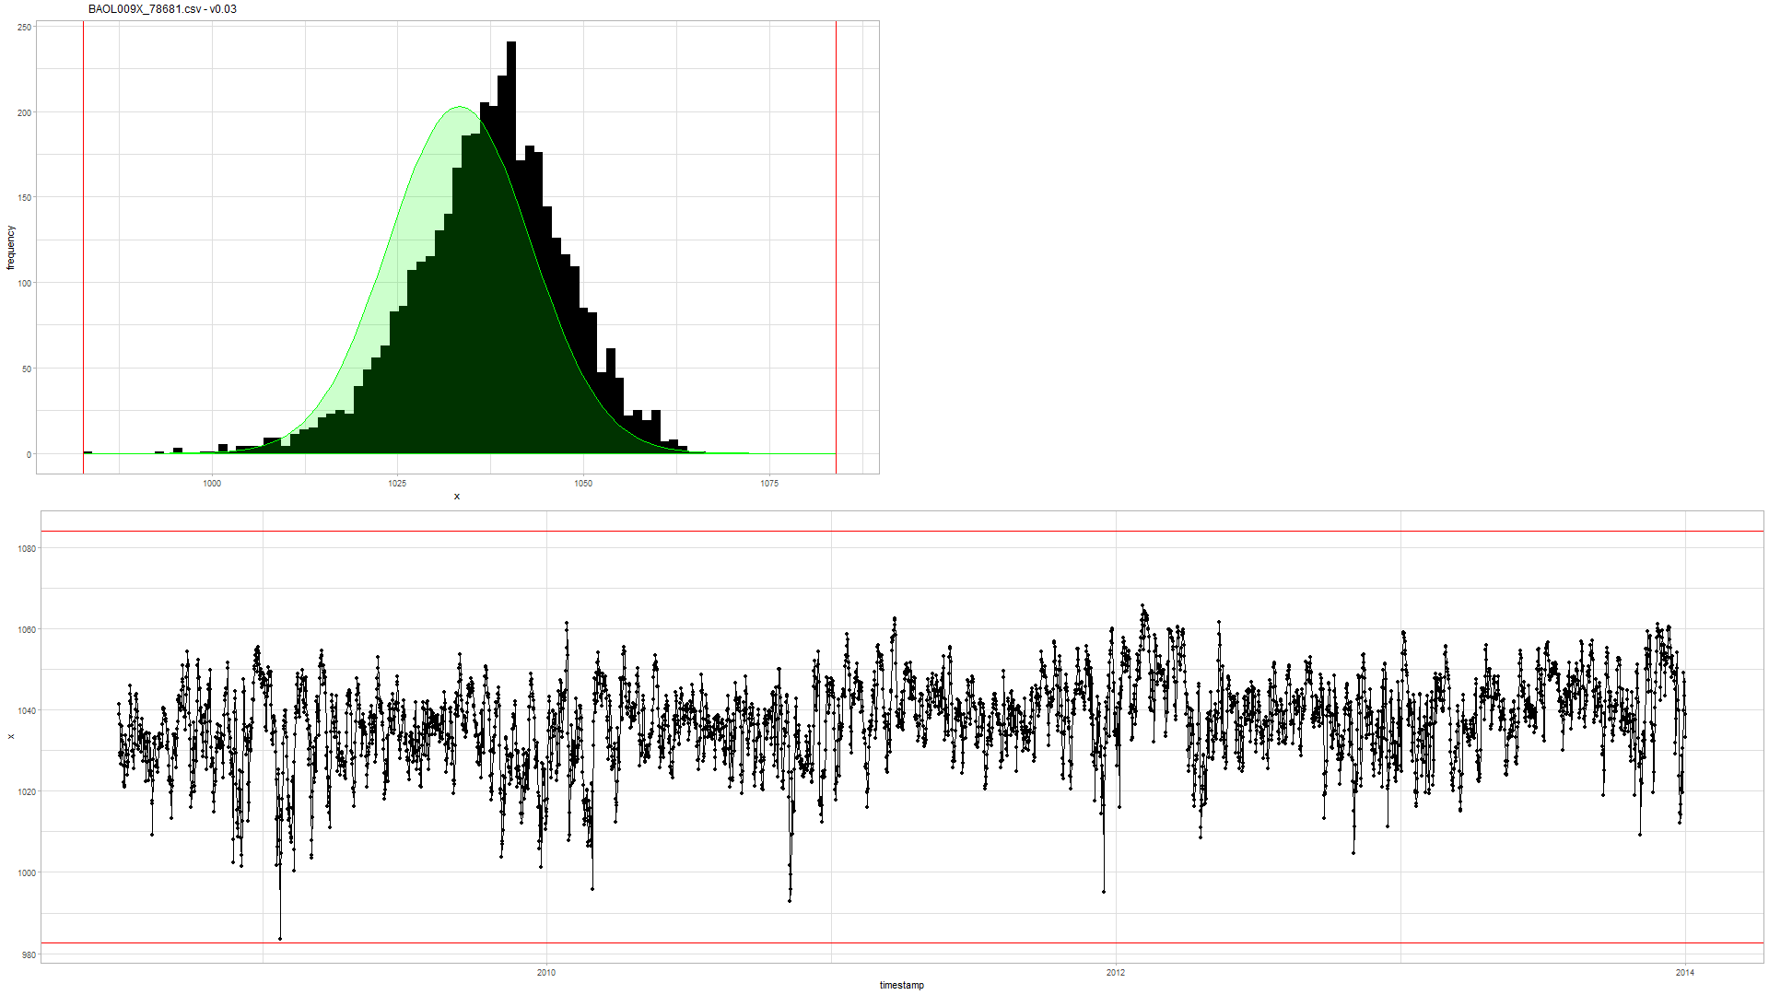

Slide 7
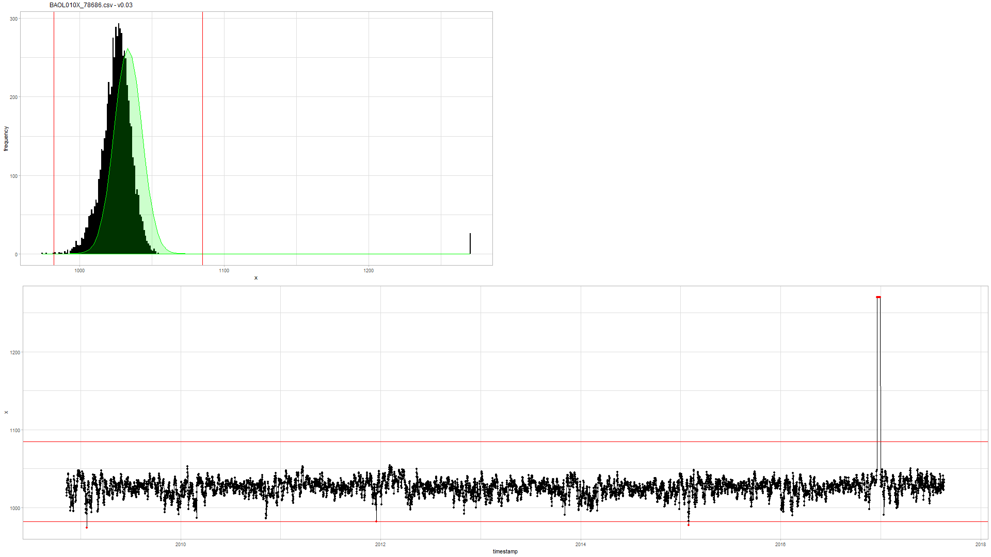

Slide 8
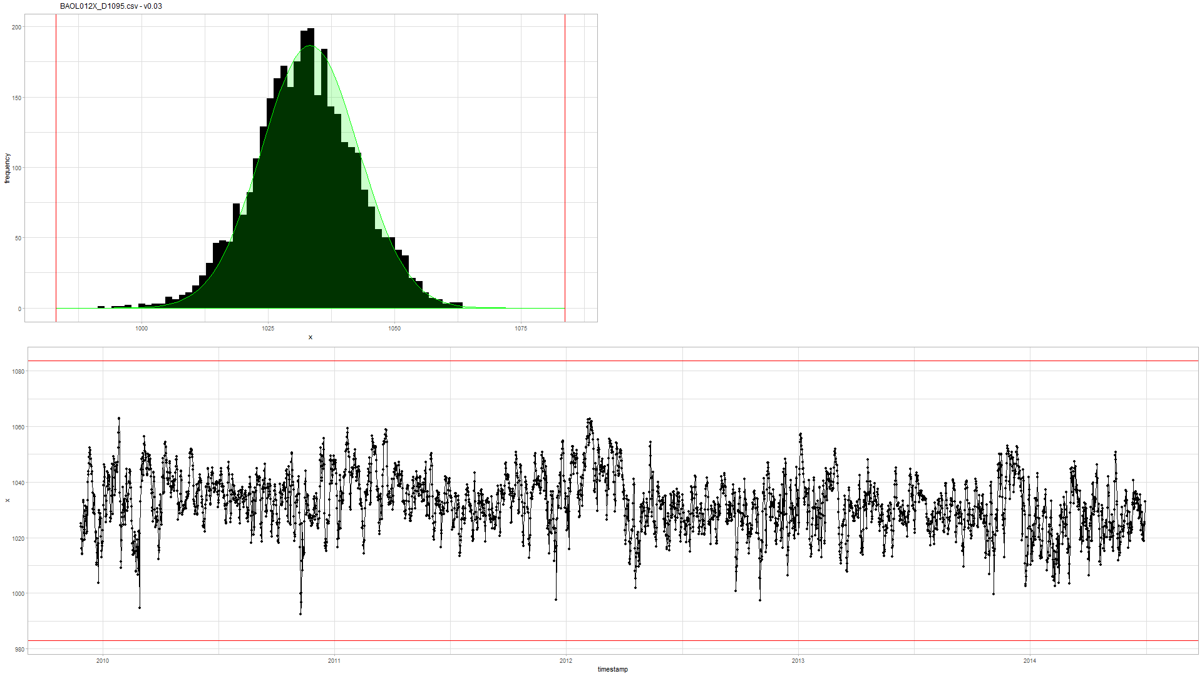

Slide 9
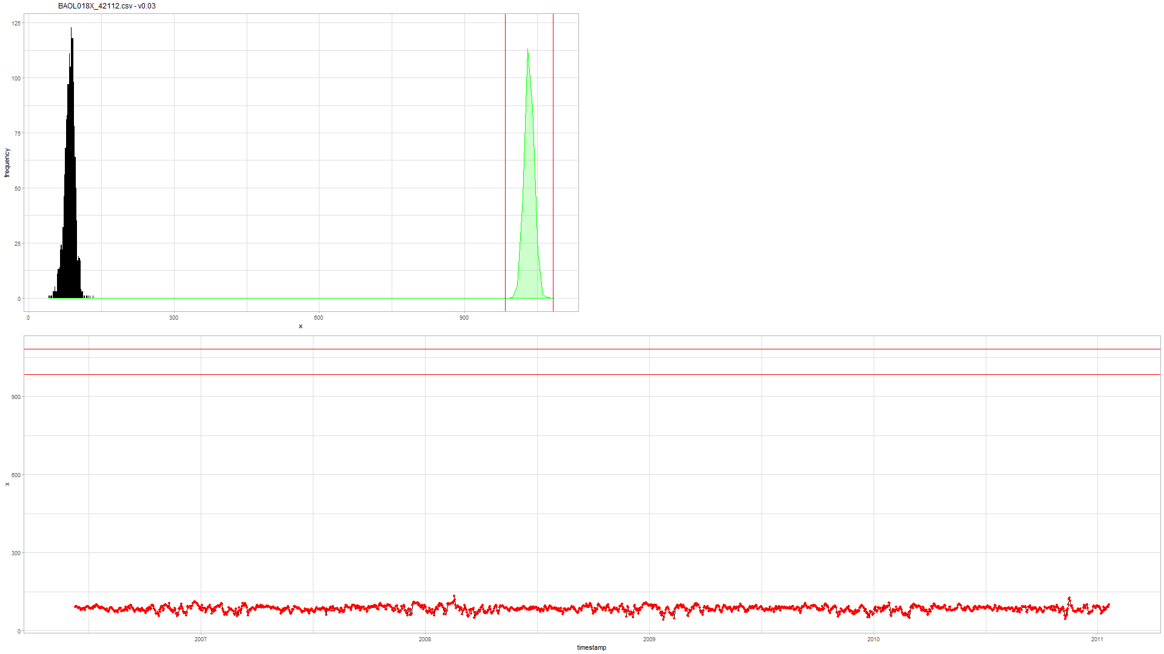

Slide 10

Future work: air pressure
detect_outliers(x) based on $Q_{n}$estimator for variance.
Option to supply altitude of the air pressure logger.
The pressure drops approximately by 11.3 Pa per meter in first 1000 meters above sea level.

Slide 11
Hydrostatic pressure
Additive outlier (AO), level shift (LS) and temporal change (TC) detection.

Slide 12
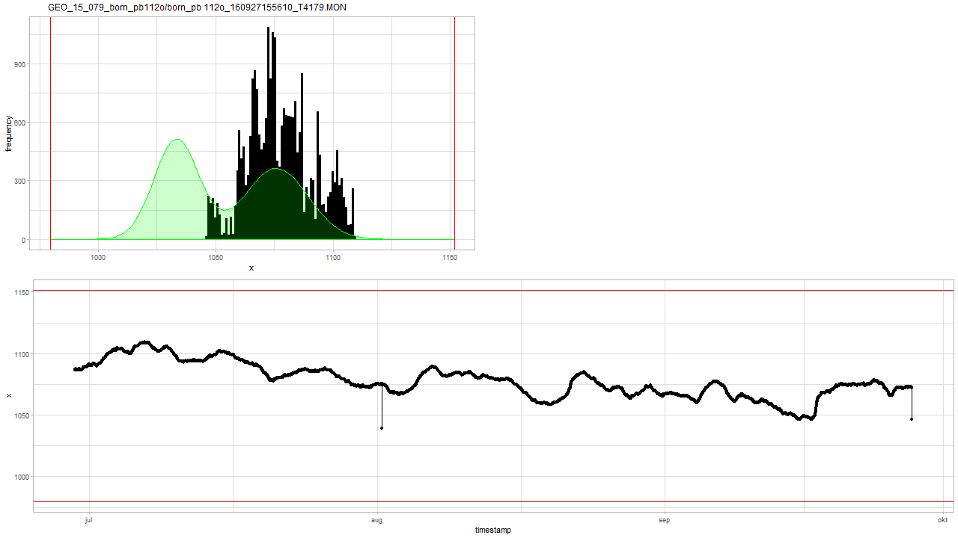
Normal noise model doesn’t work well on hydrostatic pressure data.

Slide 13
tsoutliers package

Slide 14
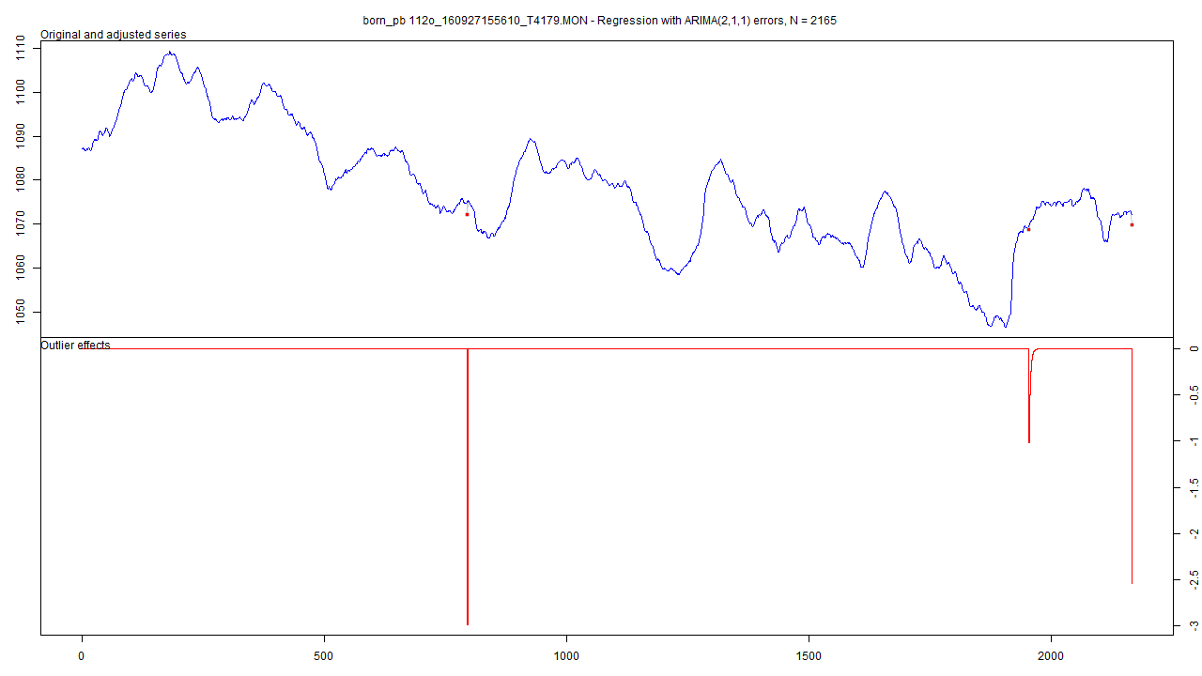

Slide 15
tsoutliers package
Pros:
Allows for a wide range of ARIMA-based models
Seems to detect LS well
Speed: 10 min average with aggregation
Cons:
Can not be used without aggregation (for >5k points): sometimes +24h (!!)
Temporal change decay fixed to 0.7
A-priori information not possible
Time-intervals are fixed
If auto-ARIMA is used: model not intelligible
Has no problems with first point and last point being outliers

Slide 16
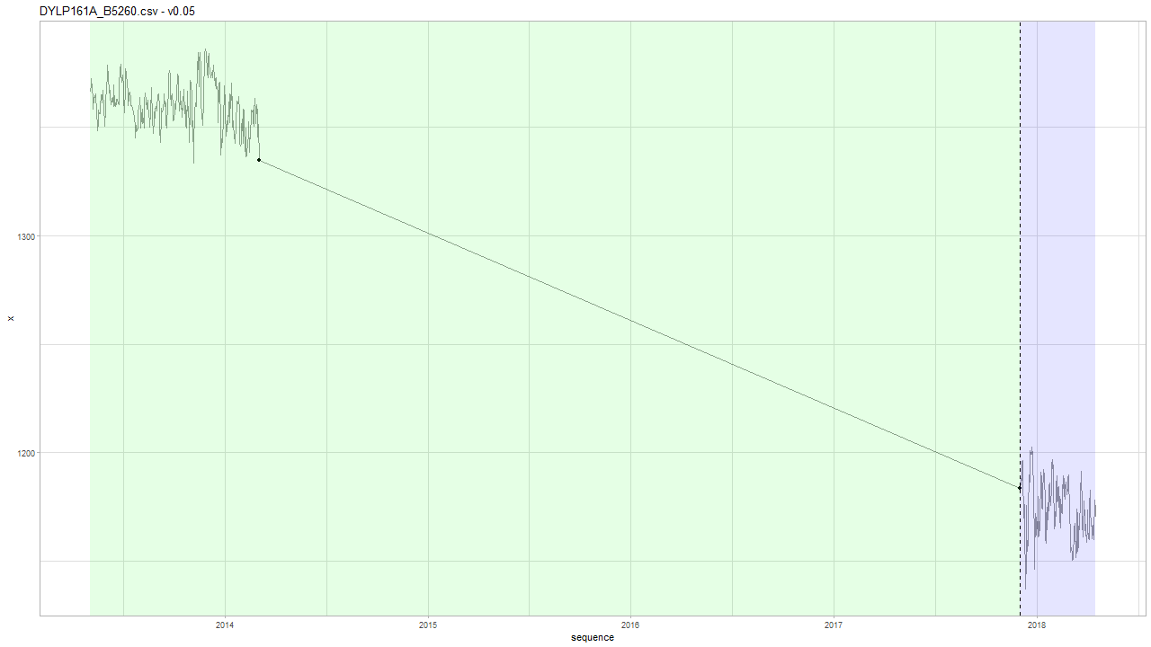

INBO: v0.05
Based on Geotech data we have $Δt$ < 1 month…
Notes:
Intuitief idee: na 4 jaar, wat is de kans dat die zo laag is gevallen?

Slide 17
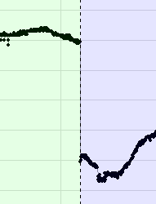
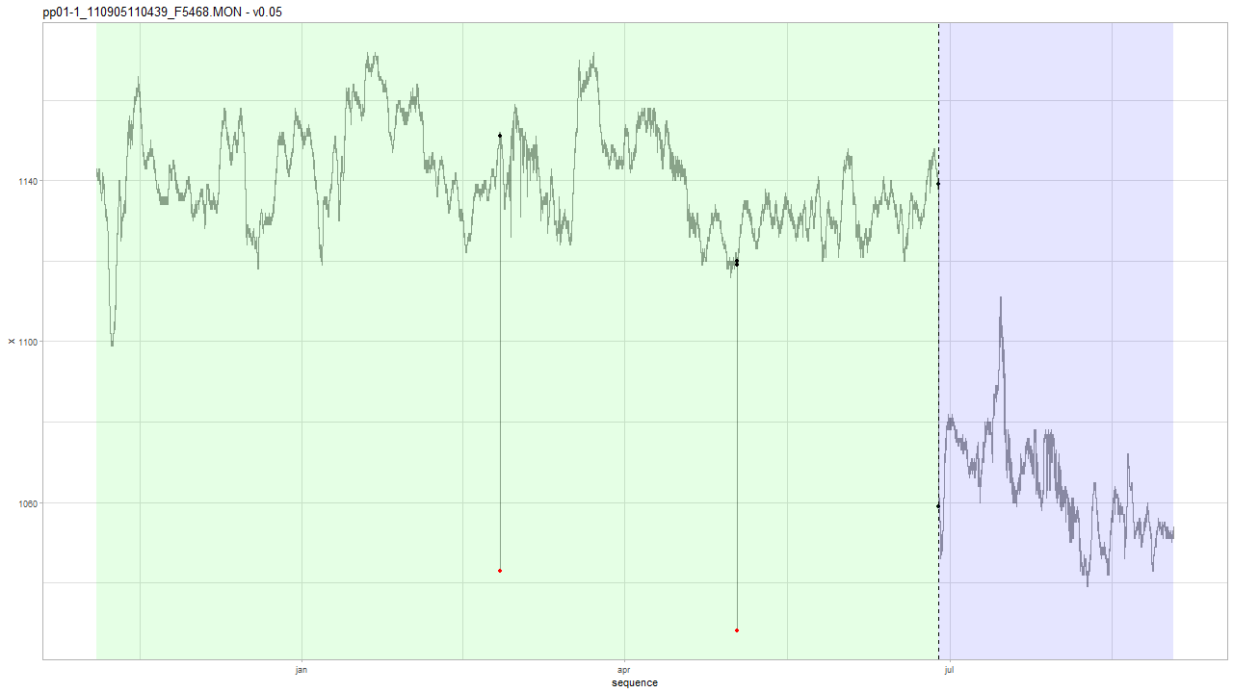


Geotech v0.05
type index alpha delta
1: AO 10824 -108.0 NA
2: AO 17175 -91.5 NA
3: LS 22552 -80.0 NA
Notes:
type index alpha delta
1: AO 10824 -108.0 NA
2: AO 17175 -91.5 NA
3: LS 22552 -80.0 NA

Slide 18
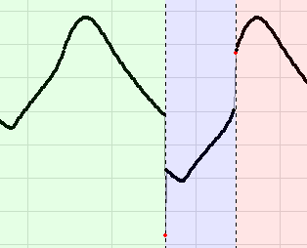
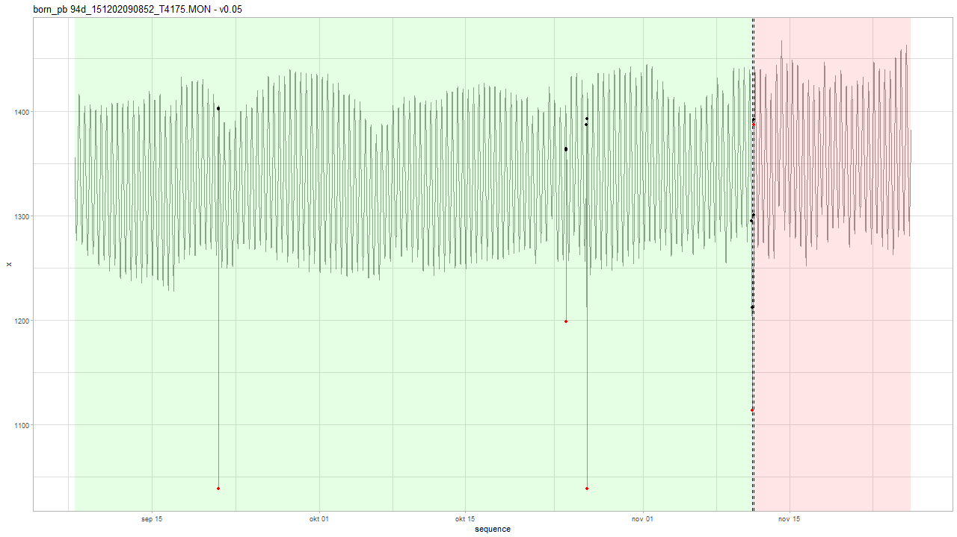
Geotech v0.05
AO and LS at the same time.
Notes:
type index alpha delta
1: AO 3968 -363.446 NA
2: AO 13555 -164.792 NA
3: AO 14117 -351.283 NA
4: AO 18671 -98.525 NA
5: LS 18671 -83.125 NA
6: LS 18731 91.175 NA
7: AO 18731 -4.842 NA

Slide 19
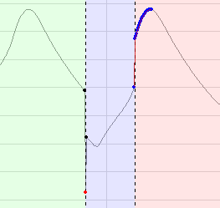
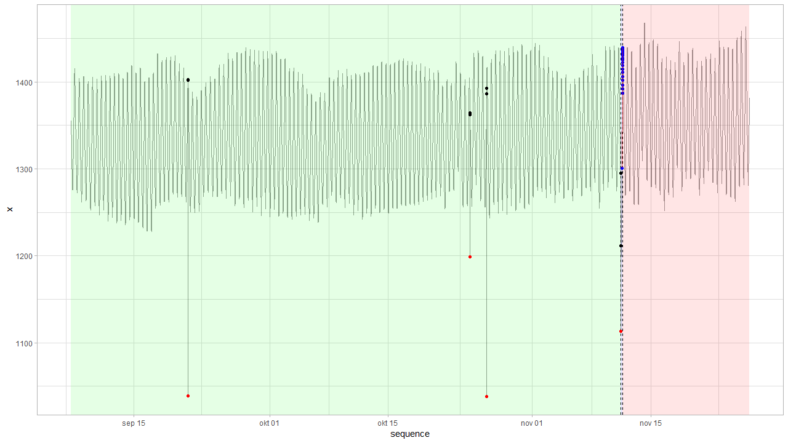
Geotech: v0.06 vs. v0.05 born_pb 94d_151202090852_T4175.MON
V0.06
Tidal effects should be incorporated in the future. As of now, disable TC for Geotech data.
Notes:
type index alpha delta
1: AO 3968 -363.44550 NA
2: AO 13555 -164.79150 NA
3: AO 14117 -351.28300 NA
4: AO 18671 -98.52490 NA
5: LS 18671 -83.12519 NA
6: LS 18731 141.76297 NA
7: TC 18731 -55.43006 0.88835

Slide 20
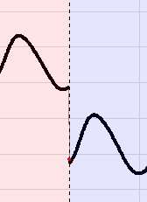
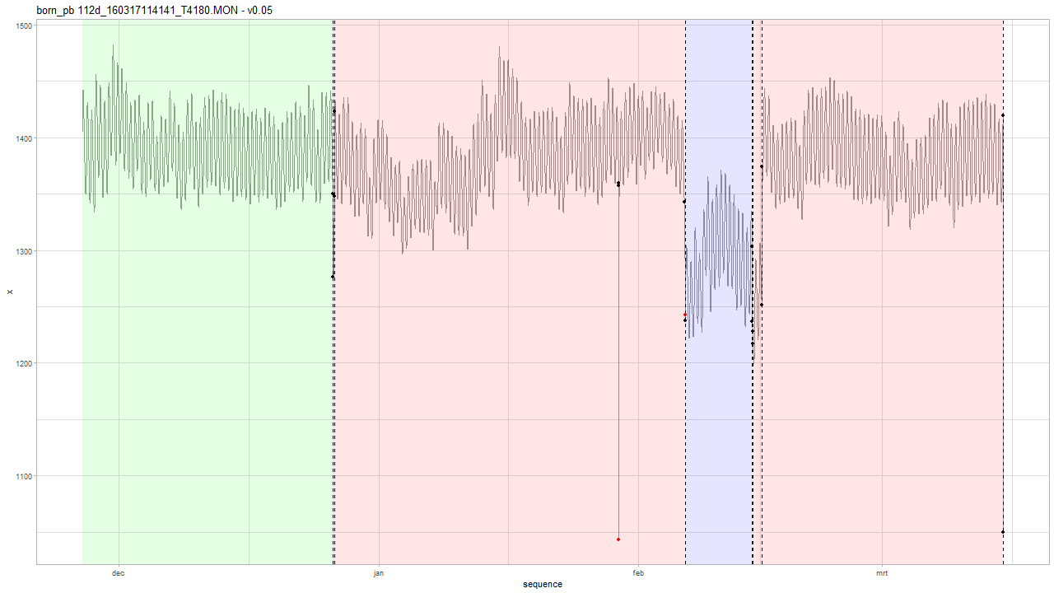
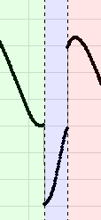

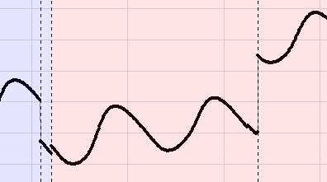
Geotech v0.05
Notes:
type index alpha delta
1: LS 8620 -74.317 NA
2: LS 8660 75.950 NA
3: AO 18420 -315.699 NA
4: LS 20693 -105.584 NA
5: AO 20693 5.075 NA
6: LS 23006 -66.091 NA
7: LS 23023 11.025 NA
8: LS 23333 122.617 NA
9: LS 31622 -369.950 NA

Slide 21
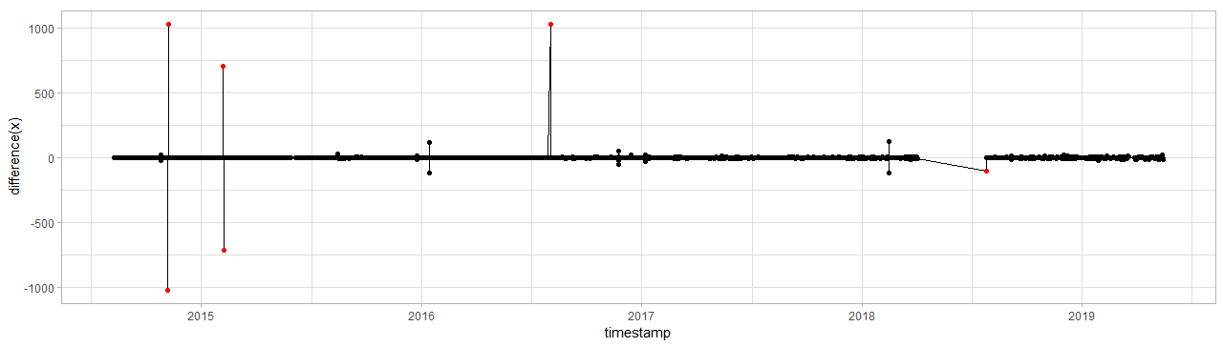
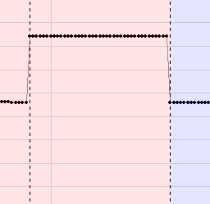
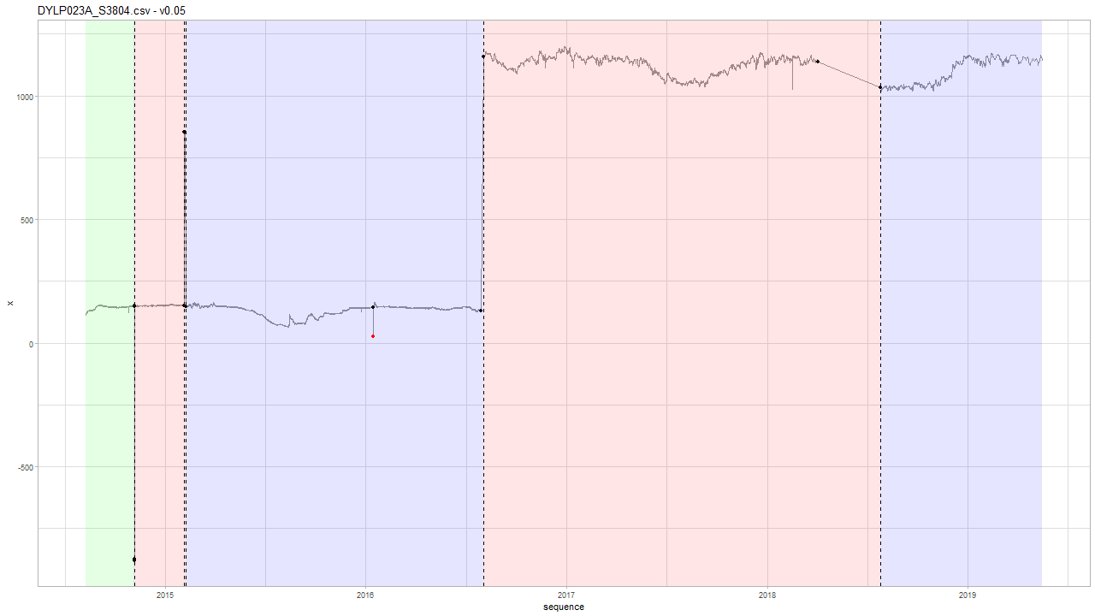
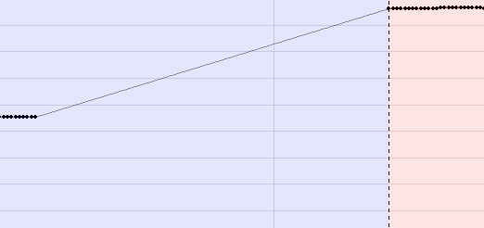
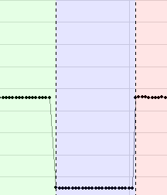

INBO v0.05
Levelshift detection
$Δt$ is larger here
Notes:
Levelshifts voorbeelden.

Slide 22
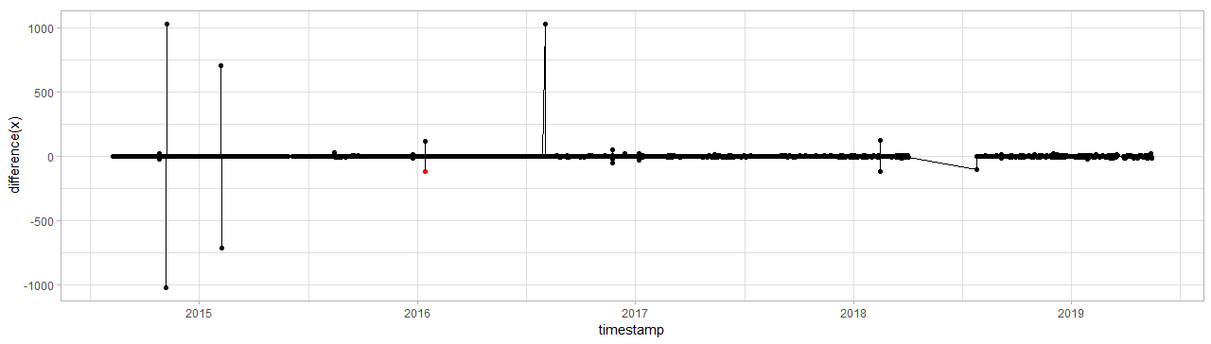

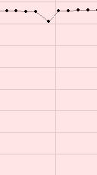
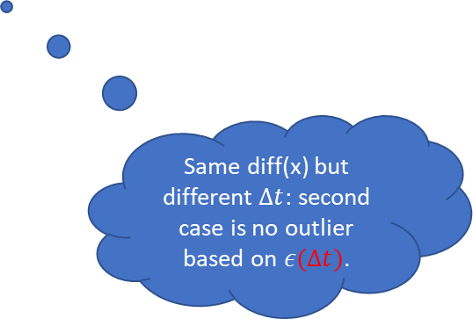
INBO v0.05
Outlier detection
Same diff(x) but different $Δt$: second case is no outlier based on $ε(Δt)$.
Notes:
Levelshifts voorbeelden.

Slide 23
DYLP023A_S3804
tsdiff vdiff lower.bound upper.bound mu sigma2 n.dens c outlier
3600 -119.1260886 -41.5 75.9 0.000790494 176.504 42216 5.533473 TRUE
3600 118.8260229 -41.5 75.9 0.000790494 176.504 42216 5.533473 TRUE
14400 -116.9593409 -135.8 172.5 -0.011306911 1776.242 10539 4.916277 FALSE
10800 122.2678611 -114.8 149.9 0.001284348 1201.918 14062 5.319899 FALSE
Notes:
Hier is te zien dat er bij de eerste timediff 1u is, terwijl bij 2e om een langere periode gaat.

Slide 24
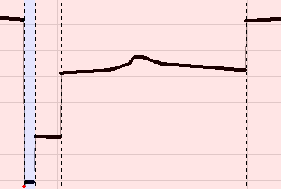
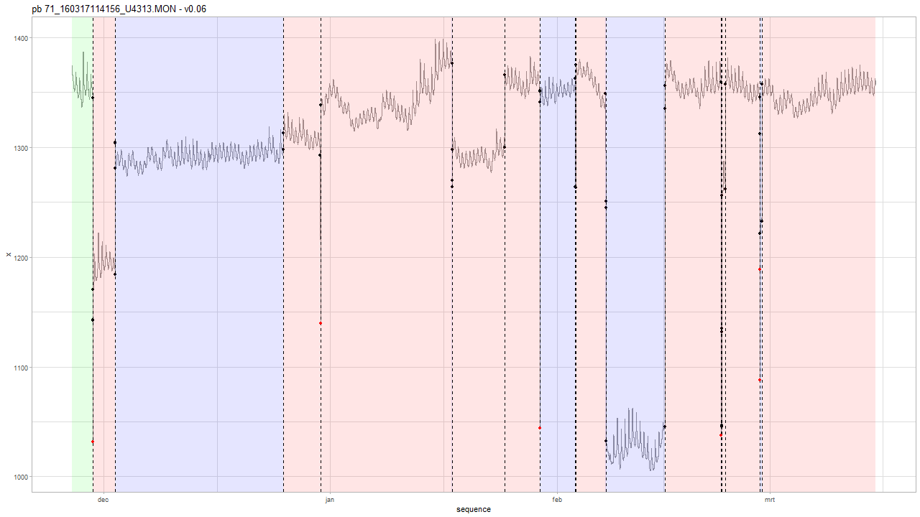
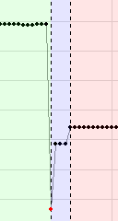
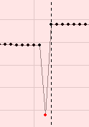
Geotech: v0.06

Slide 25
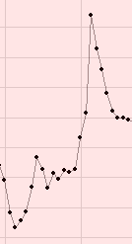
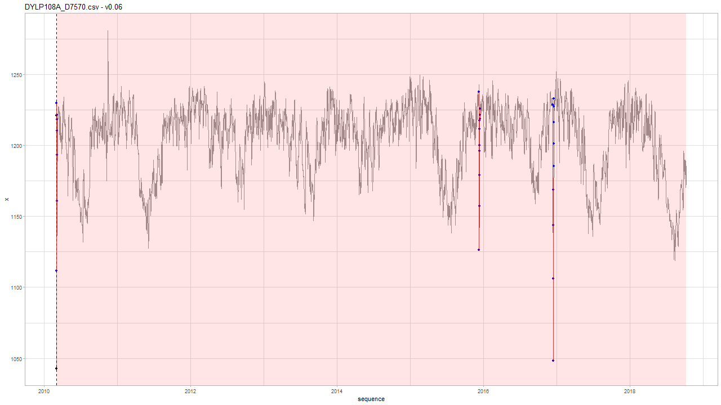
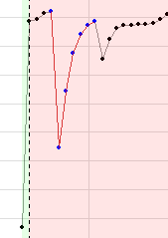
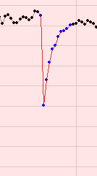
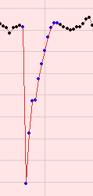
INBO: v0.06
Notes:
type index alpha delta
1: LS 2 178.426 NA
2: TC 6 -116.917 0.548
3: TC 4218 -110.551 0.717
4: TC 4955 -179.956 0.713

Slide 26
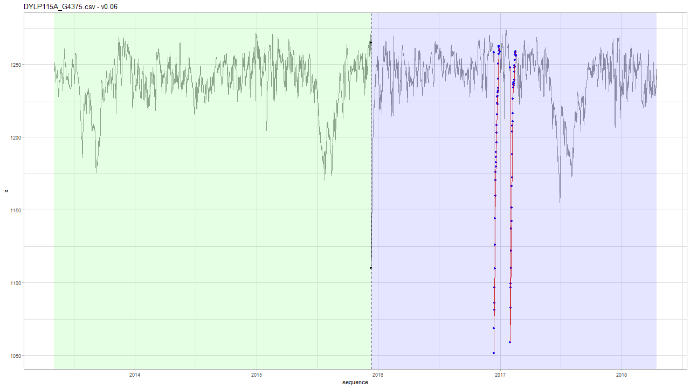
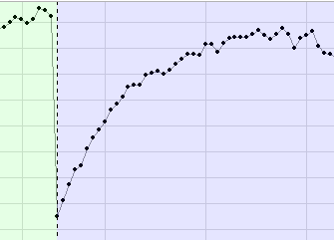
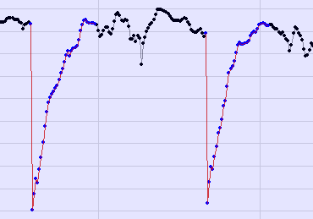
INBO: v0.06
Threshold is set on 1/10000 = 0.0001 wrong tests….
LR test = 0.0019 for LS vs TC model.
☹
Notes:
type index alpha delta
1: LS 1906 -154.7760 NA
2: TC 2643 -205.3884 0.9
3: TC 2741 -188.7047 0.9
Browse[2]> base
[1] -6.138137
attr(,"par")
[1] -154.776
attr(,"types")
[1] "LS"
attr(,"indexes")
[1] 1
Browse[2]> pt$get(base.df + 1L)
[1] -1.326422
attr(,"par")
[1] -153.64 0.90
attr(,"types")
[1] "TC"
attr(,"indexes")
[1] 1
Browse[2]> lrtest(logL0 = base, logL = pt$get(base.df + 1L), df.diff = 1L)
[1] 0.001921106

Slide 27
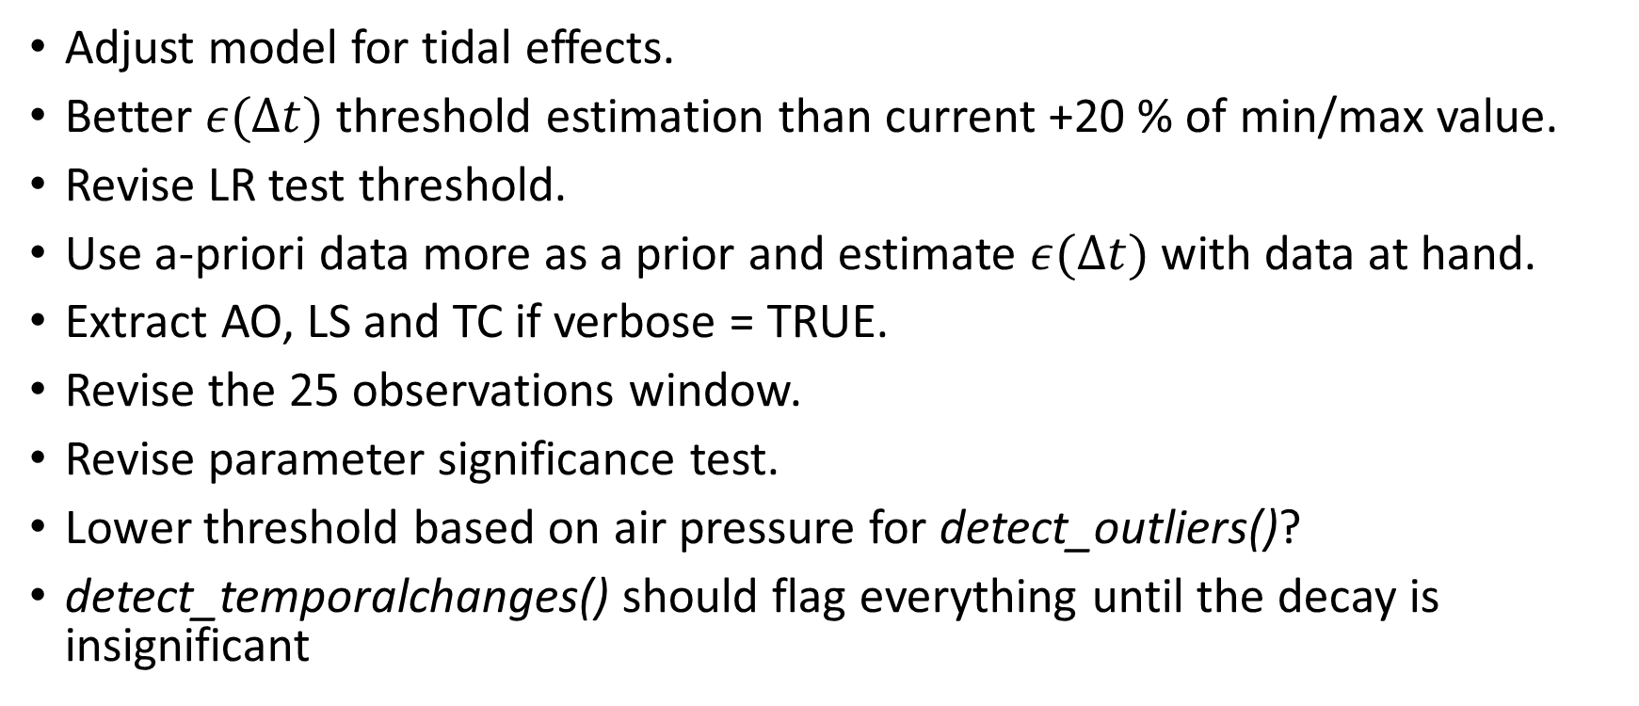
Future work: hydrostatic pressure
Adjust model for tidal effects.
Better $ε(Δt)$ threshold estimation than current +20 % of min/max value.
Revise LR test threshold.
Use a-priori data more as a prior and estimate $ε(Δt)$ with data at hand.
Extract AO, LS and TC if verbose = TRUE.
Revise the 25 observations window.
Revise parameter significance test.
Lower threshold based on air pressure for detect_outliers()?
detect_temporalchanges() should flag everything until the decay is insignificant

Slide 28
tsoutliers vs gwloggeR
Advatages vs. tsoutliers
Speed: with TC detection ON, it usually takes less than a second or 2. There are few pathological cases: DYLP029A_S4054 and born_pb 112d_151202090850_T4180.MON that take 2 minutes to complete.
No need for aggregation
Variable decay
A-priori information
Variable time-intervals
Allows for step-by-step model improvement
Interpretable model
Cons:
Ad hoc optimization (similar to tsoutliers)
Development/testing

Slide 29
The End

