Slide 1
Sprint 2
Outliers

Slide 2
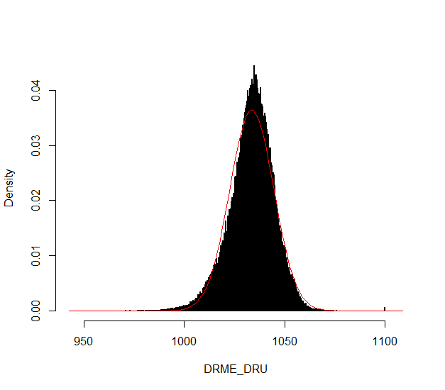
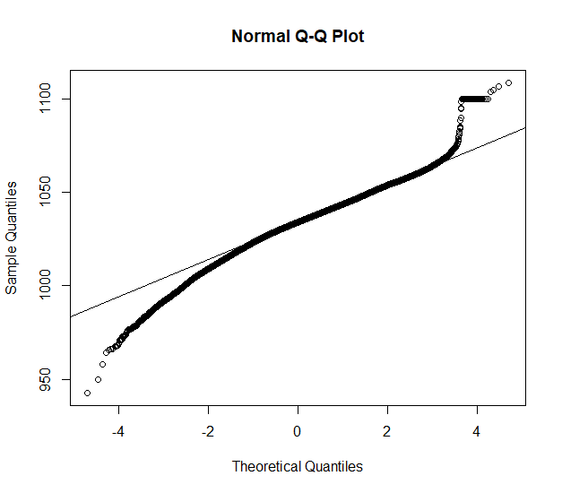
Outliers: v0.02 update
Validation
Notes:
Excluded: BAOL089|BAOL079|BAOL006
Range: 800 < x < 1200

Slide 3
Sprint 1
Outliers

Slide 4
Outliers
v0.01: detect_outliers(data)
Uses only the supplied dataset
v0.02: detect_outliers(data, type = c(“air pressure”, “air temperature”), units)
Uses simple a-priori knowledge about air pressure, temperature, etc.
v0.03: …

Slide 5
Outliers: v0.01
Uses only the supplied dataset

Slide 6
Outliers: v0.01
Validation

Slide 7
Outliers: v0.01
Validation

Slide 8
Outliers: v0.01
Validation

Slide 9
Outliers: v0.01
Validation

Slide 10
Outliers: v0.01
Validation

Slide 11
Outliers: v0.01
Validation

Slide 12
Outliers: v0.01
Validation

Slide 13
Outliers: v0.01
Validation
Scale completely wrong?

Slide 14
Outliers: v0.02
Uses simple a-priori knowledge about air pressure, temperature, etc.

Slide 15
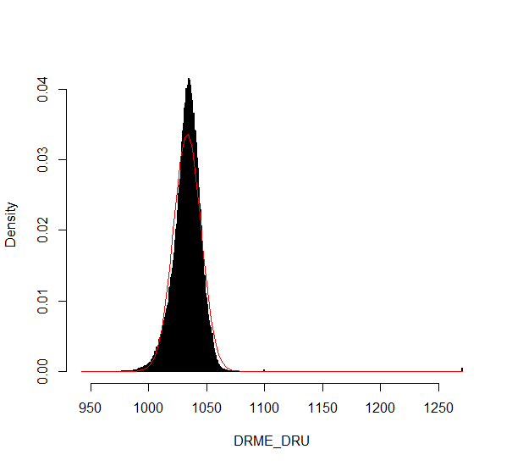
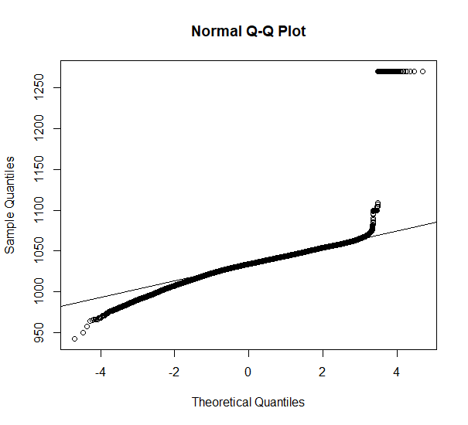
Outliers: v0.02
Validation

Slide 16
Outliers: v0.02
Validation

Slide 17
Outliers: v0.02
Validation

Slide 18
Outliers: v0.02
Validation

Slide 19
Summary
Outliers: v0.01
detect_outliers(data)
Usable on any data (not only L - lucht)
Scale can be completely wrong (cf. BAOL018X_42112)
Outliers: v0.02:
detect_outliers(data, type = c(“air pressure”, “air temperature”), units)
Needs a-priori information
Type
Units
Fixed or dynamic thresholds?
Notes:
Tresholds voor outliers kunnen berekend worden op basis van handmatige prior analyse, of

Slide 20
Outliers: v0.03
Go even further with a-priori information?

Slide 21
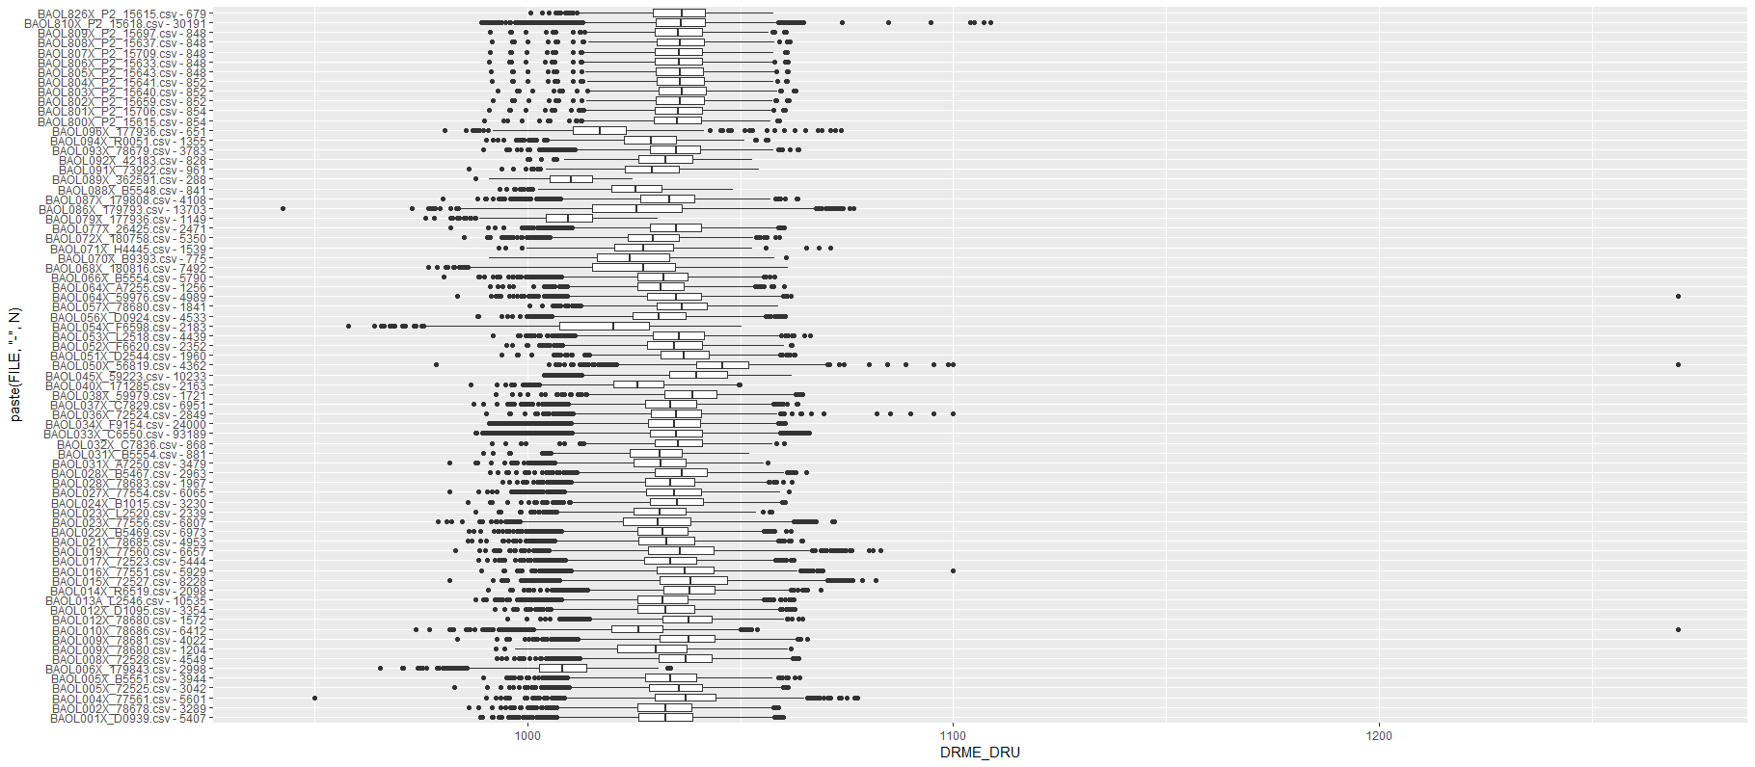
Outliers: v0.03
Even more a-priori information to explain variation
Notes:
Bijvoorbeeld, somige regio’s hebben lagere of hogere temperature, wat resulteert in hogere of lagere luchtdruk.

Slide 22
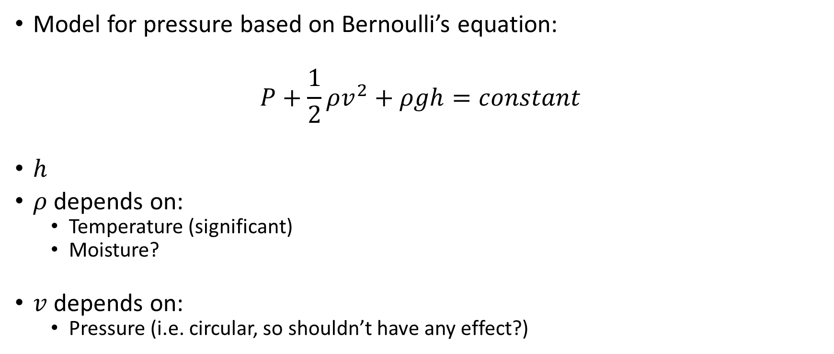
Outliers: v0.03
Model for pressure based on Bernoulli’s equation:
$$P+\frac{1}{2}ρv^{2}+ρgh=constant$$
$h$
$ρ$ depends on:
Temperature (significant)
Moisture?
$v$ depends on:
Pressure (i.e. circular, so shouldn’t have any effect?)

Slide 23
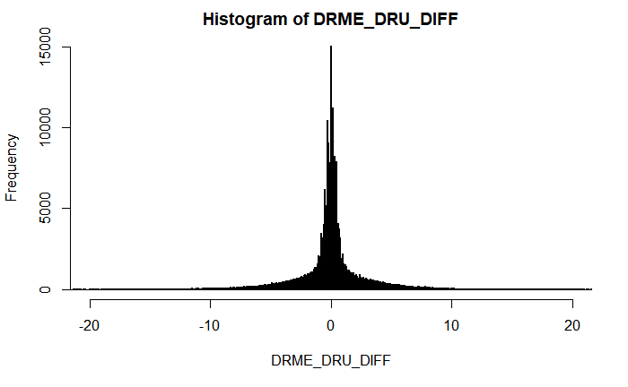
Outliers: v???
First order difference: very long tails
Notes:
Very long tails, not normal

Slide 24
Next steps

Slide 25
Next steps
Make first version of package with outlier detector 0.01 and 0.02?
If no extra data supplied, use v0.01, else v0.02?
v0.02: fixed or dynamic thresholds?
Other ideas?
Notes:
Misschien best om zo snel mogelijk met package te beginnen: dan kan gebruik meteen geevalueerd worden.

Slide 26
The End

