Slide 1
Sprint 2
Outliers

Slide 2
DRME_DMST_CDE
Flags from DB: ENT (entered); DEL (deleted) and INV (invalid).

Slide 3
DRME_DMST_CDE
On all *.csv-data:
DEL ENT INV VLD <NA>
462 556271 4697 16 0

Slide 4
DRME_DMST_CDE: VLD and DEL
PPNT_ID PPNT_CDE DRSO_ID DRSO_SER_NBR DRME_ID DRME_OCR_UTC_DTE DRME_DRU DRME_TPU DRME_DMTP_CDE DRME_DMST_CDE SEQUENCE
1: 7019 BAOL001X 275 D0939 238389 2010-11-11 10:00:00 1018.100 NA LDME VLD 1093
2: 7019 BAOL001X 275 D0939 1824560 2010-11-11 10:00:00 1018.075 6.033 LDME ENT 1130
3: 7019 BAOL001X 275 D0939 238390 2010-11-11 22:00:00 1007.300 NA LDME VLD 1094
4: 7019 BAOL001X 275 D0939 1824561 2010-11-11 22:00:00 1007.275 8.163 LDME ENT 1131
5: 7019 BAOL001X 275 D0939 238391 2010-11-12 10:00:00 1015.400 NA LDME VLD 1095
6: 7019 BAOL001X 275 D0939 1824562 2010-11-12 10:00:00 1015.375 11.213 LDME ENT 1132
7: 7019 BAOL001X 275 D0939 238392 2010-11-12 22:00:00 1012.900 NA LDME VLD 1096
8: 7019 BAOL001X 275 D0939 1824563 2010-11-12 22:00:00 1012.850 12.457 LDME ENT 1133
9: 7019 BAOL001X 275 D0939 238393 2010-11-13 10:00:00 1014.600 NA LDME VLD 1097
10: 7019 BAOL001X 275 D0939 1824564 2010-11-13 10:00:00 1014.600 10.810 LDME ENT 1134
11: 7019 BAOL001X 275 D0939 238394 2010-11-13 22:00:00 1012.700 NA LDME VLD 1098
12: 7019 BAOL001X 275 D0939 1824565 2010-11-13 22:00:00 1012.675 10.953 LDME ENT 1135
Duplicates: Detect those too?
Notes:
Duplicaten in de DB?

Slide 5
DRME_DMST_CDE: INV
Validation

Slide 6
DRME_DMST_CDE: INV
Validation

Slide 7
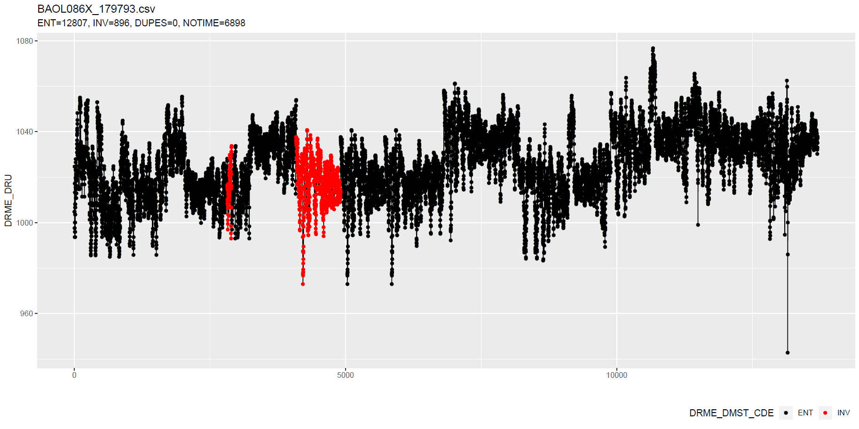
DRME_DMST_CDE: INV
Validation
No Timestamp (Inconsistent)
No Timestamp: Detect those too?
Notes:
Inconsistent because there are also black dots that have no timestamp.

Slide 8
Outliers: v0.02 update
Uses simple a-priori knowledge about air pressure, temperature, etc.

Slide 9
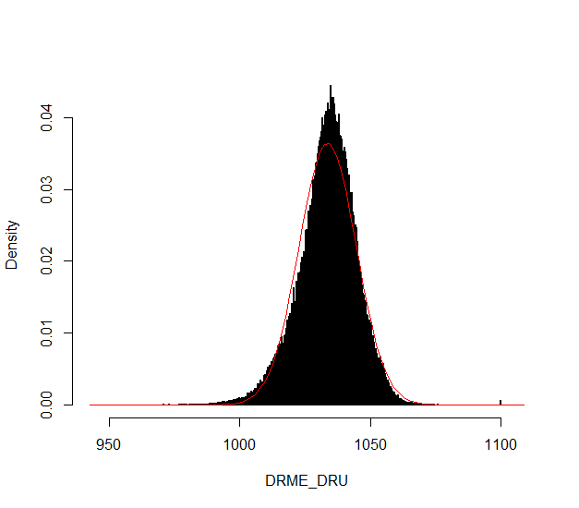
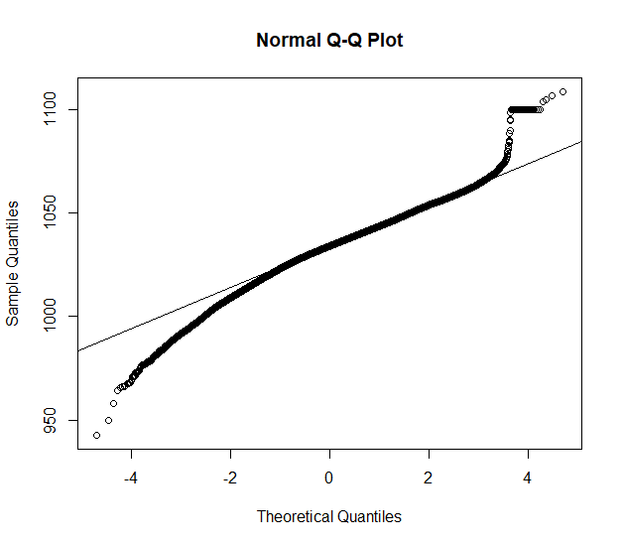
Outliers: v0.02 update
Validation
Notes:
Excluded: BAOL089|BAOL079|BAOL006
Range: 800 < x < 1200

Slide 10
ToDo
Versioning

Slide 11
Sprint 1
Outliers

Slide 12
Outliers
v0.01: detect_outliers(data)
Uses only the supplied dataset
v0.02: detect_outliers(data, type = c(“air pressure”, “air temperature”), units)
Uses simple a-priori knowledge about air pressure, temperature, etc.
v0.03: …

Slide 13
Outliers: v0.01
Uses only the supplied dataset

Slide 14
Outliers: v0.01
Validation

Slide 15
Outliers: v0.01
Validation

Slide 16
Outliers: v0.01
Validation

Slide 17
Outliers: v0.01
Validation

Slide 18
Outliers: v0.01
Validation

Slide 19
Outliers: v0.01
Validation

Slide 20
Outliers: v0.01
Validation

Slide 21
Outliers: v0.01
Validation
Scale completely wrong?

Slide 22
Outliers: v0.02
Uses simple a-priori knowledge about air pressure, temperature, etc.

Slide 23
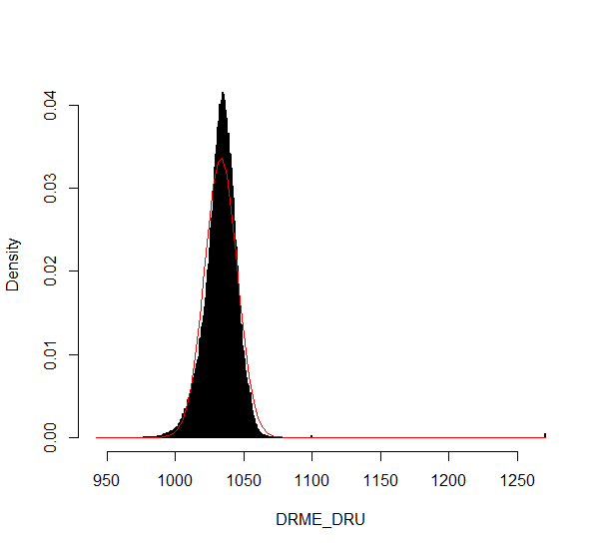
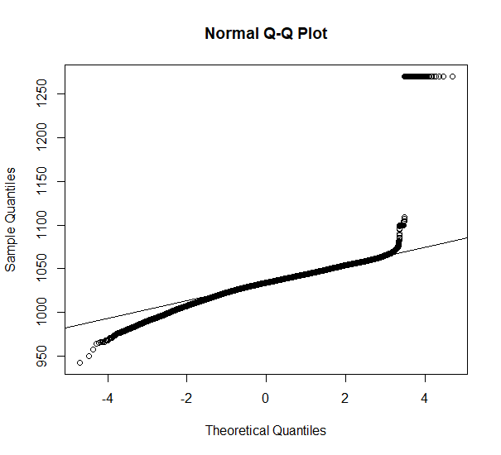
Outliers: v0.02
Validation

Slide 24
Outliers: v0.02
Validation

Slide 25
Outliers: v0.02
Validation

Slide 26
Outliers: v0.02
Validation

Slide 27
Summary
Outliers: v0.01
detect_outliers(data)
Usable on any data (not only L - lucht)
Scale can be completely wrong (cf. BAOL018X_42112)
Outliers: v0.02:
detect_outliers(data, type = c(“air pressure”, “air temperature”), units)
Needs a-priori information
Type
Units
Fixed or dynamic thresholds?
Notes:
Tresholds voor outliers kunnen berekend worden op basis van handmatige prior analyse, of

Slide 28
Outliers: v0.03
Go even further with a-priori information?

Slide 29
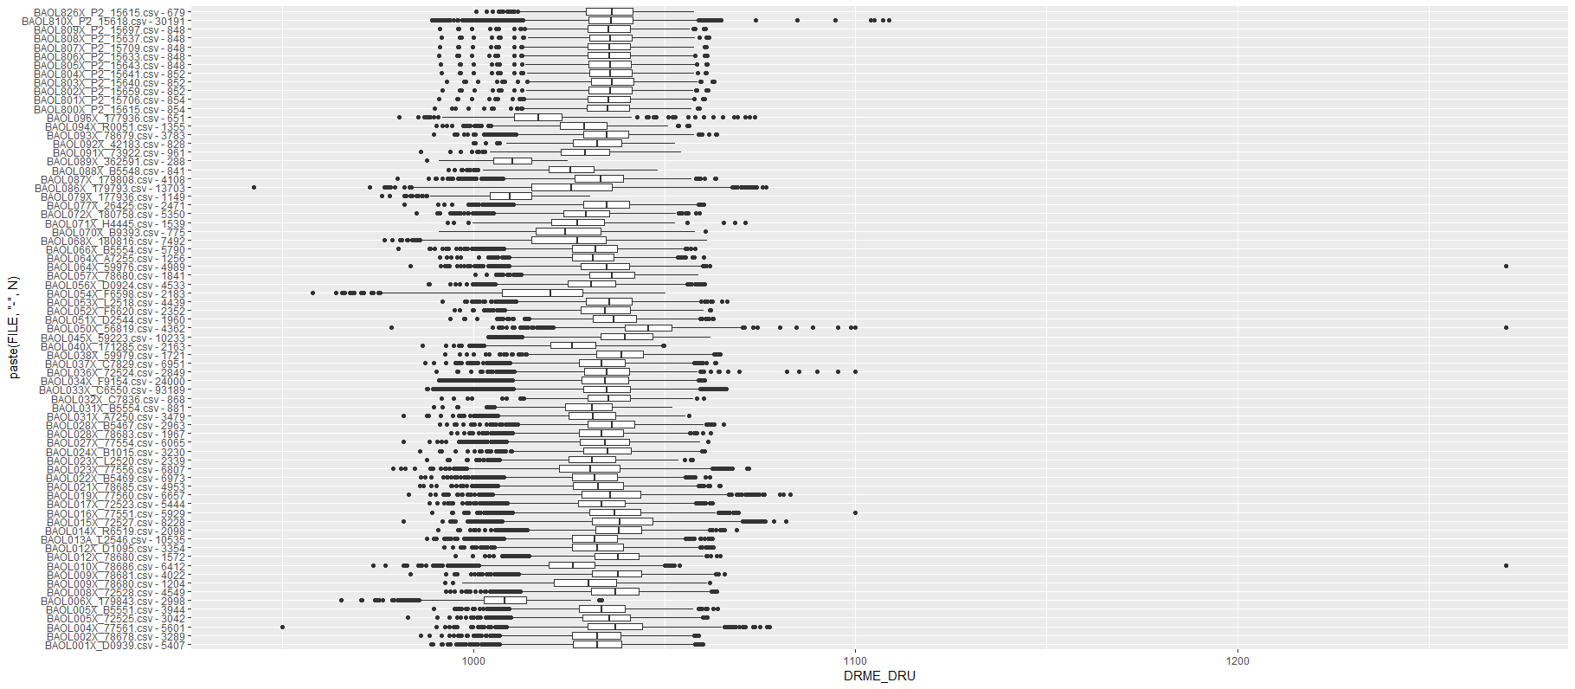
Outliers: v0.03
Even more a-priori information to explain variation
Notes:
Bijvoorbeeld, somige regio’s hebben lagere of hogere temperature, wat resulteert in hogere of lagere luchtdruk.

Slide 30
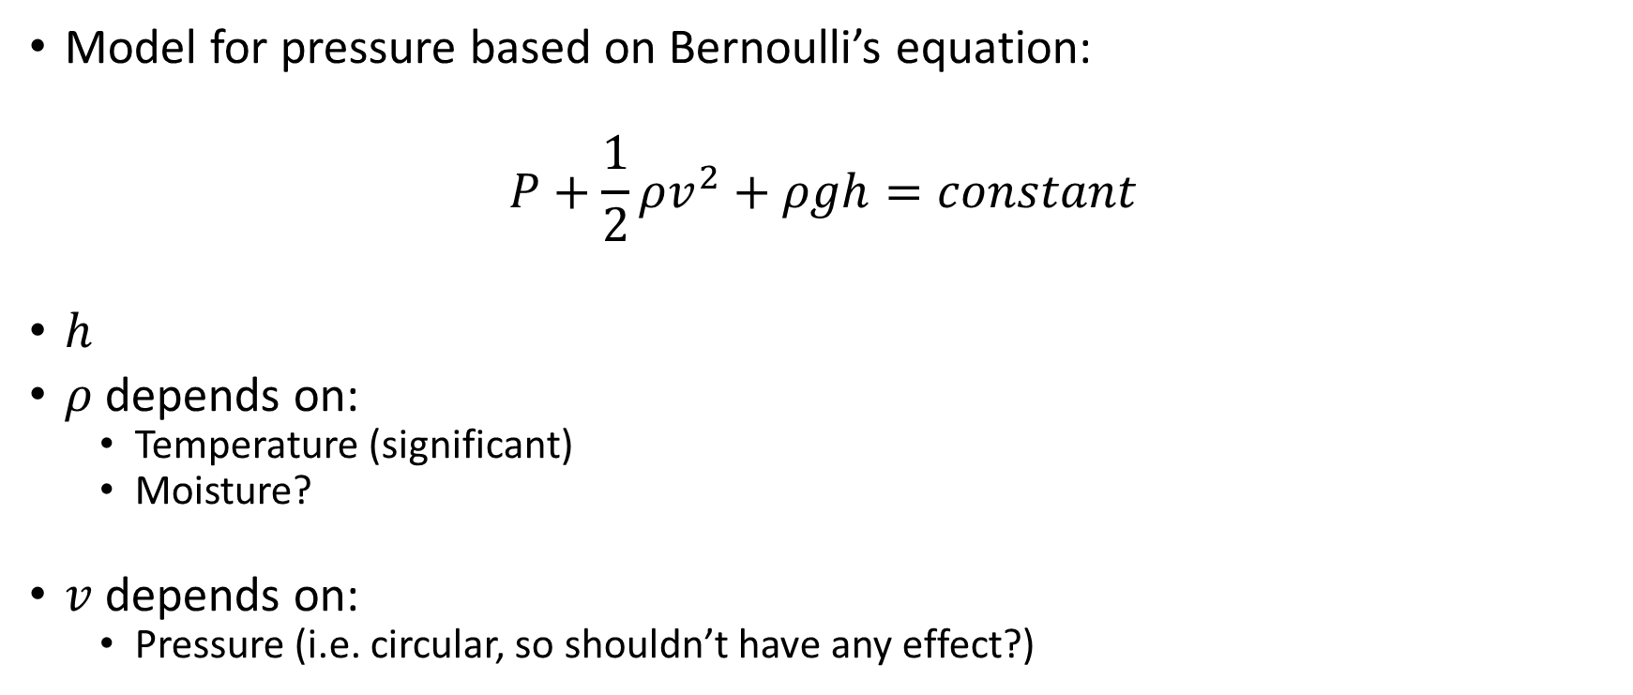
Outliers: v0.03
Model for pressure based on Bernoulli’s equation:
$$P+\frac{1}{2}ρv^{2}+ρgh=constant$$
$h$
$ρ$ depends on:
Temperature (significant)
Moisture?
$v$ depends on:
Pressure (i.e. circular, so shouldn’t have any effect?)

Slide 31
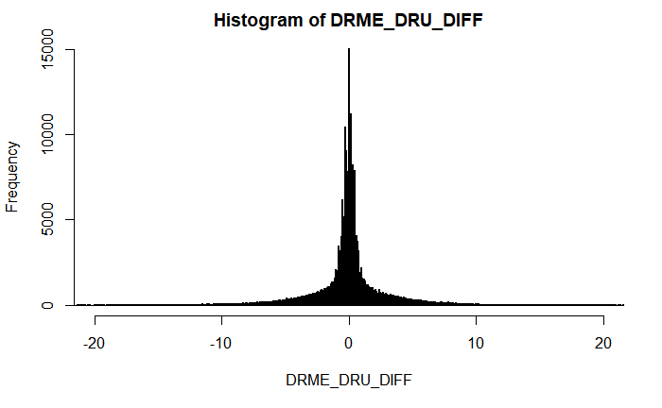
Outliers: v???
First order difference: very long tails
Notes:
Very long tails, not normal

Slide 32
Next steps

Slide 33
Next steps
Make first version of package with outlier detector 0.01 and 0.02?
If no extra data supplied, use v0.01, else v0.02?
v0.02: fixed or dynamic thresholds?
Other ideas?
Notes:
Misschien best om zo snel mogelijk met package te beginnen: dan kan gebruik meteen geevalueerd worden.

Slide 34
The End

