Slide 1


PARUL INSTITUTE OF TECHNOLOGY
FACULTY OF ENGINEERING & TECHNOLOGY
PARUL UNIVERSITY
B. Tech 8th Semester Minor
project Presentation
“Customer Relationship Management”
Presented by:
Dipen Patel (210305105302)
Intern At:
Gauraj infotech, Vadodara Branch
Supervisors:
Dr. Vinod Patidar
(Associate Professor)
PARUL INSTITUTE OF TECHNOLOGY, PARUL UNIVERSITY
1
NAME OF THE INSTITUTE, PARUL UNIVERSITY

Slide 2
PARUL INSTITUTE OF TECHNOLOGY
FACULTY OF ENGINEERING & TECHNOLOGY
PARUL UNIVERSITY
Brief Company profile
Introduction
Problem statement
Literature review
Methodology
Proposed System
Data Flow Diagram
Class Diagram
Model - Expected Outcome (GUI)
Implementation Overview
Conclusion
References
PARUL INSTITUTE OF TECHNOLOGY, PARUL UNIVERSITY
2
NAME OF THE INSTITUTE, PARUL UNIVERSITY

Slide 3
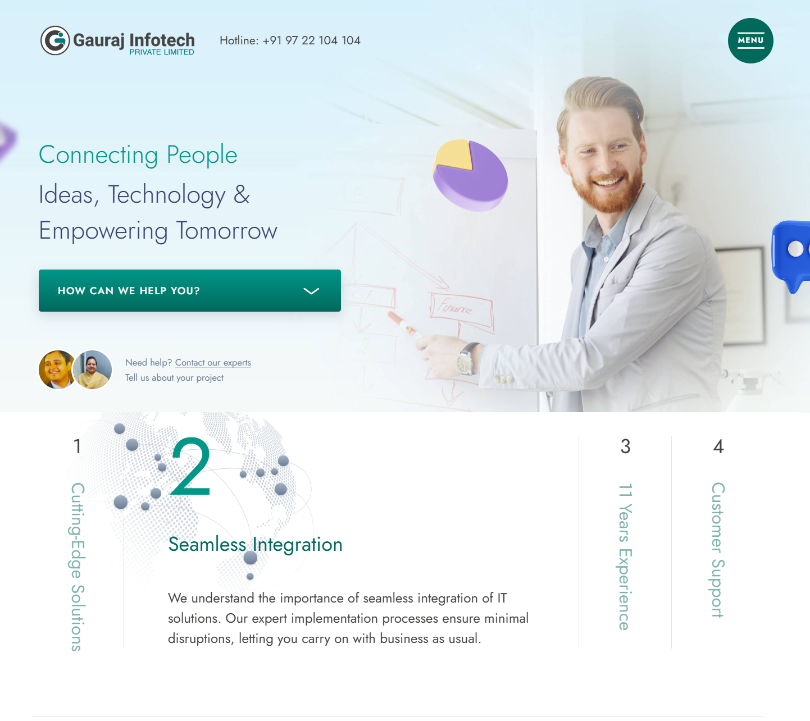
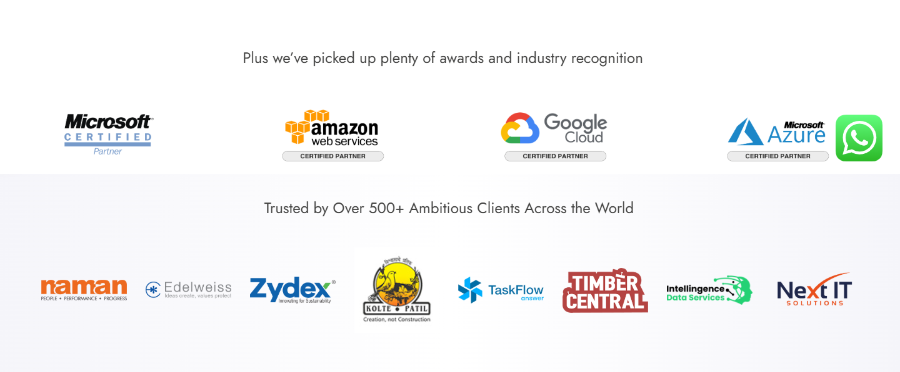
Brief Company profile
Company : Gauraj InfoTech, Sarabhai campus, vadodara branch
Role : Software developer Intern
Technology: React, Node, php, flask(Android), Azure
Project development :
developed 2 frontend website with react 1 full stack node + react + mongo(evaluation project)-CRM
Learning PHP from team lead
PARUL INSTITUTE OF TECHNOLOGY, PARUL UNIVERSITY
3
NAME OF THE INSTITUTE, PARUL UNIVERSITY

Slide 4
Introduction
AIM:
To develop a robust Customer Relationship Management (CRM) system that supports multi-stage user authentication, role-based access, customer-employee task assignments, real-time communication, and document management, with an administrative interface for data monitoring and verification.
Objective:
Implement a three-stage user authentication system with email OTP verification for signup.
Allow role-based login for employees and customers.
Enable task assignment between customers and employees.
Provide a real-time chat and document upload functionality.
Design an administrative panel for managing users, tasks, and verification.
Conduct a research study exploring CRM’s efficiency in modern e-commerce environments.
PARUL INSTITUTE OF TECHNOLOGY, PARUL UNIVERSITY
4
NAME OF THE INSTITUTE, PARUL UNIVERSITY

Slide 5
Problem Statement
Traditional CRM systems fall short in offering seamless integration of advanced features like real-time customer-employee interaction, multi-stage verification, and secure document management. Additionally, administrators struggle with limited functionalities to effectively monitor tasks and manage user roles. This project aims to bridge these gaps by developing a next-generation CRM system that leverages modern technologies to create a more efficient, user-friendly, and scalable solution.
Multi-stage verification for secure account management
Role-based access for customized user permissions
Task management for better workflow organization
Real-time chat and video call to enhance customer-employee communication
Secure document uploads to protect sensitive information
Admin monitoring tools for effective user and activity management
RFM and RFM-P analysis for more insight into customer activities
PARUL INSTITUTE OF TECHNOLOGY, PARUL UNIVERSITY
5
NAME OF THE INSTITUTE, PARUL UNIVERSITY

Slide 6
Literature Review
Multifaceted Nature of CRM Implementation
The deployment of CRM applications involves both technological and managerial aspects.
Effective CRM deployment depends on project approval, best practices, and process prototyping.
Focus should be on managing for benefits, prioritizing customer engagement and satisfaction over technical specifications.
Impact of CRM on Company Reputation and Customer Loyalty
CRM practices significantly enhance company reputation, which positively influences customer loyalty.
Customer satisfaction mediates the relationship between CRM practices and loyalty (Khan et al., 2020).
Trust among staff and strategic marketing initiatives can enhance CRM effectiveness in SMEs, especially in Pakistan.
CRM and Sustainable Business Practices
CRM components (sales, marketing, services) contribute to sustainability (Gil-Gómez et al., 2020).
CRM can act as a catalyst for digital transformation and sustainable business model innovation.
Integrating CRM with sustainability goals enhances a company's market relevance and impact.
PARUL INSTITUTE OF TECHNOLOGY, PARUL UNIVERSITY
6
NAME OF THE INSTITUTE, PARUL UNIVERSITY

Slide 7
Literature Review
Challenges in the Hospitality Sector
Budget hotels face unique CRM challenges, particularly a disconnect between customer expectations and manager perceptions.
Value for money remains pivotal for customer satisfaction despite evolving expectations (Rahimi & Kozak, 2017).
Hotels must adapt CRM strategies to meet specific customer demands and stay competitive.
The Role of Social Media in CRM
In banking, social media integration into CRM is becoming increasingly relevant.
The reluctance to adopt social media can hinder CRM adaptability and customer engagement (Mitic & Kapoulas, 2012).
Navigating safety concerns while leveraging social media is crucial for maintaining competitive advantage.
Internal Processes and Customer Service
Internal service processes play a crucial role in improving customer service (Hassan et al., 2015).
Optimizing CRM practices through methodologies like Lean can enhance customer satisfaction.
A customer-focused approach in CRM strategies connects operational efficiency to service delivery.
PARUL INSTITUTE OF TECHNOLOGY, PARUL UNIVERSITY
7
NAME OF THE INSTITUTE, PARUL UNIVERSITY

Slide 8
Literature Review
The Intersection of CRM and Knowledge Management
Customer Knowledge Management (CKM) merges CRM and knowledge management, especially in the luxury jewelry industry.
Traditional technologies for CKM challenge effective CRM strategies.
Adapting to digital tools is key for SMEs to improve customer engagement and remain competitive (Mitic & Kapoulas, 2012).
Relationship Quality and Customer Satisfaction
Effective CRM practices enhance relationship quality in the telecommunications sector, boosting customer satisfaction (Castagna et al., 2020).
Building strong customer relationships is crucial for driving satisfaction and loyalty.
Employee Empowerment and Service Recovery
Empowered employees play a key role in service recovery, improving customer satisfaction and loyalty (Sen & Sinha, 2011).
Integrating employee engagement into CRM strategies fosters effective service recovery practices.
PARUL INSTITUTE OF TECHNOLOGY, PARUL UNIVERSITY
8
NAME OF THE INSTITUTE, PARUL UNIVERSITY

Slide 9
Literature Review
Sr. No. | Paper Title | Author Name | Publish Year | Advantages | Methodology | Deficiency
1 | The Impact of Customer Relationship Management and Company Reputation on Customer Loyalty | Khan, R., Salamzadeh, Y., Iqbal, Q., & Yang, S. | 2020 | Enhances company reputation, improves customer loyalty through customer satisfaction. | Empirical analysis on SMEs in Pakistan to measure the mediating role of customer satisfaction. | Lack of focus on specific CRM technologies and their direct impact on other business sectors.
2 | Customer Knowledge Management in SMEs Facing Digital Transformation | Castagna, F., Centobelli, P., Cerchione, R., et al. | 2020 | Highlights the role of CRM in digital transformation and sustainable business innovation. | Qualitative research linking CRM components to sustainability. | Limited focus on specific tools for improving digital adoption in SMEs.
3 | Understanding the Role of Social Media in Bank Marketing | Mitic, M., & Kapoulas, A. | 2012 | Demonstrates how CRM integration with social media enhances customer engagement. | Analysis of banks' reluctance and challenges in adopting social media. | Insufficient exploration of advanced digital security measures for banking.
PARUL INSTITUTE OF TECHNOLOGY, PARUL UNIVERSITY
9
NAME OF THE INSTITUTE, PARUL UNIVERSITY

Slide 10
Literature Review
Sr. No. | Paper Title | Author Name | Publish Year | Advantages | Methodology | Deficiency
4 | Impact of Customer Relationship Management on Customer Satisfaction: The Case of a Budget Hotel Chain | Rahimi, R., & Kozak, M. | 2017 | Highlights the disconnect between customer expectations and managers’ perceptions in budget hotels. | Case study on a budget hotel chain to evaluate CRM effectiveness. | Focuses only on budget hotels, limiting the generalizability of findings.
5 | Customer Relationship Management: Digital Transformation and Sustainable Business Model Innovation | Gil-Gómez, H., Guerola-Navarro, V., Oltra-Badenes, R., et al. | 2020 | Shows CRM as a driver for digital transformation and integration with sustainability goals. | Analysis linking CRM practices with sustainability initiatives. | Needs more empirical evidence on the effectiveness of these strategies in real-world implementations.
6 | Lean in UK Government: Internal Efficiency or Customer Service? | Radnor, Z. J., & Johnston, R. | 2013 | Shows how improving internal processes through Lean methodologies enhances customer service. | Case study analysis of Lean implementation in UK public sector organizations. | Limited application beyond public sector organizations and governmental settings.
PARUL INSTITUTE OF TECHNOLOGY, PARUL UNIVERSITY
10
NAME OF THE INSTITUTE, PARUL UNIVERSITY

Slide 11
Literature Review
Sr. No. | Paper Title | Author Name | Publish Year | Advantages | Methodology | Deficiency
7 | IT Alignment Strategies for Customer Relationship Management | Sen, A., & Sinha, A. | 2011 | Demonstrates the role of employee empowerment in effective service recovery. | Empirical analysis of service recovery and employee empowerment strategies. | Limited focus on the scalability of these strategies in large organizations.
8 | Achieving Sustainable Development by Collaborating in Green Product Innovation | Melander, L. A. | 2017 | Links CRM strategies to green innovation and sustainability. | Study on the collaboration between CRM and sustainable product innovation. | Lack of focus on CRM’s role in broader business areas.
9 | Effect of Customer Relationship Management on Customer Satisfaction | Hassan, R., Nawaz, A., Lashari, M. N., & Zafar, F. | 2015 | Highlights CRM’s role in enhancing operational efficiency and customer satisfaction. | Statistical analysis of internal service processes and their connection to CRM strategies. | Limited exploration of industry-specific CRM implementations.
10 | Customer Relationship Management and Customer Satisfaction: The Mediating Role of Relationship Quality | Santouridis, I., & Veraki, A. | 2017 | Explains how CRM improves relationship quality, which in turn enhances customer satisfaction. | Empirical study on CRM strategies in the telecommunications sector. | Focuses only on the telecommunications sector.
PARUL INSTITUTE OF TECHNOLOGY, PARUL UNIVERSITY
11
NAME OF THE INSTITUTE, PARUL UNIVERSITY

Slide 12
Literature Review
Challenges:
Developing a CRM system with multi-stage authentication, role-based access, task assignment, and real-time communication faces challenges in ensuring secure data handling, seamless integration of features, and scalability for growing user needs. Additionally, managing task assignments efficiently between customers and employees while maintaining real-time communication can be complex.
Case Studies and Best Practices:
Best practices in CRM implementation involve combining multi-stage authentication for user security and role-based access to improve user experience. Real-time communication features, such as live chat and document uploads, have proven effective in enhancing customer-employee collaboration. Administrators can use dashboards for efficient task monitoring and user management.
Research Paper Focus: This research will develop a CRM model for modern e-commerce, integrating multi-stage user authentication, role-based access, and real-time communication with advanced customer analytics. It will utilize the RFMVDA (Recency, Frequency, Monetary, Visits, Durations, Actions) model for segmentation, incorporating traditional RFM metrics with new variables like visit frequency and session durations. Machine learning and Deep Neural Networks (DNN) will be applied to predict customer behavior, enhancing the CRM system’s ability to provide personalized and accurate insights into customer needs.
PARUL INSTITUTE OF TECHNOLOGY, PARUL UNIVERSITY
12
NAME OF THE INSTITUTE, PARUL UNIVERSITY

Slide 13
Methodology
Requirement Analysis: Identify system requirements through stakeholder inputs and industry standards.
System Design: Develop data flow diagrams, class diagrams, use case diagrams, and an ER model.
Database Design: Use MongoDB for efficient data storage and retrieval.
Backend Development: Implement multi-stage authentication, role-based routing, and secure APIs using Node.js and Express.
Frontend Development: Design user interfaces with React, ensuring responsiveness and ease of navigation.
Integration of Features: Enable chat functionality, document upload, and task assignment modules.
Testing: Conduct unit, integration, and user acceptance testing to ensure quality.
Research Documentation: Parallelly document the system’s efficacy and efficiency for the research study.
PARUL INSTITUTE OF TECHNOLOGY, PARUL UNIVERSITY
13
NAME OF THE INSTITUTE, PARUL UNIVERSITY

Slide 14
Proposed System
Three-stage Authentication: Email OTP verification for signup, role-based login (customer or employee), and login authentication.
Task Management: Employees can be assigned to customers, and tasks can be tracked by both parties. As well as segmented customers using RFM model.
Real-time Communication: Integrated chat and video call functionality between customers and employees.
Document Management: Secure document uploads with role-based access.
Admin Dashboard: Manage users, verify accounts, and monitor tasks and interactions.
PARUL INSTITUTE OF TECHNOLOGY, PARUL UNIVERSITY
14
NAME OF THE INSTITUTE, PARUL UNIVERSITY

Slide 15
Implementation Overview
AIM:
To develop a robust Customer Relationship Management (CRM) system that supports multi-stage user authentication, role-based access, customer-employee task assignments, real-time communication, and document management, with an administrative interface for data monitoring and verification.
Objective:
Implement a three-stage user authentication system with email OTP verification for signup.
Allow role-based login for employees and customers.
Enable task assignment between customers and employees.
Provide a real-time chat and document upload functionality as well as video call.
Design an administrative panel for managing users, tasks, and verification.
Conduct a research study exploring CRM’s efficiency in modern e-commerce environments.
Payment using stripe and customer segmentation using RFM based on payments.
PARUL INSTITUTE OF TECHNOLOGY, PARUL UNIVERSITY
15
NAME OF THE INSTITUTE, PARUL UNIVERSITY

Slide 16
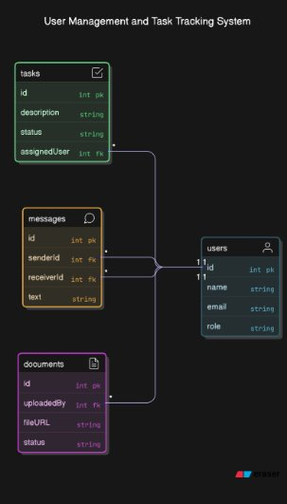
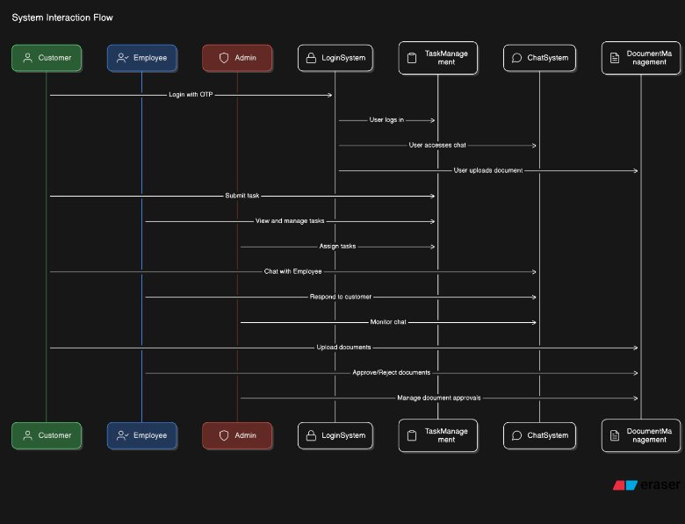
Implementation Overview
PARUL INSTITUTE OF TECHNOLOGY, PARUL UNIVERSITY
16
NAME OF THE INSTITUTE, PARUL UNIVERSITY

Slide 17
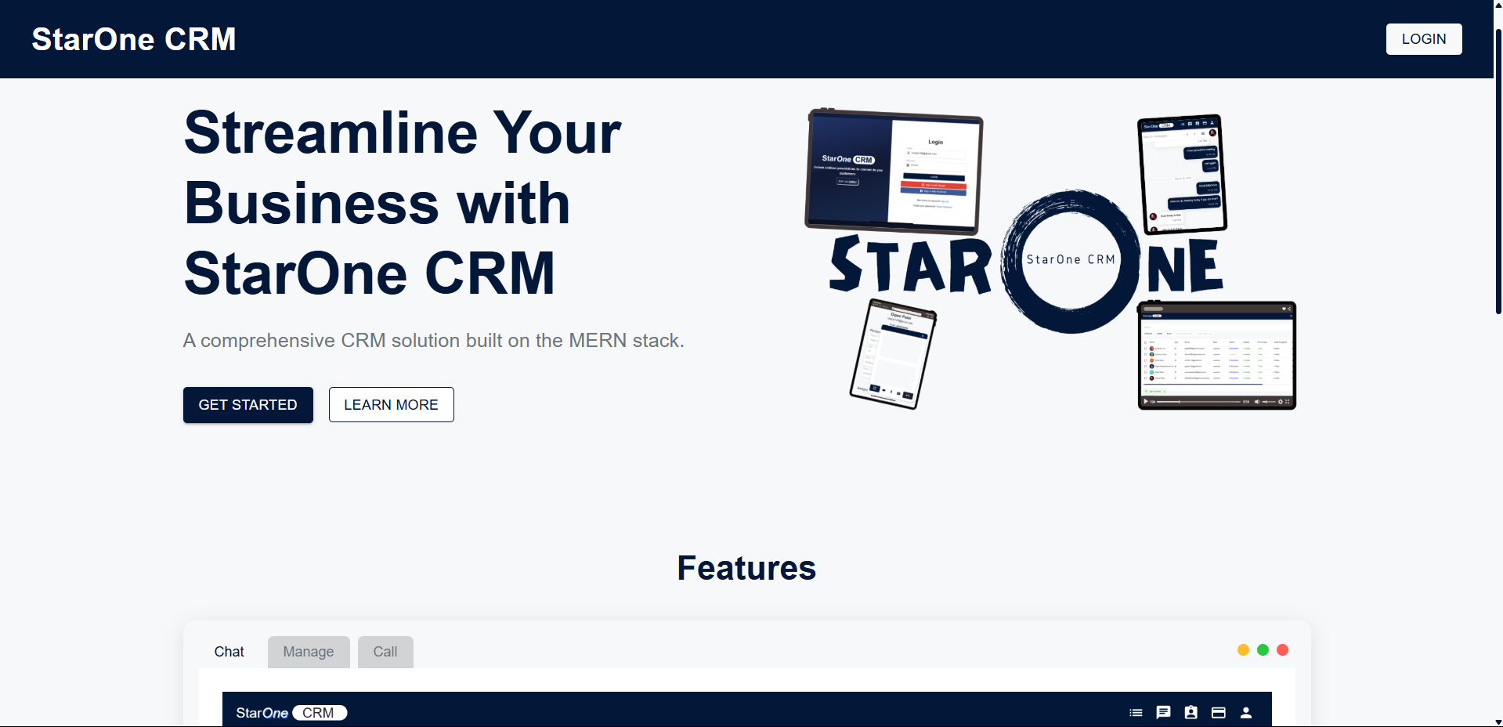
Implementation Overview
PARUL INSTITUTE OF TECHNOLOGY, PARUL UNIVERSITY
17
NAME OF THE INSTITUTE, PARUL UNIVERSITY

Slide 18
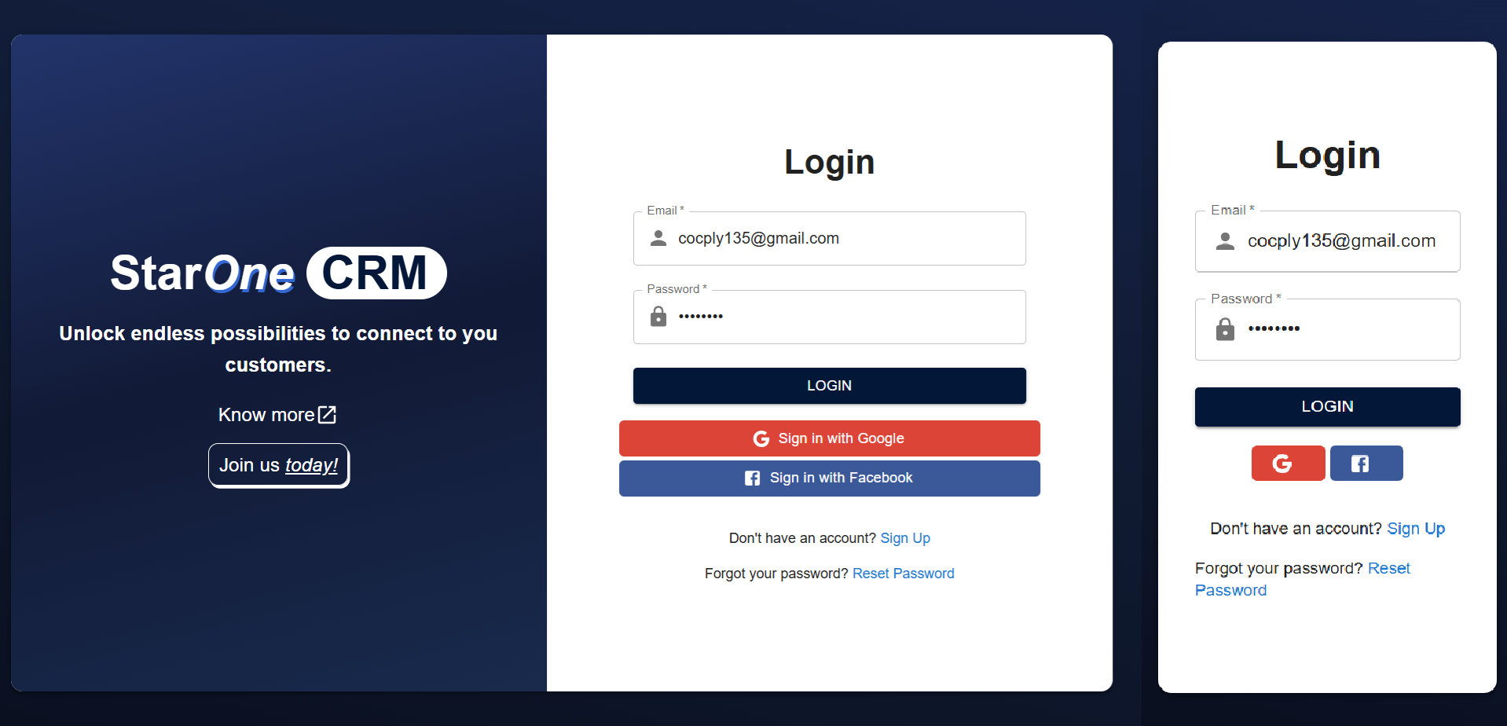
Implementation Overview
PARUL INSTITUTE OF TECHNOLOGY, PARUL UNIVERSITY
18
NAME OF THE INSTITUTE, PARUL UNIVERSITY

Slide 19
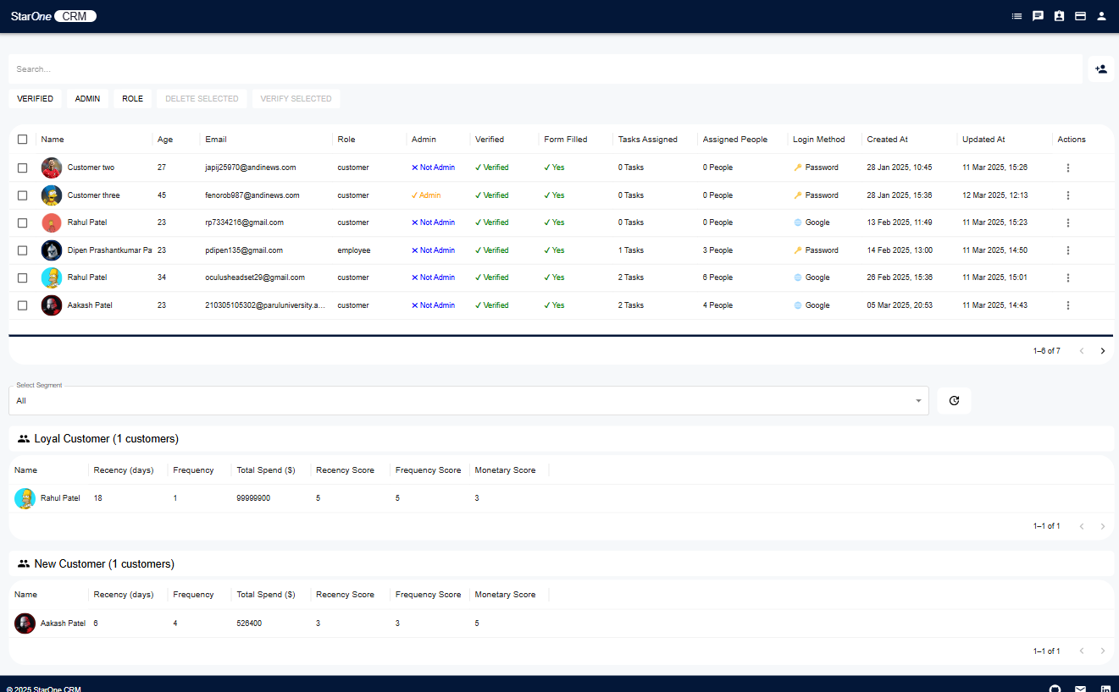
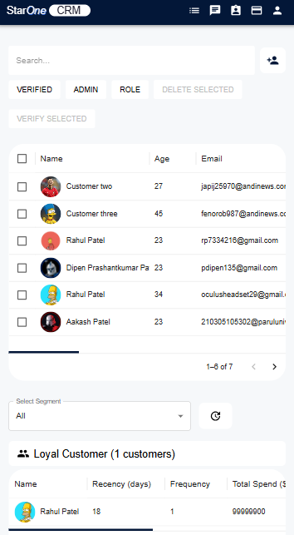
Implementation Overview
PARUL INSTITUTE OF TECHNOLOGY, PARUL UNIVERSITY
19
NAME OF THE INSTITUTE, PARUL UNIVERSITY

Slide 20
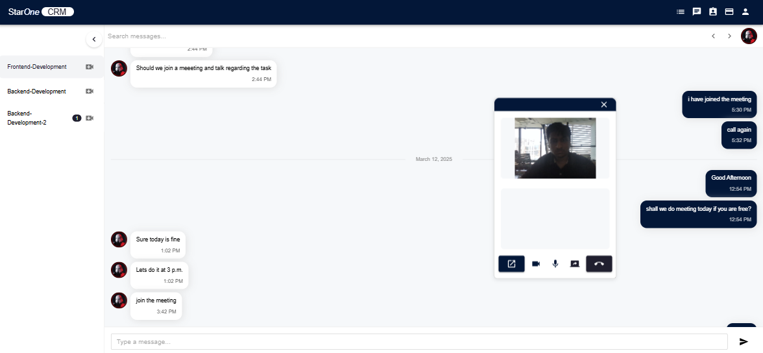
Implementation Overview
PARUL INSTITUTE OF TECHNOLOGY, PARUL UNIVERSITY
20
NAME OF THE INSTITUTE, PARUL UNIVERSITY

Slide 21
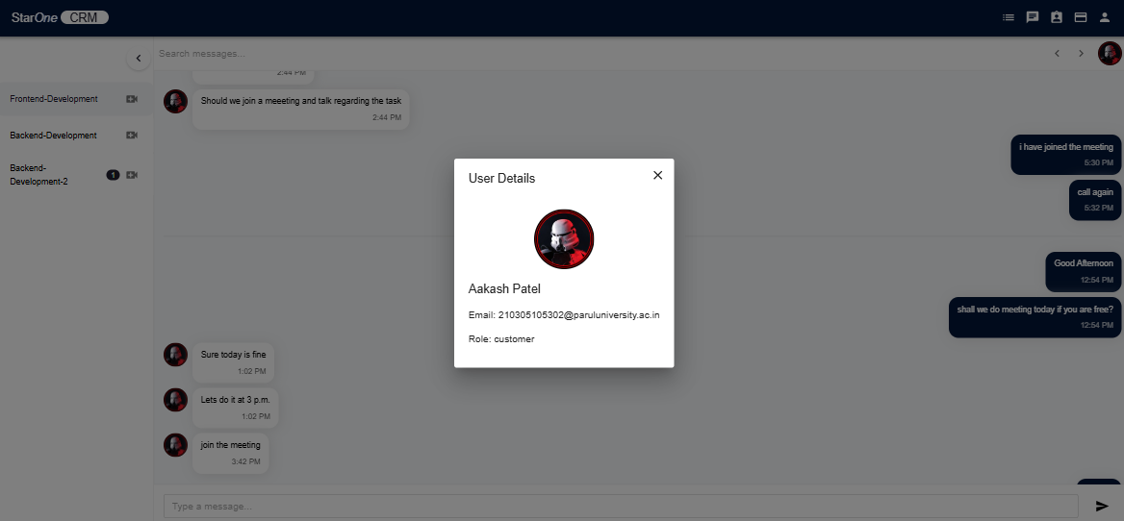
Implementation Overview
PARUL INSTITUTE OF TECHNOLOGY, PARUL UNIVERSITY
21
NAME OF THE INSTITUTE, PARUL UNIVERSITY

Slide 22
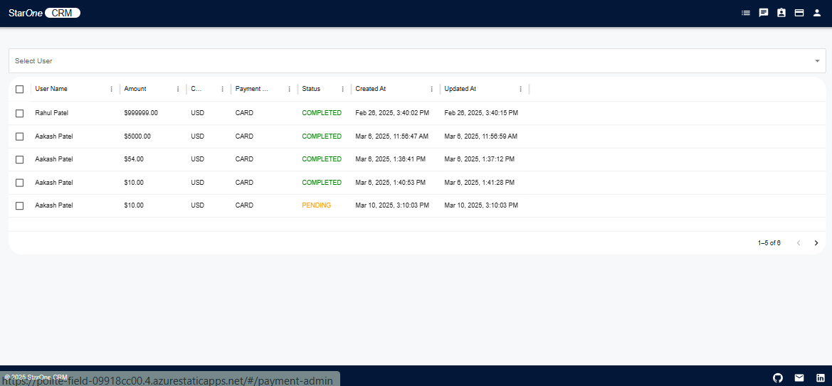
Implementation Overview
PARUL INSTITUTE OF TECHNOLOGY, PARUL UNIVERSITY
22
NAME OF THE INSTITUTE, PARUL UNIVERSITY

Slide 23
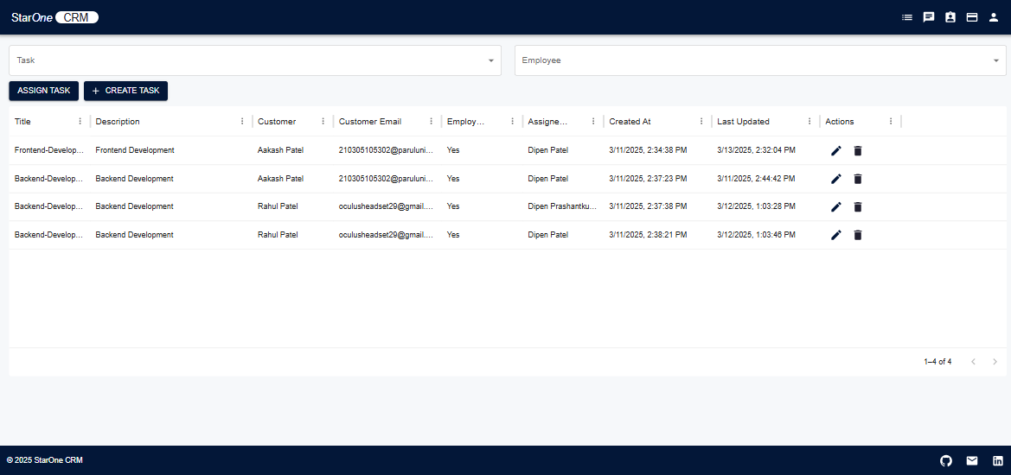
Implementation Overview
PARUL INSTITUTE OF TECHNOLOGY, PARUL UNIVERSITY
23
NAME OF THE INSTITUTE, PARUL UNIVERSITY

Slide 24
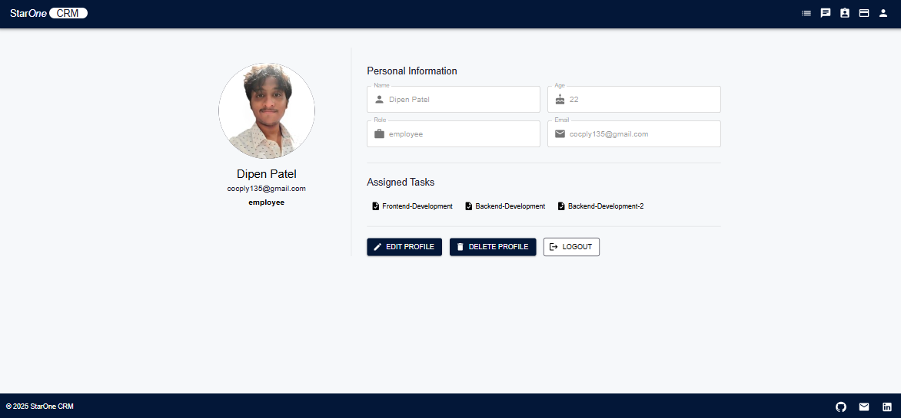
Implementation Overview
PARUL INSTITUTE OF TECHNOLOGY, PARUL UNIVERSITY
24
NAME OF THE INSTITUTE, PARUL UNIVERSITY

Slide 25
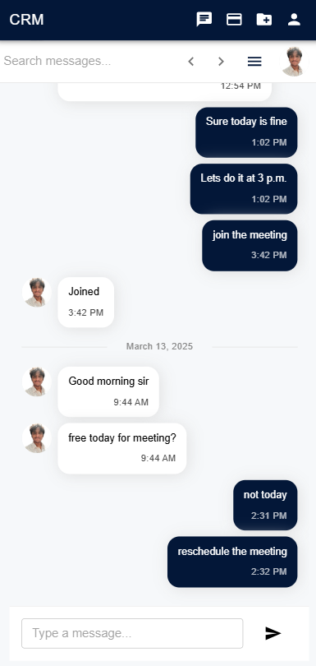
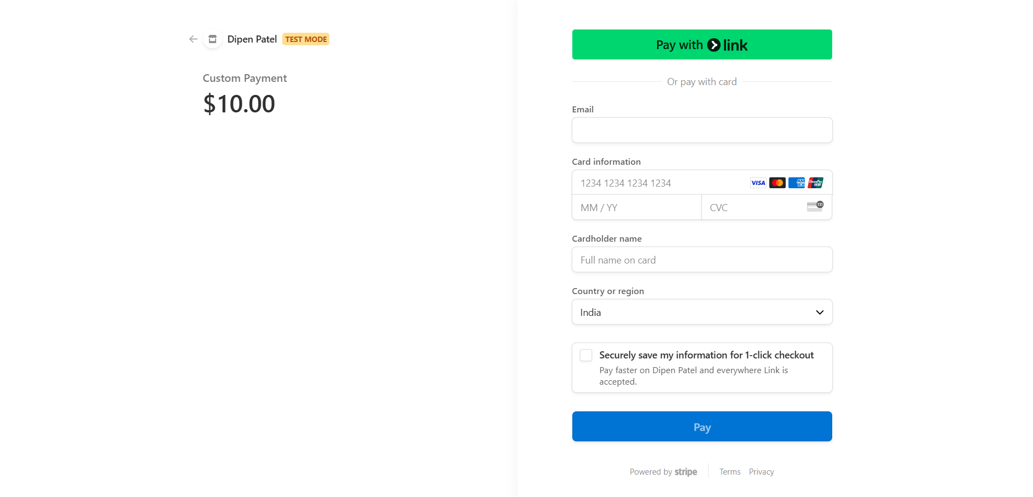
Implementation Overview
PARUL INSTITUTE OF TECHNOLOGY, PARUL UNIVERSITY
25
NAME OF THE INSTITUTE, PARUL UNIVERSITY

Slide 26
Conclusion
In conclusion, this CRM system offers a robust, scalable, and secure platform designed to enhance customer-employee interactions while providing administrative control. The system's architecture supports future growth, including the ability to expand into new districts or regions. With advanced features like analytics, predictive analysis, and machine learning on the horizon, the system is poised to provide deeper insights for decision-making. Additionally, the integration of community engagement tools ensures a participatory approach to governance. With a focus on long-term sustainability through regular updates and stakeholder involvement, the system is built to adapt and thrive over time.
PARUL INSTITUTE OF TECHNOLOGY, PARUL UNIVERSITY
26
NAME OF THE INSTITUTE, PARUL UNIVERSITY

Slide 27
References
Khan, R., Salamzadeh, Y., Iqbal, Q., & Yang, S. (2020) | The Impact of Customer Relationship Management and Company Reputation on Customer Loyalty: The Mediating Role of Customer Satisfaction. Journal of Relationship Marketing, 21, 1-26. DOI
Castagna, F., Centobelli, P., Cerchione, R., Esposito, E., Oropallo, E., & Passaro, R. (2020) | Customer Knowledge Management in SMEs Facing Digital Transformation. Sustainability. DOI
Mitic, M., & Kapoulas, A. (2012) | Understanding the Role of Social Media in Bank Marketing. Marketing Intelligence & Planning, 30, 668-686. DOI
Semantics Scholar (2020) | Research on CRM in Digital Transformation. Link
Sen, A., & Sinha, A. P. (2011) | IT Alignment Strategies for Customer Relationship Management. Decision Support Systems, 51, 609-619. DOI
Santouridis, I., & Veraki, A. (2017) | Customer Relationship Management and Customer Satisfaction: The Mediating Role of Relationship Quality. Total Quality Management & Business Excellence, 28, 1122-1133. DOI
Melander, L. A. (2017) | Achieving Sustainable Development by Collaborating in Green Product Innovation. Business Strategy and The Environment, 26, 1095-1109. DOI
Gil-Gómez, H., Guerola-Navarro, V., Oltra-Badenes, R., & Lozano-Quilis, J. (2020) | Customer Relationship Management: Digital Transformation and Sustainable Business Model Innovation. Economic Research-Ekonomska Istraživanja, 33, 2733-2750. DOI
Semantics Scholar (2020) | Research on CRM in the Hotel Industry. Link
Radnor, Z. J., & Johnston, R. (2013) | Lean in UK Government: Internal Efficiency or Customer Service? Production Planning & Control, 24, 903-915. DOI
Hassan, R., Nawaz, A., Lashari, M. N., & Zafar, F. (2015) | Effect of Customer Relationship Management on Customer Satisfaction. Procedia Economics and Finance, 23, 563-567. DOI
Semantics Scholar (2020) | Research on CRM and Customer Experience. Link
Azad, N., & Ahmadi, F. (2015) | The Customer Relationship Management Process: Its Measurement and Impact on Performance. Uncertain Supply Chain Management, 3, 43-50. DOI
Rahimi, R., & Kozak, M. (2017) | Impact of Customer Relationship Management on Customer Satisfaction: The Case of a Budget Hotel Chain. Journal of Travel & Tourism Marketing, 34, 40-51. DOI
Rodriguez, M., Peterson, R. M., & Ajjan, H. (2015) | CRM/Social Media Technology: Impact on Customer Orientation Process and Organizational Sales Performance. Advances in Marketing & Management, 636-638. DOI
Rundh, B. (2013) | Linking Packaging to Marketing: How Packaging Is Influencing the Marketing Strategy. British Food Journal, 115, 1547-1563. DOI
PARUL INSTITUTE OF TECHNOLOGY, PARUL UNIVERSITY
27
NAME OF THE INSTITUTE, PARUL UNIVERSITY

