Slide 1
Securing a WebApp
Prepared by Dipen Patel
2025ICS-008

Slide 2
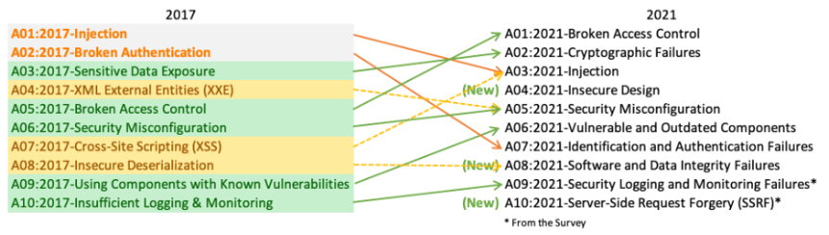
MERN Landscape and OWASP top 10
MERN Landscape: Frontend(React), Backend(Node/Express), Database(MongoDB), Service(Azure)
WebApp: CRM(Customer Relationship Management)
OWASP Top 10: List of critical web security risks
Approach: Address a risk and implement a Security Solution

Slide 3
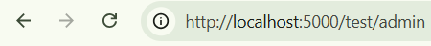
Broken Access Control
Access Control: Who cam perform which action or access which resources
Examples of broken access controls:
Vertical privilege escalation
a low level user gains admin functions
Horizontal privilege escalation
A user accesses another same level users resources
Common Reasons for broken access controls:
Unprotected functionality | Endpoint
Lack of Authentication and Request Validation
No proper User structure

Slide 4
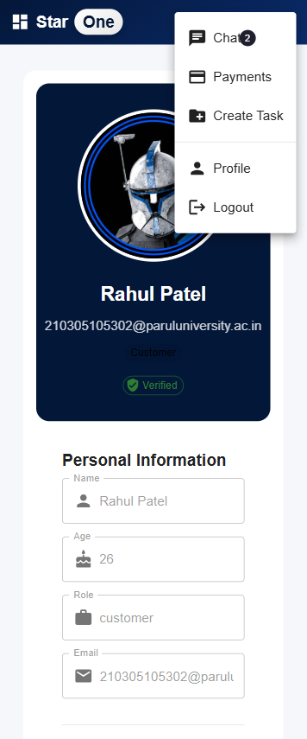
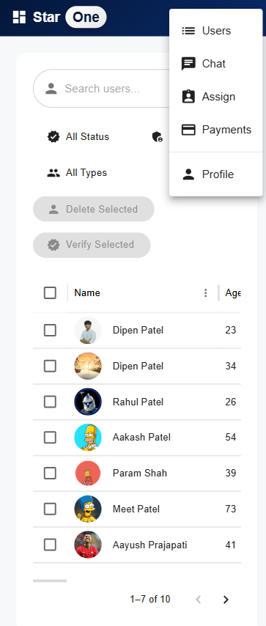
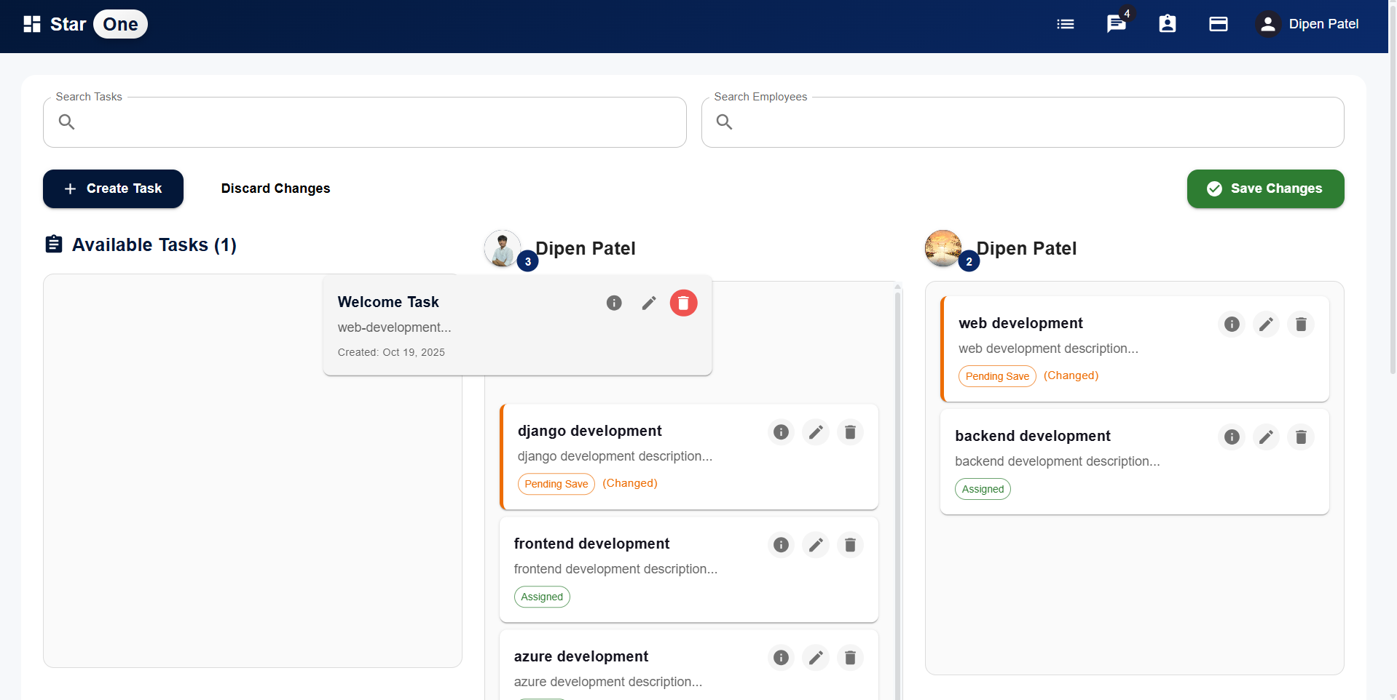
Broken Access Control
Mitigation:
Well defined Role-Based Access Control (RBAC)

Slide 5
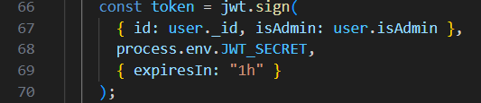
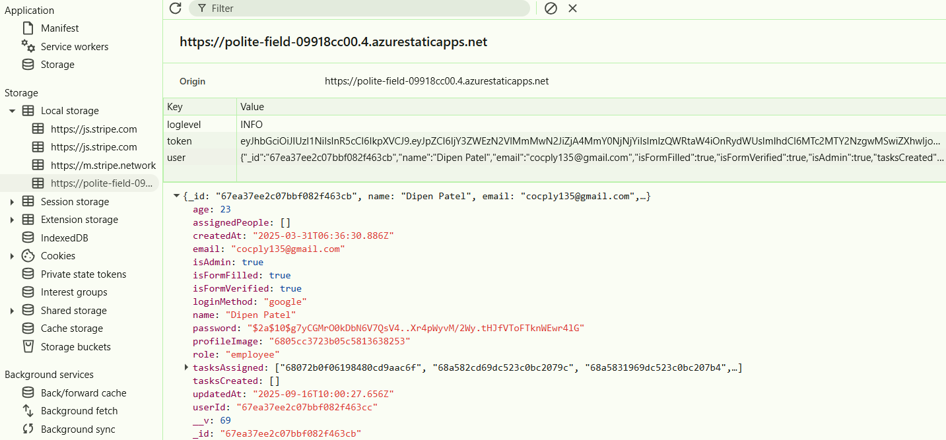
Broken Access Control
Mitigation:
Make use of Tokens to validate the user roles

Slide 6
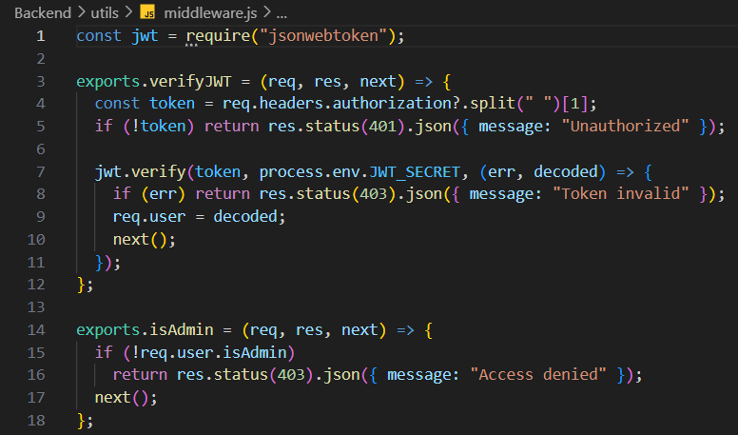
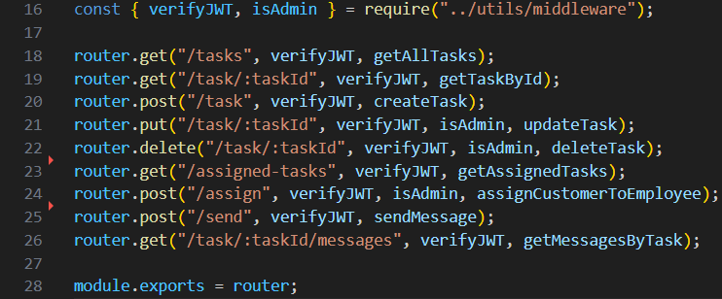
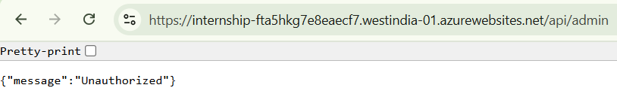
Broken Access Control
Mitigation:
Middleware for role checks and permission checks(Make sure all endpoints are covered)

Slide 7
Cryptographic Failures
expose sensitive data to attackers, such as passwords, credit card numbers, and personal identification numbers
Common Reasons for broken access controls:
Not Using Encryption
Insecure Cryptographic Functions
Improper Key Management
Unprotected Environment Variables

Slide 8
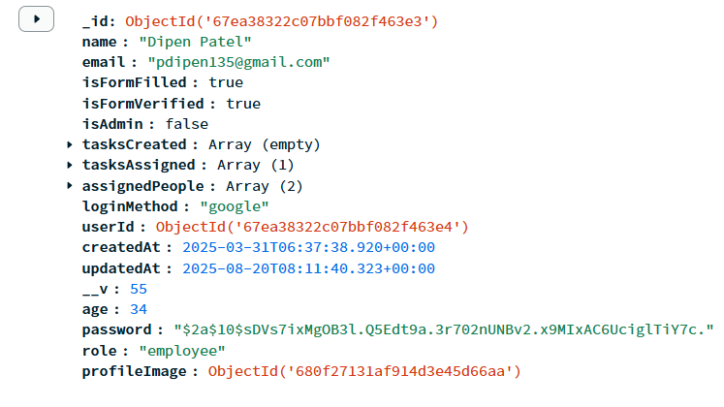
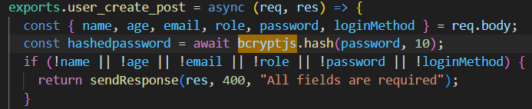
Cryptographic Failures
Mitigation:
Use bcrypt for Password Hashing
Update the Encryption Dependencies with time

Slide 9
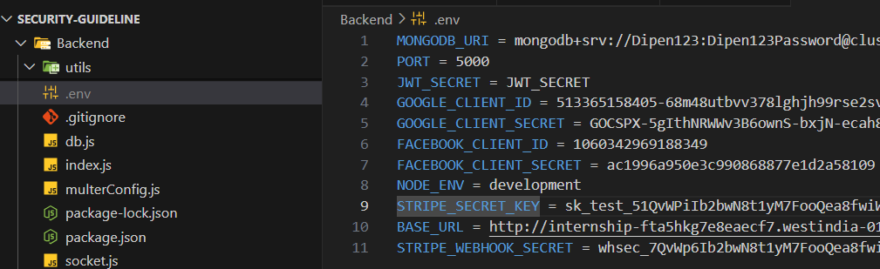
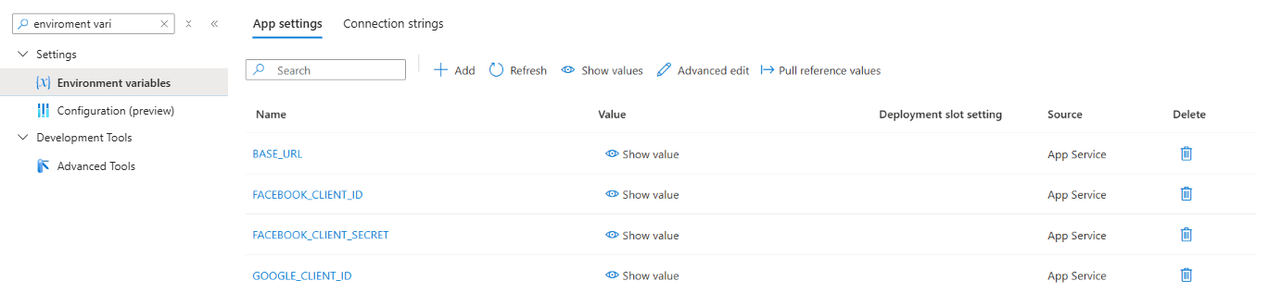
Cryptographic Failures
Mitigation:
Hide the Environment variables in .env while development
Define Environment variables in Hosting Service

Slide 10
Injection Attacks
Threat: SQL Injection allows attackers to manipulate a website’s database, potentially exposing, altering, or deleting sensitive data
http://localhost:5000/demo/find?q={“email”:”name@email.com”}
{"username": { "$ne": null },
"password": { "$ne": null }}
http://localhost:5000/demo/vuln/find?q={"email":{"$ne":“pdipen@gmail.com"}}
http://localhost:5000/demo/vuln/find?q={"email":{"$ne":"something"}}

Slide 11
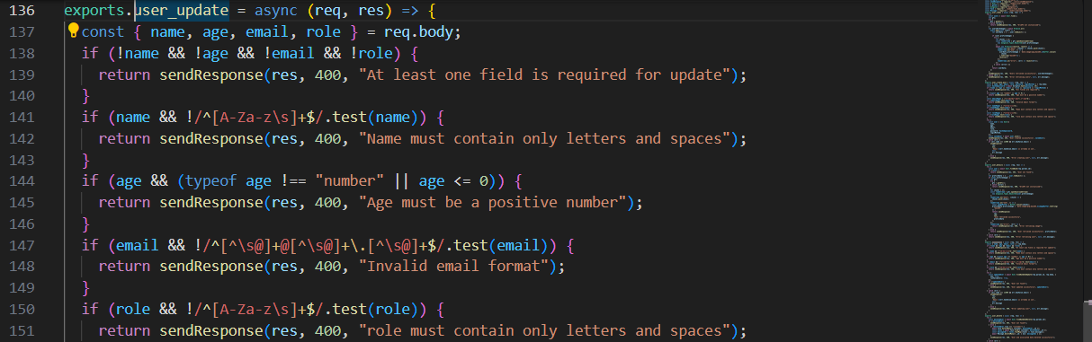
Injection Attacks
Mitigation:
Use ORM(Object-Relational Mapper) and drivers which Sanitize Database Queries
Mongoose acts as an Object Data Modeling (ODM) library for MongoDB, automatically escapes and validates input data, reducing the risk of NoSQL injection.
Input sanitization before running a database query

Slide 12
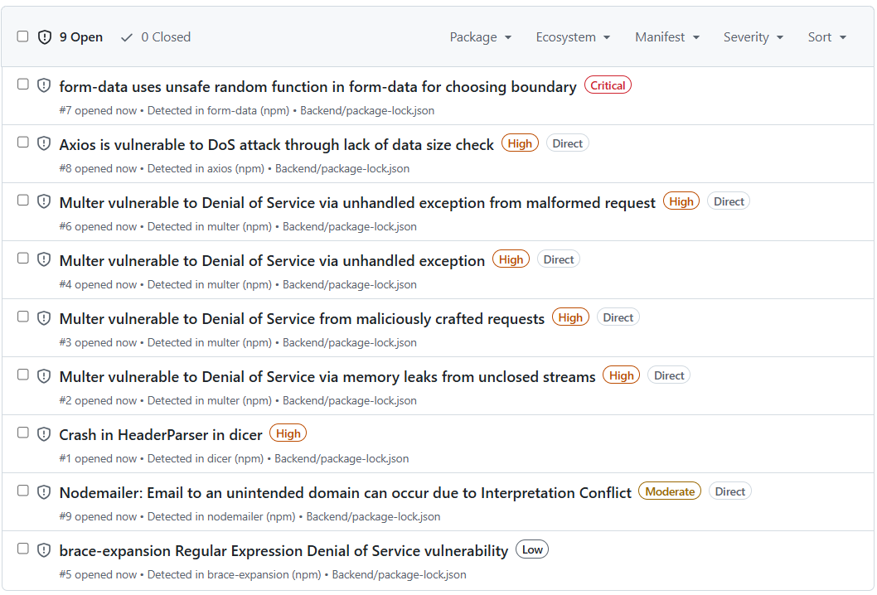
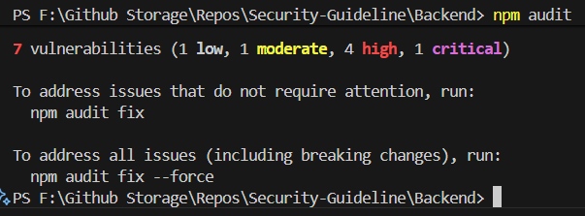
Vulnerable Components
Threat: Outdated libraries or OS vulnerabilities
Mitigation:
Do regular dependency audits
Make use of tools such as github dependabot

Slide 13
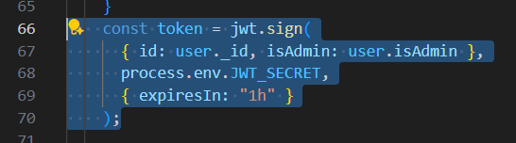
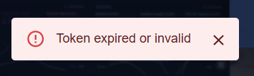
Authentication Failures
Threat: Insufficient validation, Stolen/long-lived tokens, token replay
Mitigation:
Make use of authentication Tokens for sessions.
Short access token lifetime (e.g., 5–15 minutes) and use refresh tokens for sessions.
Store tokens securely: keep access tokens out of localStorage; prefer HttpOnly, Secure, SameSite cookies.

Slide 14
What we saw
Importance of Security Guideline: Secure System Design with a proper Security Guideline from the start of development is better the patching every issue afterwards
Security isn’t a feature — it’s a continuous practice

Slide 15
Thank you
Prepared by Dipen P. Patel (2025ICS-008)

