Slide 1
Securing a WebApp: Defending OWASP Top10
Prepared by Dipen Patel 2025ICS-008

Slide 2
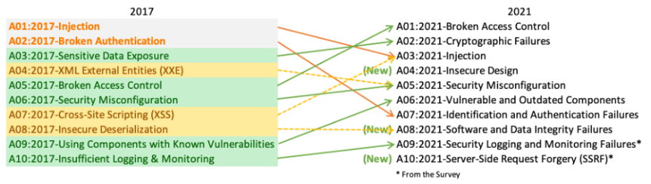
Understanding the MERN Security Landscape and OWASP top 10
OWASP Top 10 (2021): List of critical web security risks
WebApp: Frontend (React), Backend (Node/Express), Database (MongoDB)
Approach: Address each OWASP risk with MERN-specific defenses guided by Security Guideline.

Slide 3
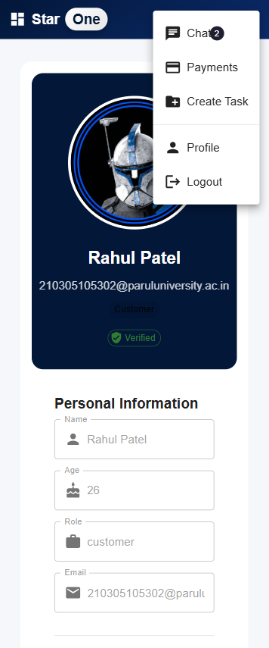
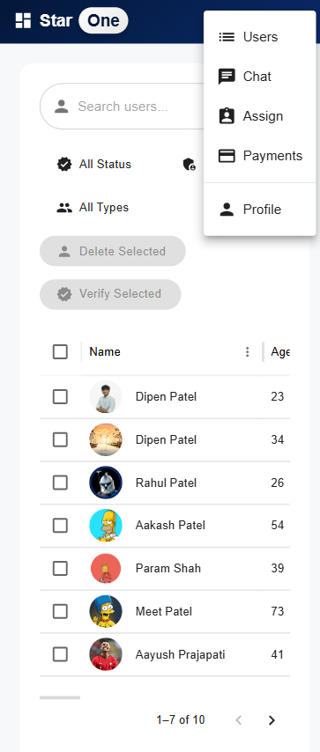
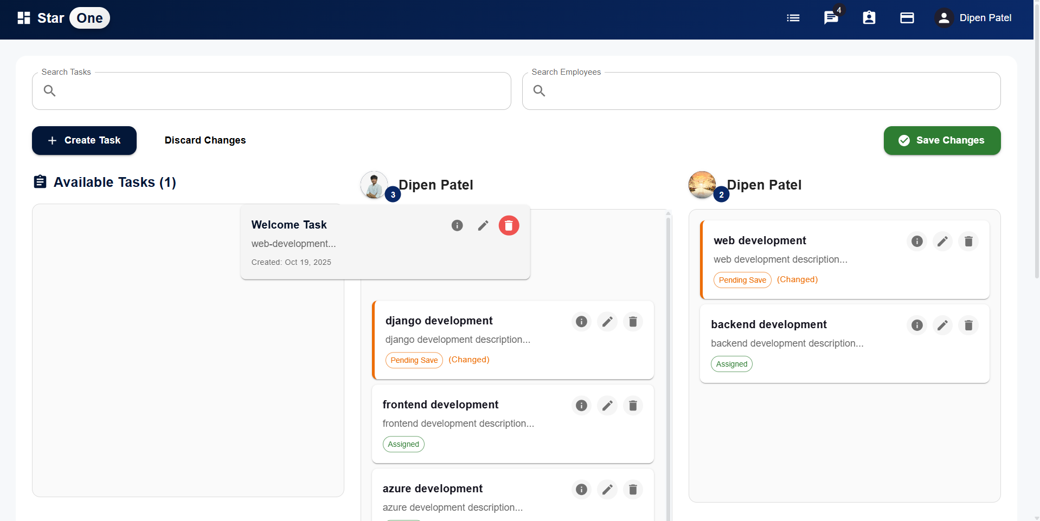
Broken Access Control
Preventing Unauthorized Access
Threat: Users bypass permissions or access others’ data using their credentials or open endpoints
Mitigation:
Role-Based Access Control (RBAC)

Slide 4
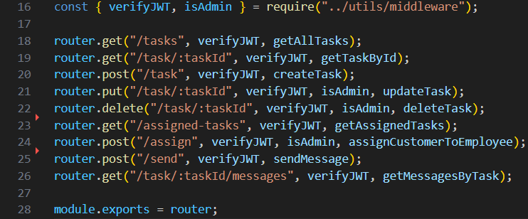
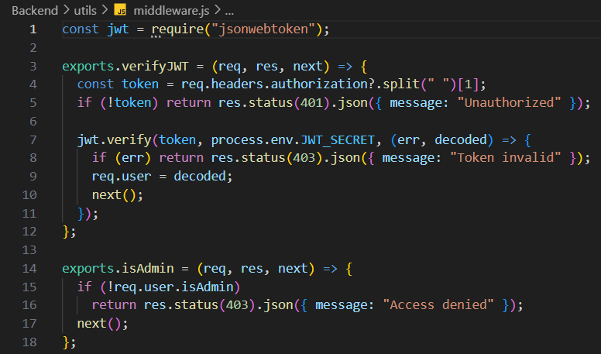
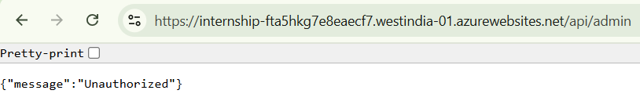
Broken Access Control
Mitigation:
Middleware for role checks and permission checks

Slide 5
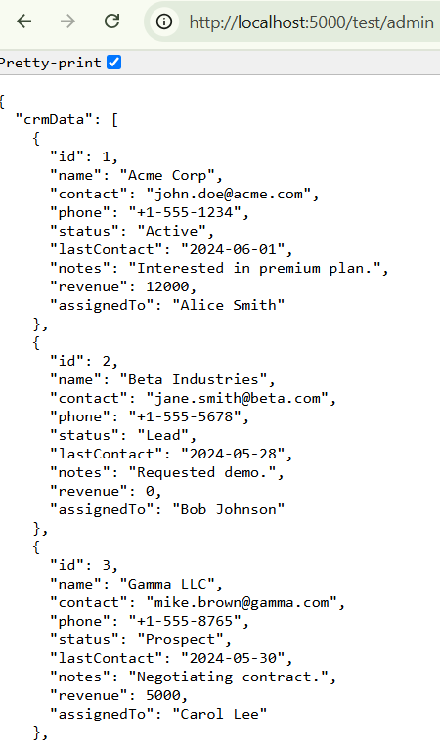
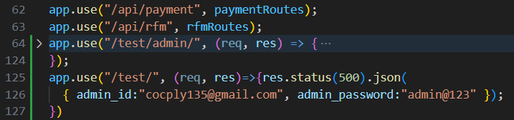
Broken Access Control
Mitigation:
Make sure all endpoints are secure

Slide 6
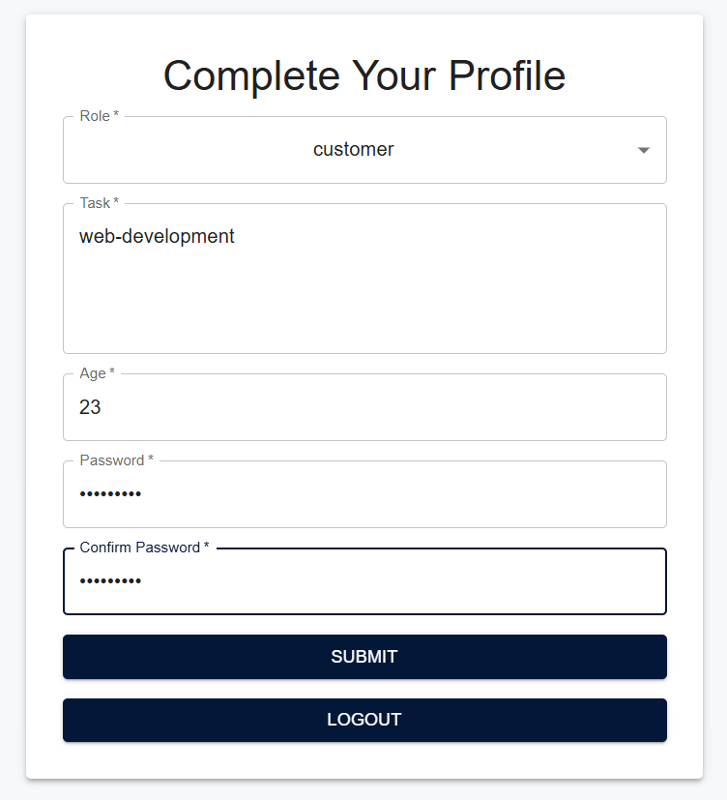
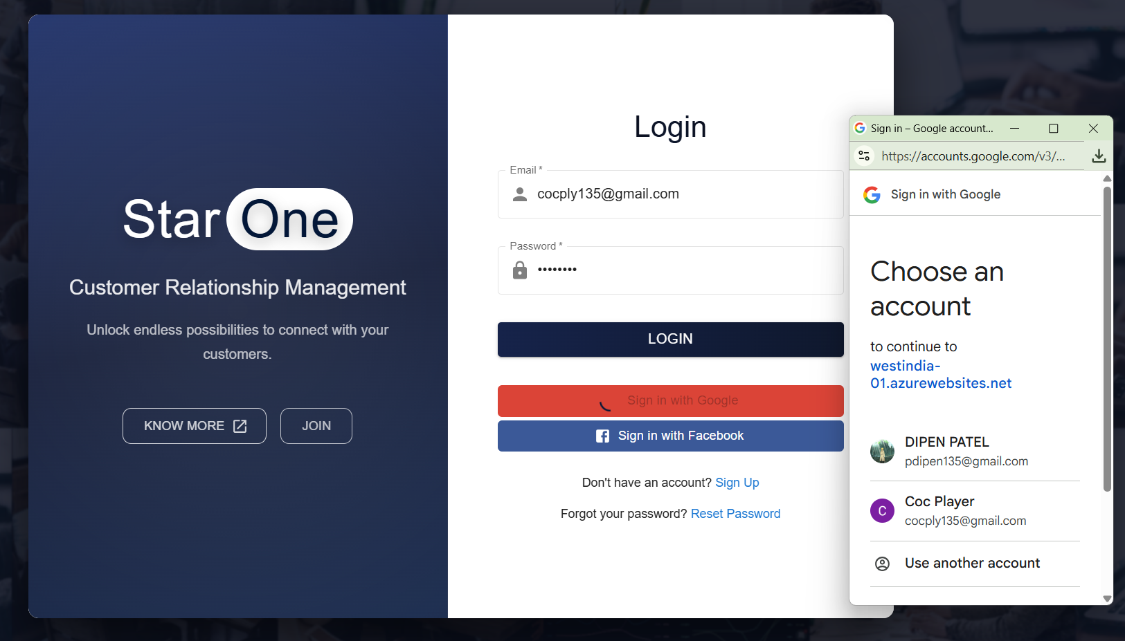
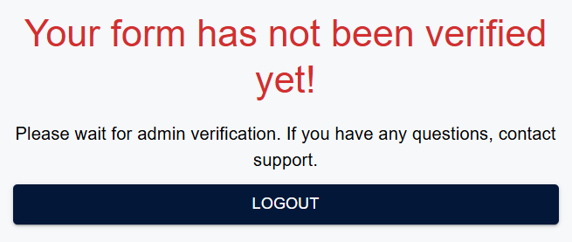
Broken Access Control
Mitigation:
Integrate Multi-Factor Authentication (MFA) for information verification and privilege escalation

Slide 7
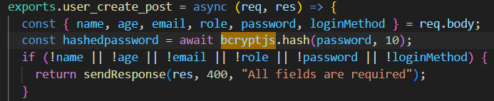
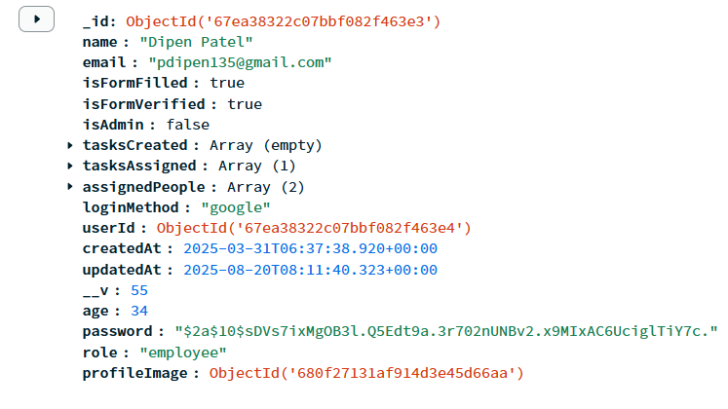
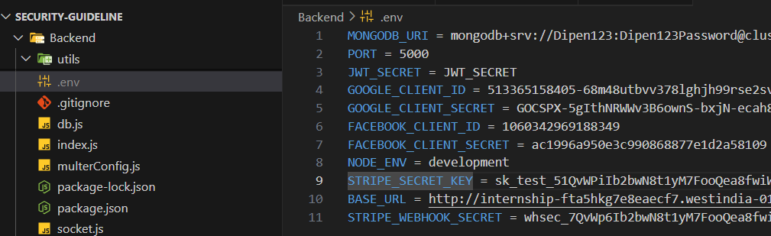
Cryptographic Failures
Securing Data in Transit and at Rest
Threat: Sensitive data exposure via weak encryption
Mitigation:
Hash passwords with bcrypt
Store secrets in .env rather than encrypting

Slide 8
Injection Attacks
Stopping Malicious Input Execution
Threat: User input alters queries or executes code: {"username": { "$ne": null },
"password": { "$ne": null }}
User.findOne({ username: { $ne: null }, password: { $ne: null } })
Mitigation:
Having middleware and encrypted data solves the issue
Input sanitization before running a database query
Layer | Tool / Practice | Protection Provided
MongoDB | Mongoose Schemas + express-mongo-sanitize | Prevent NoSQL Injection
Express | express-validator + Helmet | Input Validation + HTTP Header Hardening
React | Built-in Escaping + DOMPurify | XSS Mitigation
Node | Validator.js + CSP | Request Sanitization + Script Blocking

Slide 9
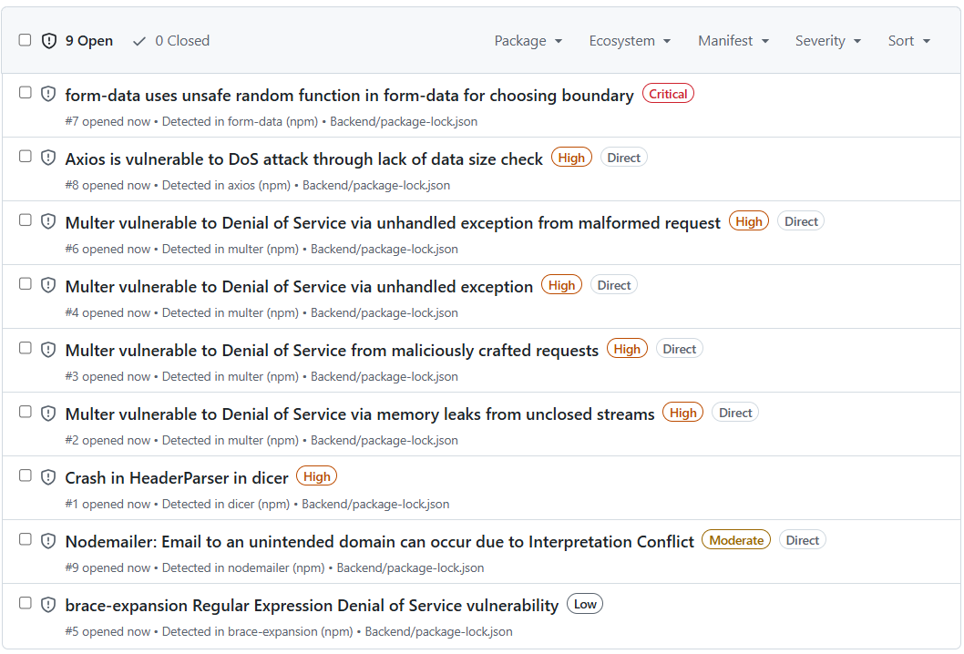
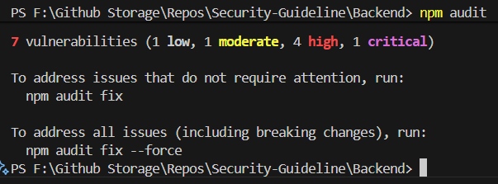
Vulnerable Components
Staying Secure with Updated Dependencies
Threat: Outdated libraries or OS vulnerabilities
Mitigation:
Do regular dependency audits
Make use of tools such as github dependabot

Slide 10
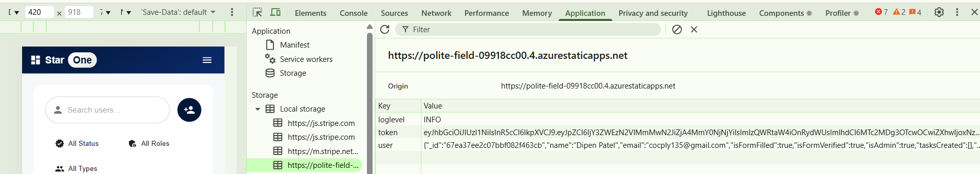
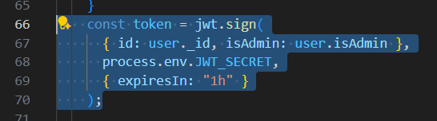
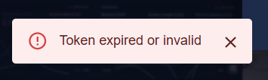
Authentication Failures
Strengthening Login and Sessions
Threat: Insufficient validation, Stolen/long-lived tokens, token replay
Mitigation:
Make use of authentication Tokens for sessions.
Short access token lifetime (e.g., 5–15 minutes) and use refresh tokens for sessions.
Store tokens securely: keep access tokens out of localStorage; prefer HttpOnly, Secure, SameSite cookies.

Slide 11
What we saw
OWASP Top 10 threats from Broken Access Control to SSRF, each showing how small mistakes in code or design can expose a full stack.
In MERN, attacks like Privilege Escalation, NoSQL Injection, JWT misuse, and weak configuration were most critical.
These risks often connect insecure design or missing validation leads to multiple layered exploits.
Importance of Security Guideline: Secure System Design with a proper Security Guideline from the start of development is better the patching every issue afterwards
Security isn’t a feature — it’s a continuous practice

Slide 12
Thank you
Prepared by Dipen P. Patel (2025ICS-008)

