Slide 1
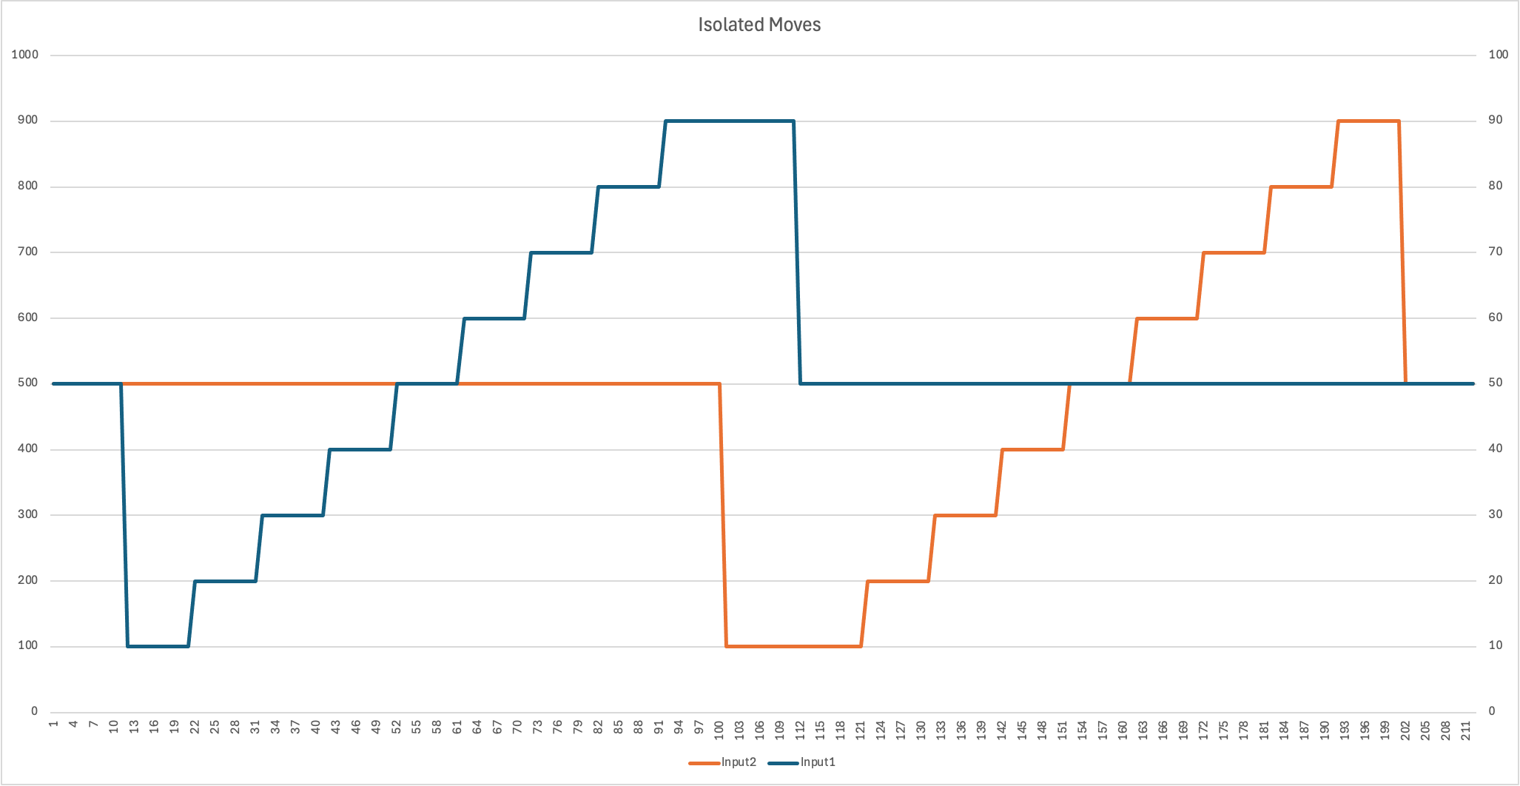
Settle
Steady
state
Move
Input1
Move
Input2
Settle

Slide 2
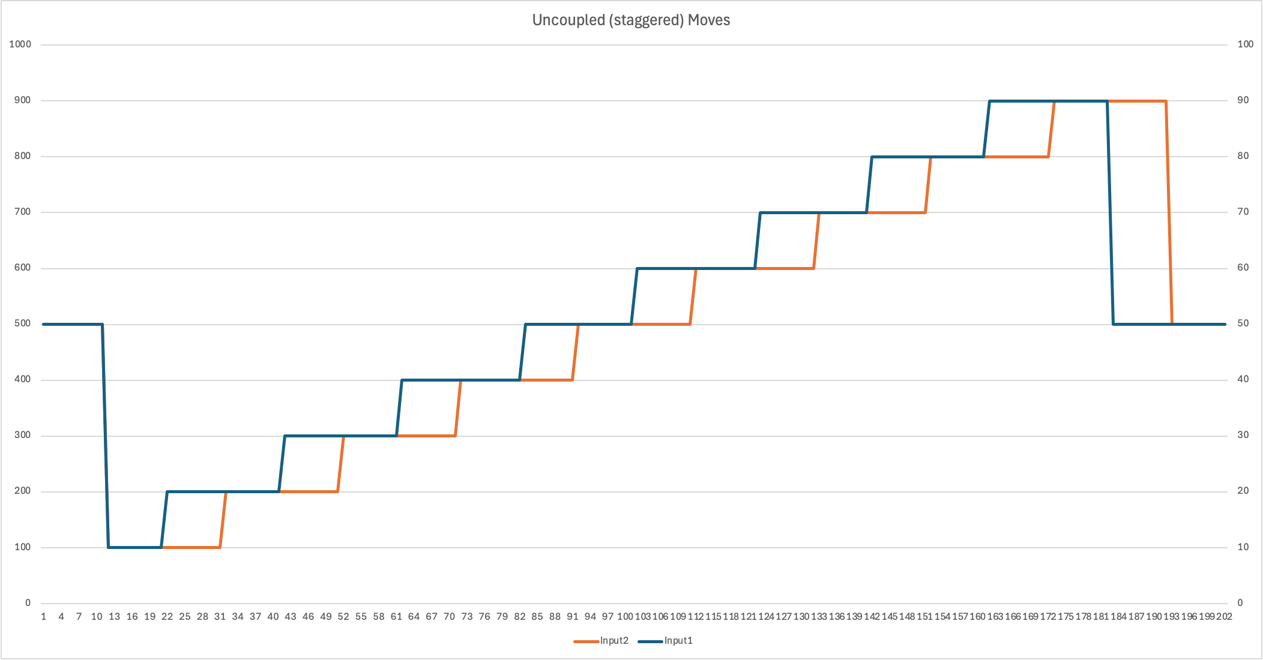
Steady
state
Staggered
moves
Settle

Slide 3
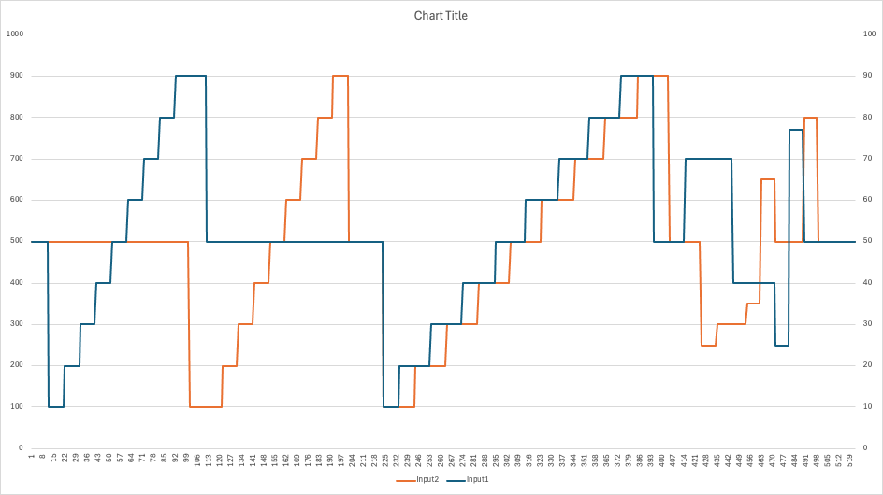
Isolated
moves
Staggered
moves
User
moves
Steady
state
Settle

