Slide 1


ME
Bureau of Standards Jamaica
Monitoring & Evaluation
Exit Meeting
By Carmen Gagnon, Volunteer Advisor CESO
December 12 2019

Slide 2

agenda
The Workplan
Process
The system
To reach final release
Timeline

Slide 3
workplan
Actual Activities | Actual Deliverables
Activity 1: Before the visit Needs analysis | The needs analysis received prior to the visit changed significantly during the weeks. The Client Services Network Diagram and Client Services WBS get the idea but are not exactly the tasks they wishes to develop.
Activity 2: Before the visit Preparation of a prototype | The prototype tried to respond to the Client Services Network Diagram sent but since the phases of the work are not the same, I had to adjust the prototype.
Activity 3: Presentation of the prototype to the working group | Needs were quickly expressed after the presentation of the prototype. The prototype helps to quickly understand the possibilities of the system and brings ideas.
Activity 4: List of adjustments | Work was started quickly to produce a list of questions to qualify clients who will receive help to obtain certification. Another Client Servicing Network Diagram came after these lists of questions on the different phases and status to reach before producing the Manual of procedures for eventually getting the certification.
Activity 5 – Programming | After each meeting, I was adjusting the system to the needs, taking in account that some parts might be developed later. A list of tasks to deliver the pilot system was produced at the end. The analysis and programming work will be shared with the IT staff of BSJ.
Activity 6 – Transfer to the BSJ web server | This has not been done during the visit but should be an easy task to do. BSJ has an IT team that can work on it.
Activity 7 – Training for IT | A programmer was assigned to me on the first day, unfortunately it was his first day at BSJ. I was able to quickly evaluate the programmer's skills by giving him some exercises to do in the system. He is qualified enough for programming but lacks experience. I offered remote mentoring.

Slide 4
The process
From Phase 1 to Phase 4

Slide 5

First - registration
Registration from the website of BSJ
If qualified, a code (TRN) and a password is sent to the client to reach the system
The client will follow Phase 1 to Phase 4 with a coordinator and/or a consultant.

Slide 6
Phase 1
Phase 3
Phase 4
Business Process Discovery
Coordinator
Certification scoping
Coordinator
Gap Audit
Consultant
Evaluation NC & DFI closure
Coordinator
Phase 2
Clause 5 +
General Information
Operation Information
Clause 4
4.1
Strategic Information
Clause 4
4.2 to 5
Clause
4 to 10
Training & Development
Management review and clean up
Pre certification Audit
Internal Audit
Clean up NC & DFI
Generate Final Manual

Slide 7

BSJME Database
Questions and Answers
Location
Clients
Information
Questions
Consultations
Standard
Clause
Sub-Clause
Phase
Documents
Status
Documents
Financial reports
Process
Annual report
Sector

Slide 8
The system
Clients - Coordinators - consultants

Slide 9
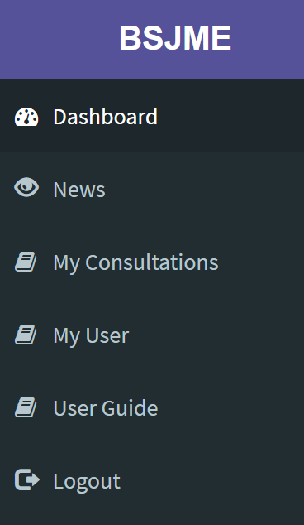
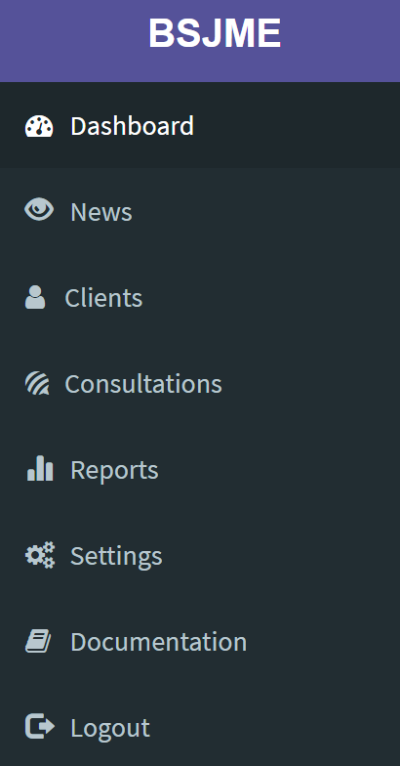
The system
For the client
For bsj staff

Slide 10

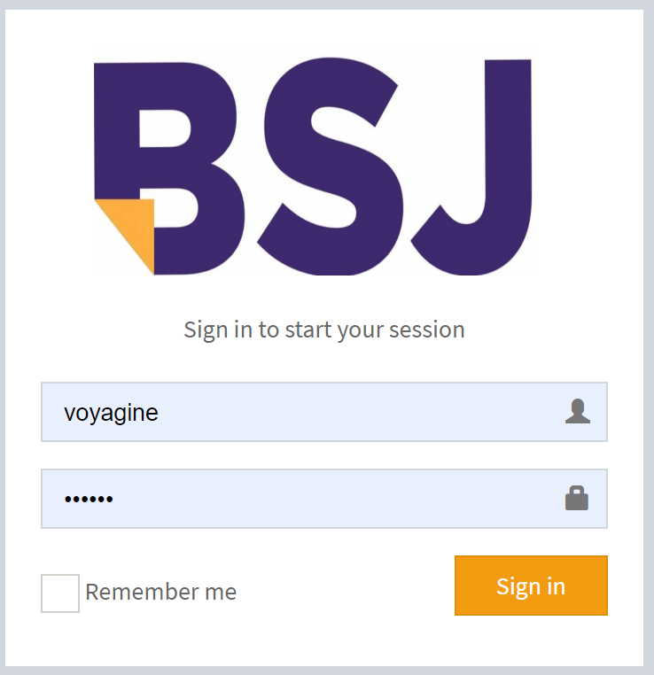



CLIENTS
All the information in one place
Client
View all the consultations
Exchanges with the coordinator, consultant
Documents
You can share all the information about consultations and documents received by clients.
Clients search is possible on different criteria
All documents related to the client can be uploaded and downloaded

Slide 11
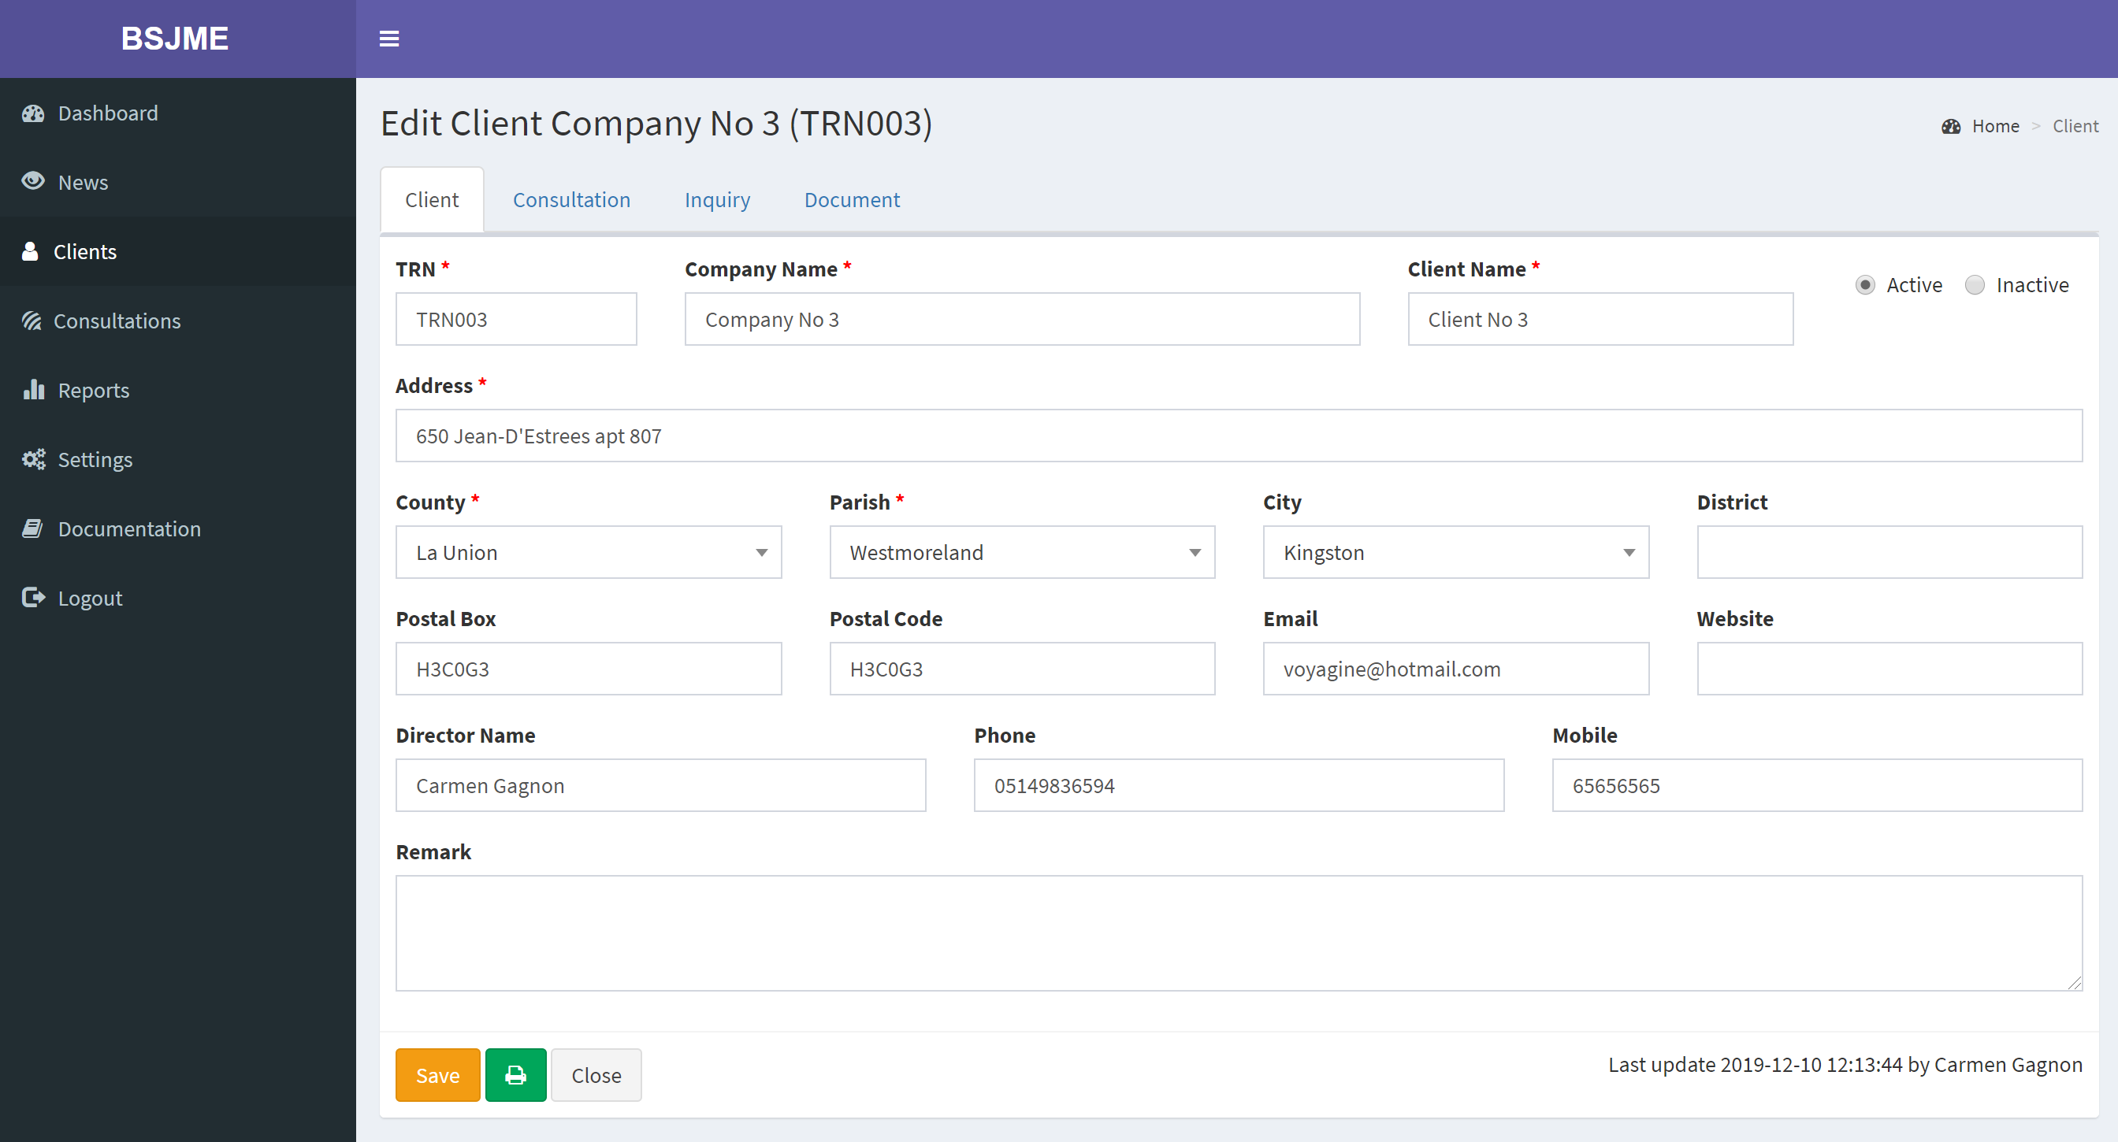
Clients

Slide 12



CONSULTATIONS
Searching a specific consultation is easy
A consultation is attached to a specific certification, status and phase which makes it easier to group the information
Can be a tool to follow-up the consultations by dates
Documents from Clients for generation of the manual can be attached to the consultation/client. The manual can be transfer as well.

Slide 13
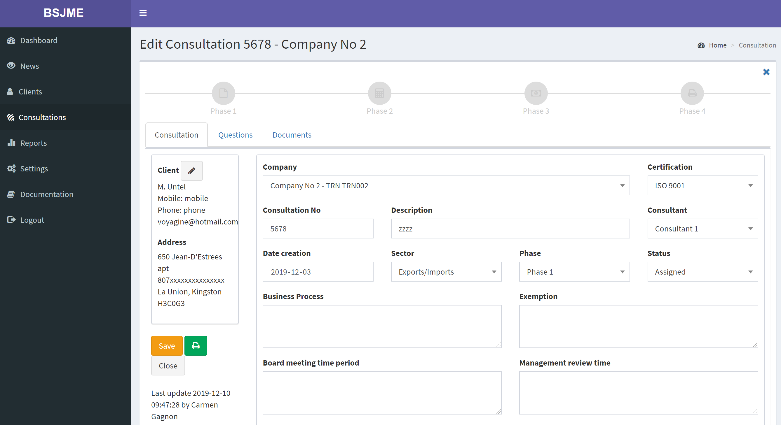
Consultations

Slide 14
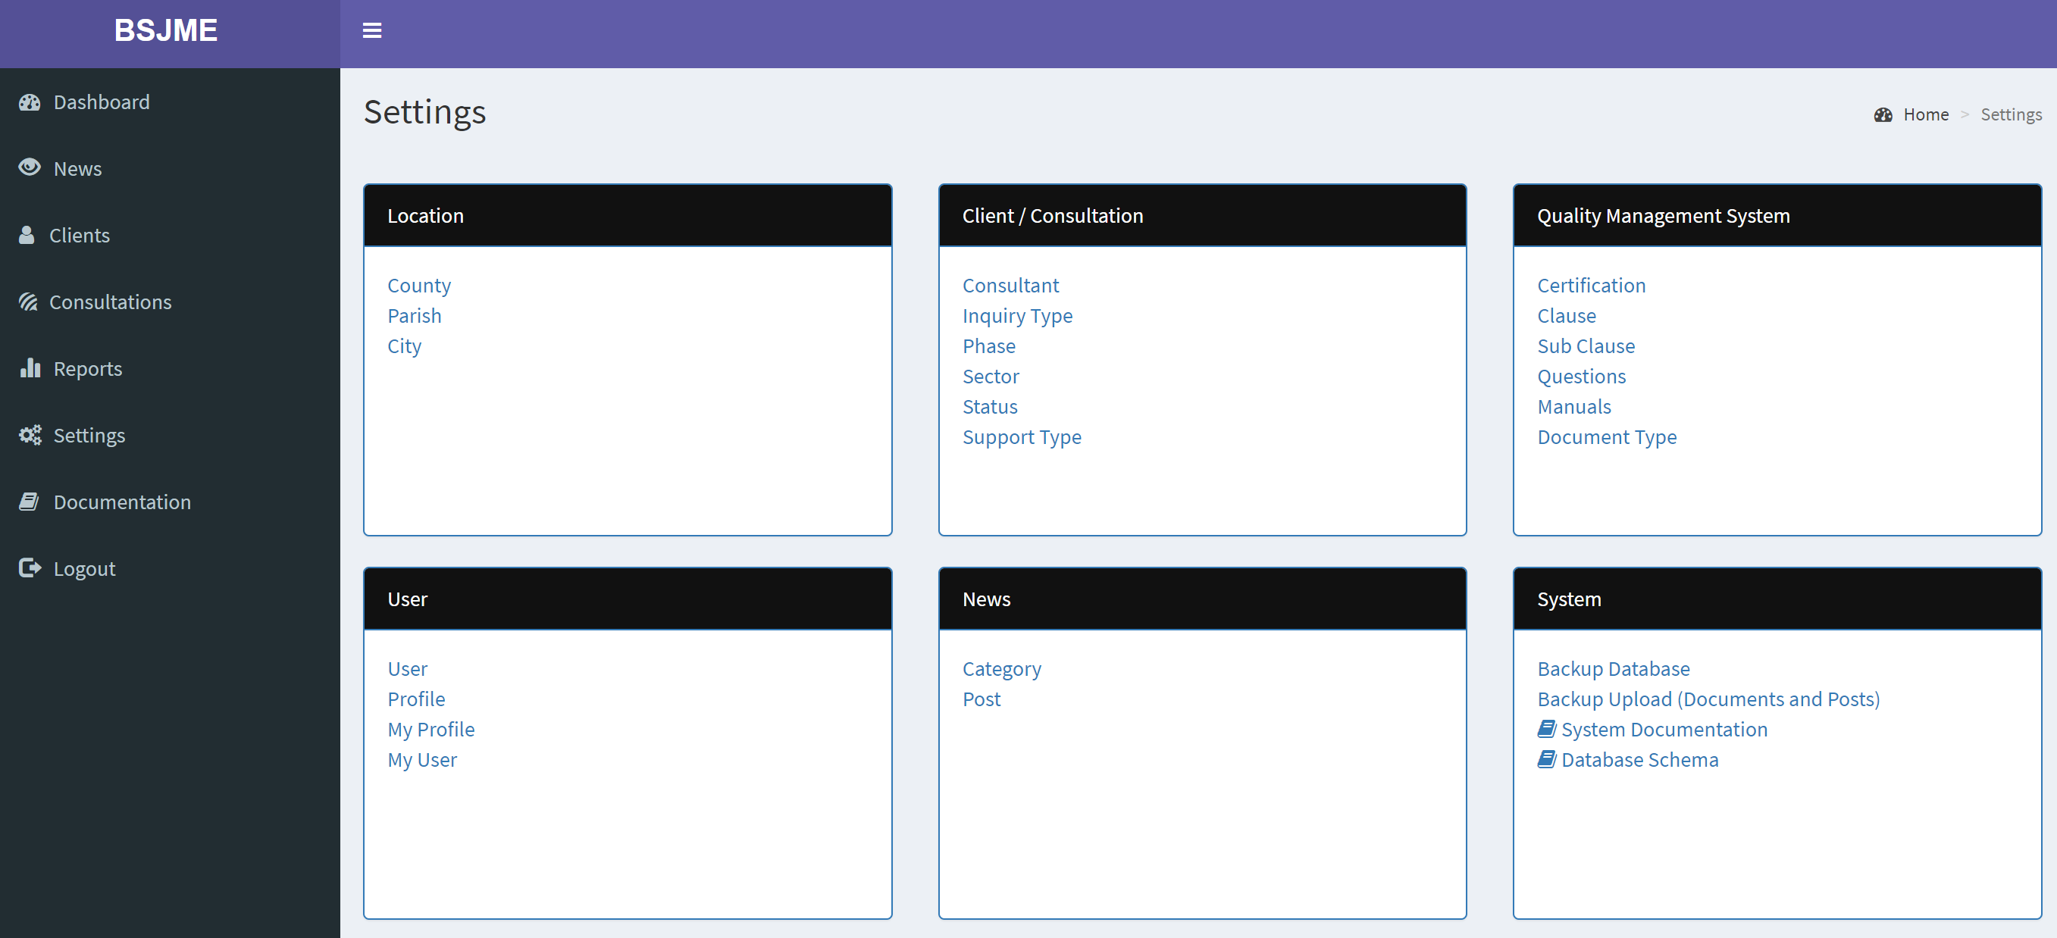
Customizable

Slide 15

Report flexibility
BSJME supports the generation of reports.
Among the reports and responses it can provide users are:
List of Clients
List of consultations
Quality & Procedures Manual
And more to develop

Slide 16
To reach the final release

Slide 17
Still to do …
Complete the needs analysis (Phase and Status) (Orville)
Template for the reports (Orville and Nicholas)
Template for other manuals (Orville)
Develop request in BSJ website (Nicholas)
Programming of the client section (Nicholas)
Programming of the coordinators and consultants sections (Carmen and Nicholas)
Programming of the manual (Carmen and Nicholas)
Conversion of the questions from Excel to the Database (Carmen)
Creation of the different profile (Orville, Nicholas and Carmen)
Profile consultant, coordinator, client
Who is updating the settings?
Who is the super administrator of the system?

Slide 18
Implementation Plan
8 days
Project Objectives April 2020
8 days
4 days
Programming
Carmen
Mentoring
Carmen
Implementation 2020
Prototype
Pilot group
Dec
January to Mid Feb
Until the end …
April
April
Dec 2019
January February March
April
2020
2020
Nicholas
Test
March
Today
Programming
Users
Programming completed
Nicholas
12 days
Prototype/Analysis
Sep – Oct 2019
10 days
Carmen Programming
Dec to Feb 2020
8 days
Nicholas Programming
Dec 2019 to Apr 2020
5 days
Group Testing and Conversion
March
April
14 days
Orville analysis and testing
Dec 2019 to Apr 2020
10 days
Implementation
Apr 2020

