Slide 1

ME
Bureau of Standards Jamaica
Monitoring & Evaluation
Prototype
By Carmen Gagnon, Volunteer Advisor
October 2019

Slide 2

What is BSJME?
BSJME is a web application that enables the Bureau of Standards Jamaica to identify, monitor and evaluate the MSMEs that could benefit from the various interventions of the Bureau.

Slide 3

BSJME Tools
Easy to use
Customizable
Efficiency
Report flexibility

Slide 4

BSJME Database
Production
Where
Clients
Step
Consultant
Interventions
Target
Phase
Performance
Status
Documents
Work plan
Manual
Activities
Inquiries

Slide 5

Monitoring & Evaluation
The system helps to monitor and evaluate the MSMEs
Profile of the clients, sectors, locations and interventions are grouped in the same place.

Slide 6
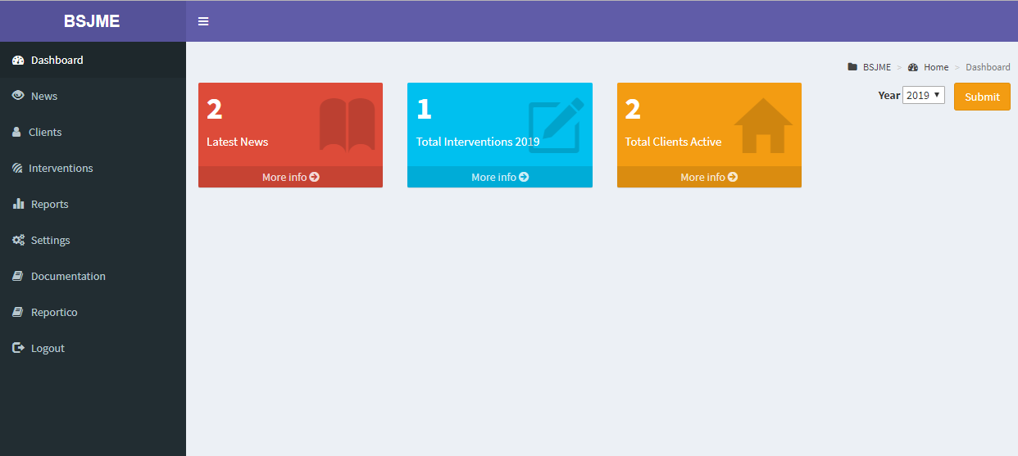
BSJME Dashboard
Give a summary of the clients registered on the site

Slide 7
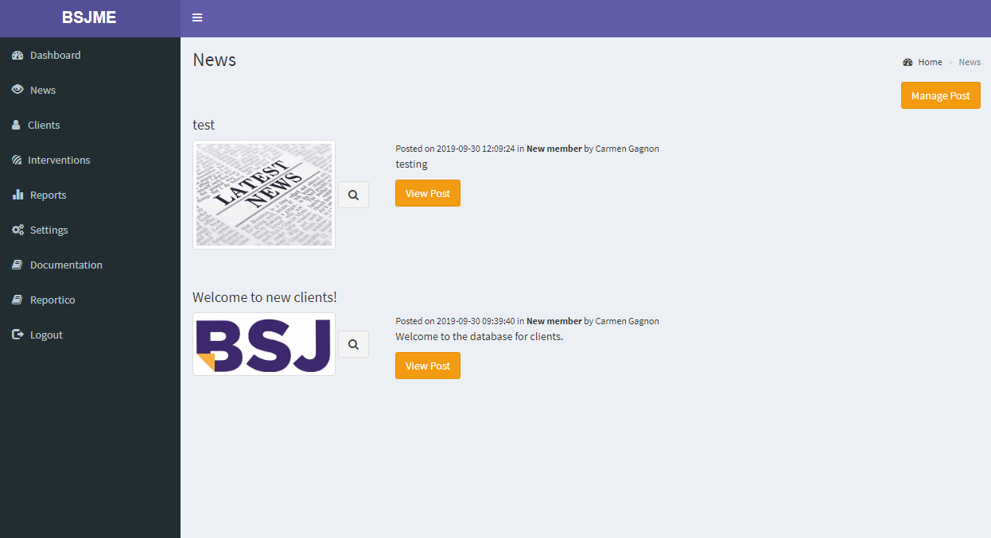
News
Allow exchanges between consultants

Slide 8
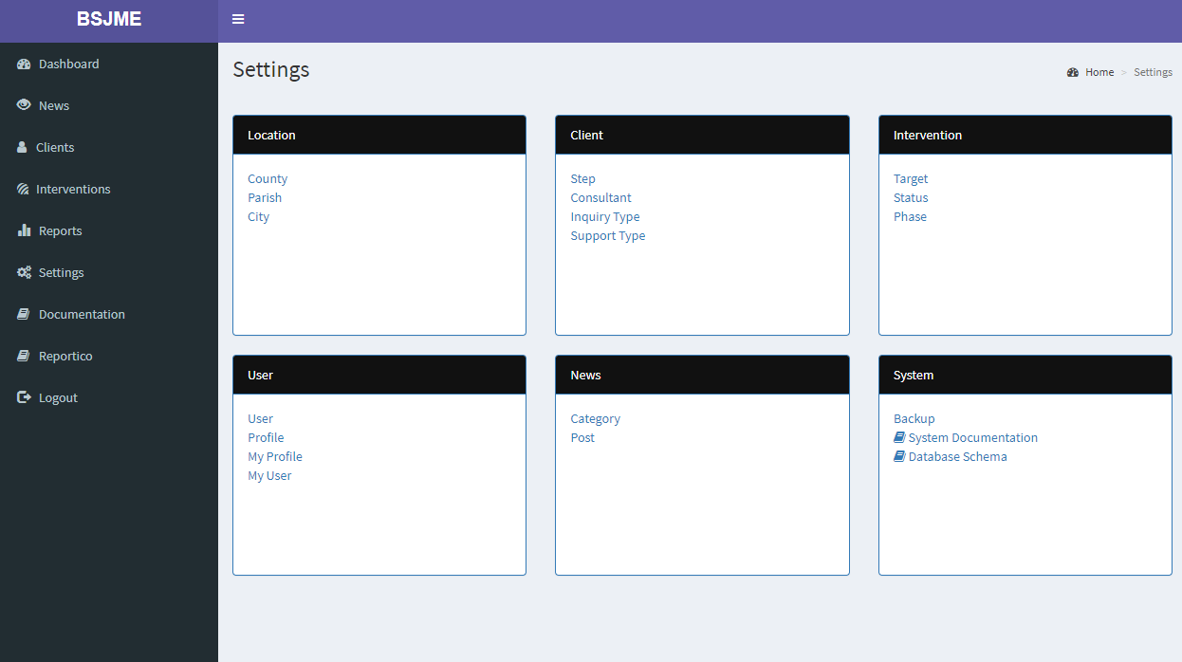
Customizable
All settings of the database customizable

Slide 9





CLIENTS
All the information in one place
Clients
Interventions
Inquiries
Documents
You can share all the information about inquiries, performance and documents received by clients.
Clients search is possible on different criteria
All documents related to the client can be uploaded and downloaded

Slide 10
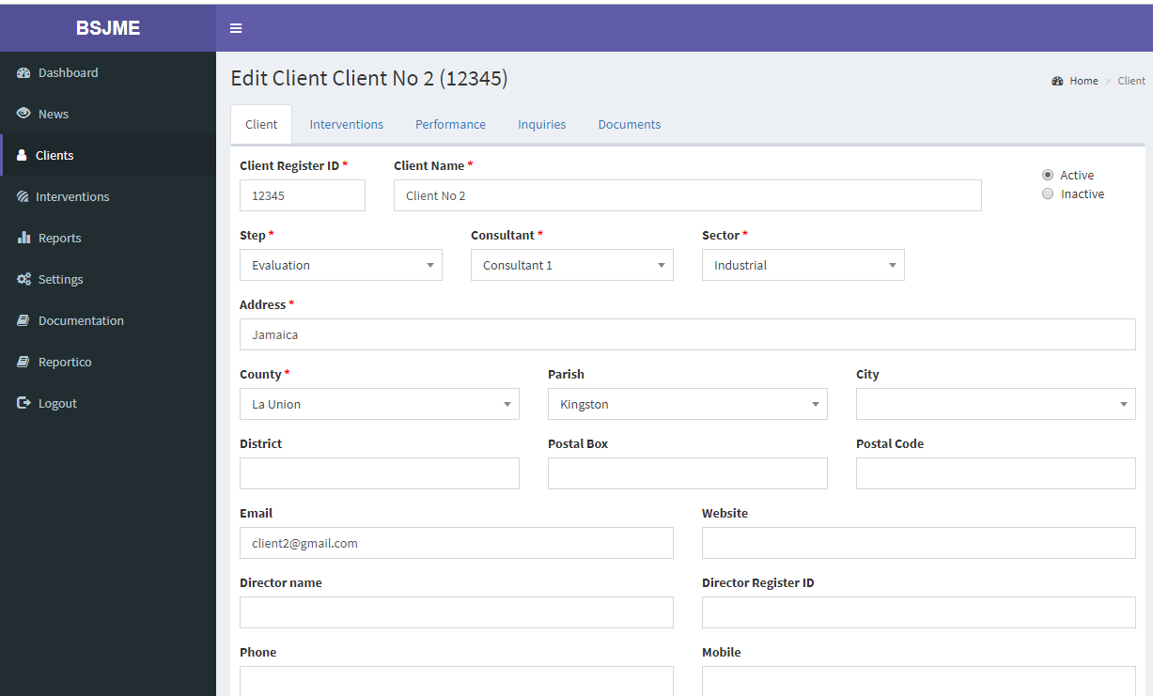
Clients

Slide 11



INTERVENTIONS
Searching a specific intervention is easy
An intervention have a specific target, status and phase which makes it easier to group the information
Can be a tool to follow-up the interventions
Documents for Clients, Work plans and manuals can be attached to the intervention/client.

Slide 12
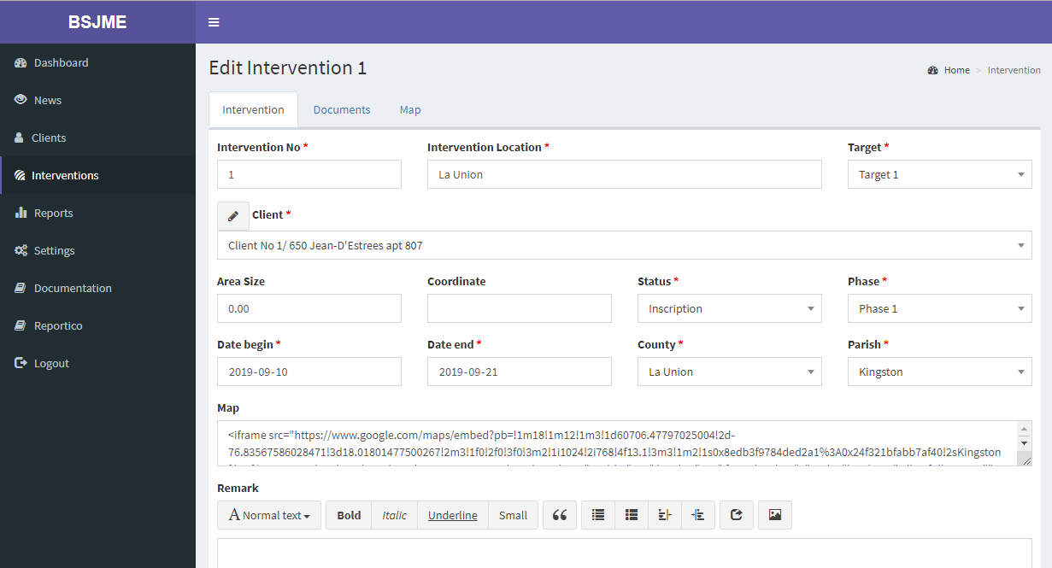
Interventions

Slide 13

Report flexibility
BSJME supports the generation of reports.
Among the reports and responses it can provide users are:
List of Clients
List of Interventions
List of Performance
List of Inquiries
And more to develop

Slide 14
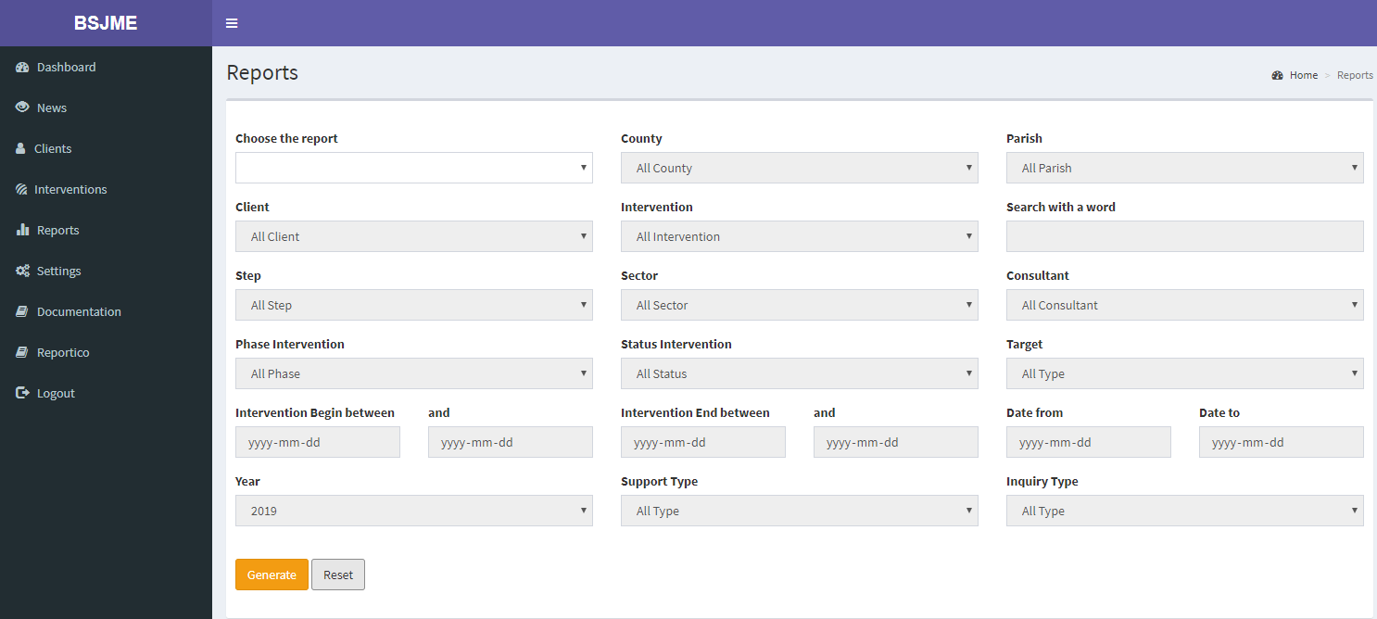
Criteria for reports

Slide 15
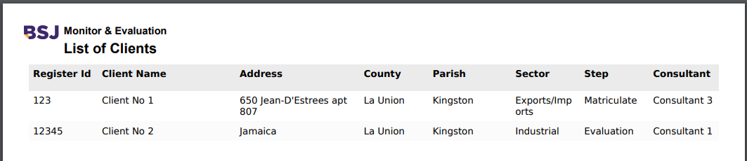
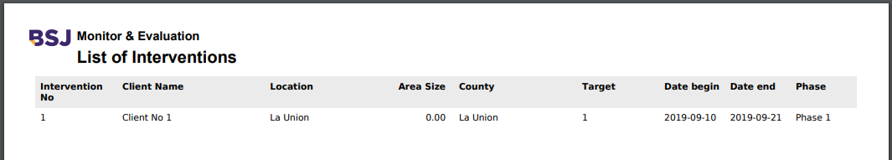
Reports

Slide 16

And … so much more to come IN dECEMBER!

