Slide 1

SpORt pROGRAM
Dimitar Dyakov, ema mateva, stoyan ponchev, petar stoev

Slide 2

INTRODUCTION
This project is a part of the "Quarantine Project".
As the name suggests, our project is basically an application that can be used by different sport clubs.

Slide 3



Concepts USED

Slide 4
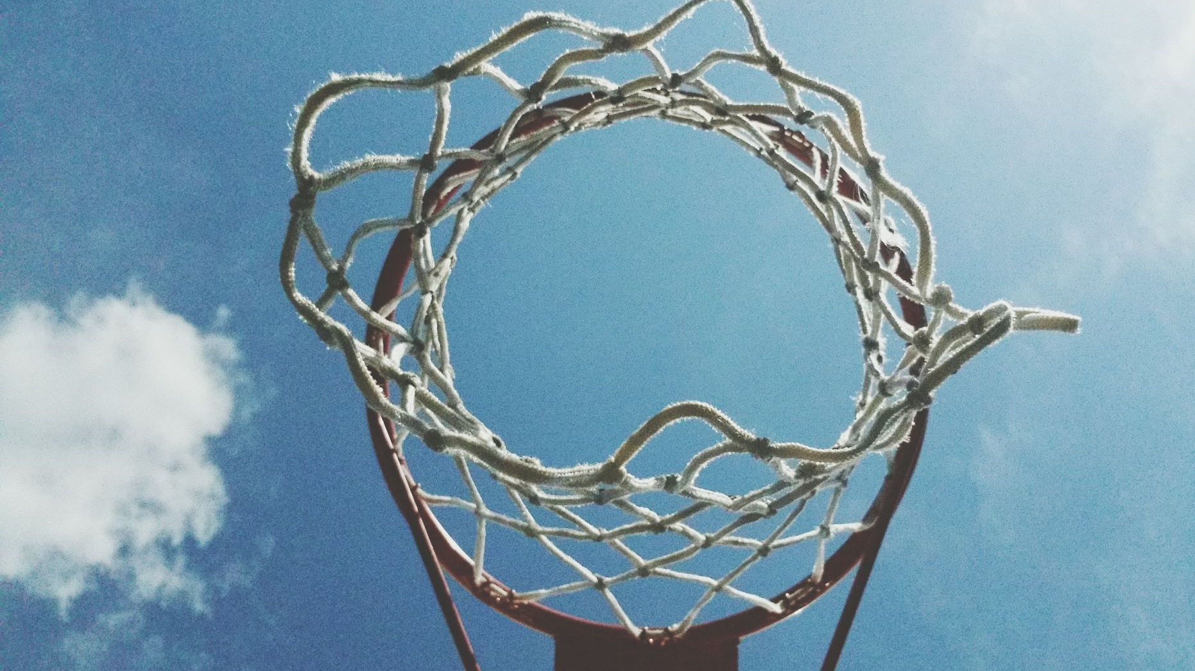
OBJECTIVES § APPLICATION
This project has been developed as a tool to make the work of the staff in the sport centers easier.
To calculate the prices easier, faster and more productive.
It's designed to be user friendly and be easily understandable.

Slide 5
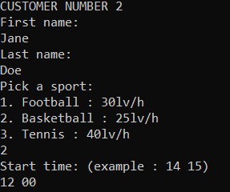
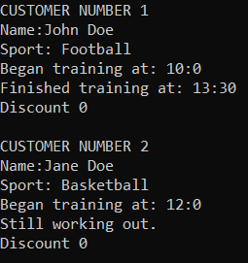
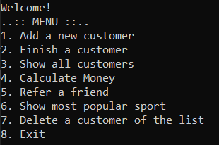

Slide 6
FUTHER ENCHANTMENTS
To be added and adjusted for the Gyms as well.
To add more sports.
Different prices for different parts of the day, with coaches.

Slide 7
cONCLUSION
Hense, conclusively, there is no doubt that this project was completed with a lot of intensive effort and time. Most significantly, the guidance of our teachers helped us to complete the project. During the whole project development phase, we came face to face with practically applicable aspect of engineering which may guide us in developing future projects

Slide 8

Thank You

