Slide 1
CIVVIX
THE DATA ADVANTAGE · WILSON COUNTY
Three Revenue Lines.
One Placed Universe.
Business license, tangible personal property, and — the piece you asked for on Friday — sales-tax situs. Every Wilson County business placed on its rooftop, checked against three obligations, delivered as finished work to three offices.
13,512
6,723
537
$61.8M
Wilson businesses placed on a rooftop from public data
active entities with no TPP schedule on file
named businesses carrying another county's mailing city
local option sales tax at stake every year
Civvix, Inc. · Dan Hogan · dan@civvix.ai · atlas.navigationholdings.com

Slide 2
THE PREMISE
Two Gaps. Both Structural. Neither Is an Oversight.
Friday's premise still holds: businesses that never file never enter any government system. The situs gap is the mirror image — businesses that did register, coded to the wrong jurisdiction by a mailing address written on a form years ago. The State never checks either one.
TPP · BUSINESS LICENSE
SALES TAX SITUS · THE NEW PIECE
The business that never entered the roll
The business the State sends to the wrong county
9,863 active for-profit entities hold a Wilson County address on the State register. 3,140 filed a TPP schedule in 2025. The other 6,723 — 68% — are outside the Assessor's roll and, after the statutory exemption screen, 7,360 carry a business-license obligation.
Surfacing them means reaching outside government data, into the sources no assessment system is built to hold. That was Friday.
Every sales-tax dollar in Tennessee is split 50/50 by situs code — half to the county and school system, half to the city or county where the sale happened (§ 67-6-712). The code comes from the registration form, and the form carries a postal city. Old Hickory is a Nashville post office that delivers deep into Wilson County.
5,538 Wilson rooftops carry another county's mailing city. 537 of them are named businesses. When the code is wrong, Wilson loses both halves — and the Department only corrects one year back.
CIVVIX · Prepared for Wilson County — Finance, Assessor of Property, County Clerk · September 2026

Slide 3
WHERE WE LEFT OFF FRIDAY
The Tax Base the County Never Recorded
The TPP and business-license screening, unchanged. One screening closes two obligations; the Assessor keeps every determination (§ 67-5-507(a)); flat fee is the only lawful structure (§ 67-5-507(c)).
6,723
9,863
3,140
31.8%
Active for-profit entities on the state register, Wilson address (Aug 2026)
TPP schedules actually filed in 2025 (TN Comptroller)
Wilson's TPP filed-compliance rate
businesses registered and active with the Tennessee Secretary of State at a Wilson County address, with no tangible-personal-property schedule on file with the Assessor.
+1,724
7,360
$2.1–3.9M
68% of the TPP-obligated universe
Net new entities per year — the gap widens on its own
Entities carrying the business-license obligation after the exemption screen
First-cycle TPP recovery, county rate only (6–11% of county average, 1.8-year look-back)
Sources: TN SoS statewide extract (July 2025 base + monthly increments through Aug 2026), screened against Wilson's own file · TN Comptroller TPRA response, Schedules Filed Per County.
CIVVIX · Prepared for Wilson County — Finance, Assessor of Property, County Clerk · September 2026

Slide 4
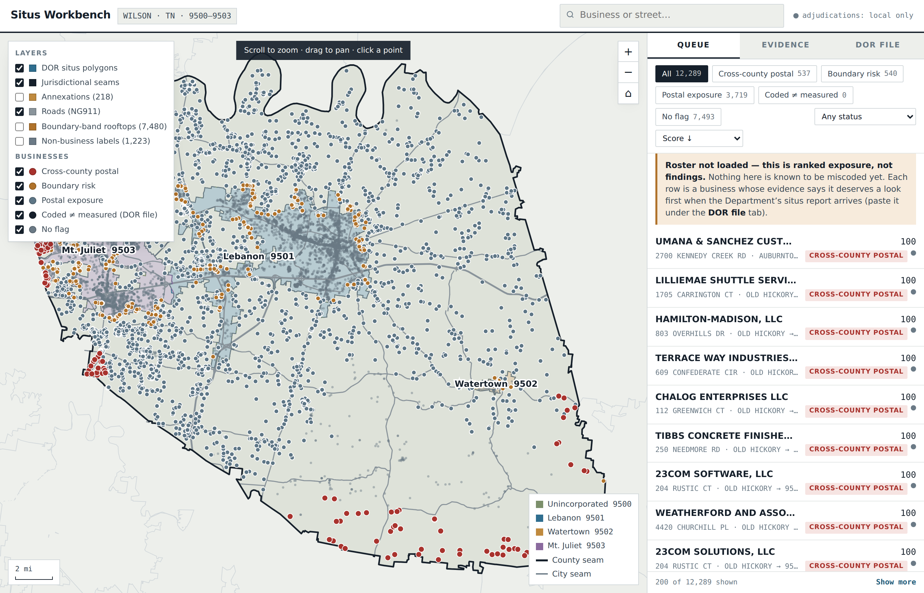
THE SITUS SERVICE · WHAT WE FOUND WITH PUBLIC DATA ONLY
Wilson County, Measured to the Foot
88,196
rooftops placed in a DOR situs polygon — zero unplaced
141 miles
of county seam — Davidson, Sumner, Rutherford, Trousdale, Smith, Cannon, DeKalb
5,538
Wilson rooftops carrying another county's mailing city (Old Hickory, Hermitage, Lascassas…)
537
named businesses on those rooftops — both halves of the tax at risk
The Wilson County workbench — every rooftop placed inside the Department's own situs polygons, seams drawn, businesses ranked by exposure. Live at atlas.navigationholdings.com. No confidential data was used to build it.
12,697
addresses where the State's own address file and its own polygon disagree — errors that run in Wilson's favour, reported the same way
CIVVIX · Prepared for Wilson County — Finance, Assessor of Property, County Clerk · September 2026

Slide 5
NO COST, NO COMMITMENT · BEFORE ANY CONTRACT
250 Wilson Addresses We Would Like You to Check
Named, registered businesses on Wilson rooftops whose evidence says they deserve the first look when Finance pulls the situs report from REP. Not findings — ranked exposure. Verifying these turns the ranking into a measured error rate for Wilson County, and every confirmed miscoding is a correction letter ready to sign.
120
60
50
20
Another county's mailing city
Within 250 ft of a seam
State file vs. State polygon
Annexation lag / layers disagree
Old Hickory, Milton, Lascassas, Alexandria, Auburntown, Hermitage — a Wilson rooftop, a Davidson / Rutherford / Cannon / DeKalb post office. Both halves of the tax at risk.
Close enough to a county or city line that a mailing address or a mapping choice puts the code on the wrong side.
The Department's own address-range file assigns a different situs than its own polygon, at the boundary — the addresses most likely miscoded by the State itself.
DOR polygon, Comptroller city limits and the 911 authority do not agree, or an annexation has not reached the roster.
Example | Postal city | Measured situs (rooftop in DOR polygon) | State address file says | Seam
Excalibur Pool Services Company | Milton (Rutherford) | 9500 Wilson unincorporated | 9500 Wilson | —
TruNorth Health Advisors, LLC | Lascassas (Rutherford) | 9500 Wilson unincorporated | 9500 Wilson | —
Too Teased LLC | Lebanon | 9500 Wilson unincorporated | 9501 Lebanon | 42 ft
Glass Key LLC | Old Hickory (Davidson) | 9500 Wilson unincorporated | 9503 Mt. Juliet | 54 ft
Nashville Video Productions, LLC | Mt. Juliet | 9500 Wilson unincorporated | 9503 Mt. Juliet | 59 ft
How it works. The list is a spreadsheet with three yellow columns. Finance pulls the situs report, enters the State's coded situs for each of the 250, marks match / no match, and keeps the roster inside the County. Civvix never sees it. What comes back is a precision rate — the number every other figure in this deck should be rebuilt on.
Delivered with this deck: Civvix_Wilson_250_Addresses_To_Verify.xlsx — public data only, no Department of Revenue data included.
CIVVIX · Prepared for Wilson County — Finance, Assessor of Property, County Clerk · September 2026

Slide 6
HOW IT WORKS
Geography First. Taxpayer Data Last.
Before anyone tells the Department a business is miscoded, the geography underneath the claim should be provable. So the map is built first, from public layers, and the confidential situs report is the last thing touched — inside your own browser.
1
2
3
4
5
6
Place
Measure
Rank
Compare
Adjudicate
Correct
Every address from the 911 authority's own points — no interpolated geocoding.
Distance in feet to every jurisdictional seam; DOR polygon vs. Comptroller city limits vs. 911 attribute.
Cross-county postal, boundary risk, postal exposure, State-vs-State conflicts — scored, with evidence.
Finance pulls the situs report from REP; it is matched to the map in the browser tab and never stored by Civvix.
A named analyst signs each packet: coded situs, measured situs, every layer's verdict, the distance, the hash.
Correction letters ready for the County's signature to DOR Financial Control — both directions, every quarter.
Zero custody. The situs report is disclosed to a contractor under § 67-1-1704(d) and protected by § 67-1-1709. It stays in the County's session; Civvix holds public data only. That is the sentence that makes this contract small on insurance, small on liability, and easy to approve.
CIVVIX · Prepared for Wilson County — Finance, Assessor of Property, County Clerk · September 2026

Slide 7
THE ENGINE
One Placed Universe. Three Obligations. Three Offices.
The same rooftop that answers "which situs code?" answers "is it licensed?" and "did it file a schedule?" That is why the three belong in one program, and why the second and third cost a fraction of the first.
12+ PUBLIC SOURCES
CIVVIX ENGINE
Finance Director
Data in
Rooftop placement
Situs correction packets, quarterly bulletin, both directions
TN Secretary of State register, deduplicated monthly (1.43M entities)
DOR situs polygons and address-range file
Comptroller certified city limits, monthly
Wilson E-911 address points and business points
Clerk license register, TPP roll (County-furnished)
ABC, Health, Commerce & Insurance, TDEC permits
Every record placed on the 911 authority's address point — the one method every finding shares.
Rules engine
Assessor of Property
Tennessee Code as automated checks: § 67-6-712, § 67-5-903, § 67-4-723.
Forced-assessment referrals with valuation and parcel fields, § 67-5-903(c)
Evidence packets
County Clerk
One finished, mail-ready packet per finding; provenance and hash on every one.
Verified unlicensed businesses, county and city obligation
Value out: recovered and protected revenue, routed to the office that owns the decision. Civvix delivers evidence, never determinations.
CIVVIX · Prepared for Wilson County — Finance, Assessor of Property, County Clerk · September 2026

Slide 8
WHAT RECOVERY LOOKS LIKE
Three Streams, One First Cycle
Friday's TPP scenarios, unchanged, plus the situs stream Aaron asked about. County rate only; the Lebanon, Mt. Juliet and Watertown rates levied on the same equipment are on top.
Revenue stream | Basis | First cycle | Recurring / year
Tangible personal property (Friday) | 6,723 non-filers × $2,197 county tax per return × 6–11% size factor × 85% collection; 1.8-year look-back | $2,110,000 – $3,868,000 | $753,000 – $1,381,000
Sales tax situs (new) | ~165 miscoded registrations (537 flagged × 0.31 precision from the Hendersonville calibration) × $5,700 local option each (⅓ of county mean), 50–100% verified, plus one year back | $940,000 – $1,880,000 | $470,000 – $940,000 protected, compounding
Business license | 7,360 obligated entities; $15 minimal / standard fees, three back years, 15% penalty — unmodelled upside on Friday | $30,000 – $60,000 | $10,000 – $20,000
Total |  | $3.1M – $5.8M | $1.2M – $2.3M
Situs is the stream that never stops
Both directions, on purpose
Calibrated, not assumed
A corrected code moves that business's tax every year, forever. Corrections found late are money the Department will not return.
12,697 addresses run the other way. Reporting them is what makes the findings survive a challenge from Lebanon or Mt. Juliet.
6–11% is sampled from forced TPP accounts; the 0.31 situs precision from a city roster with situs codes (n = 1,945). The first Wilson roster replaces both with measured rates.
CIVVIX · Prepared for Wilson County — Finance, Assessor of Property, County Clerk · September 2026

Slide 9
FIRST-YEAR RETURN · WHAT WILSON COUNTY EARNS
Year One: $3.1M Conservative, $4.4M Expected, $5.8M Upside
Every line below is a measured population times a sampled rate. Nothing is a statewide average. Where a rate is an assumption, the slide says so and names the sample that would replace it.
Stream | Population (measured) | Rate and value (sampled / sourced) | Conservative | Expected | Upside
TPP forced assessments | 6,723 active for-profit entities with no schedule — SOS register screened against Wilson's own TPP file (n = 9,863) | $2,197 county tax per return (Comptroller, Wilson) × 6 / 8 / 11% size factor (sampled from forced and discovered accounts) × 85% collection × 1.8-yr look-back (measured, Wilson) | $2,110,000 | $2,813,000 | $3,868,000
Sales-tax situs corrections | 537 named businesses on Wilson rooftops with another county's mailing city; 540 more within 250 ft of a seam (measured on 88,196 rooftops) | Precision 0.31 on exposure flags (Hendersonville roster calibration, n = 1,945 coded registrations) → ~165 miscoded; $5,700 local option per business (⅓ of the $17K county mean); 50 / 80 / 100% verified; + 1 year back | $940,000 | $1,500,000 | $1,880,000
Business license | 7,360 entities carrying the obligation after the 25.38% exemption screen (Wilson's own file) | $15 minimal / standard fee, three back years (§ 67-1-1005), 15% penalty; 40 / 55 / 70% unlicensed among non-filers (Civvix ROI model default 70% valid) | $30,000 | $45,000 | $60,000
First-year total |  |  | $3.08M | $4.36M | $5.81M
Program cost, year one |  |  | $166,500 | $166,500 | $166,500
Net to the County · return |  |  | $2.91M · 18.5× | $4.19M · 26.2× | $5.64M · 34.9×
Friday's proposal: $24,000 for ~$650,000 — one screen, one office, one pass.
The increment: +$142,500 of fee buys +$2.4M to +$5.2M of first-year recovery — 17× to 36× on the added dollar.
What replaces the assumptions: the first Wilson roster (situs precision) and the first 50 closed TPP cases (size factor). Both are in the program.
CIVVIX · Prepared for Wilson County — Finance, Assessor of Property, County Clerk · September 2026

Slide 10
BUY THREE AUDITS, OR ONE PROGRAM
What the Same Three Answers Cost, Bought Separately
Expected-case first year on Wilson's measured populations. Standalone rows are priced the way those services are actually sold; the gross recovery is held equal so the only variable is what the County keeps.
Option | How it is sold | Cost to Wilson | Gross recovery | County keeps | What is missing
Standalone sales-tax situs audit | Contingency: HdL 15%, MuniServices/Neumo 30%, Azavar to 50% of recovery, eight quarters | $225K – $750K (30%: $450K) | $1,500,000 | $750K – $1.28M | One direction only; no rooftop placement; ends after eight quarters
Standalone TPP audit | 30% of new revenue is the market form (TMA, New London CT: $278,700 on $1.8M) — void in Tennessee, § 67-5-507(c). The lawful form is a per-account audit fee ($300–700) that audits filers, not the 6,723 who never filed | $844K at 30% (or $2.0–4.7M per-account) | $2,813,000 | $1.97M | Never-filer discovery; a lawful TN price; the license side
Standalone business-license discovery | Contingency 30–50% of fees collected, usually with a minimum; city and county sold separately | $14K – $23K + minimum | $45,000 | $22K – $31K | The TPP schedule the same business skipped; nothing on situs
Three vendors, three contracts | Three procurements, three data requests, three offices fed separately | ≈ $1.31M | $4,358,000 | ≈ $3.05M | No shared map — a business one vendor finds never reaches the other two
Civvix Revenue Integrity Program | $0.60/resident situs + $250/packet + $10/lead; no contingency; quarterly; three offices | $166,500 | $4,358,000 | $4.19M | Nothing; year two ≈ $135K against $1.1–2.3M
Sources: vendor contingency rates from public contracts and RFP responses (HdL, MuniServices/Neumo, Azavar; Tax Management Associates' New London, CT contract at 30%); Tennessee prohibition on percentage-of-recovery for assessment work, T.C.A. § 67-5-507(c). Gross recovery per the ROI slide, expected case.
CIVVIX · Prepared for Wilson County — Finance, Assessor of Property, County Clerk · September 2026

Slide 11
THE INVESTMENT
From a Lead Price to a Program Price
$24,000 a year bought one screening for one office. The program is three revenue lines for three offices, monitored continuously, priced in three simple units — and the County keeps 100% of every dollar.
WHERE WE STARTED
 | Year 1 | Year 2+
Situs monitoring ($0.60 × 175,033 residents) | $105,020 | $105,020
Situs packets at $250 (~150, then ~25/yr) | $37,500 | $6,250
Double-verified TPP + license leads (2,400/yr minimum) | $24,000 | $24,000
County pays | ≈ $166,500 | ≈ $135,300
County recovers / protects | $3.1M – $5.8M | $1.1M – $2.3M
Return on the fee | 18× – 35× | 8× – 17×
$24,000 / yr
$10 per lead, TPP and license only, one office, one pass. Anticipated recovery ≈ $650,000.
THE PROGRAM
$0.60 / resident / yr
Continuous, not once
Flat fee is the law on TPP
What contingency would cost
Situs monitoring, quarterly: 175,033 residents × $0.60 = $105,020. Plus work product as produced: $250 per adjudicated situs packet; $10 per double-verified TPP / license lead, 2,400 a year minimum — Friday's $24,000 becomes the floor.
+1,724 new entities a year and a one-year DOR window: a single pass leaves money on the table every quarter.
§ 67-5-507(c) voids percentage-of-recovery for assessment work; the fee has to carry the work. It still beats any contingency.
HdL 15%, Neumo 30%, Azavar up to 50%: on the situs stream alone that is $93K–$925K a year, taken off the top, forever.
Three units, one rate card, every county and city in Tennessee: $0.60 per resident for situs ($0.30 municipal) · $250 per situs packet · $10 per double-verified lead ($5 municipal). Multi-year term, no contingency, ever.
CIVVIX · Prepared for Wilson County — Finance, Assessor of Property, County Clerk · September 2026

Slide 12
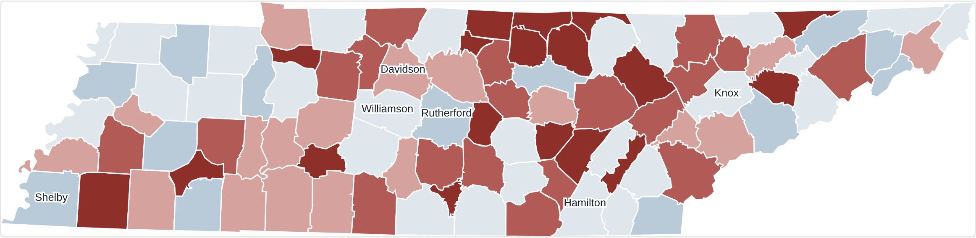
BUILT FOR ALL 95 · WILSON IS FIRST
The Whole State Is Already on the Map
Every Tennessee county's rooftops — 3.94 million — placed in the Department's situs polygons and cross-checked against the Comptroller's city limits and the 911 authorities, with 360,839 businesses from a deduplicated statewide register. Shaded by cross-county-postal businesses per 1,000; Wilson's neighbours are on the other side of the same seams.
95 / 95
counties run, zero failures
18,246 mi
of jurisdictional seams measured
Why this matters to Wilson: the Lebanon Road / Old Hickory corridor is simultaneously a finding about Davidson County's coding. The seam has two sides, and both are already measured. A county that signs first sets the template the others follow.
$0
Same three units, every jurisdiction: 7.3M residents × $0.60 county situs = $4.4M; ~4.4M municipal residents × $0.30 = $1.3M; lead minimums $2.3M — an $8M-a-year addressable market at full penetration, before first-cycle packets. Addressable, not forecast.
spent on data — every layer public
atlas.navigationholdings.com
CIVVIX · Prepared for Wilson County — Finance, Assessor of Property, County Clerk · September 2026

Slide 13
HOW THE COUNTY BUYS IT
A Competitive Solicitation, Written to a Standard of Proof
Not a sole source. The County describes the outcome and the evidence standard; any firm may bid. Every requirement exists because a finding that fails it does not survive a challenge from a city or a taxpayer.
✓
Rooftop placement
✓
Authoritative boundaries
✓
State-vs-State check
✓
Provenance
911-authority address points only; placement distance and unplaced share reported.
DOR polygons cross-checked against Comptroller city limits and the 911 jurisdiction attribute; distance to seam on every finding.
The Department's address file compared against its own polygons.
Source, custodian, effective date, CRS and snapshot hash on every finding.
✓
Both directions
✓
Zero custody
✓
Cadence and calibration
✓
Demonstration before award
Findings against the County reported with the same rigor. The County decides what is submitted.
Taxpayer data processed in County-controlled sessions; § 67-1-1709 acknowledged per person.
Quarterly re-measurement; annual precision/recall report against actual coding.
A working public-data demonstration for Wilson and two adjoining counties.
Pricing in the solicitation: per-resident situs monitoring on the Census estimate, per-packet and per-lead work product, no contingency on monitoring. Three-year term, two renewals.
CIVVIX · Prepared for Wilson County — Finance, Assessor of Property, County Clerk · September 2026

Slide 14
NEXT STEPS
What We Are Asking For
1
The roll, the list, and the report
The Assessor's TPP account roll and the Clerk's active licence list (Friday's ask) — plus one pull of the situs report from the Department's REP portal by Finance. It never leaves your browser, and it turns 537 ranked businesses into a named, verified correction list at no cost and no commitment.
2
Thirty minutes with the Assessor
Stephen Goodall's office owns the assessment decision and the appeal workload; they should hear the dispute-absorption design directly. Finance owns the situs letters; the same half hour covers both.
3
Agreement in principle on the program
Three revenue lines, one placed universe, three simple units ($0.60 per resident, $250 per packet, $10 per lead), every determination left with the County — and a solicitation the County can put on the street this quarter.
Civvix, Inc. · Dan Hogan · dan@civvix.ai · civvix.ai · atlas.navigationholdings.com

