Slide 1
StudyBox
Developed by: Jay Arias, David Pablo, Razin Khan, Luis Ayala

Slide 2
Overview
Study/work extension app
Designed to make virtual workspace more comfortable for the user while increasing productivity
Functionality
Blocks specific websites
Minimizes distractions
User Customization
Background images, sound, etc
Screen dimmer
much more!

Slide 3
Inspiration
From experience:
Productivity highest when distractions are at a minimum
Certain sounds increase productivity and focus (Studies have shown)
Having a user friendly work environment can only be beneficial
Will make work more enjoyable for the user

Slide 4
Intended Audience
Principally for those who utilize computers to work
Students
Remote workers
Anyone desiring a better browser experience!

Slide 5
User Well-being
StudyBox improves user productivity
Reduces distractions
Physical benefits
Screen dimming
Good for eyes
Personalization
Freedom to set the mood
Background noises while working
Background music while working

Slide 6
Current Progress
Extension UI
Text boxes allow the user to jot down notes
Buttons
Clear Notes button clears any notes user wrote
Add Note button saves the note user wrote
Lofi playlist button allows user to listen to music
Features
Edit, delete, or add notes
Background music/noises can be played
Keep track of study time/habits
Displays randomly generated inspirational quotes from free API

Slide 7
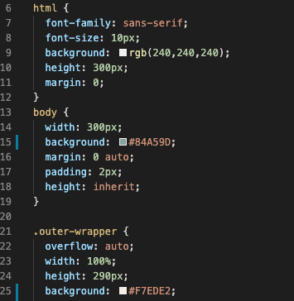
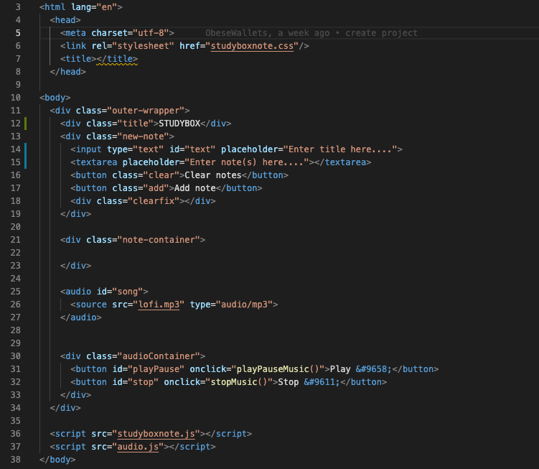
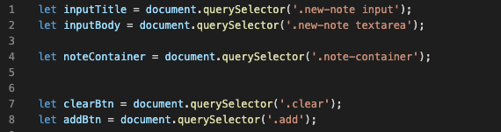
Code Snippets

Slide 8
Technical Highlights
Document & Code base set up
Most group members use macbooks which makes it a bit tougher
Implementation of music background
Youtube does not allow us to embed videos
Difficulty playing music from mp3 files
Due to API limitations
Time management differed upon each groupmate
Meeting virtually
limited the amount of help that could be given to each other
All in out everyone contributed evenly to the project

Slide 9
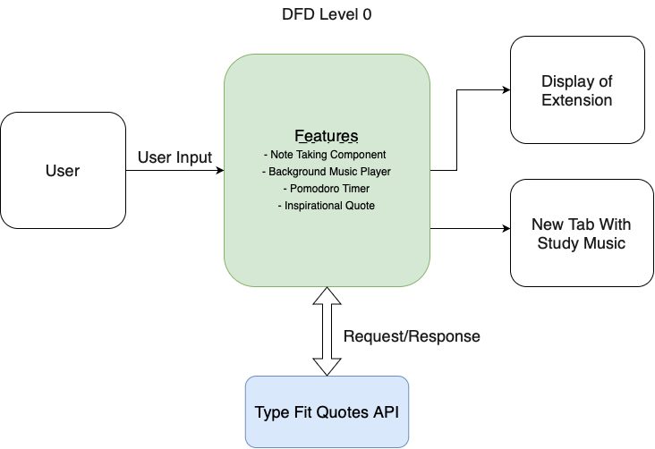
Design Overview

Slide 10
StudyBox Demo

Slide 11
ANY QUESTIONS?

