Slide 1
TEAM - II
- PLACEMENT WEBSITE

Slide 2
OUR TEAM
FRONTEND DEVELOPERS-
1. Richa
2. Ankit Raj
3. SUDARSHAN KHARADE
4. POLU VIVEKANANDA
5. K V CHAKRADHAR
6. PALAKOLANU VISHNU
BACKEND DEVELOPERS
1. DARISI PRIYATHAM
2. SMARIDDHI RATHORE
3.YOGESH JHANWAR

Slide 3
PROJECT OVERVIEW
Providing an integrated platform for the company and the students of our college.
We aim to give the students a central platform from where they students can find out about the every detail of the company visiting our college.

Slide 4

Added Features
The landing page of our website ,where the users can login with their personal Gmail id or with their college email id..

Slide 5
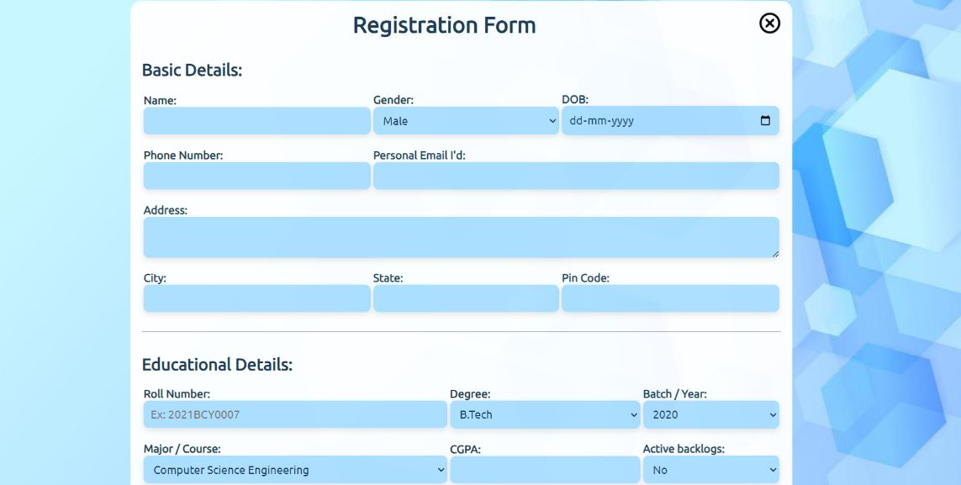
Registration Form

Slide 6
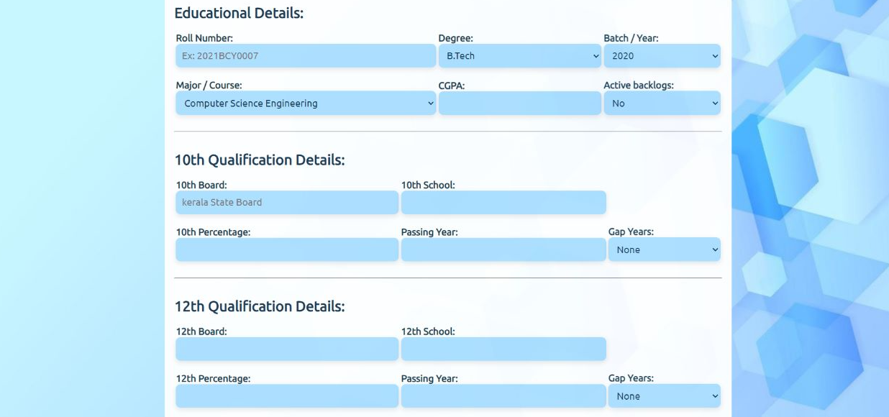

Slide 7
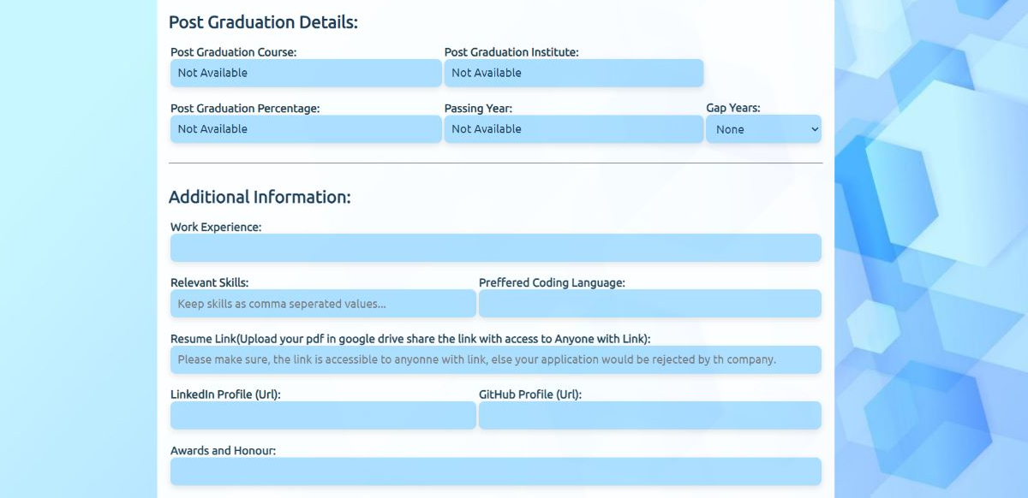

Slide 8
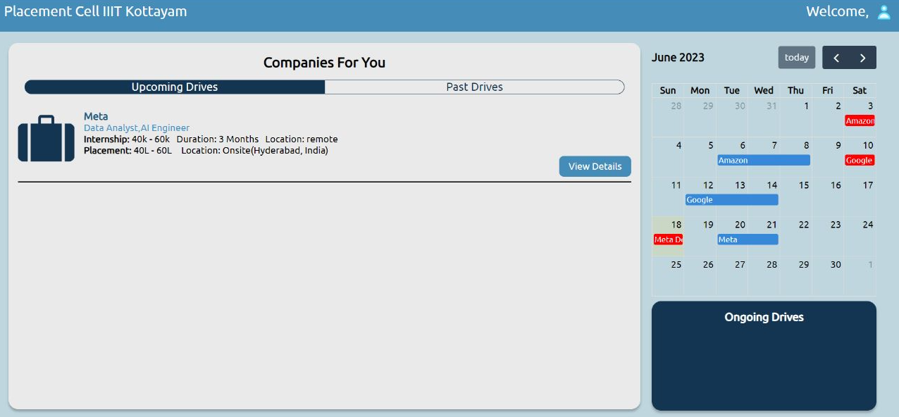
STUDENT DASHBOARD
Students can find out about all the upcoming, ongoing and past drives from here.

Slide 9
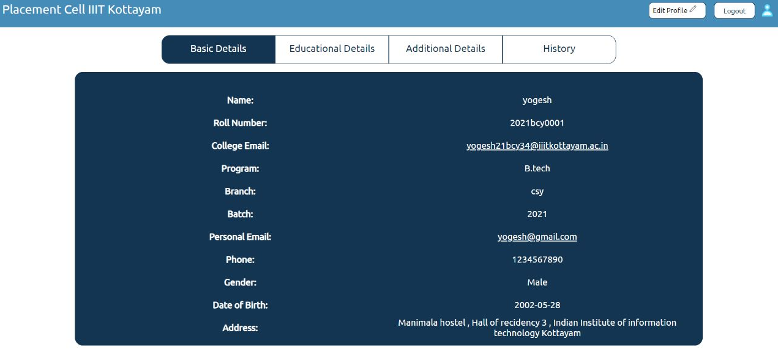
USER PROFILE PAGE

Slide 10
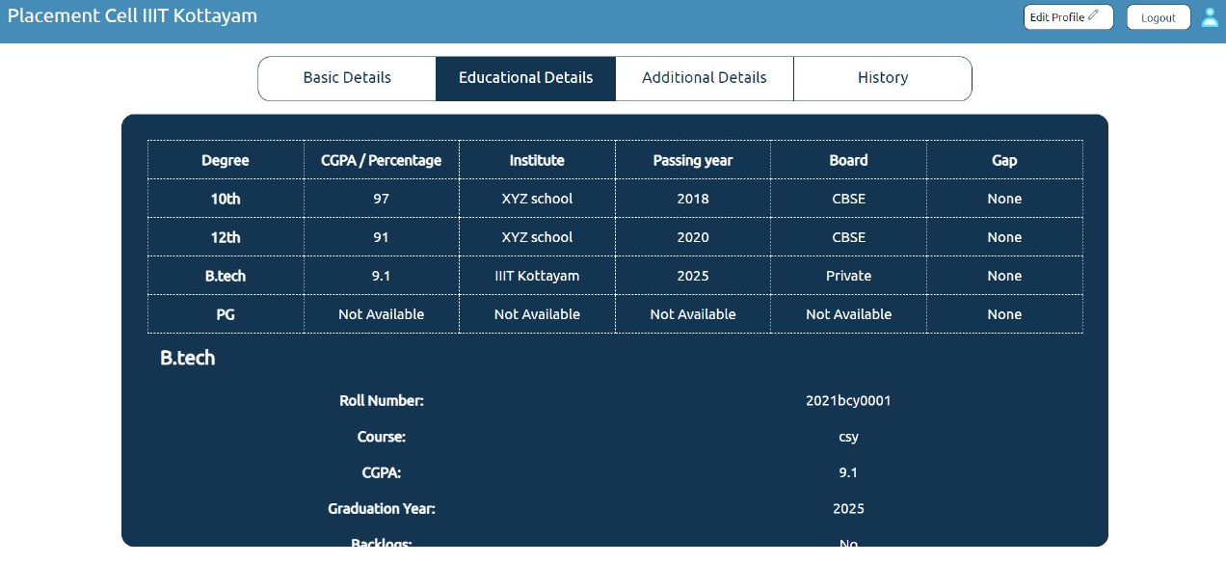

Slide 11
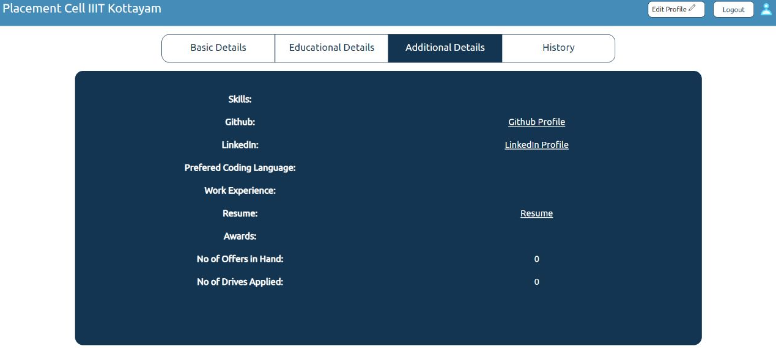

Slide 12
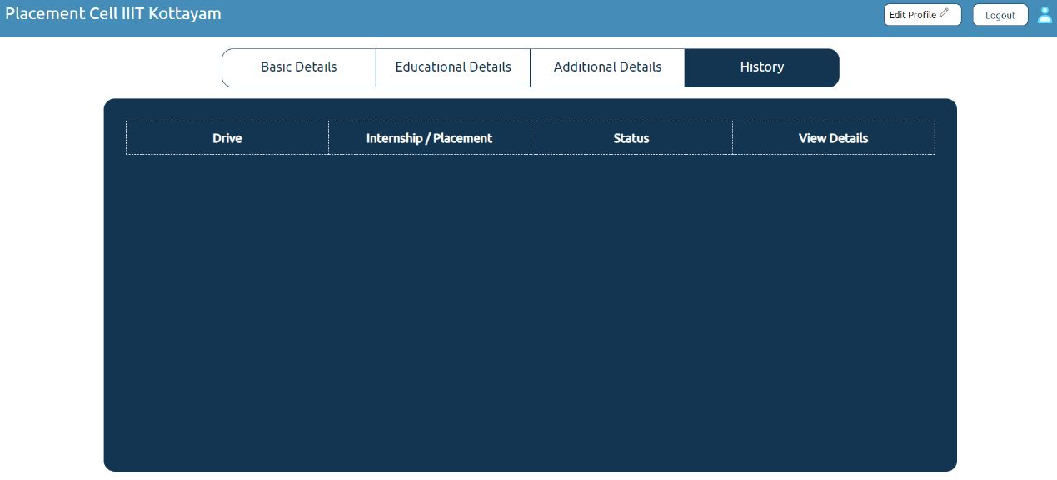

Slide 13
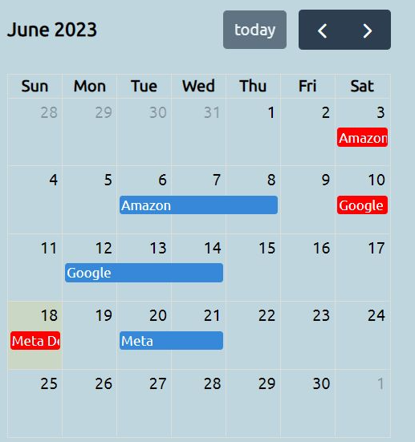
This is upcoming calendar of drive which displays upcoming
events, on clicking on marked dates it shows description.
Here colour is given for past drivers which is red and for
upcoming drive it is blue.

Slide 14
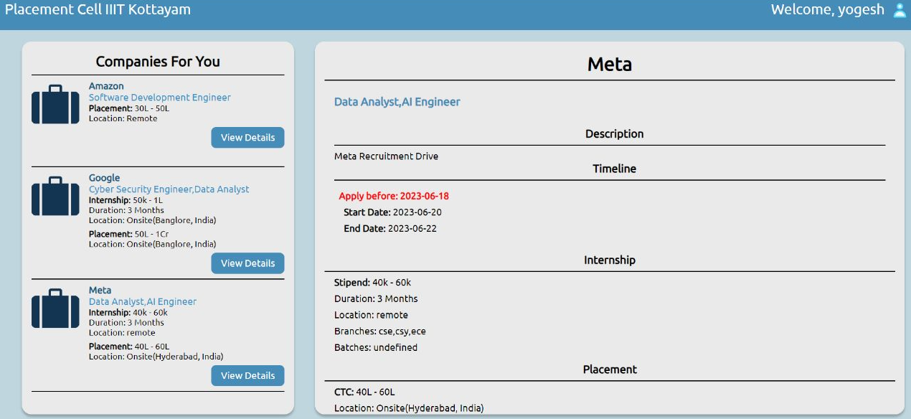
DRIVE DESCRIPTION

Slide 15
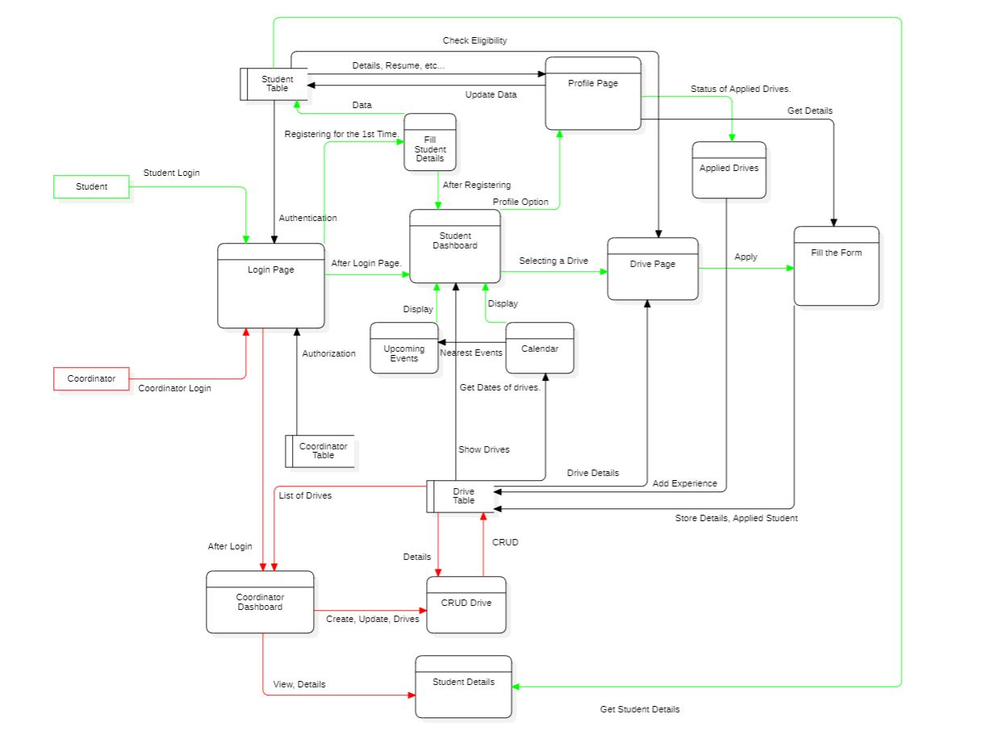
DATA FLOW DIAGRAM

Slide 16
THANK YOU

