Slide 1
How to submit data with GitHub

Slide 2
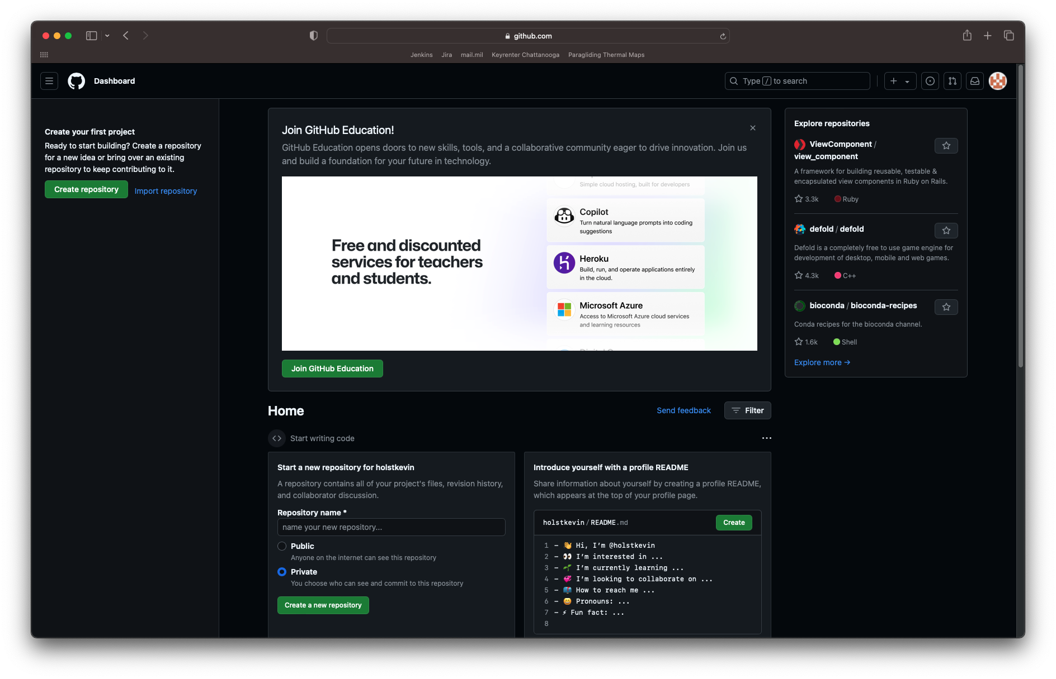
GitHub Dashboard
These instructions assume that you have a GitHub account and are logged in.
If you do not, please go to github.com and create a free account.
Also, this is just one way to submit data directly through the GitHub website. There are other ways to accomplish the same thing, and if you’re familiar with them, by all means use what’s comfortable to you.

Slide 3
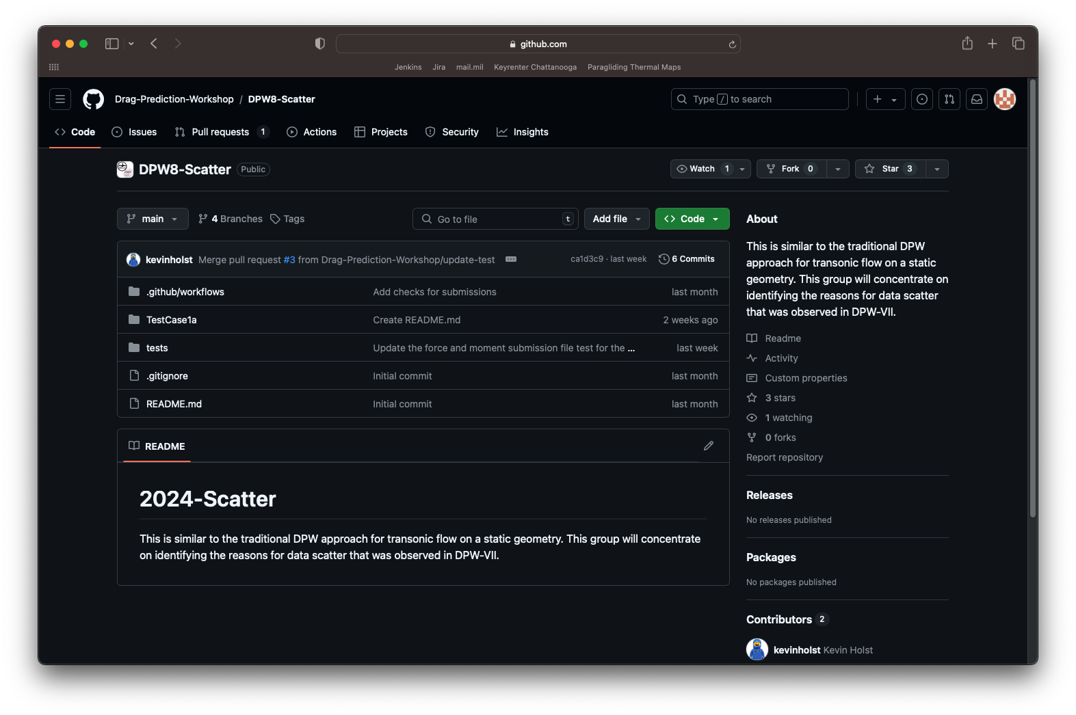
DPW8-Scatter Repository https://github.com/Drag-Prediction-Workshop/DPW8-Scatter
Navigate to the desired repository. DPW8-Scatter is shown here. Select the repository for your working group
If you are a member of more than one working group, you only need to submit data to one repository. You can choose which one
Click the Fork button. This will create your own version of the repository, which you will use to submit your data.

Slide 4
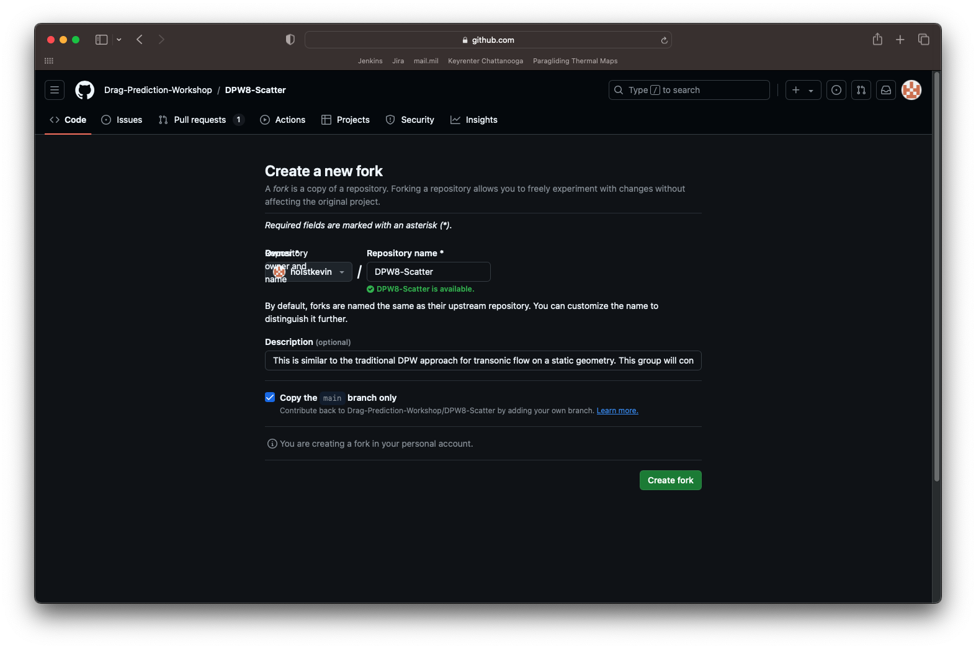
Your fork of DPW8-Scatter
After clicking Fork, you’ll be walked through the process of creating a new fork from the repo.
You can name this fork whatever you’d like, but I would recommend just keeping the name the same and copying the main branch only.

Slide 5
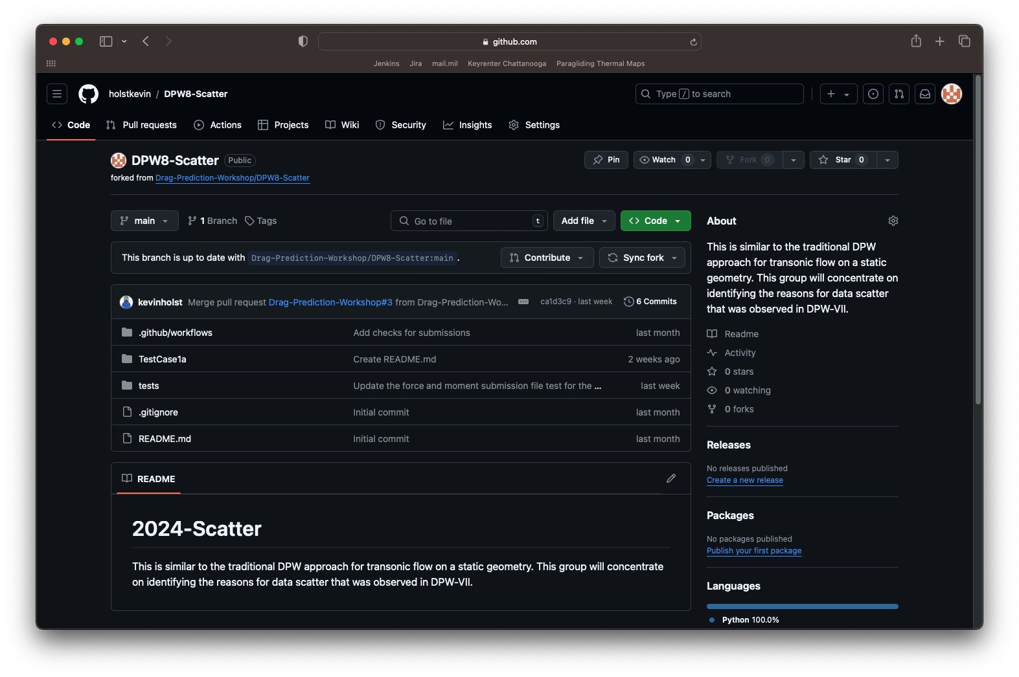
Your fork of DPW8-Scatter
After creating the fork, you’ll be brought to a landing page for your new fork of the repository.
Some key features here are
Contribute – This is how you will push your data up to the main repository
Sync fork – Clicking this will bring updates from the main repository into your local fork

Slide 6
Your fork of DPW8-Scatter
Next we’ll create the folder structure for your submission.
A folder for TestCase1a has already been created, but you’ll need to create subfolders for your participant ID and submission ID
Start by clicking the TestCase1a folder

Slide 7
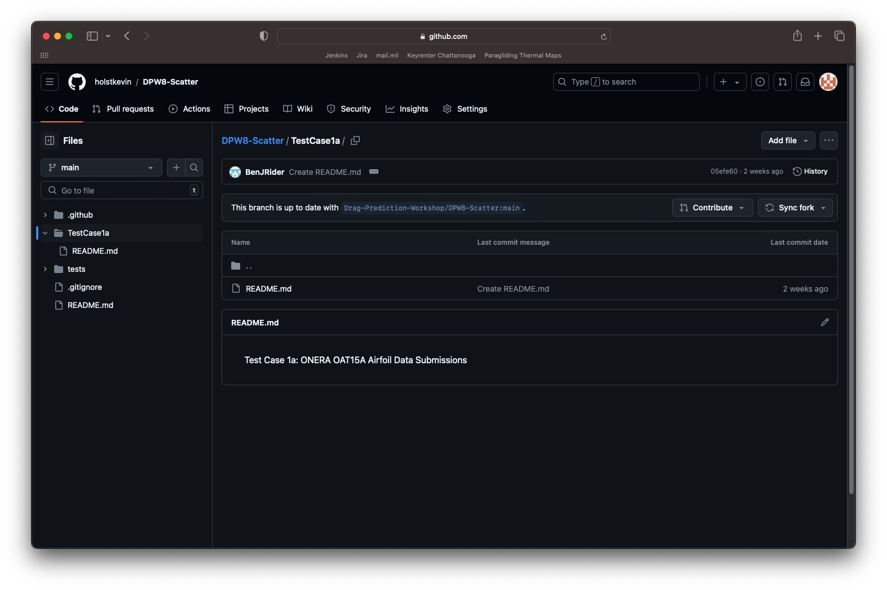
Your fork of DPW8-Scatter
If you already have a folder in place for your participant ID, you can skip this step.
Click Add file and select Create new file

Slide 8
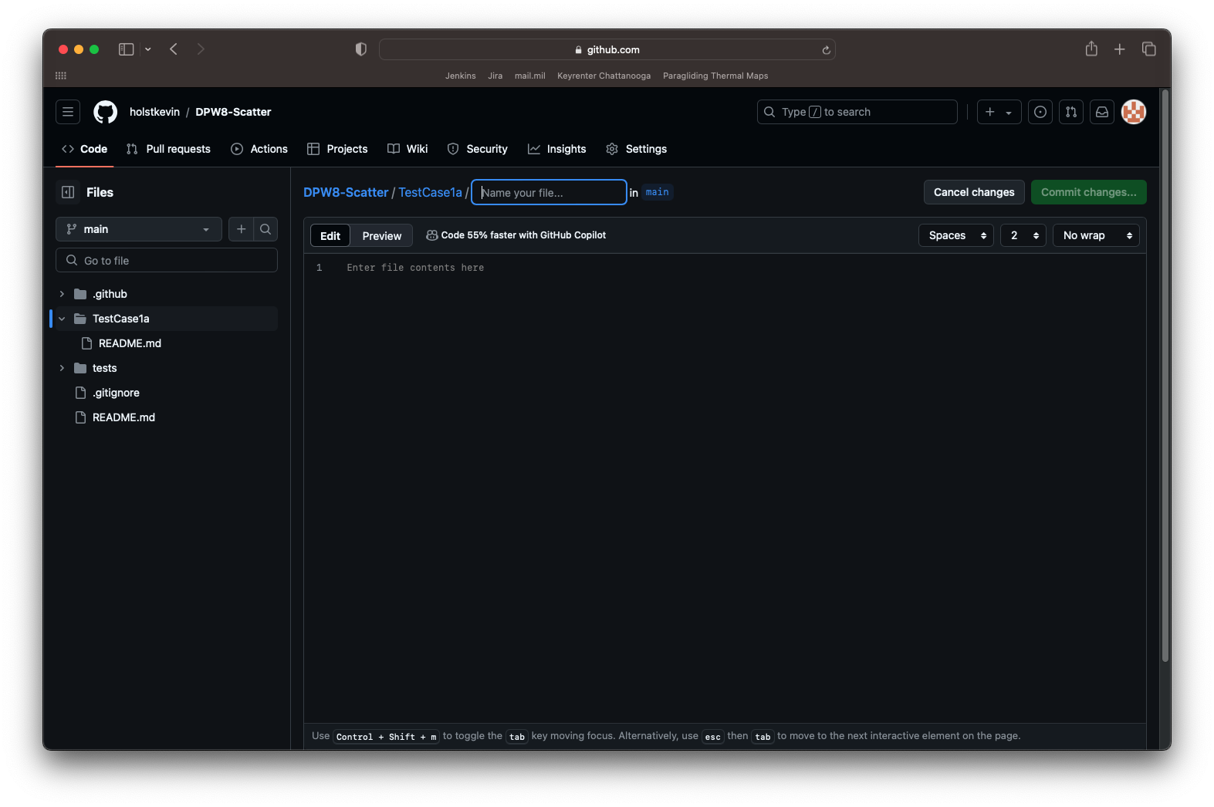
Your fork of DPW8-Scatter
We’d like to create a README.md file within a new directory called 999_StarkIndustries, so in the Name your file… box type I would type: 999_StarkIndustries/README.md
Obviously replace 999_StarkIndustries with your participant ID and description
After doing this, you can leave the README.md file blank for now or include any information in there that you’d like.
Click Commit changes…

Slide 9
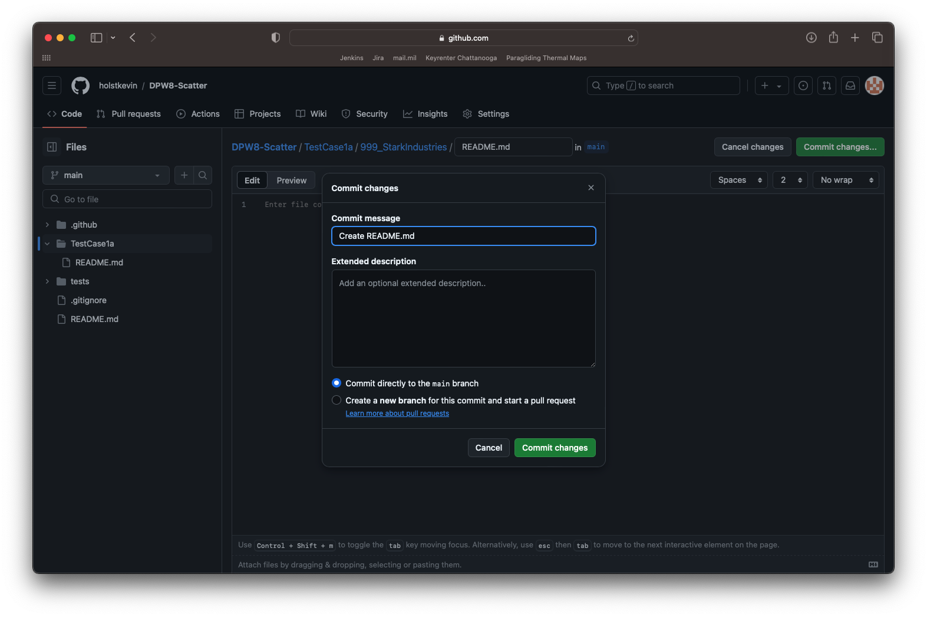
Your fork of DPW8-Scatter
Create a commit message with whatever you like
Add a description if you’d like
Click Commit directly to the main branch
Note: you can create a local branch if you prefer that workflow, but that won’t be described here.
Then click Commit changes
This will create a folder in TestCase1a called 999_StarkIndustries with a README.md file in that folder.

Slide 10
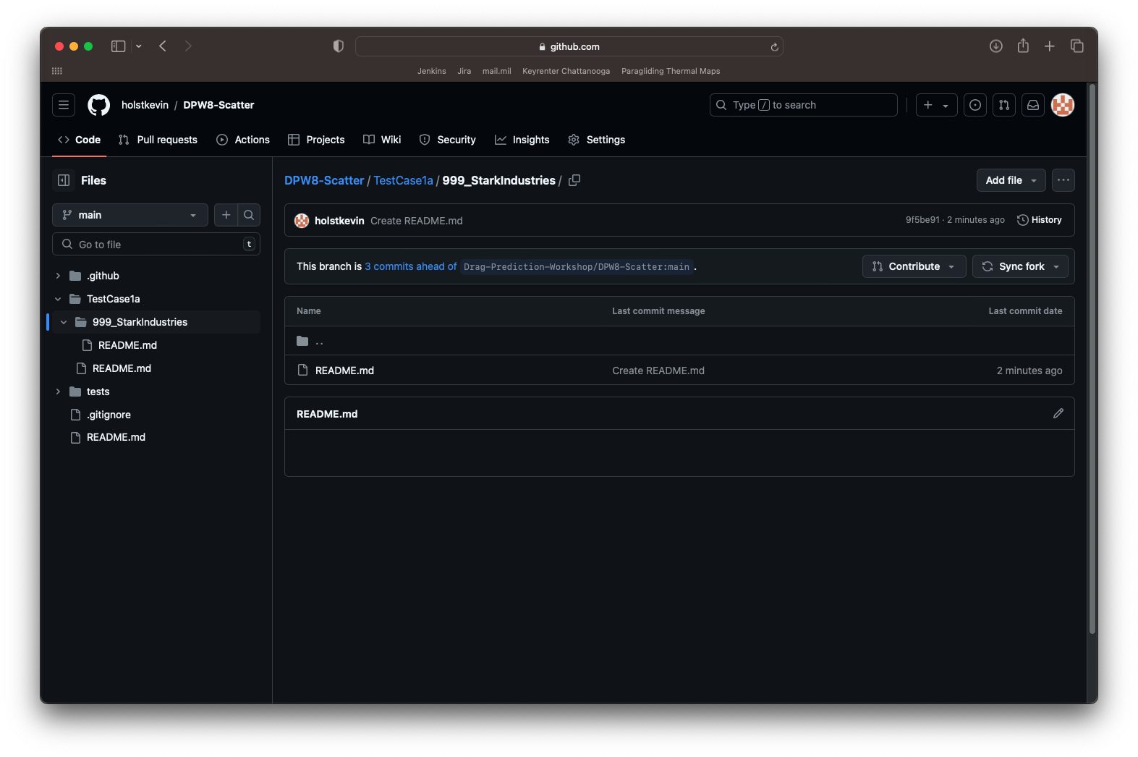
Your fork of DPW8-Scatter
From your newly created participant folder, we’re going to create a new folder for this submission.
Git tracks files, not folder, so we have to create a new file in order to create the folder.
Repeat the process from before by clicking Add file and Create a new file

Slide 11
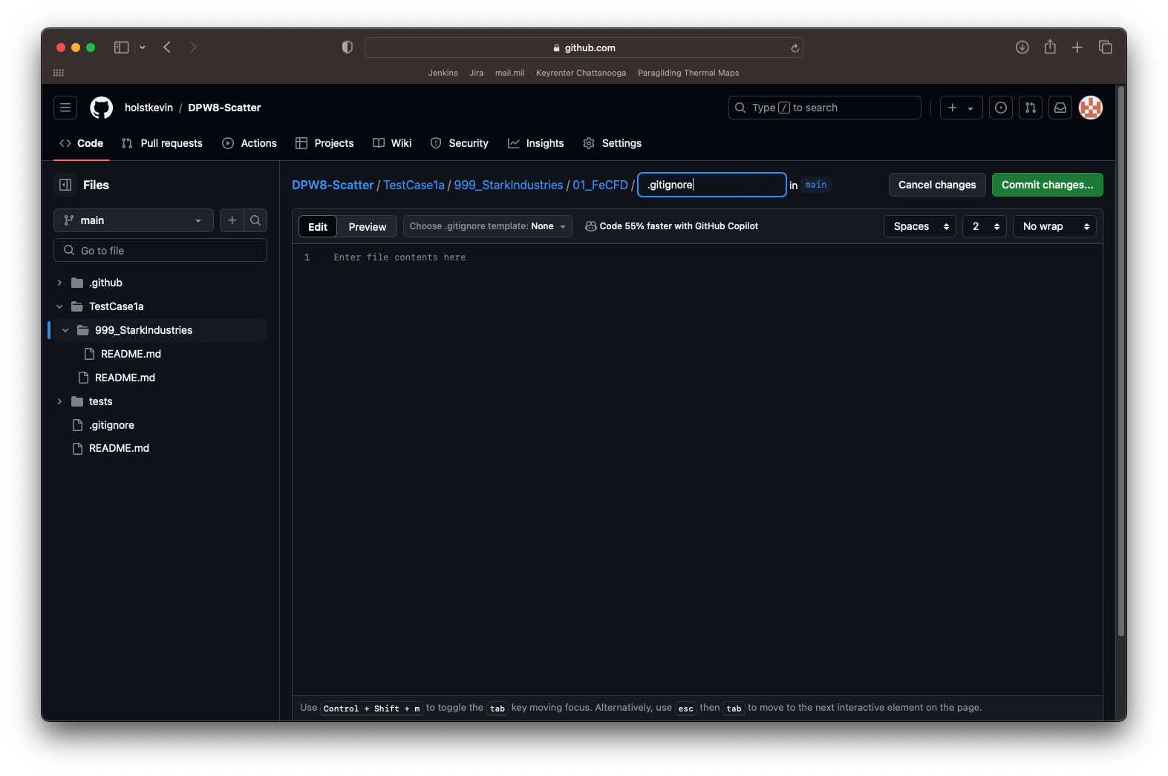
Your fork of DPW8-Scatter
Repeat the process from before by clicking Add file and Create a new file
This time we’ll be creating a folder for the submission, which is titled 01_FeCFD, and we’re adding a file called .gitignore, which will be ignored automatically by git
Click Commit changes… without adding anything to the file, and commit this file to the main branch like before
Now you have a folder to place your submission files into

Slide 12
Your fork of DPW8-Scatter
Navigate to your newly created submission folder, and then click Add file again, but this time choose Upload file

Slide 13
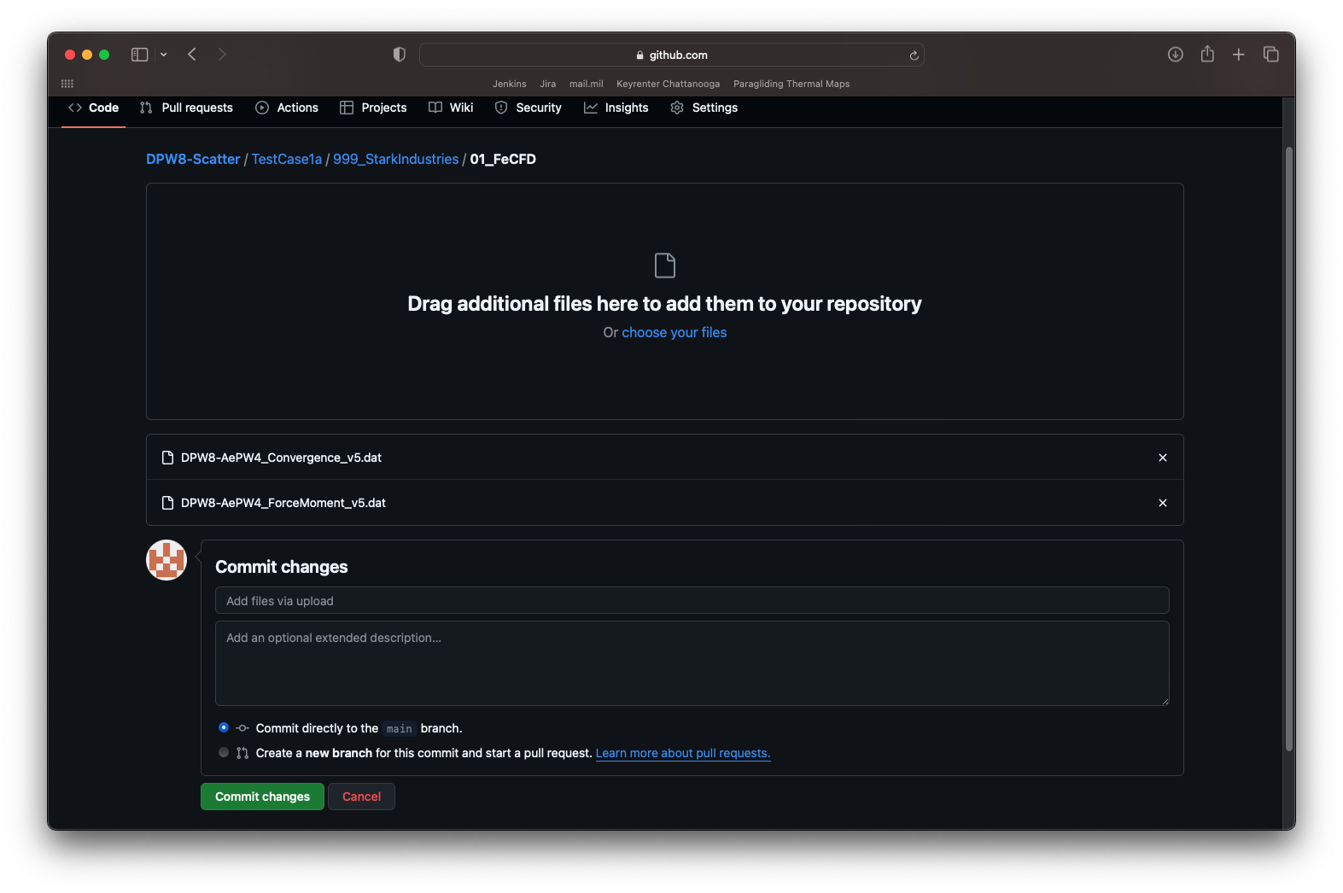
Your fork of DPW8-Scatter
Navigate to your newly created submission folder, and then click Add file again, but this time choose Upload file
Here you can choose files through a file browser window or drag and drop files into this window. I’ve uploaded two files to the repo here.
Click Commit changes to commit these files directly to your main branch

Slide 14
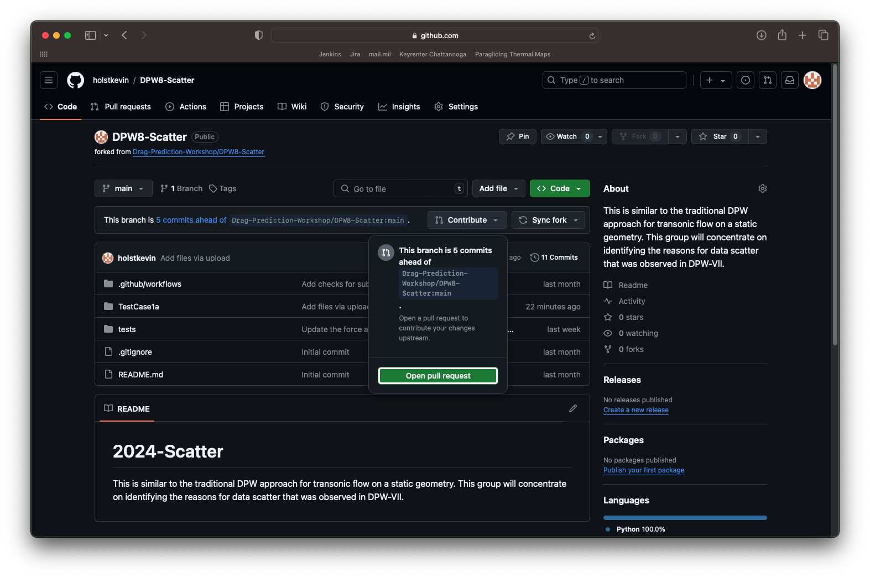
Your fork of DPW8-Scatter
Your files are now uploaded to your fork of the repository.
You can add more submissions by repeating the process of creating a submission folder and adding additional files.
Once all of the files are uploaded to your fork, navigate to the front page of your repo, and click Contribute and Open pull request

Slide 15
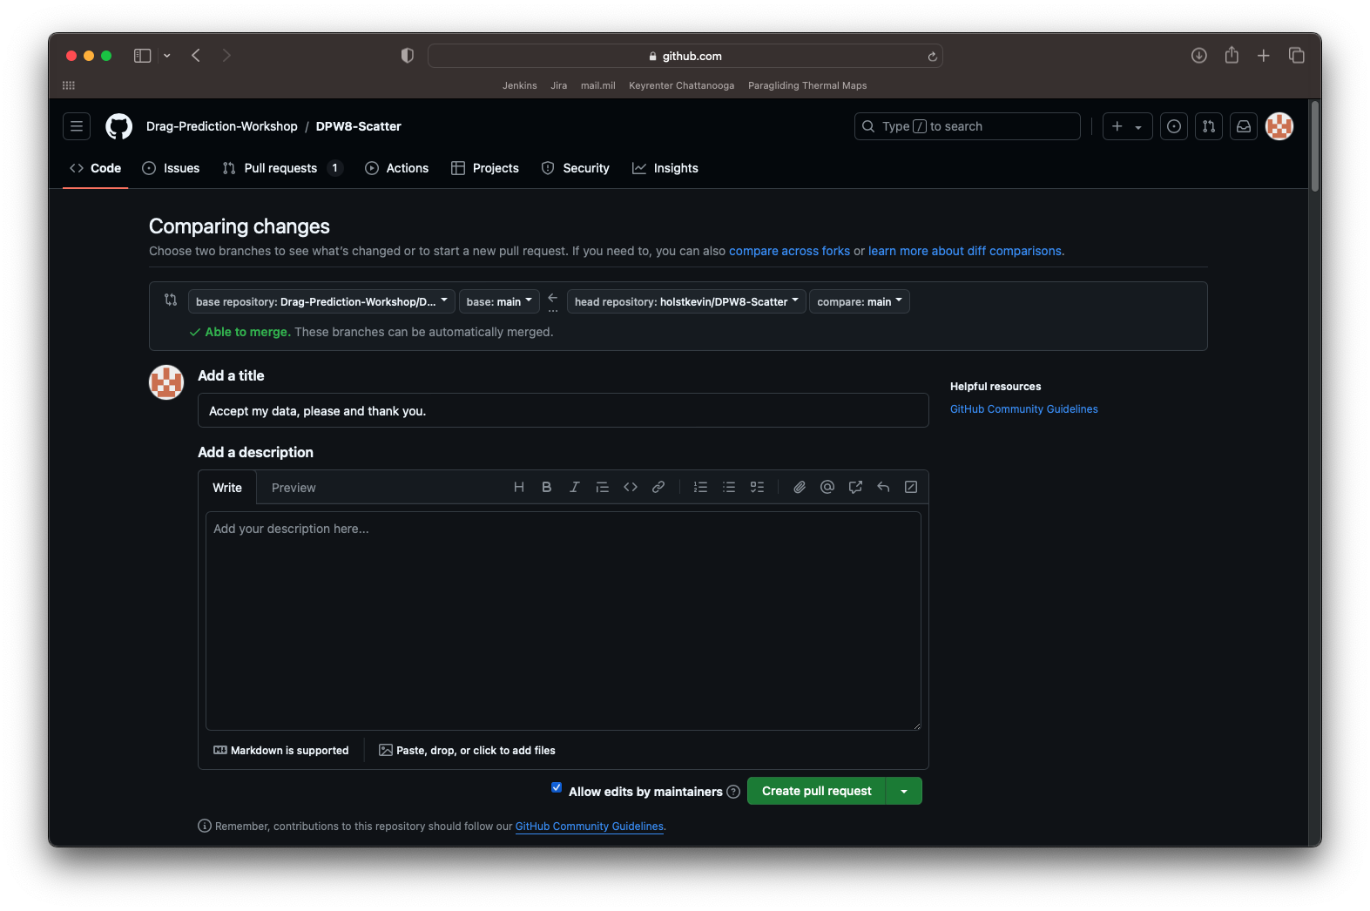
Your fork of DPW8-Scatter
From here, you’ll have to add a title for your pull request, fill in some description, as necessary, and then click Create pull request
This will inform the group leads that your data files are awaiting review

Slide 16
Final thoughts
This method only relied on the web interface for GitHub. If you’re familiar with their command line interface or GitHub application, you absolutely can use those as well.
Undoubtedly people will run into issues along the way, so please feel free to reach out to the group leads with any questions.
Also, there is a wealth of information on the Fork and Pull method of contributing to a repository. Here’s one tutorial that is slightly more advanced and uses the command line interface: https://gist.github.com/Chaser324/ce0505fbed06b947d962

