Slide 1
DPW7 AGENDA
June 25-26, 2022

Slide 2
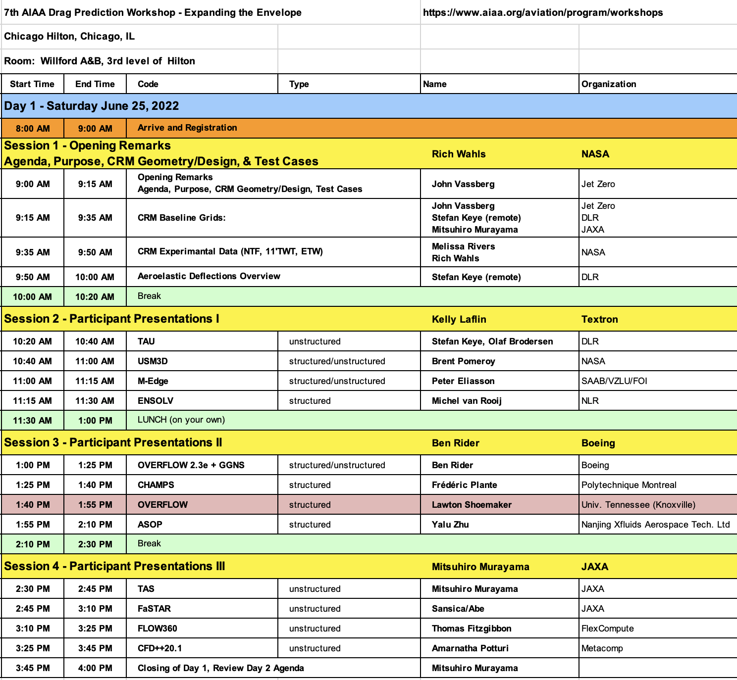

Slide 3
