Slide 1


Review of 2D buffet simulations on OAT15A profile
F. Sartor, C. Fournis (presenter)
ONERA - DAAA/ACI
June 2026
Ce document est la propriété de l'ONERA. Il ne peut être communiqué à des tiers et/ou reproduit sans l'autorisation préalable écrite de l'ONERA, et son contenu ne peut être divulgué. This document and the information contained herein is proprietary information of ONERA and shall not be disclosed or reproduced without the prior authorization of ONERA.

Slide 2
Outline
Introduction
Overview work performed on OAT15A within DPW-8
Grids and approach
Simulations using elsA
Steady-state simulations
Time-accurate simulations
Comparison with experimental data
Conclusions

Slide 3
Introduction: DPW-8
DPW
AePW
Sources of
DPW-7 Scatter
Static Aeroelastics
High Angle
Large Deflection
Test Environment
Buffet
High Speed
Focus of this presentation
DPW and AePW
ONERA involved in many activities, mainly in DPW
DAAA/ACI contributed to Buffet and Scatter Working Group (elsA and CODA)
WG#3 Buffet
Test case 1: OAT15A simulations (steady/unsteady)
Test case 2 and 3: CRM, not discussed here

Slide 4
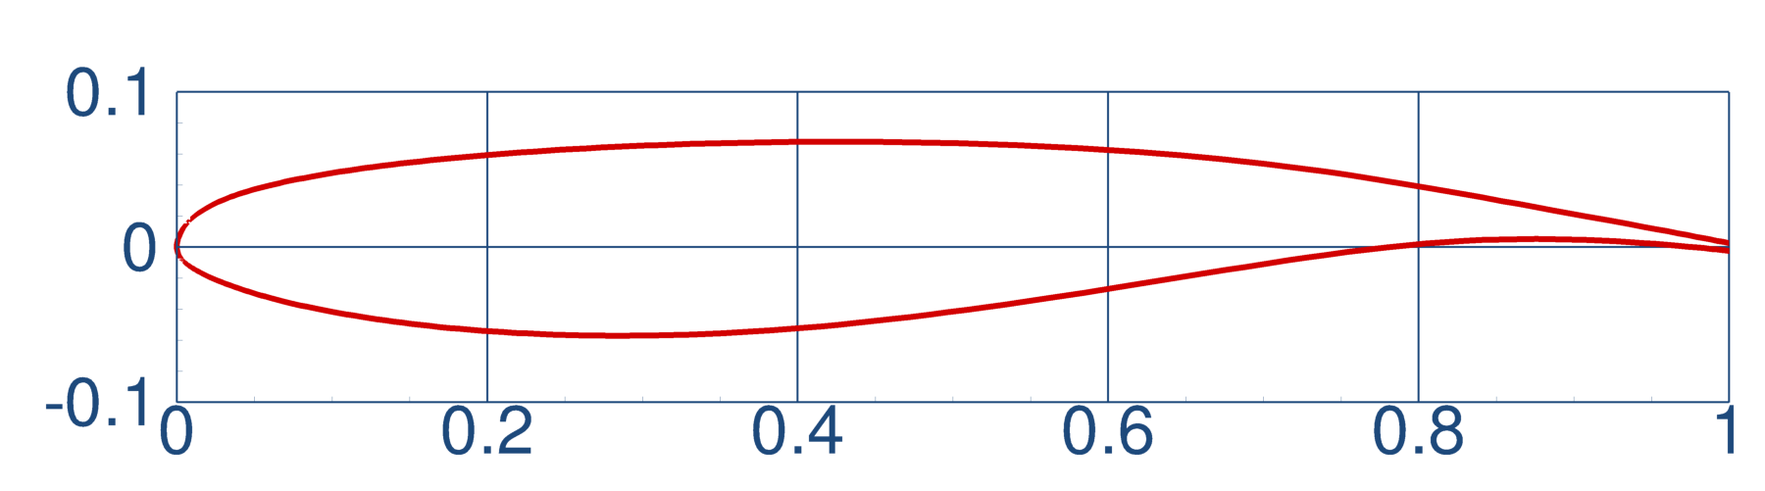
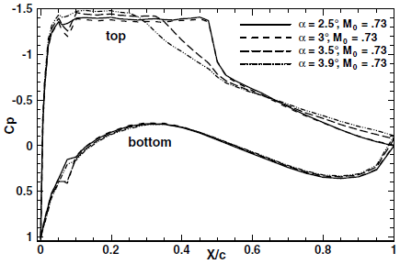
Introduction: Test case 1
OAT15A
→ Reference for 2D buffet since Jacquin et al. (2009)
ONERA shared CAD files with geometry details
Experimental data: Cp, Cp_{rms}, time-history signals, PSD
Some 2D grids also provided by the workshop (Cadence, HeldenMesh, ONERA)
Experiments from Jacquin et al
Experiments indicated buffet onset around 3.5°
What solver can reproduce it? On which grid?
What can be delivered using different approaches?
Best practices for turbulent models, numerical schemes, limiters?
In this presentation:
Solver
elsA
Grids
Supplied
Custom
Approach
RANS
URANS
Turb. Model
Mainly SA
Other tested
Scheme
Any
AoA
1.36°- 3.90°
10 in total

Slide 5
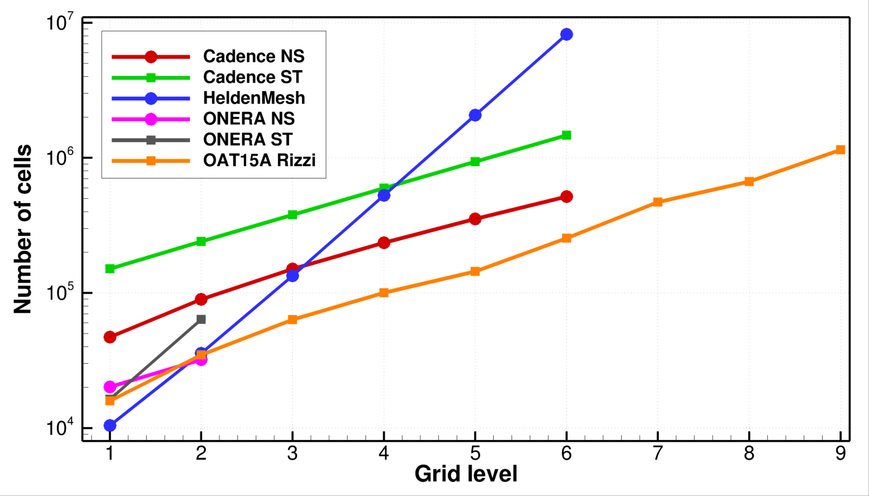
Introduction: available grids
6 families, 30 grids in total:
Cadence (unst.): 6 levels
Helden Mesh (unst.): 6 levels
ONERA O-grid (unst.) : 2 levels
Cadence (st): 6 levels
ONERA O-grid (st): 2 levels
ONERA Rizzi (st): 9 levels
Fine: > 1,000,000, cells
Medium: ~ 200,000 cells
Coarse: ~20,000 cells
Number of cells vs grid level
Visualisation of grid level 1 for all 6 tested grids

Slide 6
Introduction: simulations completed
elsA code:
Co-developed by ONERA and Safran
Finite volume, centered cells, RANS/URANS approach
Structured or unstructured, depending on the grid
Intensively used for buffet simulations since many years, both in 2D and 3D
First approach:
test ALL the grids in RANS/URANS using the same “standard” parameters, for all AoA
ONERA best practices have second order in both conservative and turbulent fluxes
This does not yield buffet! Not even one grid, one AoA, for all the turbulence models tested
Decided to use first order turbulence
This behavior have already been observed with elsA in the past for 2D and 3D buffet simulations
Final approach:
elsA solver, RANS on most grids, SA, Roe scheme, all AoA
First order on turbulent fluxes
Run of roughly 300 steady and 300 unsteady cases
Additional 100 parametric simulations changing some parameters, only on AoA=3.5°
Conclusions analyzing and comparing the “only” 15 cases that show buffet at 3.5°

Slide 7
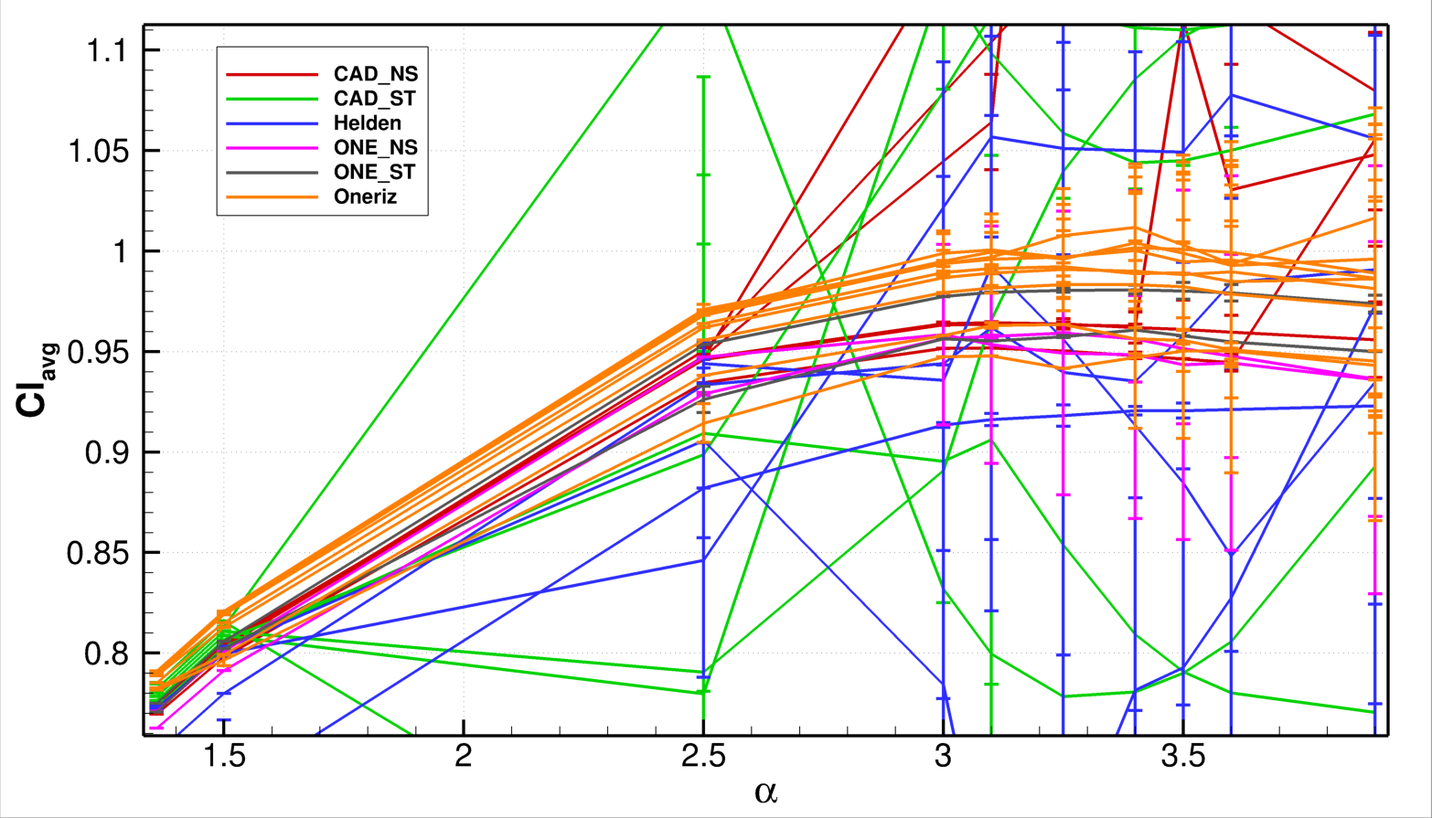
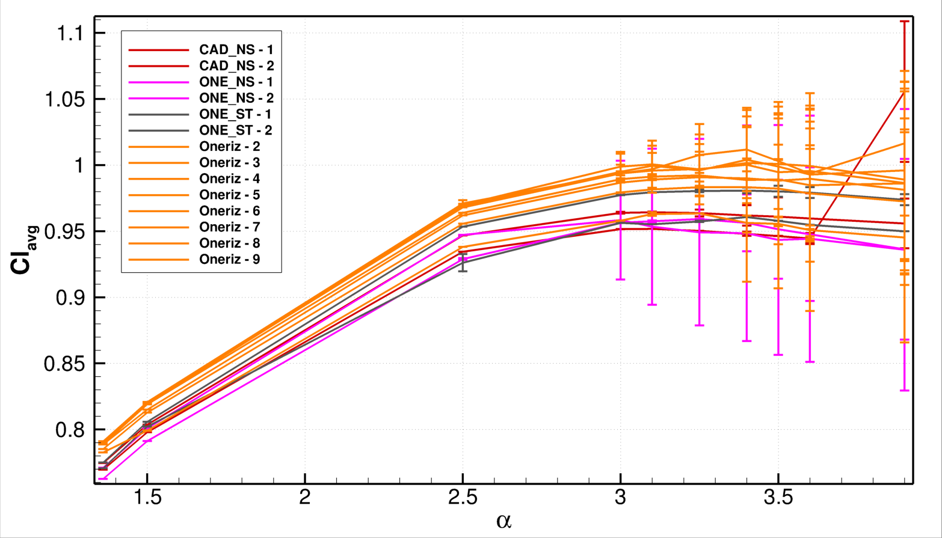
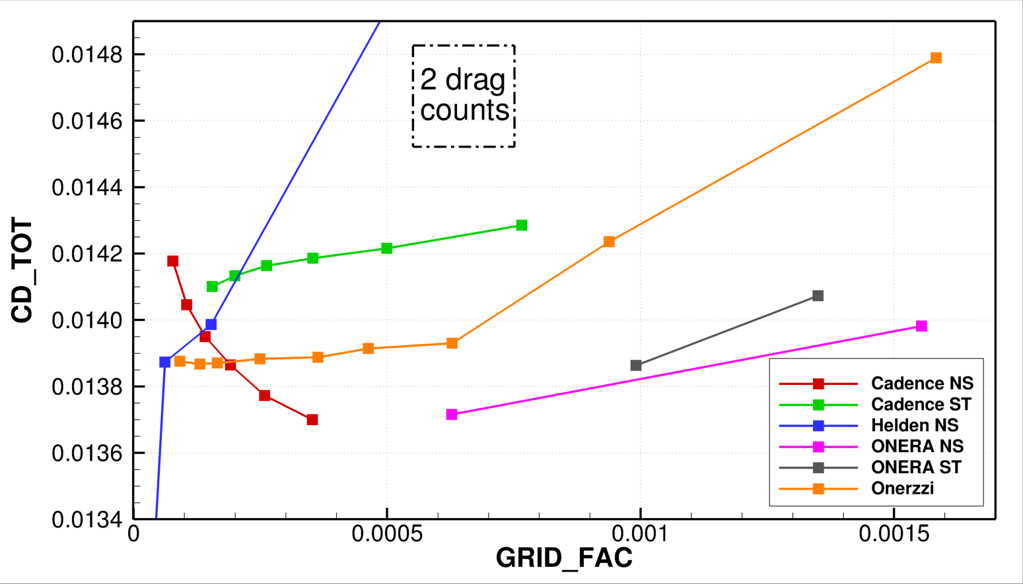
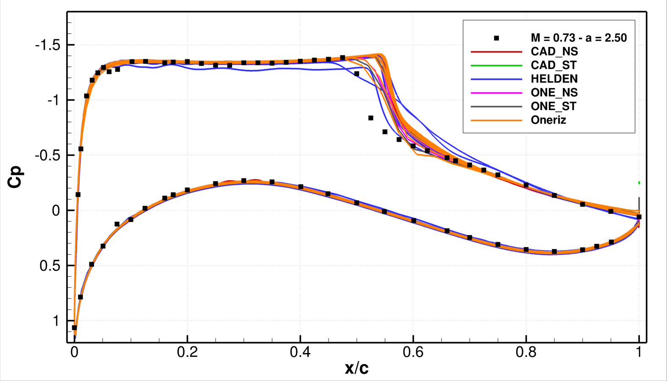
RANS results using elsA
Result example of steady-state simulation, using all grids, elsA solver using standard best practices
Cl vs alpha. Error bars showing Cl_{std}
Low-dissipation setup not converging
Down-selection of converging grids
Still a lot of grid dependency
Some grids are unsteady already at 3.0°
Some cases still not converging at all
Polars for cases that converge at low AoA
Grid convergence: only ONERA-Rizzi grid shows some sort of grid convergence
Reasonable comparison with exp. data
No grid has correct shock location with this combination of model/limiter
Grid convergence at 1.36 deg only for “Onerizzi”
Cp at AoA = 2.50°for all grids

Slide 8
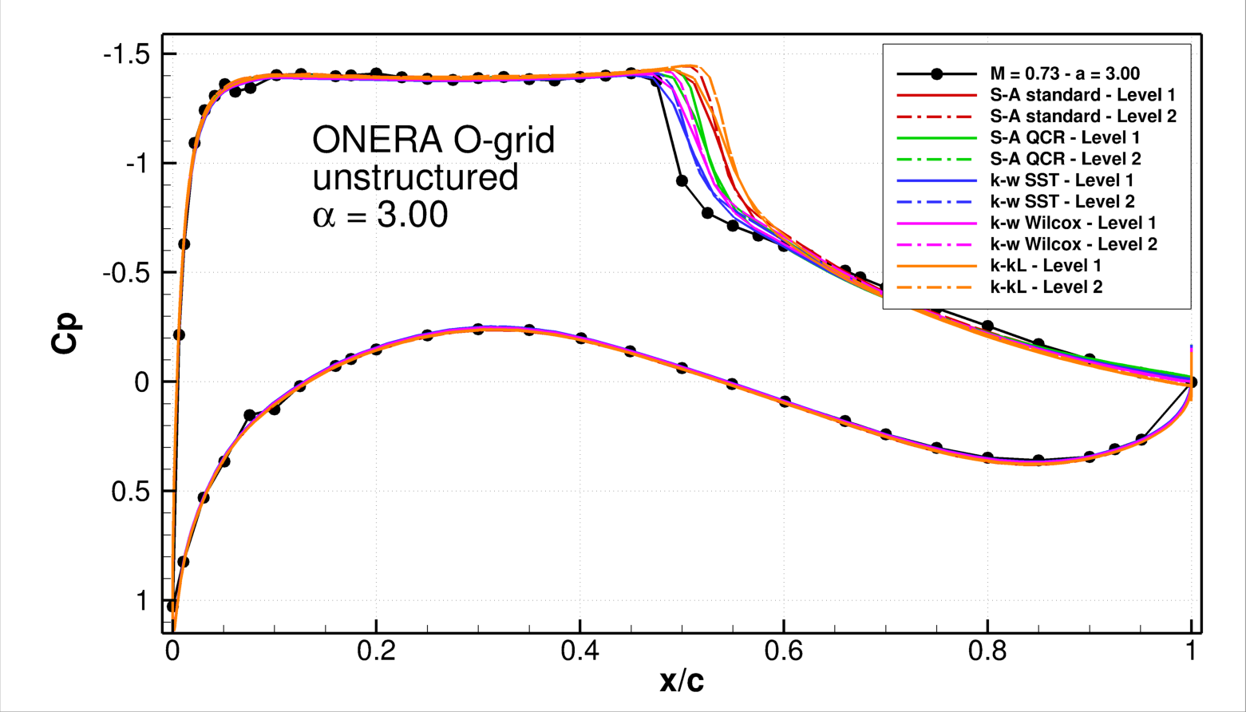
RANS results using elsA
Focus on ONERA O-grids (2 levels): effect of turbulence model for AoA = 3.00°
Conclusions:
As expected, turbulence-model dependency
k-w SST closer to experiments than SA, but shock still too downstream
Different results when changing grid
Model dependency more important than grid dependency
RANS reliable only for small angles of attack:
need for time-accurate simulations
Turbulence model and grid dependency for ONERA O-grid (unstructured)

Slide 9
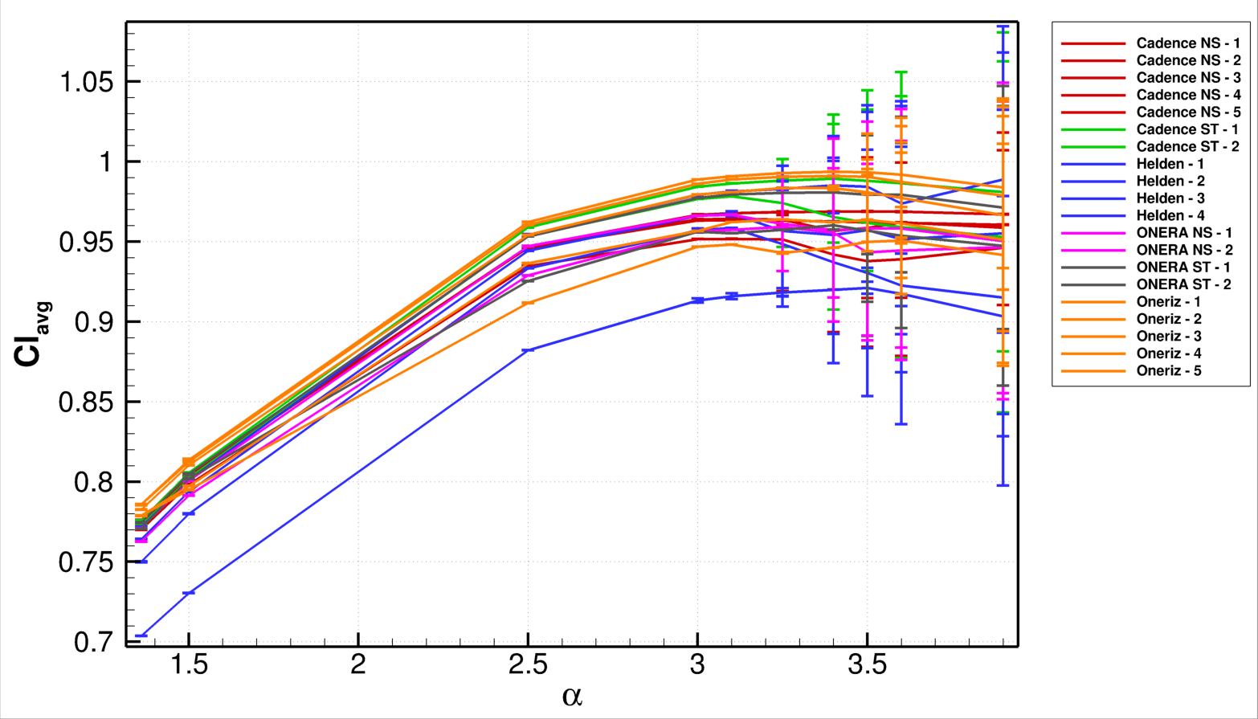
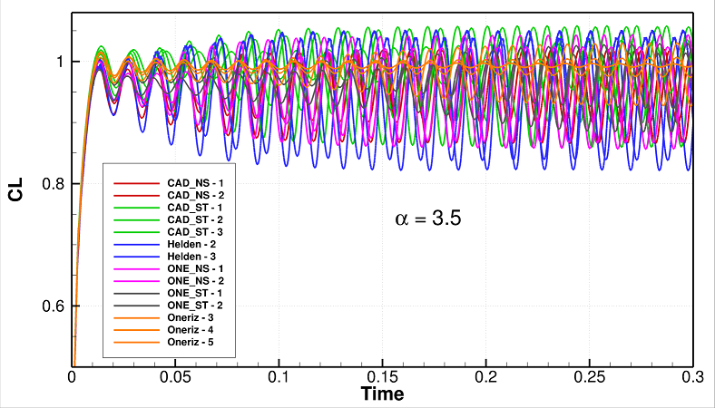
URANS results using elsA: time-accurate simulations
Time-history of lift coefficient quite similar in transient, average Lift and buffet frequency, different amplitudes
Lift polars still not showing grid convergence
Some agreement about buffet onset
Polars of average Cl, error bars with std of lift (unsteady cases)
Typical CL-iterations for all unsteady cases when AoA = 3. 50

Slide 10
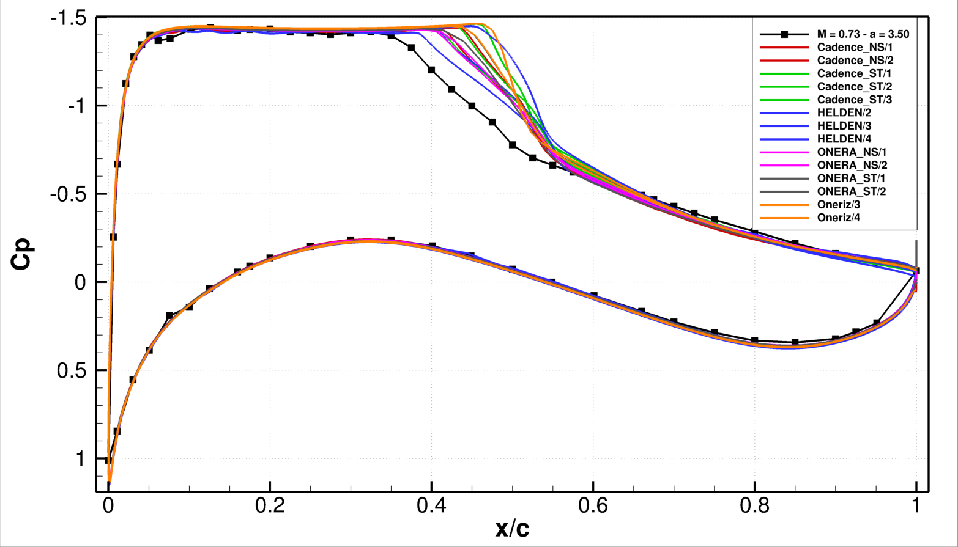
URANS results using elsA: average Cp
Focus on all grids, using best practices for time-accurate simulations. AoA = 3.50°
Average Cp distribution for all unsteady cases
Animation of Cp distribution vs average on ONERA O-grid, AoA = 3.50°
Shock location always downstream w.r.t. experiments among the 14 grids showing buffet at 3.50°
All other grids yields steady solutions (no shock movements)
Favorable comparison elsewhere: upstream shock, downstream separation, pressure side, LE, TE

Slide 11
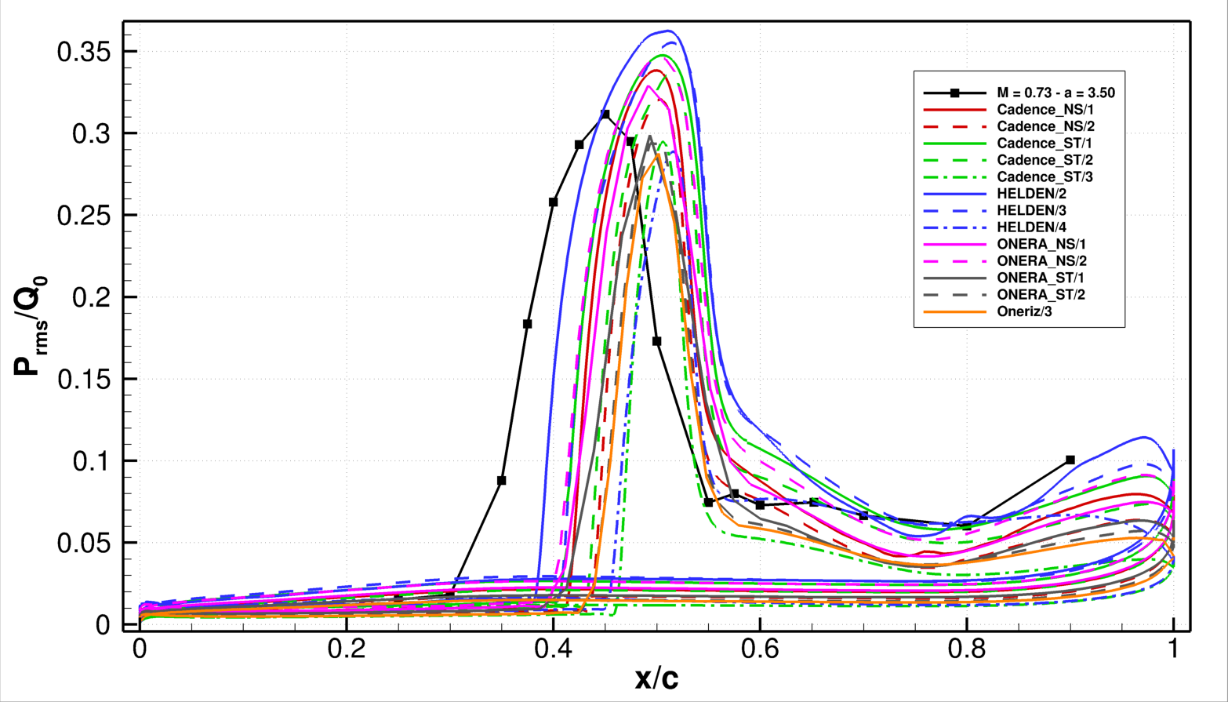
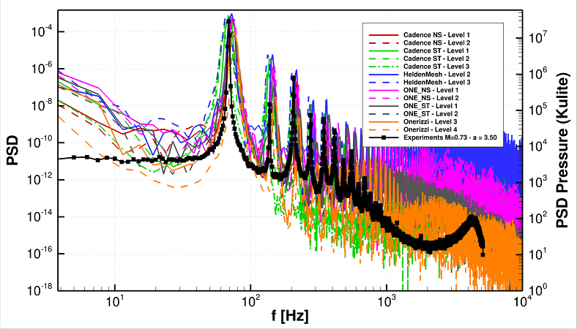
URANS results using elsA: fluctuations
Focus on all grids, using best practices for time-accurate simulations. AoA = 3.50°
RMS on suction side for all unsteady cases at 3.50°
Power Spectral density of all unsteady cases at 3.50°
RMS show shock downstream, but similar amplitudes
Good agreement in separated region
Power Spectral Density: very good agreement for the main buffet frequency

Slide 12
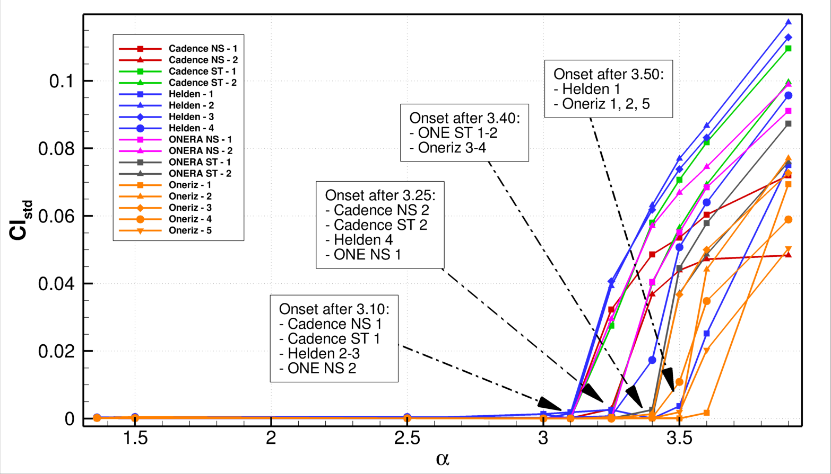
URANS results using elsA: buffet onset
Buffet criterion: CL oscillations
No grid convergence
Coarse grids: onset sooner
Unst. grids: ~ onset sooner
Some grids never show buffet!
Conclusion: very hard to select the best grid or refinement level
Buffet onset criterion: increase of STD of lift coefficient

Slide 13
Conclusions
Recap of work performed:
Started elsA “best practices”, no buffet at all
Moved to second order for conservatives, first for turbulent equation(s):
RANS: poor residual convergence for high AoA, need for time-accurate simulations
URANS: tested all grids with “standard best practices” (only few of them are unsteady)
URANS: some extra simulations for tStep, inner-iterations, model, scheme
Conclusions
Very strong grid dependency, even at low AoA:
When changing the grid, the behavior changes
No grid convergence: if we refine we get different results
Time-step and inner iteration:
Fairly stable. Minimum number of iteration per period required
Buffet simulations:
Shock always slightly downstream w.r.t. experiments
Buffet frequency and shock amplitudes fairly well captured and consistent
Onset depends both on grid family and grid level
“Best grid”: hard to tell, but O-grids (20-40k cells/vertex) can give satisfying results

Slide 14
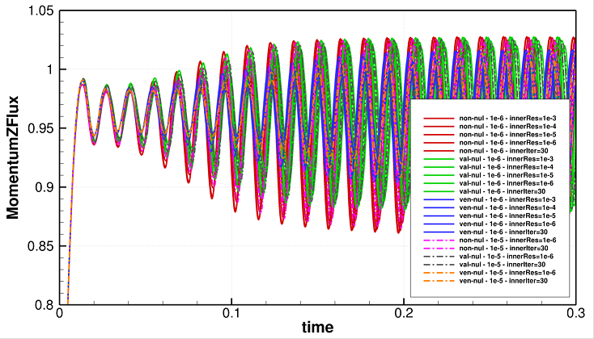
URANS using elsA: choice of the parameters
Check of best practices commonly used for OAT15A
Test on ONERA O-grid unstructured
Time step = 1e-5 and 1e-6 sec
Number of inner iterations: fixed (between 3 and 60) or with convergence criterion
Result:
Min. number of [steps] x [inner-it] needed for observing buffet
Similar transient (if buffet is observed)
No impacts on shock average position
Small impact on shock-motions amplitude
Slight difference in main buffet frequency
Time-history of lift with different limiters, time-step and inner-iterations
Conclusion:
Better to keep small time step (1e-6 s), limiter on both res (1e-4) and few max inner iterations (8)
Buffet frequency ~ 70 Hz → buffet period ~ 0,014 sec
Time step 1e-5 with 30 inner iterations → ~1,500 “expensive” steps/period
Time step 1e-6 with 8 inner iterations → ~15,000 “cheap” steps/period
Check later for grid-dependency

