Slide 1
Presentation on
Digital Computer &
Organization
Made By:-
Daksh Pahwa
IC-2K18-17

Slide 2
Index :
Introduction
Input - Output Organization
Memory Organization
CPU Organization
Control Unit

Slide 3
Introduction

Slide 4
What is Computer Architecture?
The study of the structure, behavior and design of computers.
Hennessy & Patterson: The interface between the hardware and the lowest level software.
Computer Architecture is study of the system from hardware point of view and emphasis on how the system is implemented .

Slide 5
What is Computer Organization?
Computer Organization is study of the system from software point of view and gives overall description of the system and working principles without going into much detail. In other words, it is mainly about the programmer’s or user point of view.

Slide 7
Von Neumann Architecture
In 1945 , was first published by John von Neumann.
It consists of a Control Unit, Arithmetic and Logic Unit (ALU), Memory Unit, Registers and Input/Outputs.
Von Neumann architecture is based on the stored-program computer concept .
Instruction data and program data are stored in the same memory. This design is still used in most computers produced today.

Slide 9
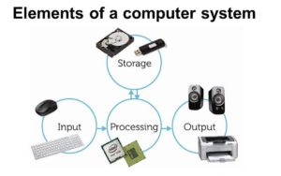
Components of Computer
The term Computer Hardware is used to describe computer components that can be seen and touched. The major components of general-purpose computer system are Input Unit, Main/Internal Memory or Storage Unit, Output Unit, Central Processing unit.

Slide 10
Bus Interconnection
A bus is a communication pathway connecting two or more devices.
A key characteristic of a bus is that it is a shared transmission medium.
A bus that connects major computer components (processor, memory, I/O) is called a System Bus.
There are many different bus designs, on any bus the lines can be classified into three functional groups data, address, and control lines which you can see in the below diagram.

Slide 11
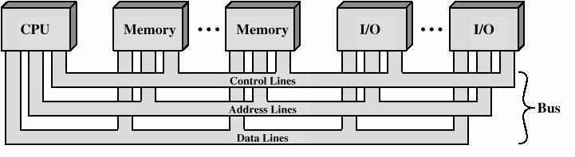

Slide 12
Each line is assigned a particular meaning or function . The lines can be classified into 3 functional groups
1. Data line 2.Address line 3.Control line
DATA LINE : Provide a path for moving data between system modules . These lines, collectively, are called the data bus. Data bus may consist of from 32 to 100 separated line . Each line can carry only one bit at a time . Number of line in the bus determine the data rate and overall the system performance

Slide 13
ADDRESS LINE
Used to designate the source or destination of the data on the data bus. The width of the address bus determines the maximum possible memory capacity of the system.
Control line
Used to control the access to and the use of the data and address lines.Since the data and the address line shared by all the components, there must be a means of controlling their use.
Control signal transmit both commands and timing information between the modules.
Typical control lines include Memory write, Memory read ,I/O write , I/O read , Clock , Reset, Bus request, Bus grant, Interrupt request, Interrupt ACK ,Transfer ACK

Slide 14
INPUT – OUTPUT Organization

Slide 15
The Input-output subsystem of a computer provides an efficient mode of communication between the central system and the outside environment. It handles all the input-output operations of the computer system.
PERIPHERALS:- Input or output devices that are connected to computer are called peripheral devices. These devices are designed to read information into or out of the memory unit upon command from the CPU and are considered to be the part of computer system. These devices are also called peripherals.
There are three type of Peripherals,
Input Peripherals.
Output Peripherals.
Input-output Peripherals.

Slide 16
There are three type of Peripherals-
Input Peripherals- An input device is a peripheral(piece of computer hardware equipment) used to provide data and control signals to an information processing system such as a computer or other information appliance.
Output Peripherals-An output device is any peripheral that receives data from a computer, usually for display, projection, or physical reproduction.
Input-output Peripherals-The I/O (input and output) peripheral are used primarily for communication between the computer and the external environment. They provide the ability to enter commands to the PC, and vice versa, i.e. send commands to outside to perform some task on a given device.

Slide 17
Working Of Peripherals
An input device converts incoming data and instructions into a pattern of electrical signals in binary code that are comprehensible to a digital computer. An output device reverses the process, translating the digitized signals into a form intelligible to the user.
Input peripherals : Allows user input, from the outside world to the computer. Example: Keyboard, Mouse etc.
Output peripherals: Allows information output, from the computer to the outside world. Example: Printer, Monitor etc.
Input-Output peripherals: Allows both input(from outside world to computer) as well as, output(from computer to the outside world). Example: Touch screen etc.

Slide 18
Direct Memory Access
DMA stands for "Direct Memory Access" and is a method of transferring data from the computer's RAM to another part of the computer without processing it using the CPU. While most data that is input or output from your computer is processed by the CPU, some data does not require processing, or can be processed by another device. n these situations, DMA can save processing time and is a more efficient way to move data from the computer's memory to other devices. In order for devices to use direct memory access, they must be assigned to a DMA channel. Each type of port on a computer has a set of DMA channels that can be assigned to each connected device. For example, a PCI controller and a hard drive controller each have their own set of DMA channels.

Slide 19
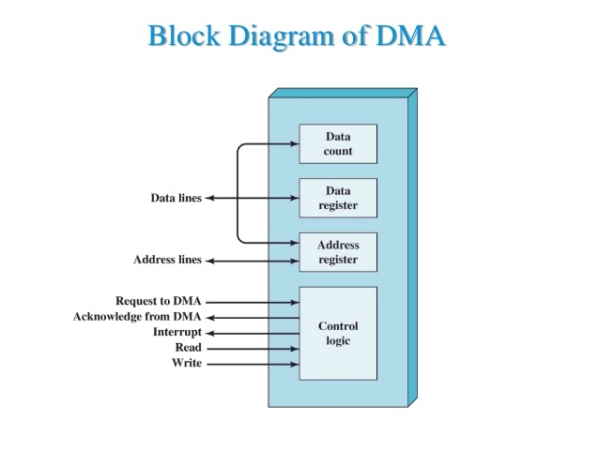

Slide 20
Priority Interrupt
Priority Interrupt are systems, that establishes a Priority over the various sources(interrupt devices) to determine which condition is to be serviced first when two or more requests arrive simultaneously . This system may also determine which condition are permitted to interrupt to the computer while another interrupt is being serviced . Usually, in Priority Systems, higher-priority interrupt levels are served first, as if they delayed or interrupted, could have serious consequences . And the devices with high-speed transfer such as magnetic disks are given high-priority, and slow devices such as keyboards receives low-priority.

Slide 21
I/O Processor
An input-output processor (IOP) is a processor with direct memory access capability. In this, the computer system is divided into a memory unit and number of processors.
Each IOP controls and manage the input-output tasks. The IOP is similar to CPU except that it handles only the details of I/O processing. The IOP can fetch and execute its own instructions. These IOP instructions are designed to manage I/O transfers only.

Slide 22
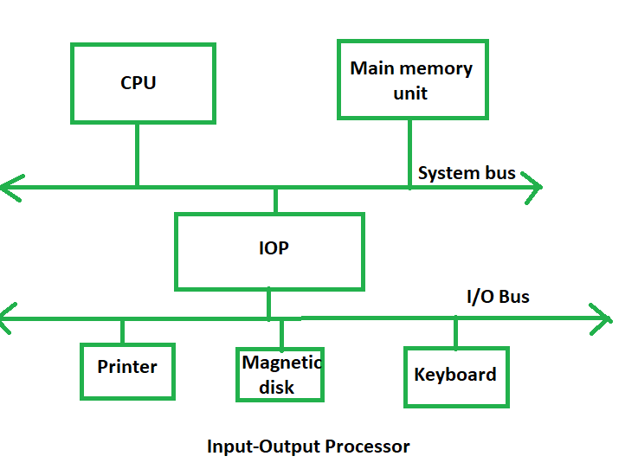

Slide 23
Interrupt Driven I/O
Interrupt driven I/O is an alternative scheme dealing with I/O. Interrupt I/O is a way of controlling input/output activity whereby a peripheral or terminal that needs to make or receive a data transfer sends a signal. This will cause a program interrupt to be set. At a time appropriate to the priority level of the I/O interrupt. Relative to the total interrupt system, the processors enter an interrupt service routine. The function of the routine will depend upon the system of interrupt levels and priorities that is implemented in the processor. The interrupt technique requires more complex hardware and software, but makes far more efficient use of the computer’s time and capacities.

Slide 24
Synchronous Data Transfer
In Synchronous data transfer, the sending and receiving units are enabled with same clock signal. It is possible between two units when each of them knows the behavior of the other. The master performs a sequence of instructions for data transfer in a predefined order. All these actions are synchronized with the common clock. The master is designed to supply the data at a time when the slave is definitely ready for it. Usually, the master will introduce sufficient delay to take into account the slow response of the slave, without any request from the slave

Slide 25
Asynchronous Data Transfer
In most computer asynchronous mode of data transfer is used in which two component have a different clock. Data transfer can occur between data in two ways serial and parallel. In case of parallel multiple lines are used to send a single bit whereas in serial transfer each bit is send one at a time. To tell other devices when the character/data will be given a concept of start and end bit is used. A start bit is denoted by 0 and stop bit is detected when line return to 1-state at least one time, here 1-state means that there is not data transfer is occurring.

Slide 26
Strobe Control
In computer or memory technology, a strobe is a signal that is sent that validates data or other signals on adjacent parallel lines. In memory technology, the CAS (column address strobe) and RAS ( row address strobe ) signals are used to tell a dynamic RAM that an address is a column or row address.

Slide 27
Working Mechanism Of Scanner
Scanners operate by shining light at the object or document being digitized and directing the reflected light (usually through a series of mirrors and lenses) onto a photosensitive element. In most scanners, the sensing medium is an electronic, light-sensing integrated circuit known as a charged coupled device (CCD). Light-sensitive photo sites arrayed along the CCD convert levels of brightness into electronic signals that are then processed into a digital image.

Slide 28
CCD is by far the most common light-sensing technology used in modern scanners. Two other technologies, CIS (Contact Image Sensor), and PMT (photomultiplier tube) are found in the low and high ends of the scanner market, respectively. CIS is a newer technology that allows scanners to be smaller and lighter, but sacrifices dynamic range, depth-of-field, and resolution. PMT-based drum scanners produce very high-quality images.
Another sensing technology, CMOS (Complementary Metal Oxide Semiconductor), appears primarily in low-end, hand-held digital cameras where its low cost, low power consumption and easier component integration permits smaller, less expensive designs. Traditionally, high-end and professional digital cameras employ CCD sensors, despite their expense and the complexity of their design, because they exhibit much superior noise characteristics. Although some innovative designs that render low-noise CMOS-based images are emerging, CCD still dominates the high end of the market.

Slide 29
Working principle of keyboard
Working Principle of a Keyboard:-Inside the keyboard, there are metallic plate, circuit board and processor, which are responsible for transferring information from the keyboard to the computer. Depending upon the working principle, there are two main types of keys, namely, capacitive and hard-contact. Let's discuss in brief about the functioning of capacitive and hard contact key . When a capacitive key is pressed, the metal plunger applies a gentle pressure to the circuit board. The pressure is identified by the computer and the circuit flow is initiated, resulting in the transfer of information from the circuit to the currently installed software. The key identifying to computer is identified using a keyboard driver and finding the preferred key called source code.

Slide 30
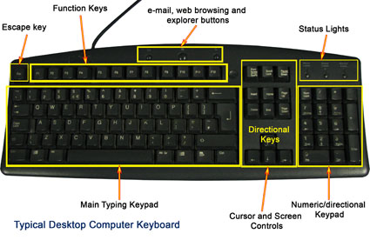

Slide 31
Working Mechanism Of Mouse
The main goal of any mouse is to translate the motion of your hand into signals that the computer can use. Let's take a look inside a track-ball mouse to see how it works:
A ball inside the mouse touches the desktop and rolls when the mouse moves. The underside of the mouse's logic board: The exposed portion of the ball touches the desktop.

Slide 32
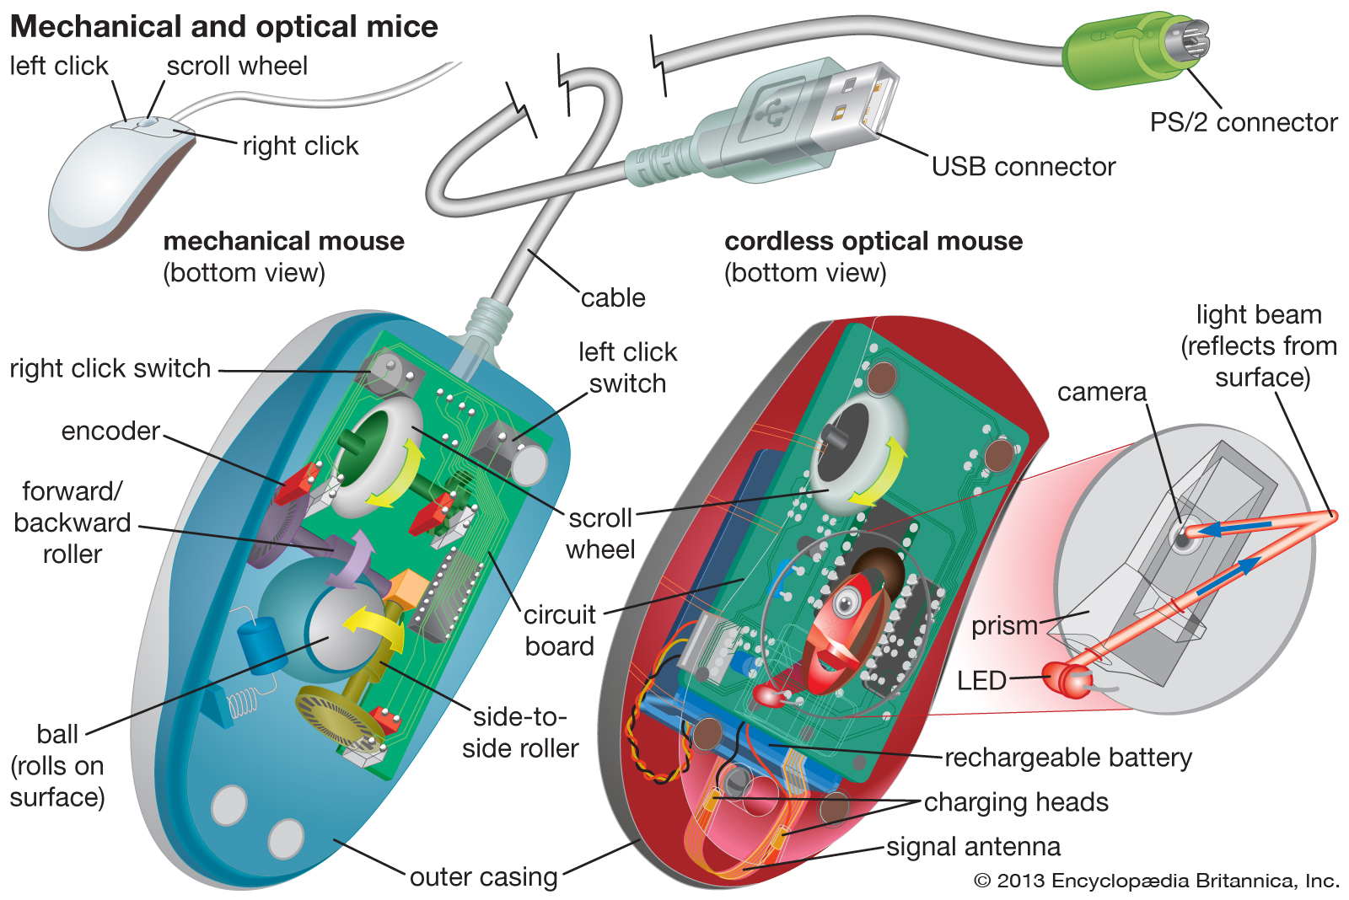

Slide 33
Touch Screen Panel
Touch screen technology is the direct manipulation type gesture based technology. Direct manipulation is the ability to manipulate digital world inside a screen. A Touch screen is an electronic visual display capable of detecting and locating a touch over its display area. This is generally refers to touching the display of the device with a finger or hand. This technology most widely used in computers, user interactive machines, smart phones, tablets etc. to replace most functions of the mouse and keyboard.

Slide 34
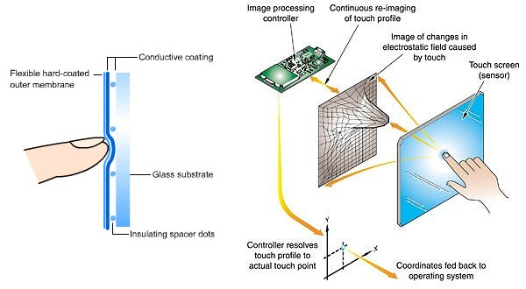

Slide 35
Memory ORGANIZATION

Slide 36
Secondary Memory This memory is permanent in nature. It is used to store the different programs and the information permanently (which were temporarily stored in RAM). It holds the information till we erase it. Different types of secondary storage devices are: Hard Disc, Compact Disc, DVD, Pen Drive, Flash Drive, etc.
Data in the computer’s memory is represented by the two digits 0 and 1.These two digits are called Binary Digits or Bits. 1 Byte= 8 bits(e.g,11001011) To represent a large amount of data in memory , higher data storage units are used like KB(Kilobyte),MB(megabyte),GB(Gigabyte),TB(terabyte),etc.

Slide 37
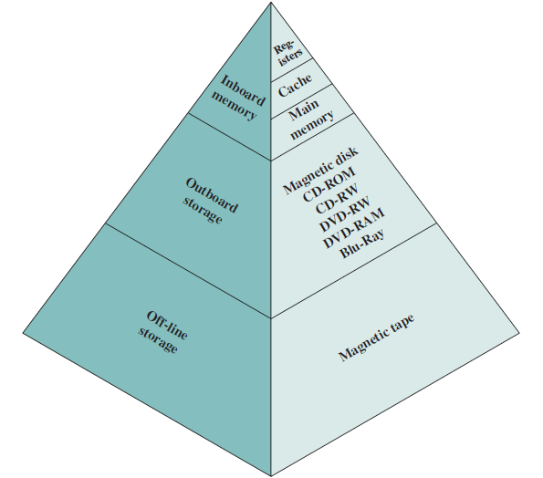
Memory Hierarchy

Slide 38
Primary Memory
The memory with which the CPU can directly communicate is called primary memory.
Primary memory is also called as main memory.
Available as semiconductor chips , therefore also called as semiconductor memory.
The CPU takes instruction from this memory and execute it.
Main Memory and CPU both perform parallel data transfer.

Slide 39
RAM(Random Access Memory)
RAM is semiconductor memory which can perform read and write operation.
Whenever the electrical power goes off , the content of this memory is lost.
It is also know as Volatile Memory or Temporary Memory.
These are available in semiconductor chip , called Integrated circuit (IC).
Internally a RAM is organized with equal size registers.
Each register hold a binary number called ‘Memory Word’.

Slide 40
1) Static RAM
Bit stored in the form of voltage.
Uses Bipolar or MOS Technology.
Low Access time , therefore faster.
Expensive and low packing density.
Does not require a refreshing circuit.
Large power dissipation.
Used for cache memory.

Slide 41
2) Dynamic RAM
Bit stored in the form of charge.
The smallest unit is MOS cell.
High Access time, slower.
Inexpensive and high packing density.
Small power dissipation.
Used as main memory.
Suitable for video , graphics, information.

Slide 42
ROM(Read Only Memory)
The content of this memory can be read only.
ROM is also available in semiconductor chips.
Organized as group of equal-sized addressable registers.
Address of particular register is applied to a particular ROM chip, then a control signal “read” is provided by the CPU to read a content of that register.
ROM is used to hold some permanent program and some fixed data.
ROM is a Permanent or non-volatile memory and The program written in the ROM cannot be modified by the user .

Slide 43
Types of ROM
1) Masked-ROM : This is factory programmed ROM. A program is written into this ROM while Fabrication. Once the program is written it can not be changed. Masked ROMs are extensively used in embedded control system in which a permanent program resides in the ROM.
2) PROM (programmable read-only memory) : PROM is a computer memory chip that can be programmed once after it is created. Once the PROM is programmed, the information written is permanent and cannot be erased or deleted.

Slide 44
3) EPROM (Erasable Programmable Read-Only Memory): EPROM is programmable read-only memory (programmable ROM) that can be erased and re-used. Erasure is caused by shining an intense ultraviolet light through a window that is designed into the memory chip.
4 ) EEPROM (Electrically Erasable Programmable Read-Only Memory) : EEROM is user-modifiable read-only memory (ROM) that can be erased and reprogrammed (written to) repeatedly through the application of higher than normal electrical voltage. Unlike EPROM chips, EEPROMs do not need to be removed from the computer to be modified. However, an EEPROM chip has to be erased and reprogrammed in its entirety, not selectively. It also has a limited life - that is, the number of times it can be reprogrammed is limited to tens or hundreds of thousands of times.

Slide 45
Secondary Memory
These are the storage Devices. Large programs and huge amount of data are stored in this memory.
When power goes off the information is not lost and permanent memory.
The information is stored in the form of magnetic field. Thus these are also know as “Magnetic Memory”.
The example of these Memory are Hard disk , floppy disk, and magnetic tape.
There storage capacity is relatively large and devices are slowest.

Slide 46
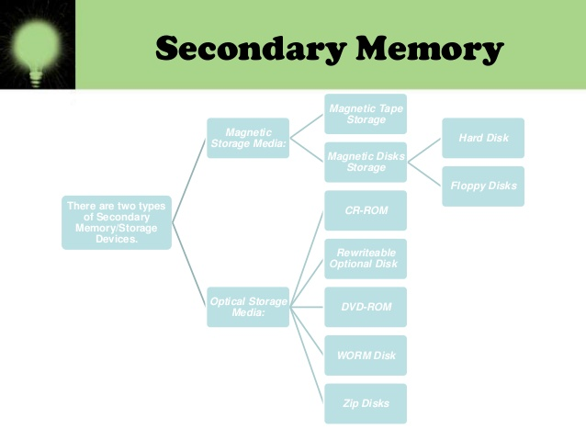

Slide 47
Secondary Storage
Compact Disc(CD) : It is a thin plastic disc coated with metal. Computer can read and write data stored on it . This is an optical storage device with a storage capacity of up to 700 MB and it can store varieties of data like pictures , sounds, movies , texts , etc.
Hard Disc : This is the main storage device of the computer which is fixed inside the CPU box. Its storage capacity is very high that varies from 200 GB to 3 TB. As it is fixed inside the CPU box, it is not easy to move the hard disc from one computer to another.
DVD (Digital Versatile Disc) : It is an optical storage device which reads data faster than a CD.A single layer , single sided DVD can store data up to 4.7 GB i.e., around 6 times than that of CD and a double layer DVD can store data up to 17.08 GB i.e. around 25 times that of CD. Though DVDs look just like CDs , they can hold much more data, for example , a full length movie.

Slide 48
CD-ROM : CD-ROM refers to Compact Disc-Read Only Memory. Data or information is recorded at the time of manufacturing and it can only be read. A CD-ROM cannot be used to record fresh data by the computer.
Blu-ray Disc :This is a newly invented optical data storage device whose storage capacity can be form 25 GB up to 200 GB. It is mainly used to store high quality sound and movie data . They are the scratch resistant discs ,t hat’s why , storing data on these is much safer than a CD OR DVD. So , these are some the common devices we use to store information and data in the computer.
CD-RW : CD-RW stands for Compact Disc Re-writable. CD-RW can be used to write information over and over again ,i.e. previous information can be erased and new information can be written on it using a CD writer fixed inside the CPU box . CDs are slow in comparison to hard discs to read or write the information on them . They are portable storage devices.

Slide 49
MAGNETIC DISKS : A magnetic disk is a storage device that uses a magnetization process to write, rewrite and access data. A magnetic disk primarily consists of a rotating magnetic surface and a mechanical arm that moves over it. The mechanical arm is used to read from and write to the disk. The data on a magnetic disk is read and written using a magnetization process. Data is organized on the disk in the form of tracks and sectors, where tracks are the circular divisions of the disk. Tracks are further divided into sectors that contain blocks of data. All read and write operations on the magnetic disk are performed on the sectors.
MAGNETIC TAPES : A magnetic tape drive is a storage device that makes use of magnetic tape as a medium for storage .It uses a long strip of narrow plastic film with tapes of thin magnetically coating .Magnetic tape drives store data on magnetic tape using digital recording. The tapes are usually stored on cartridges or cassettes, but for drives that are used as data storage tape backups, the tape is often wound on reels. Magnetic tape is not the most dense data storage medium.

Slide 50
CACHE MEMORY ORGANIZATION
Cache Memory is a special very high-speed memory. It is used to speed up and synchronizing with high-speed CPU. Cache memory is costlier than main memory or disk memory but economical than CPU registers. Cache memory is an extremely fast memory type that acts as a buffer between RAM and the CPU. It holds frequently requested data and instructions so that they are immediately available to the CPU when needed.

Slide 51
VIRTUAL MEMORY
Virtual Memory is a storage allocation scheme in which secondary memory can be addressed as though it were part of main memory. The addresses a program may use to reference memory are distinguished from the addresses the memory system uses to identify physical storage sites, and program generated addresses are translated automatically to the corresponding machine addresses . The size of virtual storage is limited by the addressing scheme of the computer system and amount of secondary memory is available not by the actual number of the main storage locations.

Slide 52
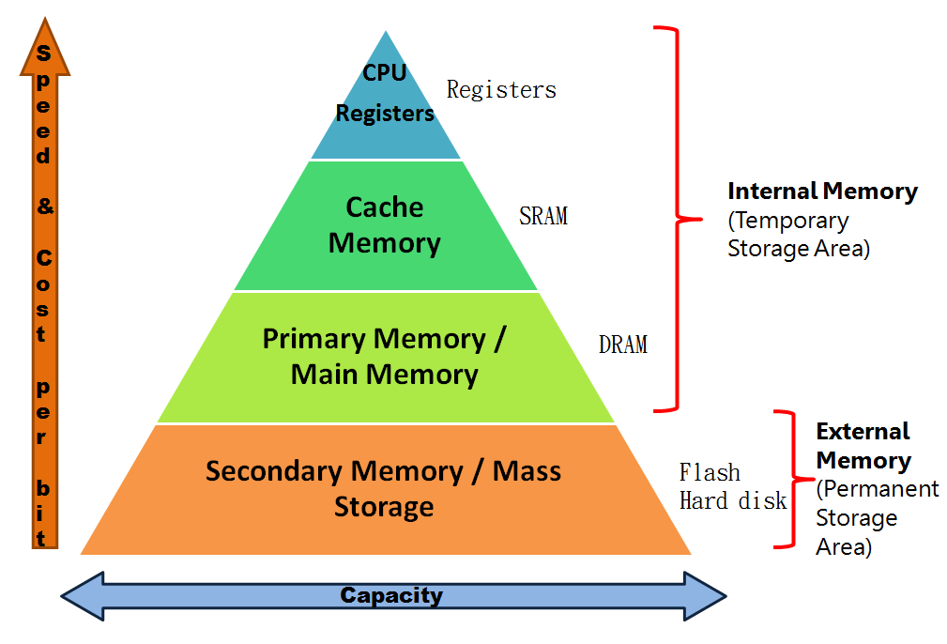

Slide 53
CPU ORGANIZATION

Slide 54
General Register Organization
When we are using multiple general purpose registers, instead of single accumulator register, in the CPU Organization then this type of organization is known as General register based CPU Organization. In this type of organization, computer uses two or three address fields in their instruction format. Each address field may specify a general register or a memory word. If many CPU registers are available for heavily used variables and intermediate results, we can avoid memory references much of the time, thus vastly increasing program execution speed, and reducing program size.

Slide 55
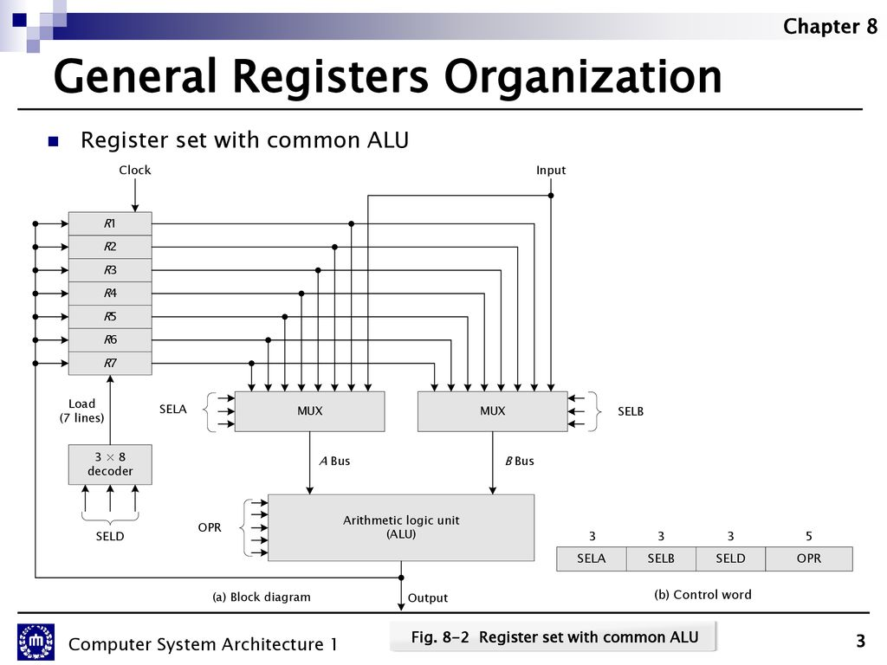

Slide 56
Stack Organization
The computers which use Stack-based CPU Organization are based on a data structure called stack. The stack is a list of data words. It uses Last In First Out (LIFO) access method which is the most popular access method in most of the CPU. A register is used to store the address of the topmost element of the stack which is known as Stack pointer (SP). In this organization, ALU operations are performed on stack data. It means both the operands are always required on the stack. After manipulation, the result is placed in the stack.

Slide 57
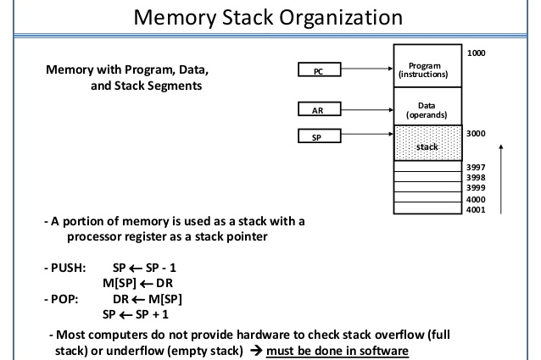

Slide 58
Instruction Format
A instruction is of various length depending upon the number of addresses it contain. Generally CPU organization are of three types on the basis of number of address fields :
1) Single Accumulator organization
2)General register organization
3)Stack organization

Slide 59
Addressing Mode : The term addressing modes refers to the way in which the operand of an instruction is specified. The addressing mode specifies a rule for interpreting or modifying the address field of the instruction before the operand is actually executed.
Zero Address Instructions : Address is stored in the opcode , in the zero address instruction. A stack based organization uses zero address instruction.
One Address Instructions : This use a implied ACCUMULATOR register for data manipulation. One operand is in accumulator and other is in register or memory location. Implied means that the CPU already know that one operand is in accumulator so there is no need to specify it. i.e. there will be one opcode field and one address field.

Slide 60
Two Address Instructions : Here two address can be specified in the instruction. Unlike earlier in one address instruction, the result was stored in accumulator here result can be stored at a different location rather than just accumulator, but require the number more of the bit to represent address.
Three Address Instructions : This has three address field to specify a register or a memory location. The program created is much short in size but the number of bits per instruction increase.

Slide 61
Instruction Set Selection
The instruction set, also called ISA (instruction set architecture), is part of a computer that pertains to programming, which is basically machine language. The instruction set provides commands to the processor, to tell it what it needs to do. The instruction set consists of addressing modes, instructions, native data types, registers, memory architecture, interrupt, and exception handling, and external I/O.

Slide 62
ADDRESSING MODES
Immediate.
Direct.
Indirect.
Register.
Indexed.

Slide 63
Direct
The operand’s offset is given in the instruction as an 8 bit or 16 bit displacement element. In this addressing mode the 16 bit effective address of the data is the part of the instruction. Here only one memory reference operation is required to access the data.

Slide 64
Indirect
This addressing mode utilizes the computer's ability of Segment : Offset addressing .In this mode address field of instruction contains the address of effective address . Here two references are required. 1st reference to get effective address. 2nd reference to access the data. Indirect addressing is generally used for variables containing several elements like, arrays. Starting address of the array is stored in, say, the EBX register.

Slide 65
Indexed
The address of the operand is obtained by adding to the contents of the general register (called index register) a constant value. The number of the index register and the constant value are included in the instruction code. Index Mode is used to access an array whose elements are in successive memory locations.

Slide 66
IMMEDIATE
In this mode data is present in address field of instruction .Designed like one address instruction format . Limitation in the immediate mode is that the range of constants are restricted by size of address field.

Slide 67
Register
In this addressing mode, a register contains the operand. In this , the operand is placed in one of 8 bit or 16 bit general purpose registers. The data is in the register that is specified by the instruction. Here one register reference is required to access the data.

Slide 68
CONTROL UNIT

Slide 69
Microprogramming Concepts
Process of writing microcode for a microprocessor. Microcode is low-level code that defines how a microprocessor should function when it executes machine-language instructions. Typically, one machine-language instruction translates into several microcode instructions. On some computers, the microcode is stored in ROM and cannot be modified; on some larger computers, it is stored in EPROM and therefore can be replaced with newer versions.

Slide 70
Execution Cycle
It is the part of the cycle when data processing actually take place and the instruction is called upon data & The result of this processing is stored in another register this is called Execution cycle. The other three cycles(Fetch, Indirect and Interrupt) are simple and predictable. Each of them requires simple, small and fixed sequence of micro-operation. In each case same micro-operation are repeated each time around. Execute Cycle is different from them. Like, for a machine with N different opcodes there are N different sequence of micro-operations that can occur .

Slide 71
Instruction Word Format
Instruction format An instruction is normally made up of a combination of an operation code and some way of specifying an operand, most commonly by its location or address in memory though non memory reference instructions can exist. Some operation codes deal with more than one operand; the locations of these operands may be specified using any of the many addressing schemes . Classically, the number of address references has been used to specify something about the architecture of a particular computer. In some instruction formats and machine architectures, the number of operand references may be fixed; in others the number is variable.

Slide 72
Fetch Cycle
The fetch execute cycle is the basic operation (instruction) cycle of a computer (also known as the fetch decode execute cycle).
During the fetch execute cycle, the computer retrieves a program instruction from its memory. It then establishes and carries out the actions that are required for that instruction.
At the beginning of the fetch cycle, the address of the next instruction to be executed is in the Program Counter(PC).

Slide 73
Step 1: The address in the program counter is moved to the memory address register(MAR), as this is the only register which is connected to address lines of the system bus.
Step 2: The address in MAR is placed on the address bus, now the control unit issues a READ command on the control bus, and the result appears on the data bus and is then copied into the memory buffer register(MBR). Program counter is incremented by one, to get ready for the next instruction.(These two action can be performed simultaneously to save time).
Step 3: The content of the MBR is moved to the instruction register(IR).

Slide 74
QUESTIONS ?

Slide 75
THANK YOU

