Slide 1

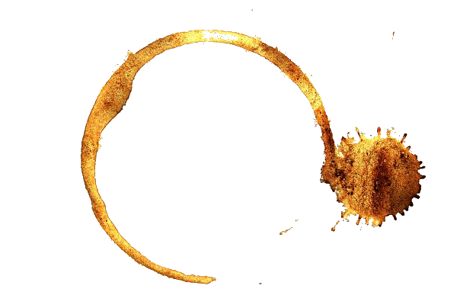
Internal Memo
Re:

